Slide 1
IXPDB & Euro-IX Tools
ENOG16, Tiblisi
Arnold Nipper – IXPDB Admin

Slide 2
Association of IXPs
73 affiliated members
54 IXPs in the Euro-IX region, 49 countries, operating over 100 peering LANs
19 IXPs from the rest of the world
Newest Member:
  Piter–IX - Russia
  ANIX - Albania

Slide 3










10 Euro-IX Patrons

Slide 4
Euro-IX Activities
2 Fora a year
  34th in Toulouse hosted by TOUIX and France-IX
  35th in Zandaam hosted by AMSIX
Manage Website & Database
Fellowship & Mentor-IX Programs to support IXPs in need
Peering Toolbox – BCPs and other information for Peers and on Peering – Coming Soon!
Reports – Benchmarking, traffic, hardware, route servers.
Newsletters - https://www.euro-ix.net/en/communications/newsletters/
Route Server Large BGP communities list: https://www.euro-ix.net/en/forixps/large-bgp-communities/
Speak to me about joining or benefits!

Slide 5
IXPDB & Euro-IX Tools

Slide 6
Some History
It’s not new, the original code was written around 15 years ago…
Membership feedback from consultations and the Membership Survey clearly showed IXPs wanted a place to publish an accurate and complete data set.
As members of IX-F it didn’t make sense for all of us to create individual databases or directories
In 2016 we considered the limitations of the underlying database and structure.
We wanted to move forward with automation and work started on the IXP Member List JSON Schema, which is also available for IXP in PeeringDB
In 2017 we contracted the website and IXP Database work to CZ.NIC.

Slide 7
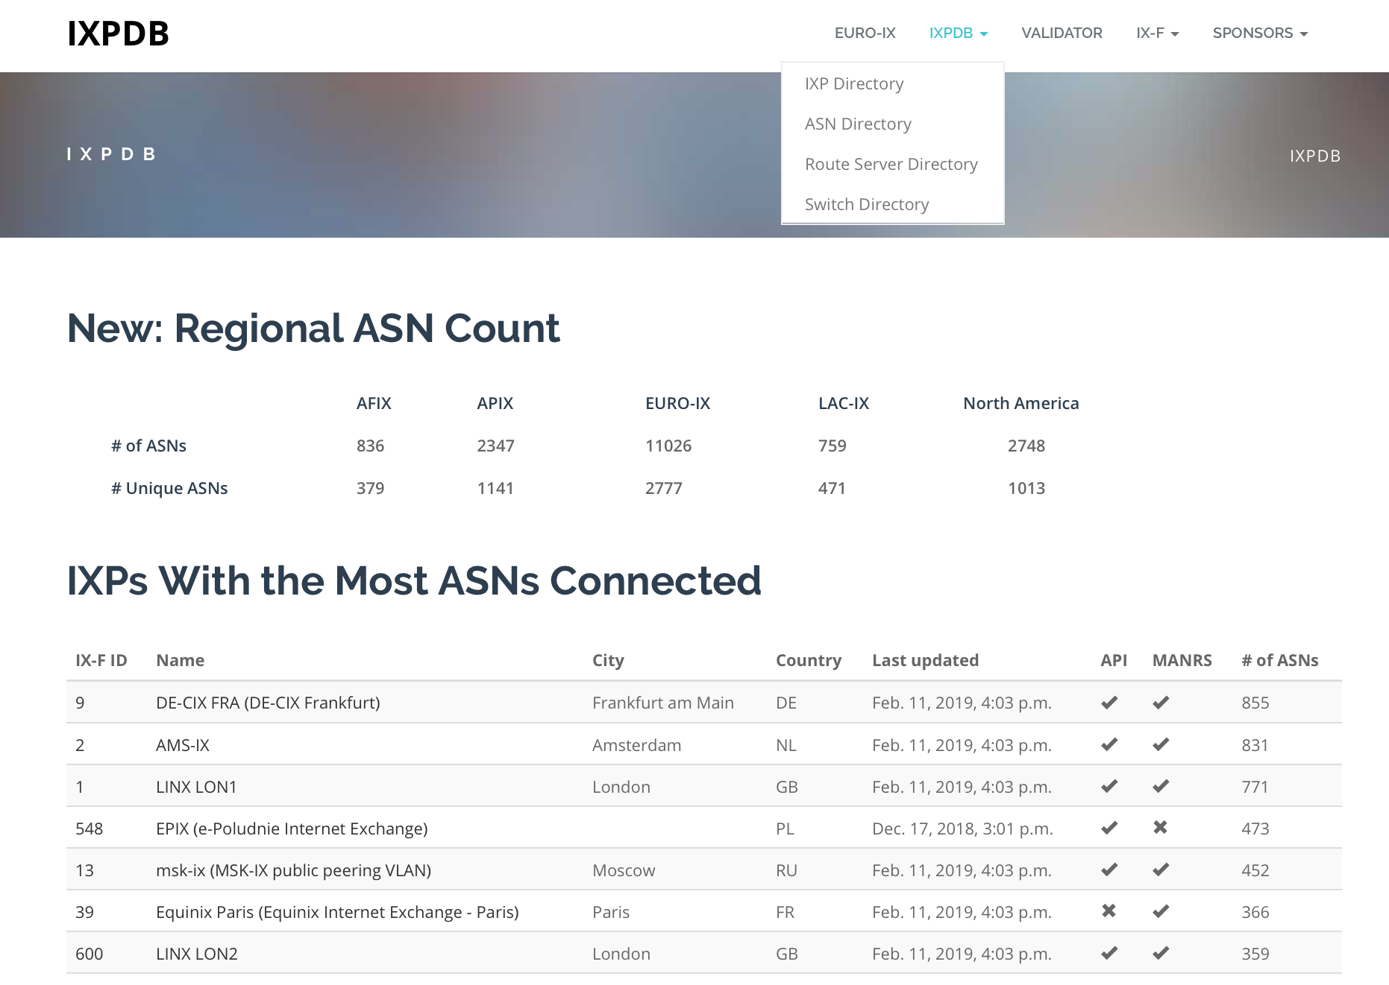
What we’ve been working on - Home
You can access the IXPDB via https://ixpdb.euro-ix.net/

Slide 8
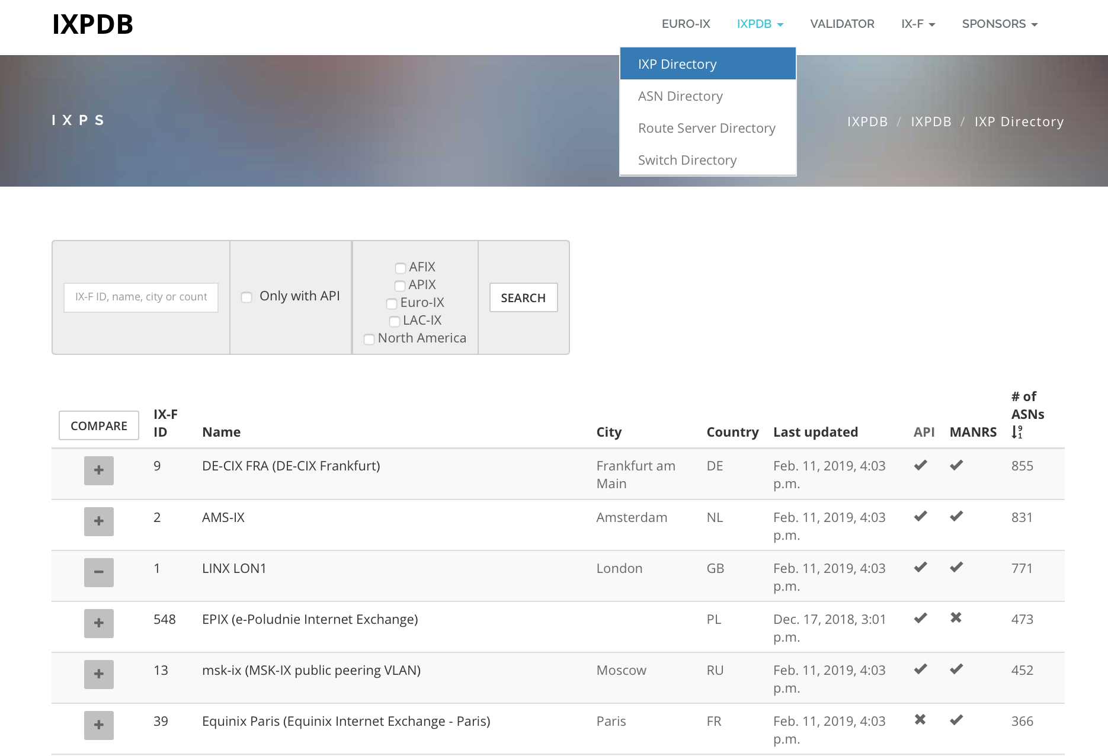
What we’ve been working on – IXP Directory
https://ixpdb.euro-ix.net/en/ixpdb/ixps/

Slide 9
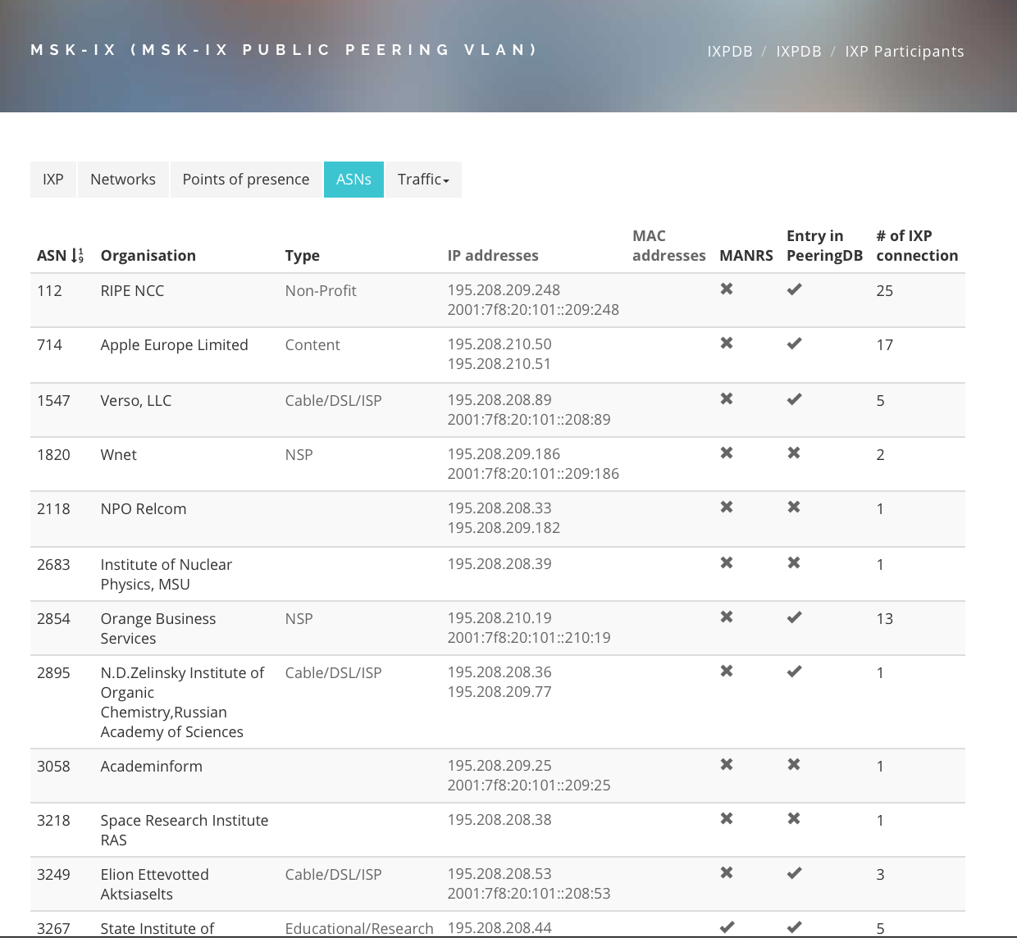
What we’ve been working on – ASN at the IXPs

Slide 10
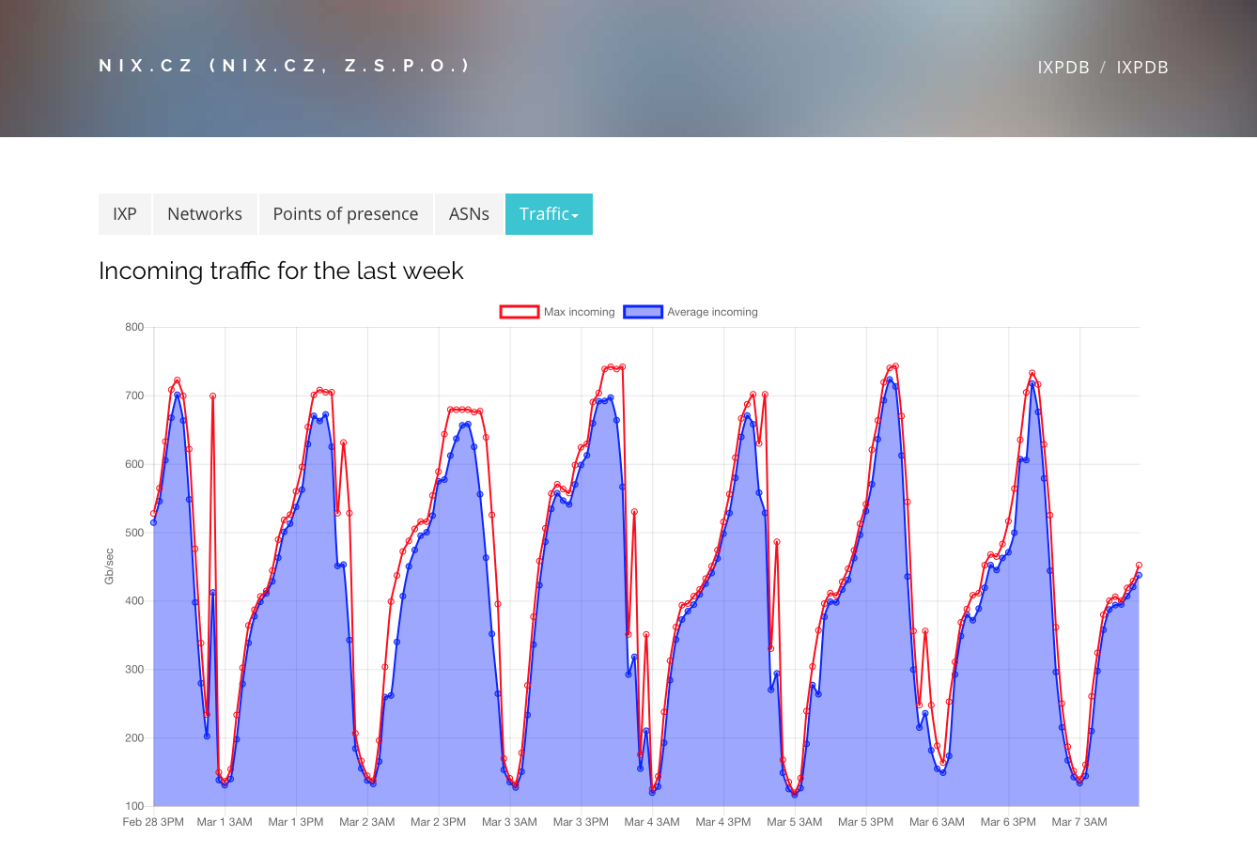
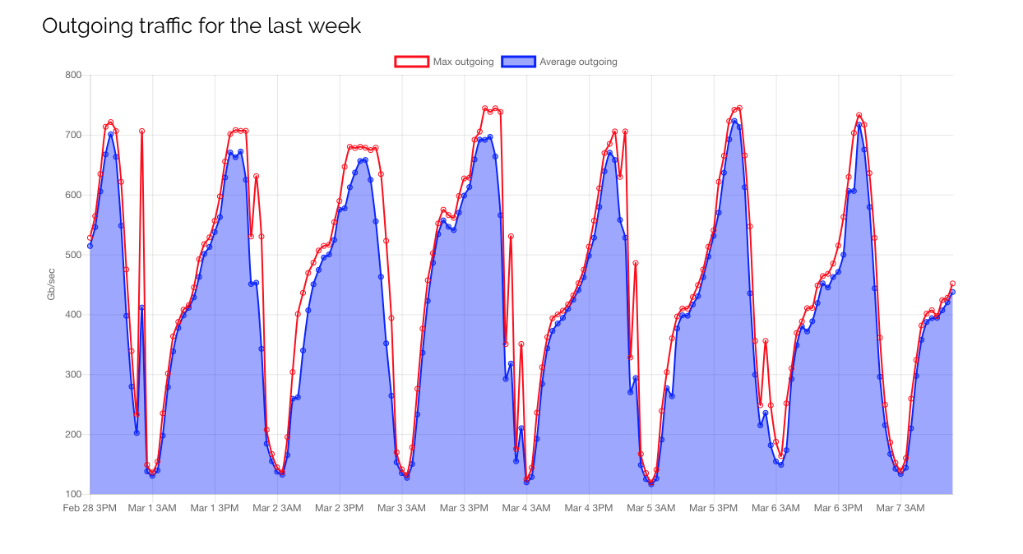
What we’ve been working on – IXP Traffic

Slide 11
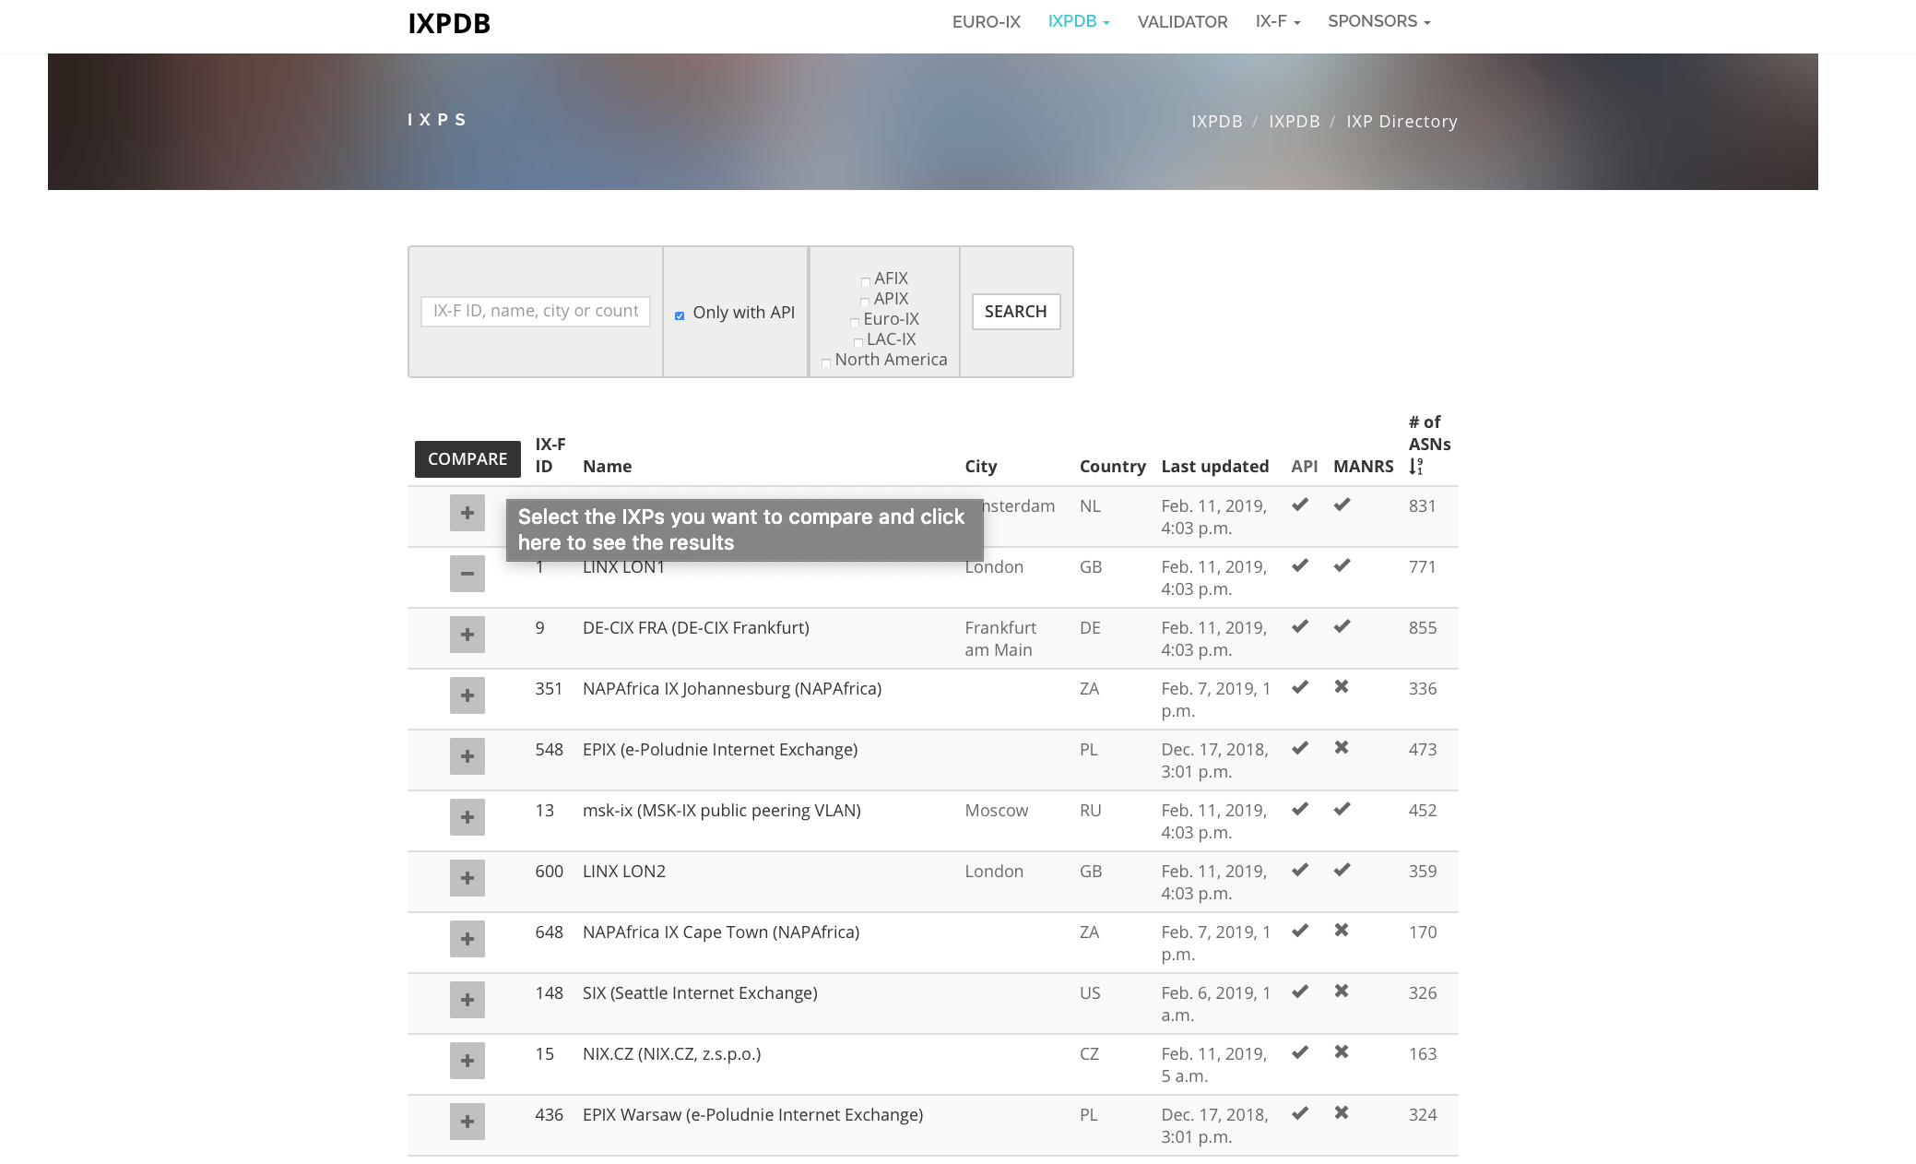
What we’ve been working on – Compare IXPs

Slide 12
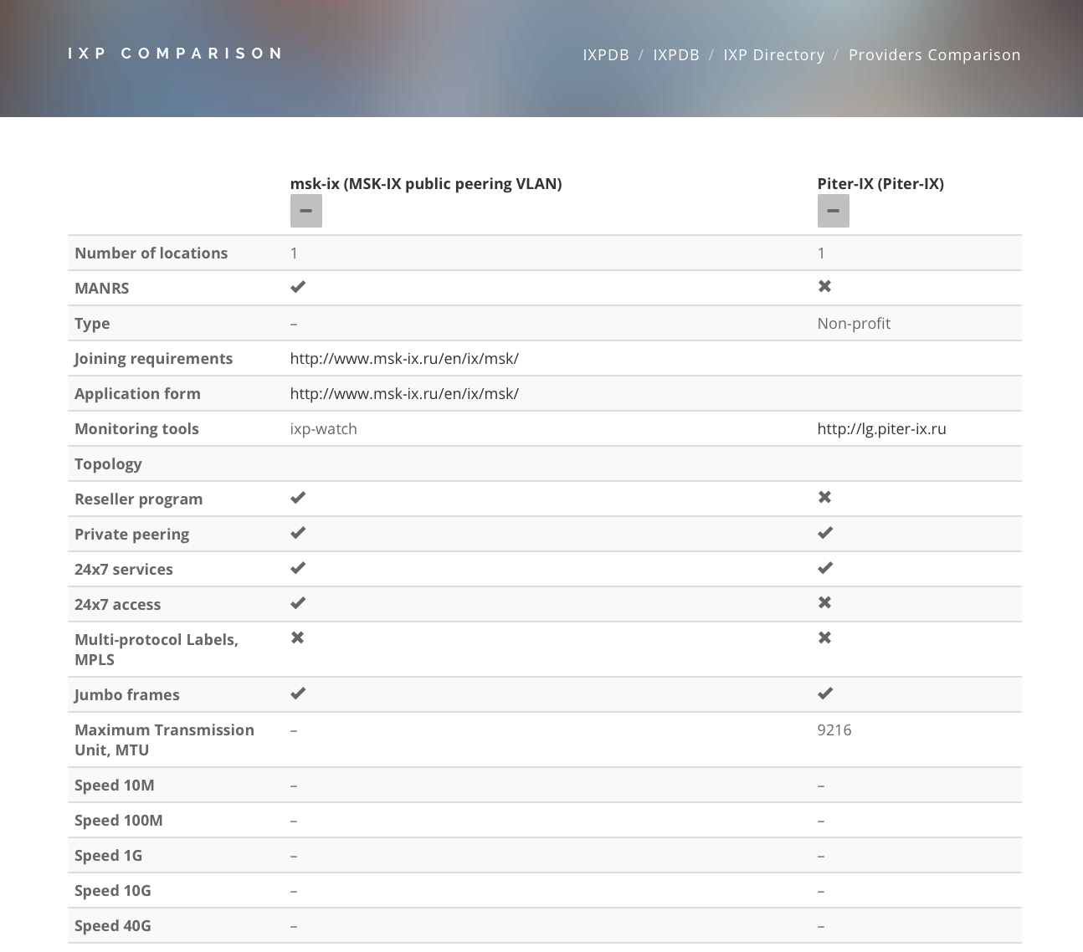
What we’ve been working on – Compare IXPs
Lets compare two Euro-IX Members who export their JSON API –

Slide 13
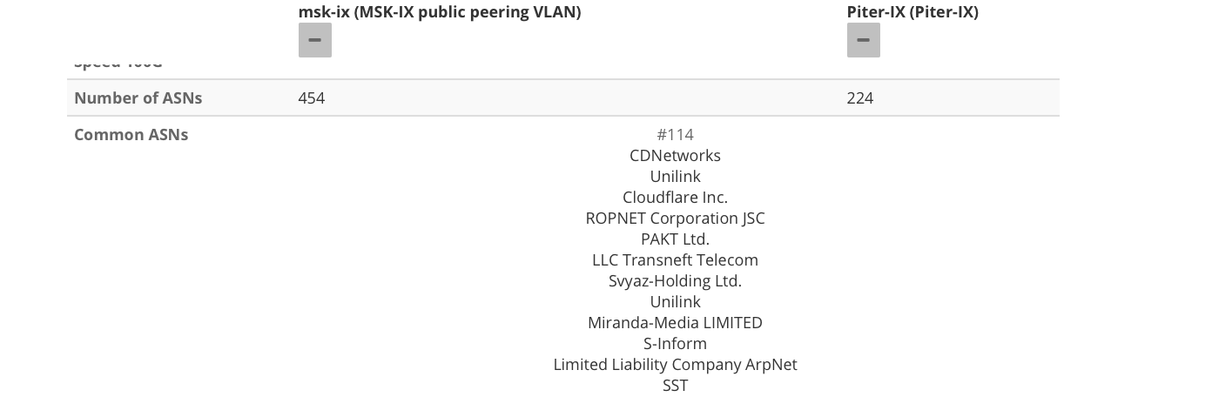
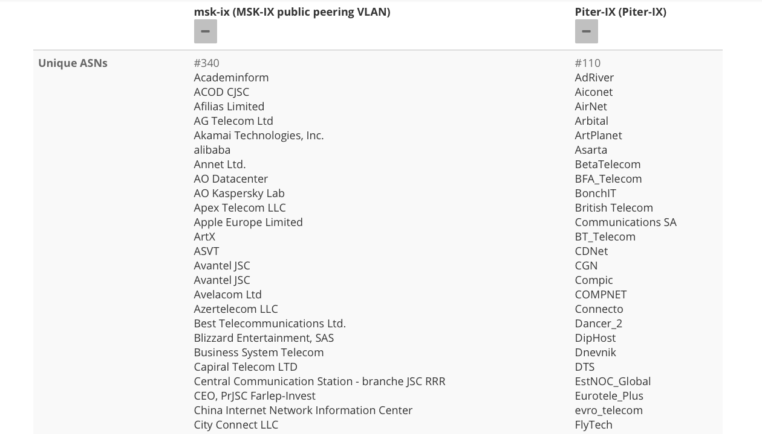
What we’ve been working on – Compare IXPs

Slide 14
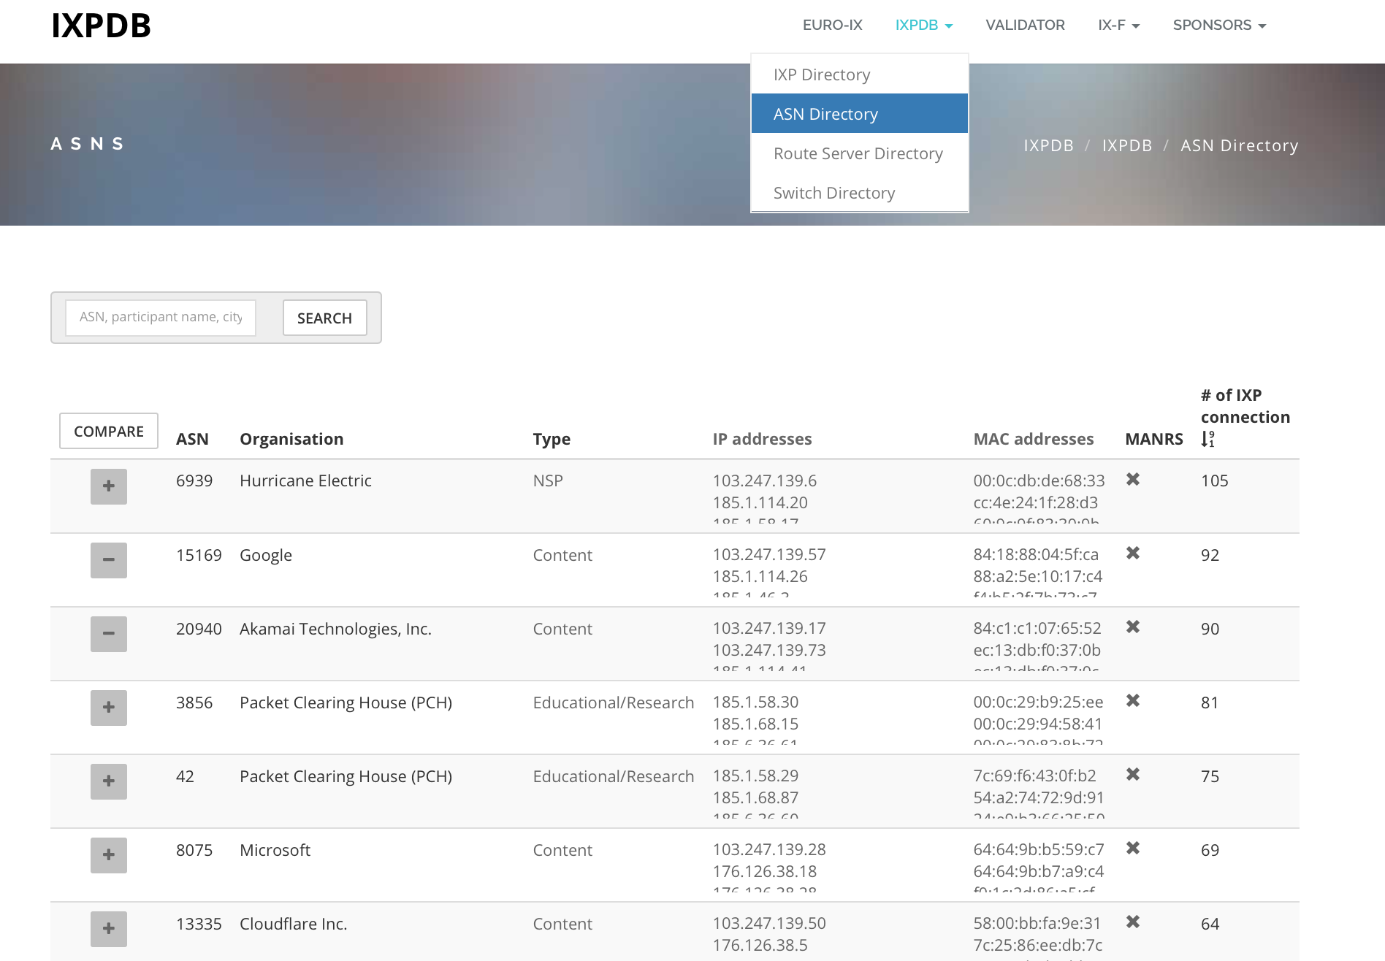
What we’ve been working on – ASN Directory
https://ixpdb.euro-ix.net/en/ixpdb/asns/

Slide 15
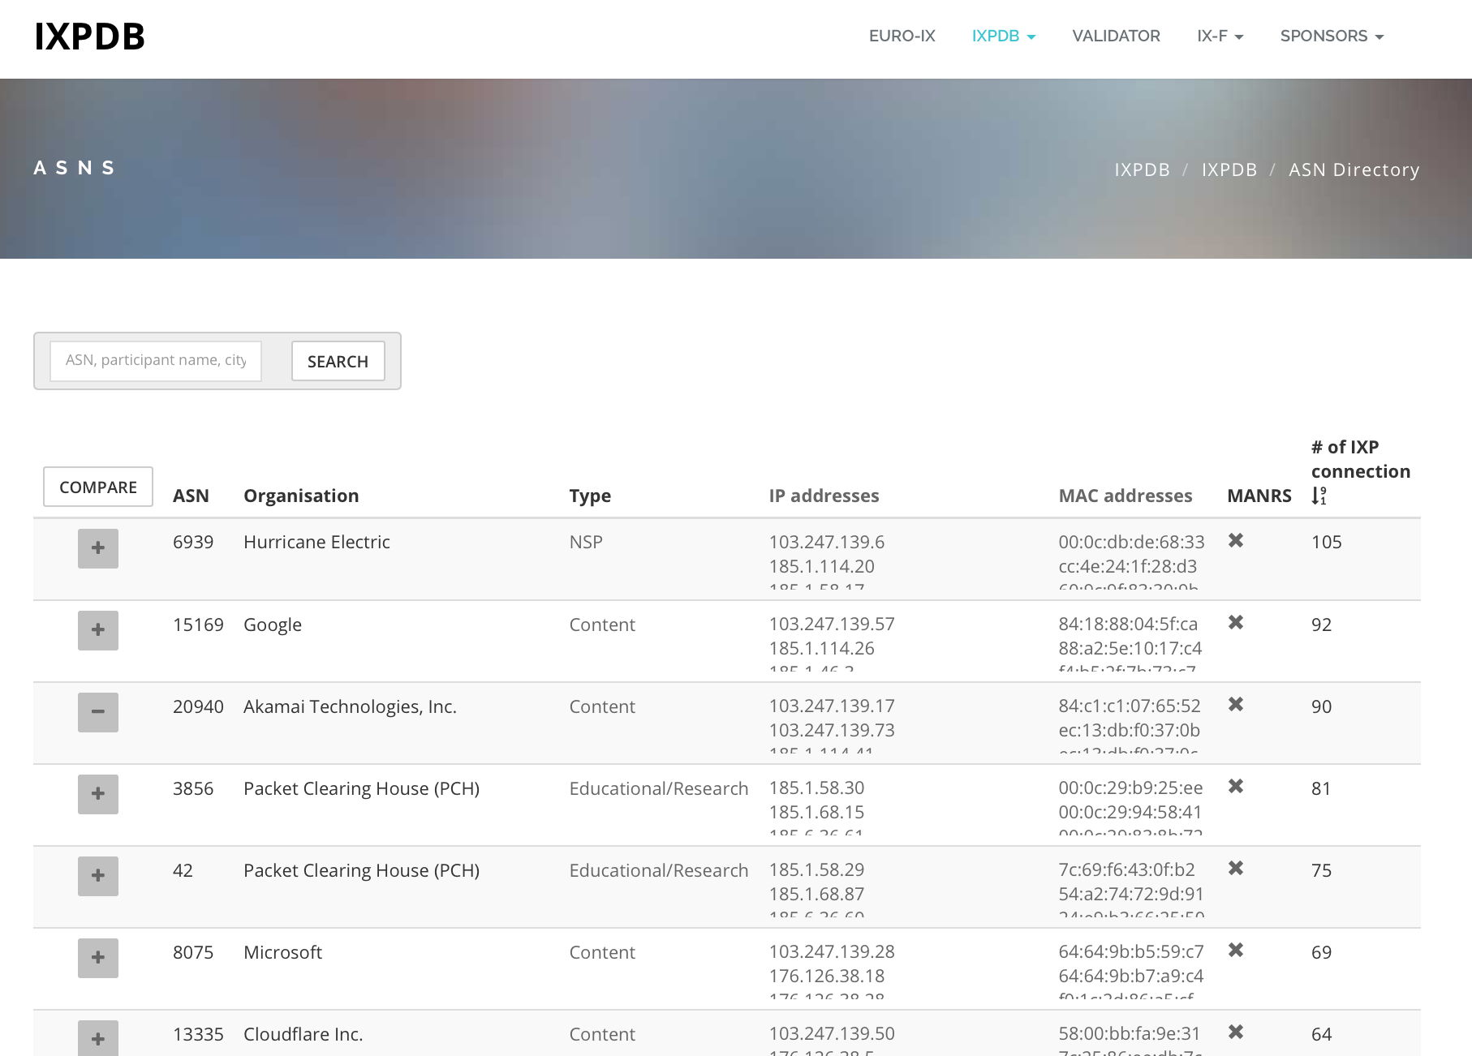
What we’ve been working on – Compare ASNs

Slide 16
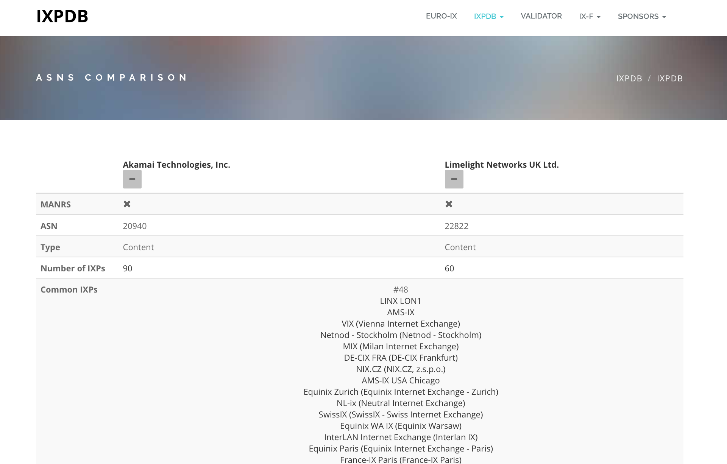
What we’ve been working on – Compare ASNs

Slide 17
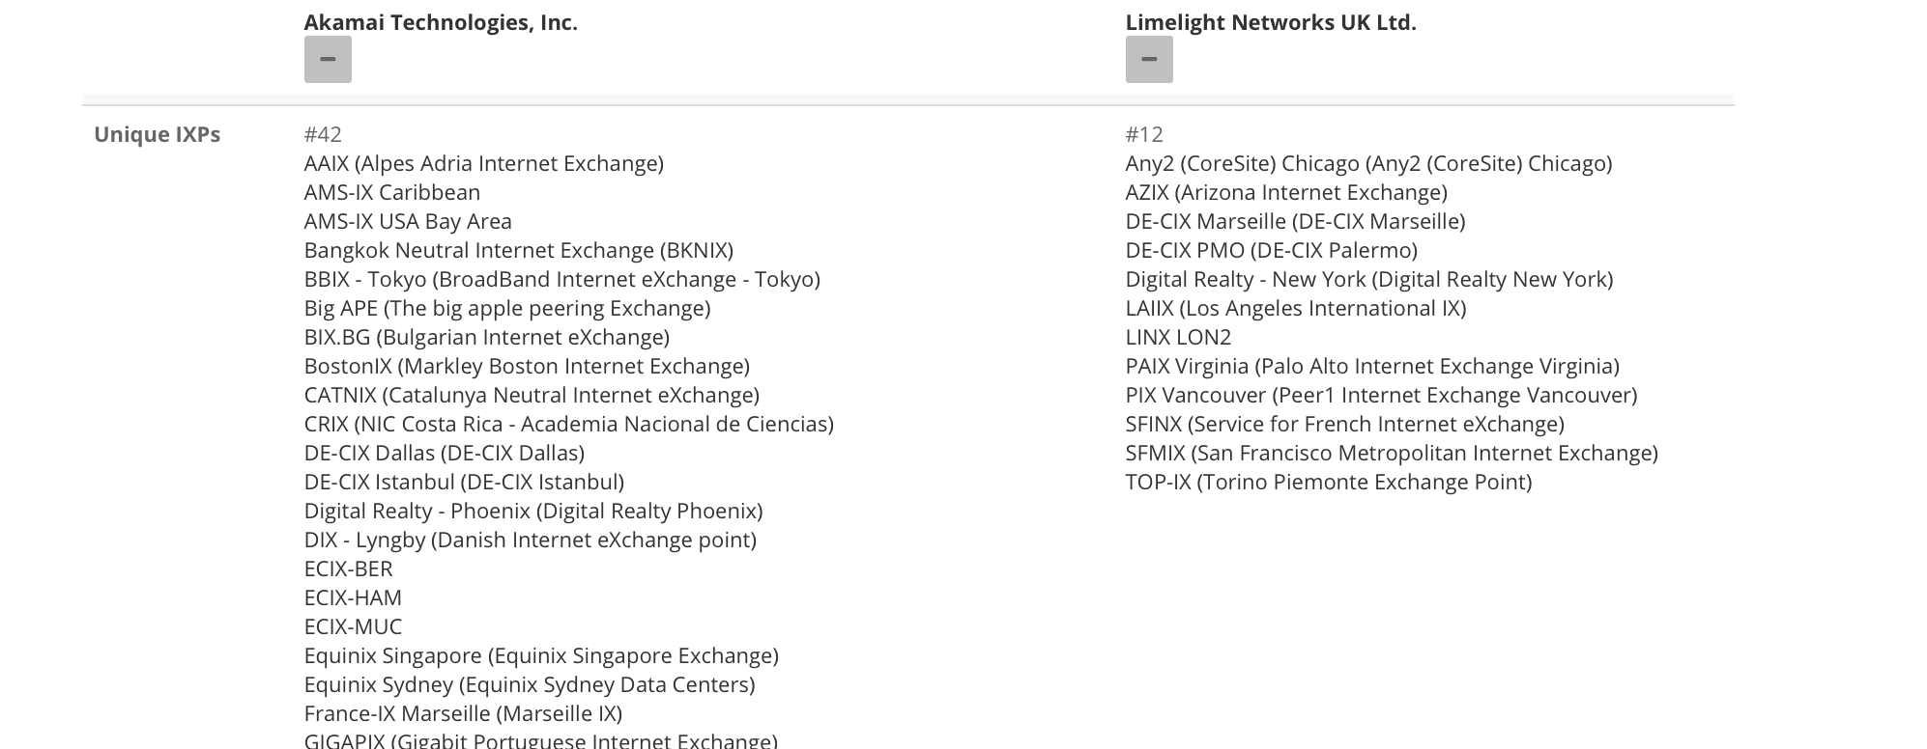
What we’ve been working on - Compare ASNs

Slide 18
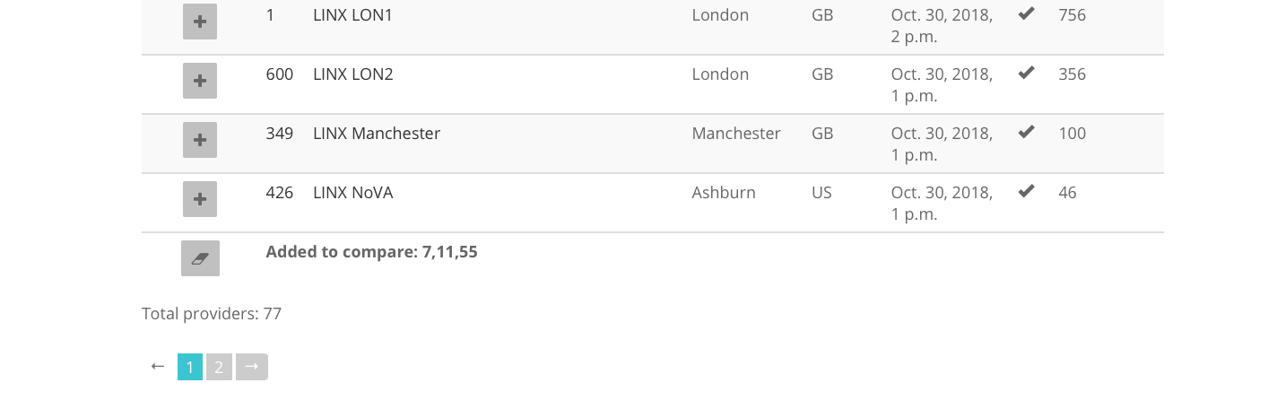
What we’ve been working on..
Don’t forget to clear your search ☺

Slide 19
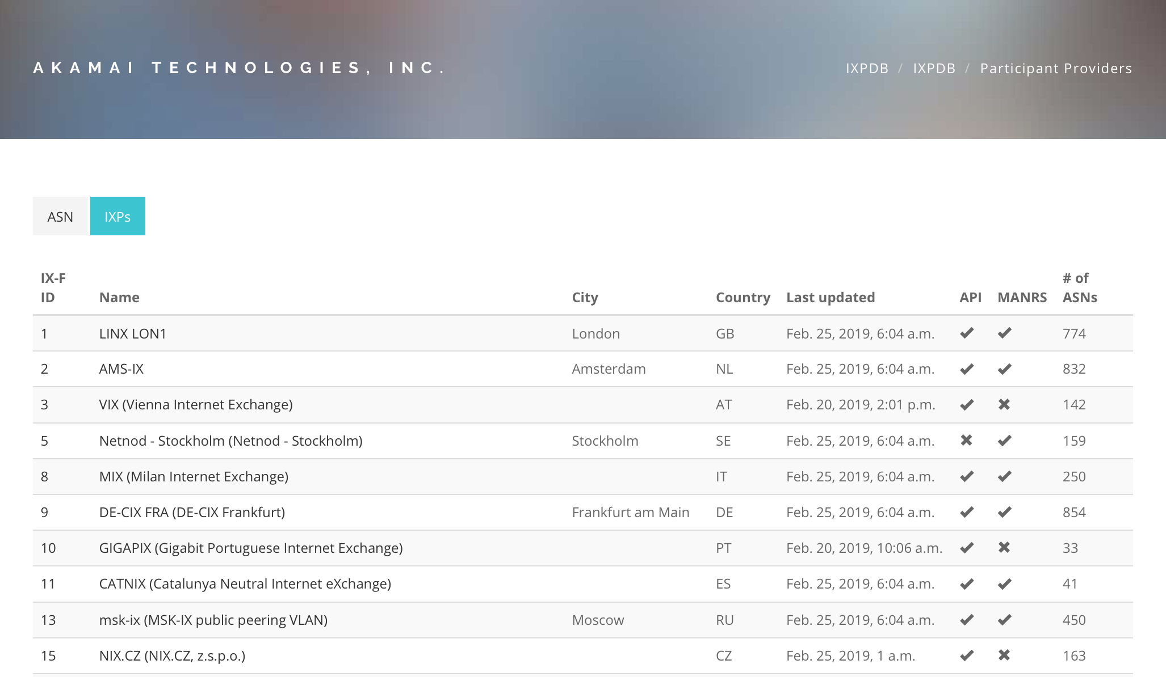
What we’ve been working on - ASN Details

Slide 20
What’s next
New JSON spec to be published
  Further Route Server & Switch data
API Authentication – IXPs can choose what data they want public and private (IXPs/Members only)
Other data collection work with Route Servers – prefix / ASNs
Work with IXPs to implement a solution – how to guides / tutorials / IXP Manager / Asteroid / Support from other IXPs
You too can help, speak to your IXPs
96 APIs today!

Slide 21
Other Information
Mailing list for users - https://lists.euro-ix.net/mailman/listinfo/ixpdb
GitHub JSON Member List Schema – https://github.com/euro-ix/json-schemas
API is live – https://api.ixpdb.net
IXPDB admin team - ixpdb-admin@euro-ix.net
If you think this is good work like we do, support us!
secretariat@euro-ix.net

Slide 22




IXPDB Sponsors - Thank You!

Slide 23
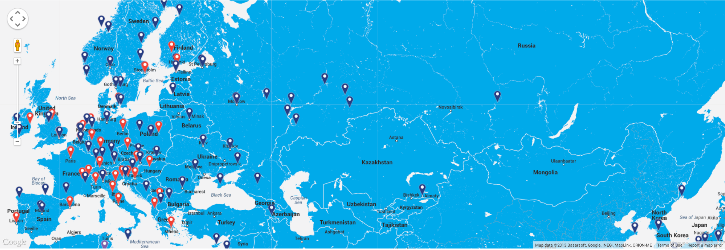
A look into the ENOG region..
62 IXPs in the ENOG region
216 in the Euro-IX region

Slide 24
A look into the ENOG region..
With data from the IXPDB we see 62 IXPs in the ENOG region
Data from the region is limited and not complete ☹
We need your help, speak to your IXPs and ask them to speak to us ☺
This table shows the countries that we have data on, we know data is missing, let’s fix this together!
Country | IXP Count | ASN Count
Armenia | 1 | 8
Belarus | 1 | 0
Georgia | 1 | 0
Kazakhstan | 2 | 0
Poland | 13 | 1572
Ukraine | 9 | 253
Kyrgyzstan | 1 | 0
Russia | 34 | 984
Total | 62 | 2817

Slide 25
A look into the ENOG region..
Here’s a nice traffic graph showing growth in IXP traffic
Data is missing, next year we would like to show more IXP data and ASNs peering in the region!

Slide 26
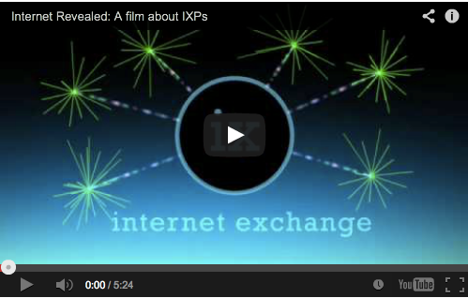
The Internet Revealed a film about IXPs
Short video about IXPs, available now in English, Italian, German, French, Spanish, Portuguese, Arabic, Mandarin, Russian, Romanian and Greek subtitles.

Slide 27
Thank You

