Slide 1

NAT64Check
Version 2
Sander Steffann Jan Žorž
sander@steffann.nl zorz@isoc.org

Slide 2
Problem statement and real world status
(Six Degrees of Inner Turbulence)
IPv6 and IPv4 are incompatible on the wire.
We need transition and translation mechanisms between the two protocols
Mobile operators are massively switching devices to IPv6-only connectivity
  millions of users
  using 464XLAT (Android) or plain NAT64 (Apple) as a transition tool to access IPv4 content
Some people do weird stuff while adding AAAA to their DNS records
Important questions:
  Do content providers know how their content will be seen from such environments?
  Do connectivity providers know what their users’ experience on IPv6-only would be?

Slide 3
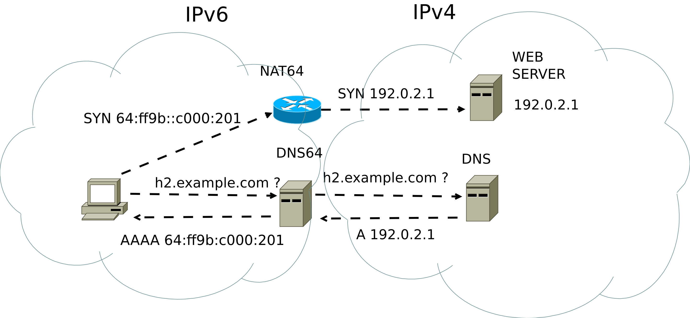
Some dark magic behind NAT64/DNS64
(Paralysed)

Slide 4
Go6lab NAT64/DNS64 public test-bed
(The Test That Stumped Them All)
Aimed at everyone who would like to test NAT64/DNS64 functionality
4 different implementations, 4 different instructions how to direct traffic there
Used by operators
  Testing the idea of providing NAT64/DNS64 and/or 464XLAT to their users
Used by application providers
  To see how their apps works in NAT64/DNS64 environment
Used by HW/SW vendors
  Testing their solutions against multiple NAT64 vendors
Gained quite some traction and momentum this days
Instructions: https://go6lab.si/current-ipv6-tests/nat64dns64-public-test/

Slide 5
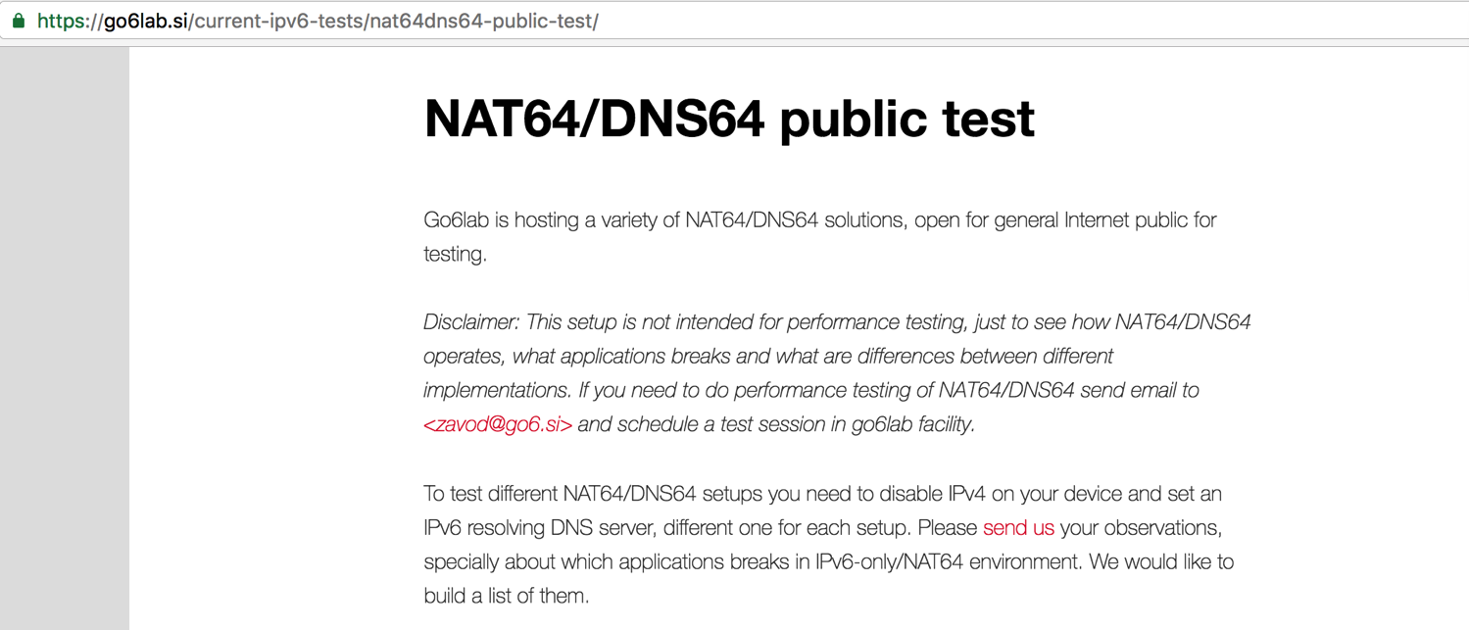
Go6lab NAT64/DNS64 test-bed

Slide 6
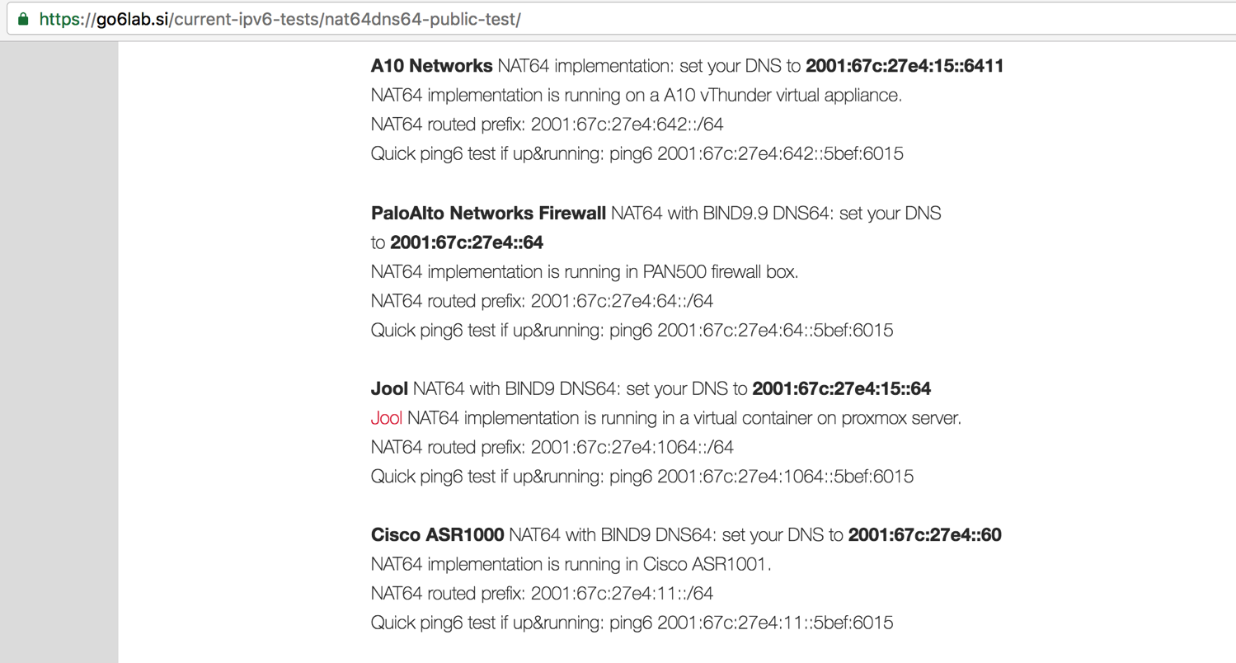
Go6lab NAT64/DNS64 test-bed

Slide 7
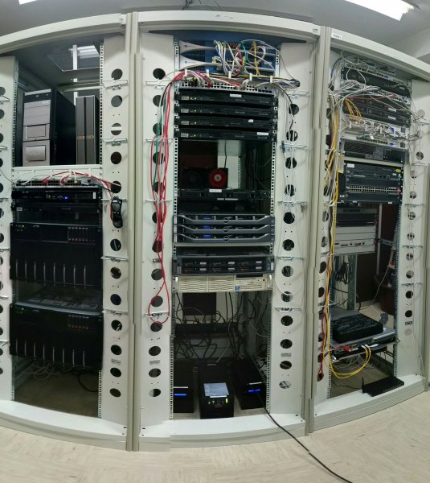
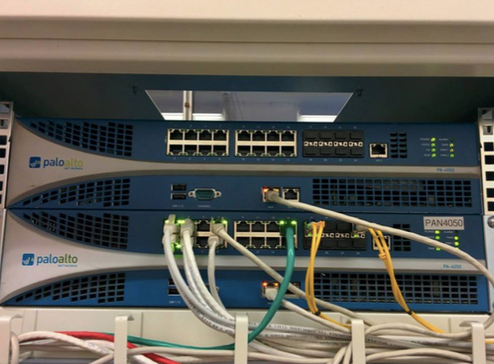
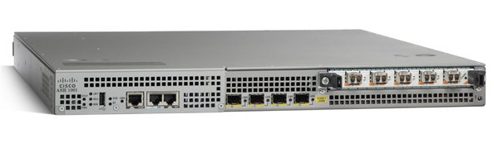
Go6lab NAT64/DNS64 test-bed HW/SW
(Systematic Chaos)

Slide 8
Some DNS admins put “crap” in AAAA records
(The Enemy Inside)
Have you ever seen any of this values for AAAA record?
  ::
  ::1
  ::ffff:[IPv4_addr]
  fe80::[some_value]
  64:ff9b::[some_value]
  2001:DB8::[some_value]
If you have seen something like this and you know who did it, talk to that people and tell them to fix it. This sort of thing isn’t useful to anybody and severely impacts user experience.
More: http://www.employees.org/~dwing/aaaa-stats/ (courtesy of Dan Wing)

Slide 9
When deploying in real life you need “fixes”
(Build Me Up, Break Me Down)
So, what can we do about it?
We can figure out who this people are, contact them, warn them about the issue, educate them and ask them to fix the problem.
Remember: If you are not part of solution, you are part of the problem.
At the same time we can protect our users from bad user experience and set the “exclude” rules in our DNS64 servers. IANA allocated 2000::/3 as global unicast address pool, so whatever else is used in AAAA - it’s by default bogus and we can safely ignore that.

Slide 10
When deploying in real life you need “fixes”
(Stream of Consciousness)
BIND9 example of DNS64 configuration in go6lab:
dns64 2001:67c:27e4:64::/96 {
clients { any; };
mapped { !rfc1918; any; };
exclude { 0::/3; 4000::/2; 8000::/1; 2001:DB8::/32; };
break-dnssec yes;
};
Explanation of “exclude” configuration parameter: If DNS64 server gets an AAAA record with a value of anything outside 2000::/3 - it ignores it and synthesizes the AAAA record from NAT64_prefix::IPv4_address

Slide 11
When deploying in real life you need “fixes”
(Stream of Consciousness)
Unbound example of DNS64 configuration in go6lab:
server:
module-config: "dns64 validator iterator"
dns64-prefix: 2001:67c:27e4:64::0/96
private-address: 0::/3
private-address: 4000::/2
private-address: 8000::/1
private-address: 2001:DB8::/32
# private-address: 64:FF9B::/96
# private-address: ::ffff:0:0/96
# private-address: ::1/128
# private-address: ::/128
interface: 2001:67c:27e4::64

Slide 12
Project history
( Falling into infinity )
Version 0:
  Jan wrote some Bash scripts
Version 1:
  Sander wrote a Python/Django application
  Corinne designed a web interface
Notes:
Falling into infinity

Slide 13
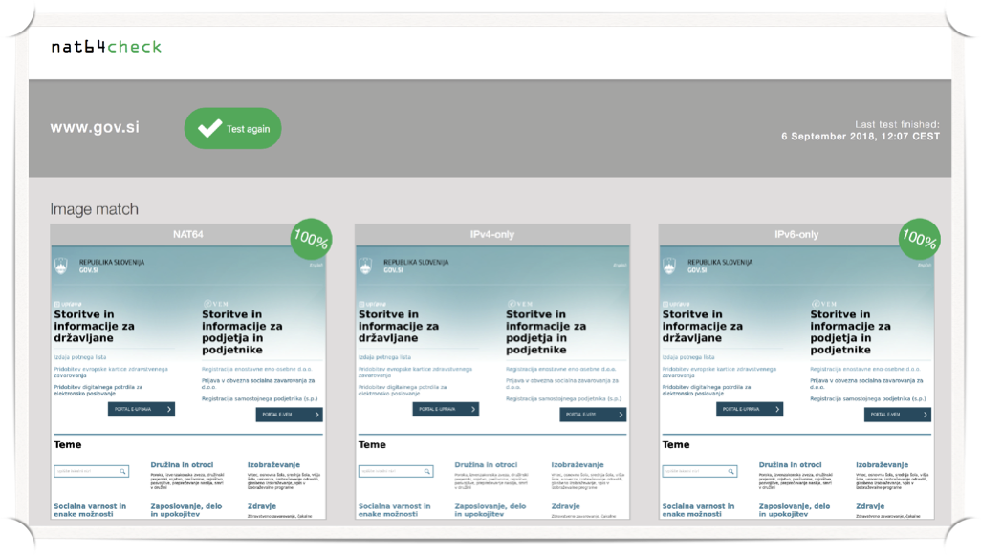
The good
( The mirror )
Notes:
Awake - The mirror

Slide 14
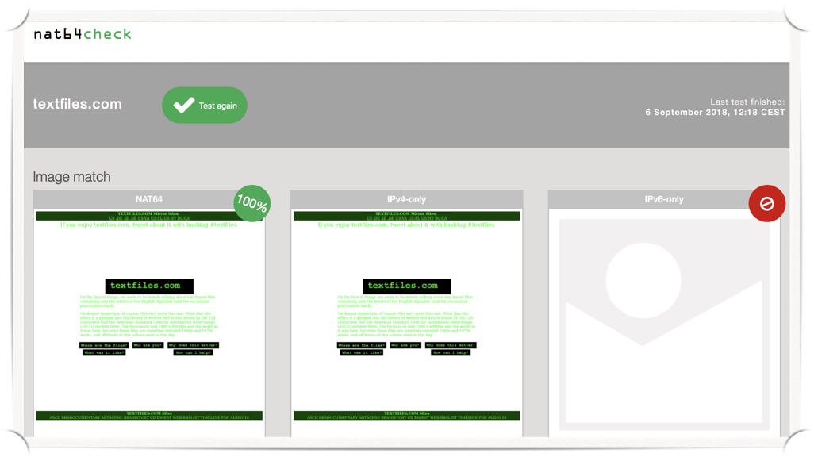
The bad
( The mirror )
Notes:
Awake - The mirror

Slide 15
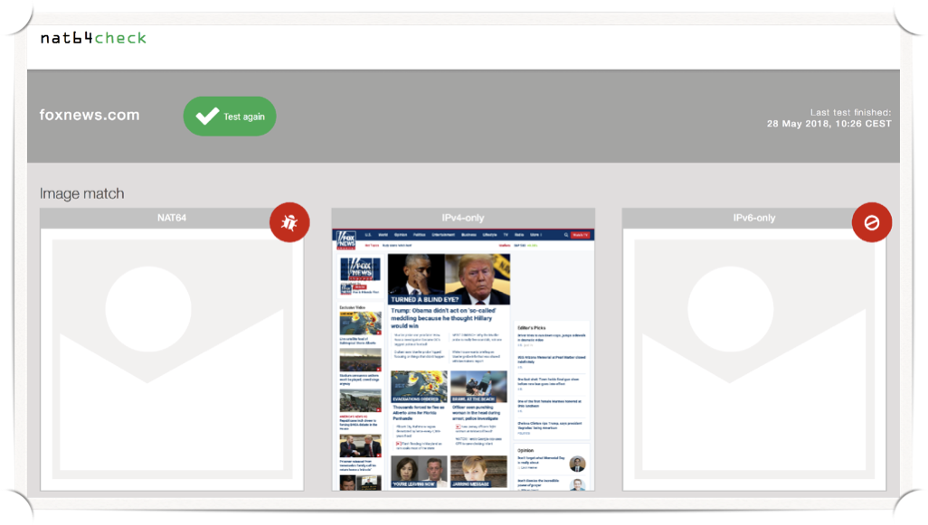
The ugly
( The mirror )
Notes:
Awake - The mirror

Slide 16
Version 1 flaws
( A change of seasons )
Unclear what the cause of a failure is
Bad error detection
Two different systems:
  ipv6-lab.net in NL
  go6lab.si in SI
No coordination between them
Still online at https://nat64check.go6lab.si/
Notes:
A change of seasons

Slide 17

Version 2
( Systematic Chaos )
Distributed system
  Central web interface
  Many test-locations possible
  Easy to install if you want to run your own test-location
Better error detection and feedback
Extendability for different tests
Notes:
Systematic chaos

Slide 18
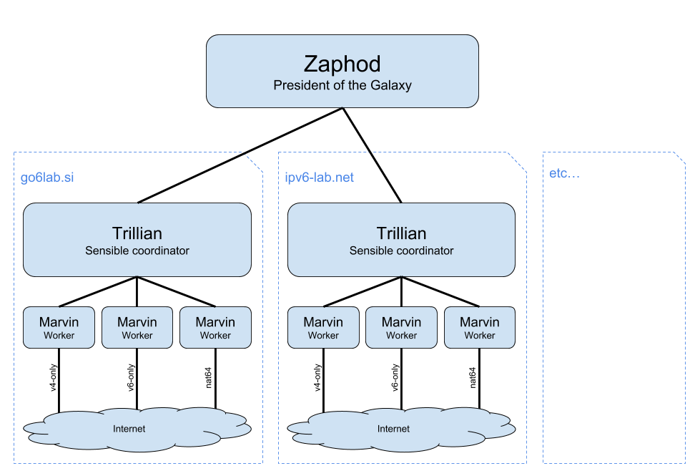
Technical design
( Illumination Theory )
Notes:
Once in a lifetime

Slide 19
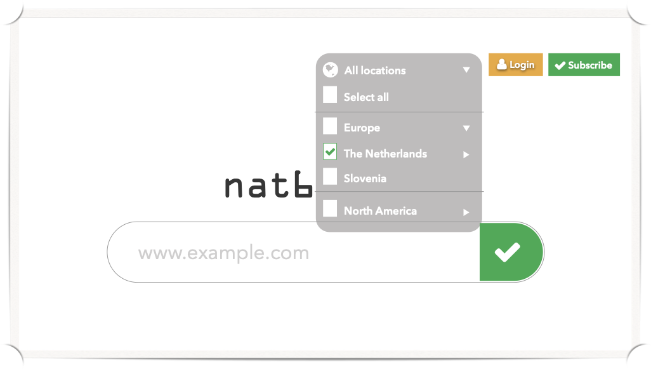
Country selection
multiple choices allowed
( The Astonishing )
Notes:
The Astonishing

Slide 20
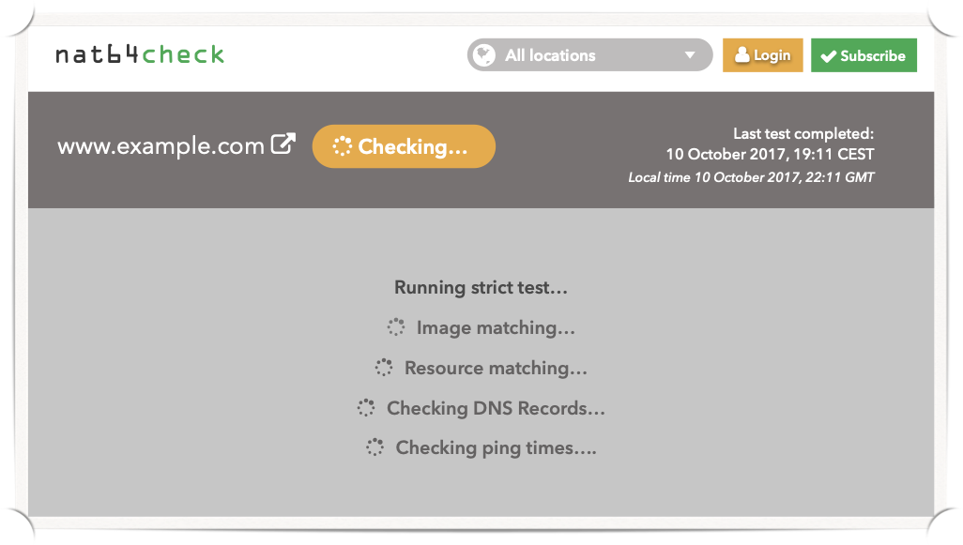
Better feedback
while testing
( Octavarium )
Notes:
Octavarium

Slide 21
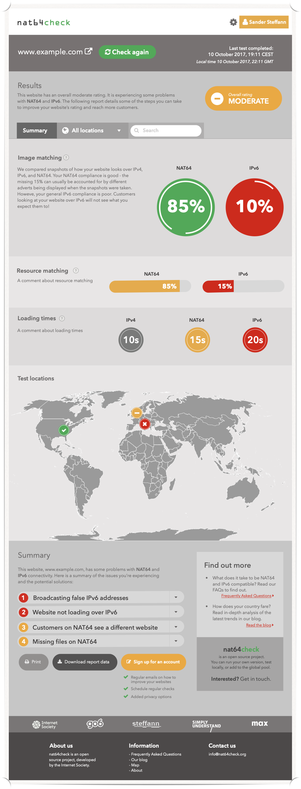


Clear summary
all test locations combined
Notes:
Metropolis pt. 2, Scenes from a memory

Slide 22
Clear summary
all test locations combined
Notes:
Metropolis pt. 2, Scenes from a memory

Slide 23
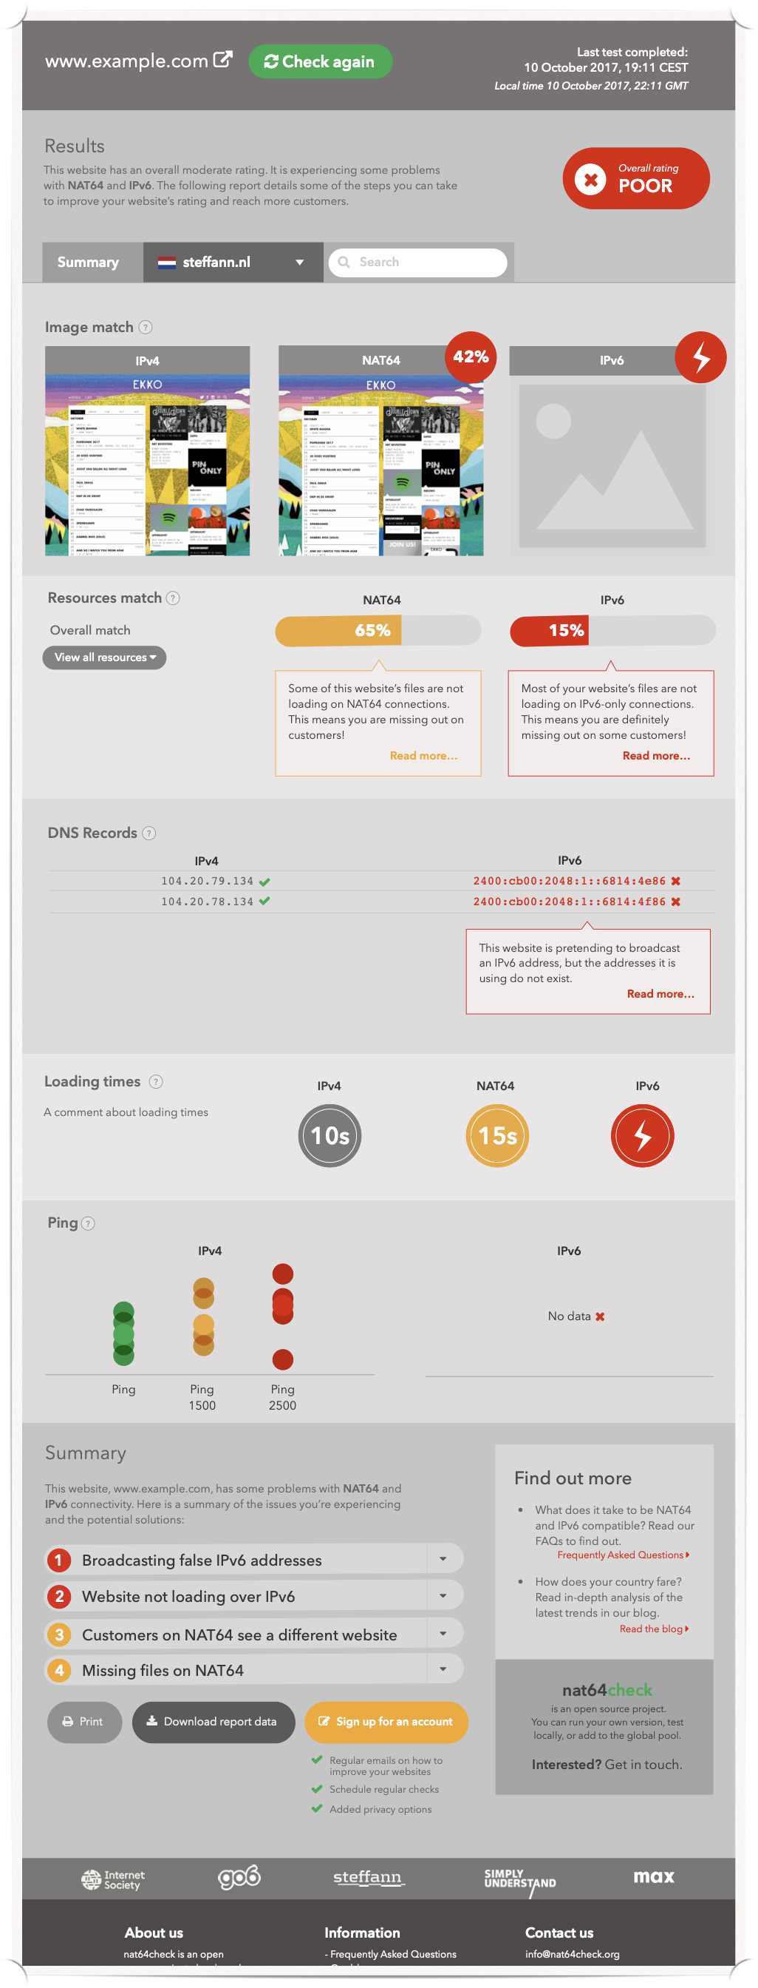
Detailed view
shown per test location
( Looking glass )
Notes:
Majesty

Slide 24
Detailed view
shown per test location
( Looking glass )
Notes:
Majesty

Slide 25
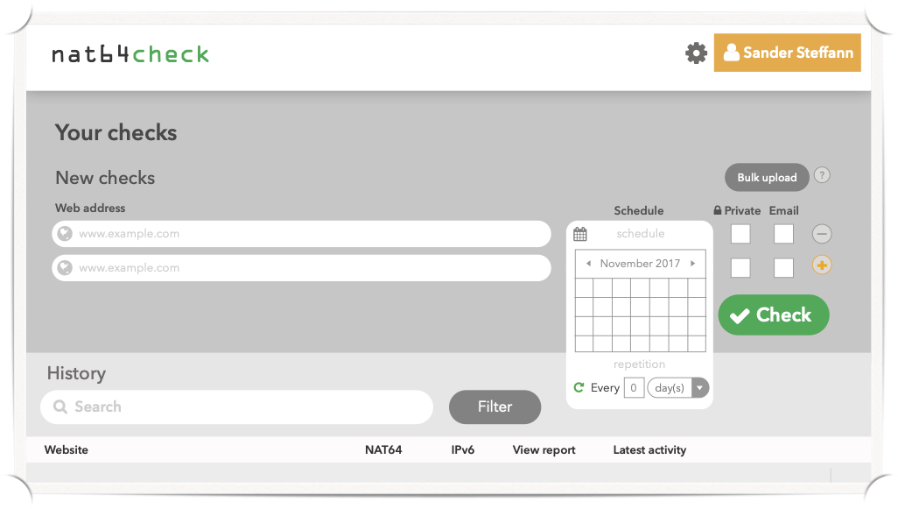

Recurring tests
get alerts when things break
Notes:
A dramatic turn of events

Slide 26
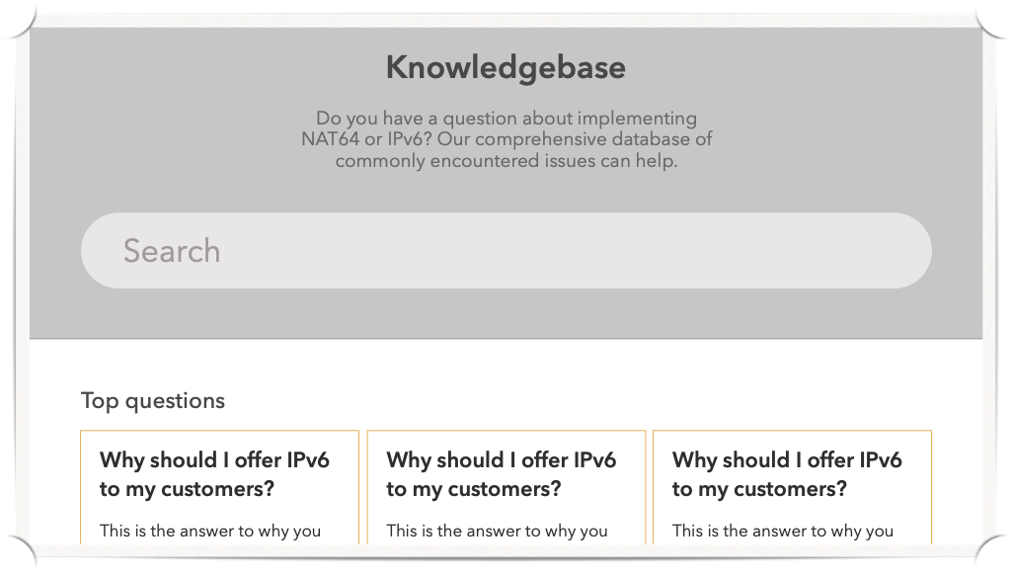
Background information
learn more about IPv6, NAT64 and the modern internet
( Train of Thought )
Notes:
Train of thought

Slide 27
Credits / blame
( Images and Words )
Project chaser:
  Kevin Meynell
Technical design:
  Jan Žorž
  Sander Steffann
Marvin:
  Prototype:
  Musa Stephen Honlue
  Final implementation:
  Sander Steffann
Trillian:
  Implementation:
  Sander Steffann
Zaphod:
  Design:
  Corinne Pritchard
  Front-end implementation:
  Internetbureau Max
  Back-end implementation:
  Sander Steffann
Notes:
Images and words

Slide 28
Version 2 is now out!
( Learning To Live )
We need VM’s around the world!
…as many as possible, so the platform grows.
https://www.nat64check.org/
Many thanks to ISOC
for sponsoring the development

