Slide 1
Role of Machine Learning in Network Monitoring and Automation
Cengiz Alaettinoglu

Slide 2
Machine-Learning Analytics Empowers Network Automation
Automated calculation and provisioning of TE tunnels to optimize traffic and relieve congestion
SDN Traffic Engineering
SDN Path Provisioning
Automated provisioning of new service paths based on policy and network state
Application Services
JSON-based REST APIs
Flow records correlated with routing data for path-aware, service-aware traffic analytics
Traffic Analytics
Performance
Analytics
Latency, jitter, utilization and loss correlated with routing data for path-aware, service-aware performance analytics
Route Analytics
Real-time monitoring of the network control plane and overlay services, forensic analysis and what-if modeling
IGPs, BGP-LS, BGP
MPLS L2 and L3 VPNs
RSVP-TE Tunnels & Segment Routing
Multicast
Traffic Engineering
MPLS VPNs
Multicast
Notes:
Intent: Provide an overview of the Explorer Suite, its components and high level architecture. Use this to align and describe the solution. Differentiate from other products with the fact that we see the network as the routers see it and we have real-time, historical, and future state/predictive analysis
Guidelines: Spend most time on the products/modules that align best with the client’s environment and goals you have discovered. If the client is unclear how Route Explorer works, you can use the next slide to explain. Don’t worry about network sizing and product licensing in the first meeting.
Asks: Ask use case questions so you can tailor the initial product demo to their problems/goals/needs.
The Packet Design Explorer Suite is comprised of the following products:
Route Explorer is the foundation for the product suite. It provides the control plane visibility and models on which traffic flow (Traffic Explorer) and SNMP performance metrics (Performance Explorer) are layered for path-aware service management.​
​
Open APIs enable customers to leverage Explorer Suite metrics and analytics in their own applications and portals and is the basis for the Packet Design SDN solution, including the two turn-key apps shown here. Customer investments in the Explorer Suite are future-proofed because the products are SDN-ready and can be leveraged to deliver custom applications for competitive differentiation. ​
​
An easy way to summarize the capabilities of the Explorer Suite is as follows:​
​
Past: With its “network DVR”, Network Engineers can play back routing events that occurred in the last few minutes, hours, days or weeks to solve transient, hard-to-find problems.​
​
Present: Real-time monitoring gives Operations teams visibility into routing and traffic health, and alerts them to errors and abnormal conditions (baseline threshold breaches) for immediate response. ​
​
Future: Unlike other planning tools (e.g. Riverbed Opnet, Cisco MATE, Juniper WANDL), Route Explorer maintains an always-current Layer 3 network model that can be used for highly accurate what-if analysis. Furthermore, modeling is interactive, not a laborious batch process requiring imported data and deep expertise. ​

Slide 3
Network Automation Service Provider Trials
Provisioning assured bandwidth service paths
No RSVP or SR tunnels
Provisioning service paths
Various constraints
Segment routing (SR-TE)
Proactive service restoration
Link failure prediction
Critical services are rerouted before failure
On-demand traffic engineering
Multiple fiber cuts cause congestion and call drops
On-demand tunnels are created for alleviating congestion
On-demand multi-layer traffic engineering
Optimizing at the IP/MPLS layer alone still leaves some congestion
New optical paths are signaled and LAGs are reconfigured to add capacity to the IP/MPLS layer

Slide 4
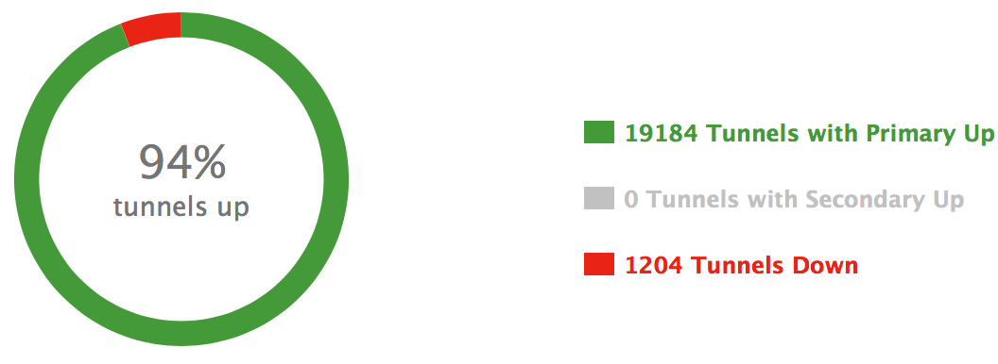
Why Automate?
Medium-size service provider has 6% of its RSVP-TE tunnels down
Due to race conditions after link failures
1200 down tunnels is too many for any operator to figure out the root cause
If these tunnels are for traffic engineering, can we really say we are successfully doing traffic engineering?
It is time for software/DevOps to manage the network?

Slide 5
Machine Learning
Applications
Autonomous driving, natural language processing, classification, recommender systems, anomaly detection, prediction, clustering, self-customization, database mining, handwriting recognition, …
Algorithms
From simple linear regression to deep neural networks
Neural networks are not new; however, access to large data sets and huge compute resources are now available and are responsible for recent attention
Very popular in 1980s; stagnated until recently
It is not necessarily good at
Magic – many algorithms require supervision
Telling what it learned
It is not always accurate; Siri doesn’t get me. I can’t even read my own handwriting…

Slide 6
Machine Learning
Trends
E.g. Detecting an optical interface card failure
Normal vs abnormal – anomaly detection
BGP route hijacking
Clustering
Subscriber behavior analysis
Recommender Systems
Find similar past behaviors

Slide 7
1. Assured Bandwidth Service Paths
Service provider wants to offer a portal where customers can request assured bandwidth service paths
Can the network assure the service?
Cannot disrupt current services; i.e. it cannot cause congestion
Shortest paths only
No existing tunnels, nor plans to introduce tunnels

Slide 8
Path Computation
Computing the shortest path is easy
Checking the interface utilizations along the shortest path is not sufficient
What happens tonight when the traffic peaks?
Or over the course of the week?
What happens when a link fails?

Slide 9
Role of Machine Learning
With nothing learned, all requests are accepted
Very high probability of causing congestion for many requests
With just the real-time network demands and paths learned
Very low probability of causing congestion in short term
High probability of causing congestion later
With week-long network demands and paths are learned
Very low probability of causing congestion now or later
Why stop at a week?
Traffic has both diurnal and weekly patterns
Networks evolve – new routers, new applications; better to forget at some point
Why not use neural networks here?

Slide 10
2. Intent Based Service Paths
Intent: provide subscribers paths with various service requirements
Low-delay paths for financial enterprises
Bandwidth-guaranteed paths for fat flows for broadcasters
Diverse paths for full redundancy
Geo-constrained paths for sensitive data
“Pay what you use” on-demand, on-the-fly paths
Subscribers
Cola, Pepsi, Red Bull,…
Paths
LA to NY low-delay path for Cola
Path may be non-shortest using RSVP-TE and SR-TE

Slide 11
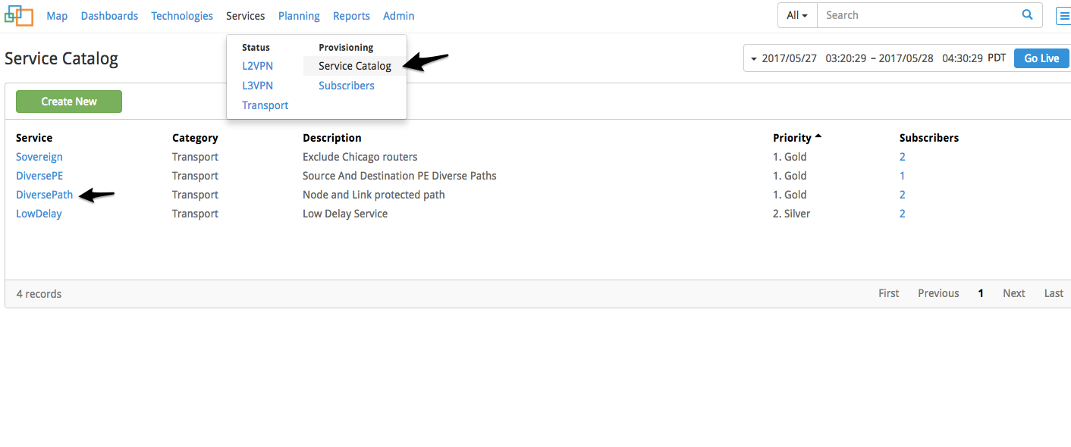
Service Creation

Slide 12
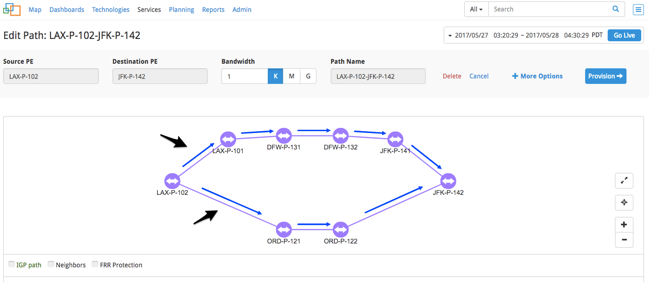
Diverse Path Creation Example

Slide 13
3. Proactive Service Restoration
Optical interface cards generate heat and eventually fail
The CRC error rate increases as the card degrades
This behavior can be learned
Service provider wants to proactively reroute critical services away from degrading equipment

Slide 14
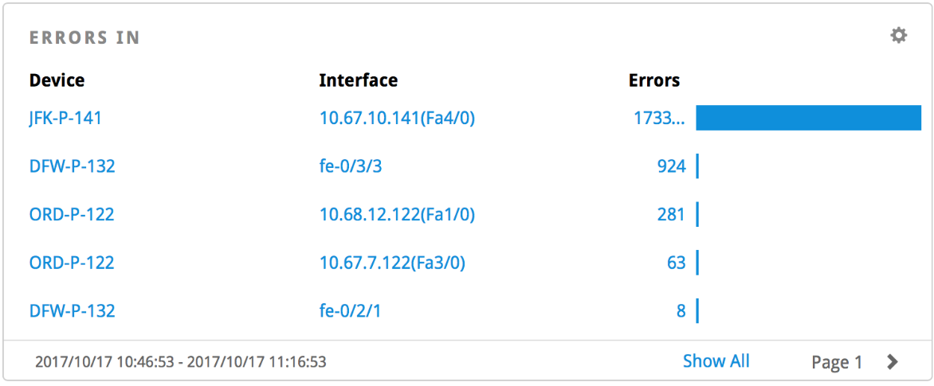
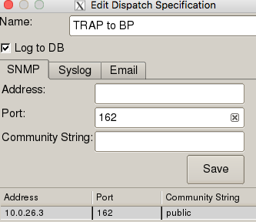
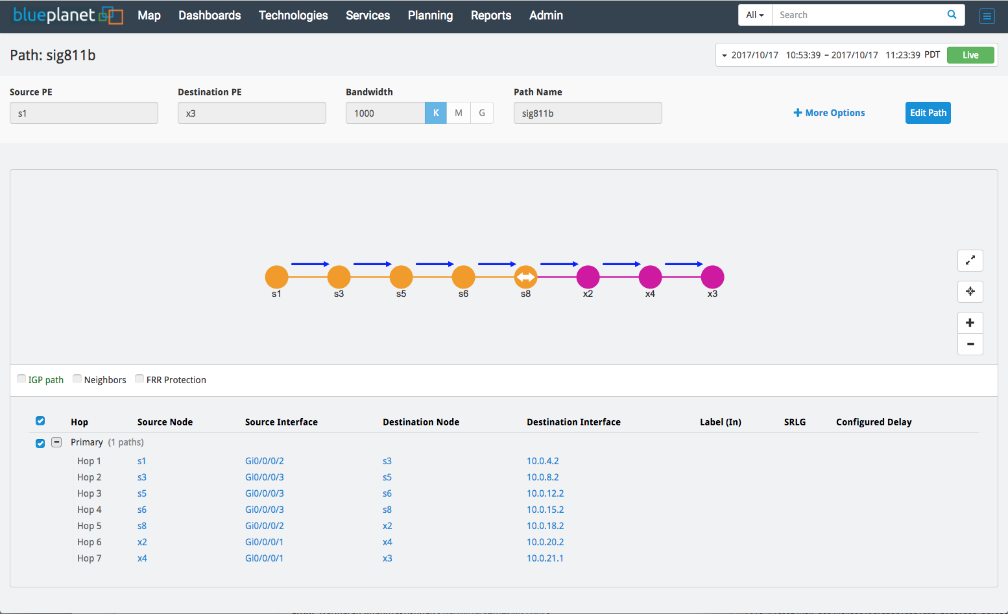
Self-Driving Network Trial
Performance Explorer detects link errors
Orchestrator is notified
Orchestrator requests new paths for critical services
New policy: “Exclude the problem link”
Path Provisioning application re-computes new paths avoiding the problem links
Orchestrator reconfigures routers

Slide 15
Role of Machine Learning
CRC error rates are baselined for anomaly detection
Need to be careful as there are no CRC errors when idle
The growth in CRC error rate can be detected
Normalization
Why not use a neural network here?
Really good match for the problem

Slide 16
Neural Networks
🏥
Input layer
The pixel values of the image
Hidden layers
Output layer
Probability of a heart attack
Age of the person
BMI
Smoker or not
Whether has high blood pressure
Training data set: 300,000 retinal images and expected outputs
Coefficients are determined by best-matching the training set
Test data set: 13,600 retinal images and expected outputs
70% accurately predicted
72% is the medical accuracy rate with a blood test

Slide 17
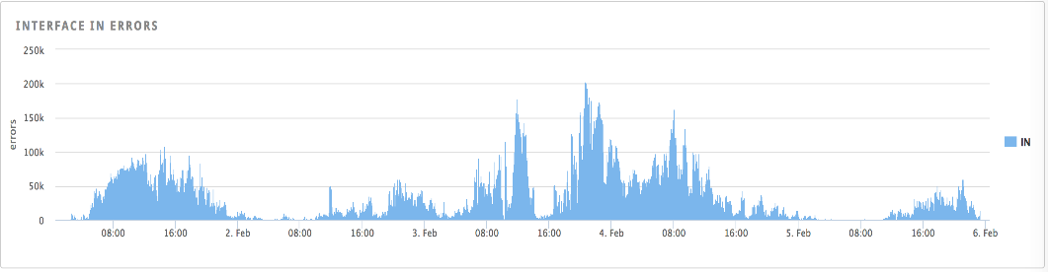
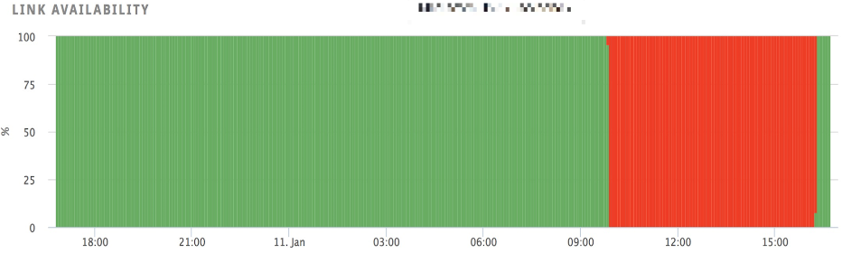
Optical Interface Failure
CRC Errors
Link Availability
Input layer: 5-minute CRC error rate for the last 30 days
Output layer: probability of a failure in next 1 hour, 1 day, 1 week, 1 month
Hidden layers: start with 2 layers and check the results if more needed
Training data set
Test data set

Slide 18
1980s All Over Again
Algorithm – yes
Access to compute power – yes
Large data sets – not yet
In the dataset:
48 link failures over the week
12 links
Only one link stayed down for more than one hour
9 interfaces with significant CRC errors, including this link

Slide 19
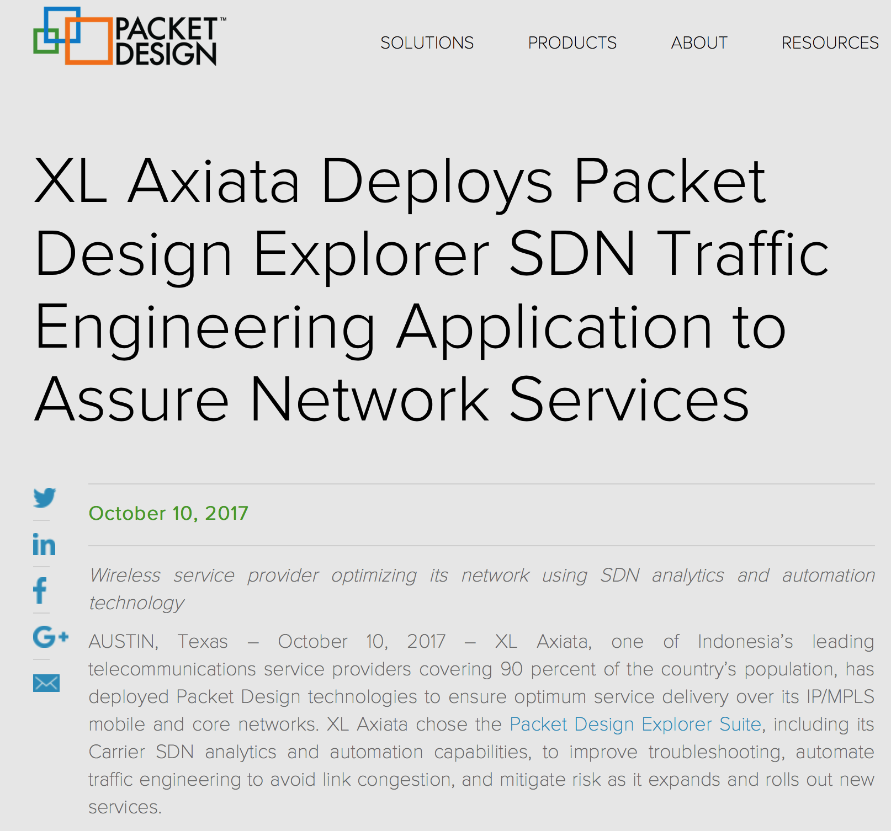
4. On-demand Traffic Engineering
Congestion caused by fiber cuts
Normally the network is run uncongested
Traditional optimization algorithms are too slow
NP-Complete
Take hours to compute
Packet Design congestion-avoidance algorithm runs in seconds
Polynomial time

Slide 20
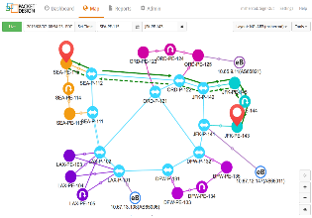
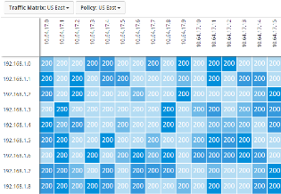





SDN Traffic Engineering Application
Policies
Topologies
Real-time physical or virtual
Link delay/loss/jitter
Baselines
Anomalies
Alerts
Traffic Matrices
Service aware
Peak or current traffic levels
Full-mesh or tactical
Network Policies
Under-/over-provision
Optimization criteria
Resiliency requirements
Etc.
TE Recommendations
Add, delete, merge, split tunnels
Closed loop: analytics & policy-based recommendations, provisioning, monitoring
Physical & Virtual Routers, Switches & Network functions
Programming
SDN controllers
Orchestrators
Notes:
The Explorer SDN Platform enables closed loop analytics and automation to create more agile networks. Instead of requiring offline planning that can take hours or days, the SDN Platform computes in seconds the optimum traffic engineering configurations to achieve desired goals.

Slide 21
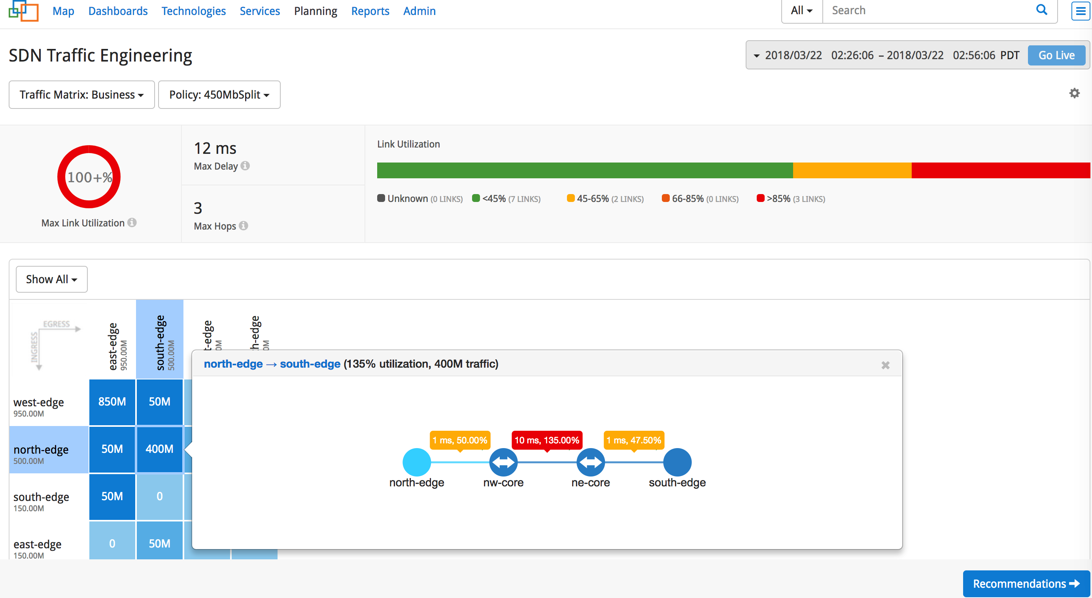
Traffic Demands and Network Conditions

Slide 22
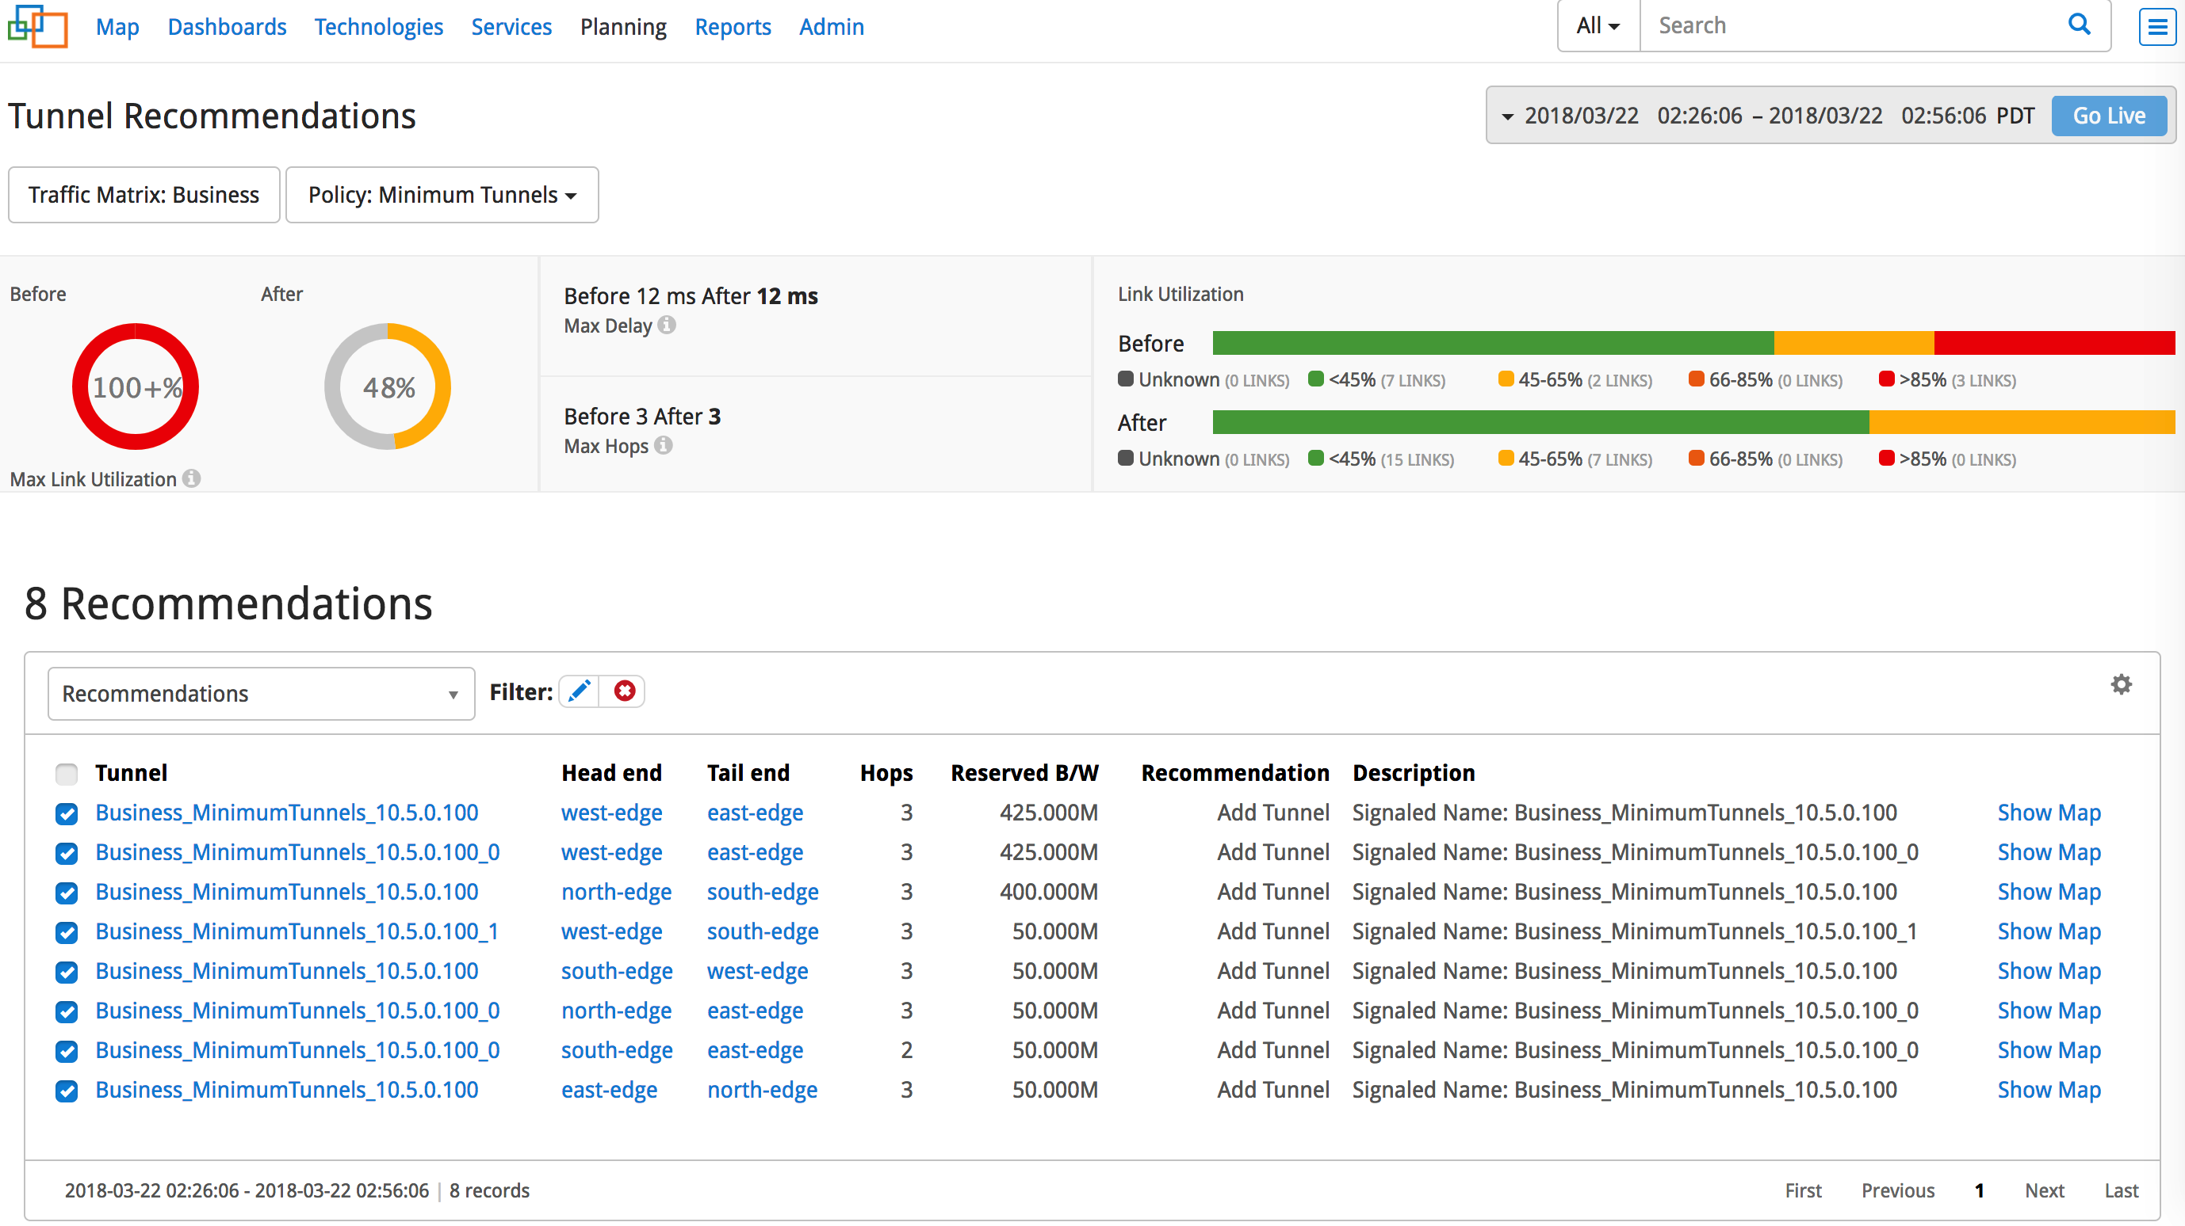

TE Saves 60% Capacity

Slide 23
5. On-Demand Multi-Layer Traffic Engineering
IP/MPLS
Transitional links
Optical
Traffic engineering at the IP/MPLS layer
IP rerouting is faster than optical – in sub-seconds
Optimization algorithm must work in seconds also, not hours
Optimizing at the IP/MPLS layer alone may not always succeed
Especially with fiber cuts
Optical network is slow but can help
Capacity of some optical paths can be adjusted
Flex-Ethernet, liquid-spectrum, partial restoration at the optical layer
New optical transport paths can be signaled

Slide 24
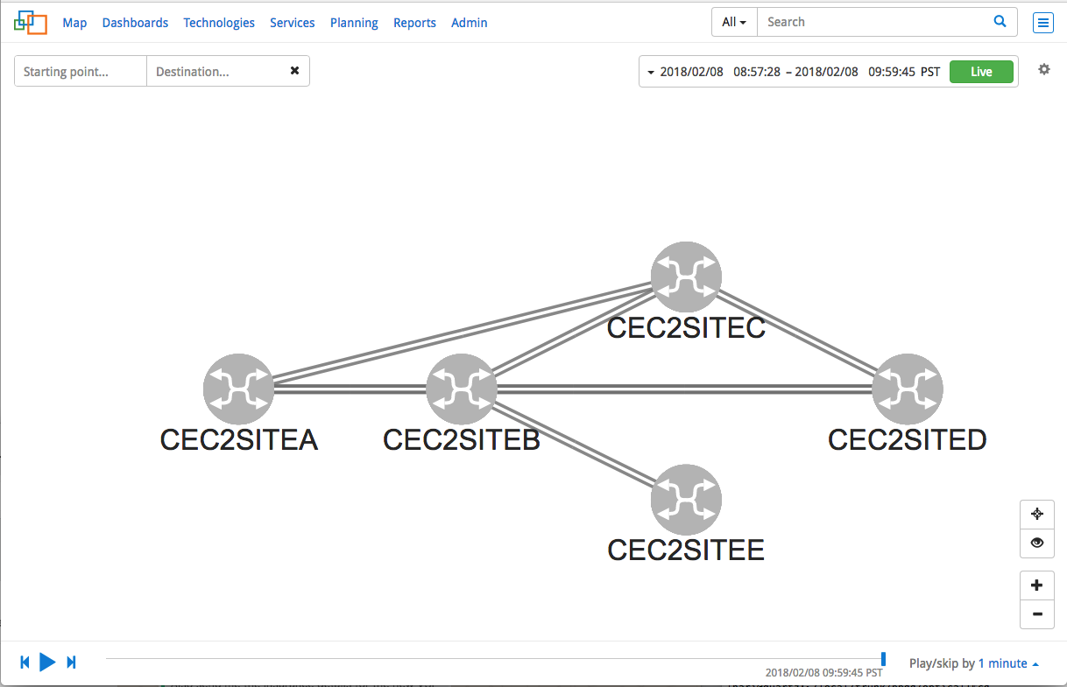
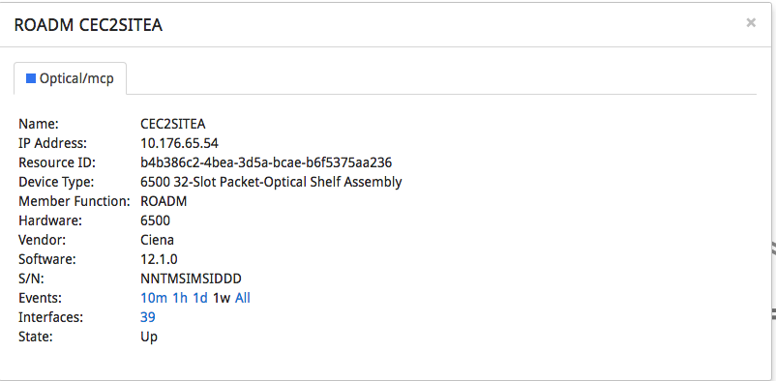
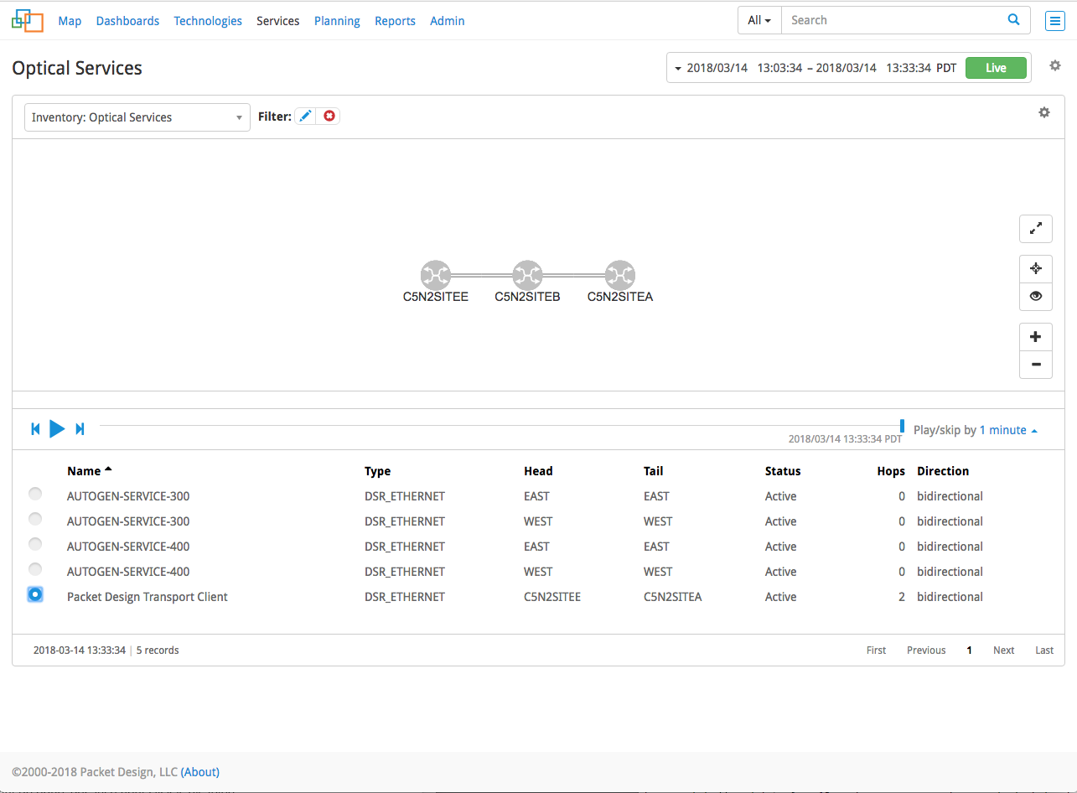
IP/MPLS and Optical Topology Correlation
Optical Service Path for an IP Link

Slide 25
Multi-Layer Traffic Engineering
It is possible to re-engineer the IP links/ports and optical service paths
However, optical rerouting is destructive and takes ~5 minutes
Re-engineer unused ports
Ports of the failed links are unused
Look for under-utilized link aggregation groups (LAGs)
Create new IP links between these ports
Only where capacity is needed
Coordinate IP and optical network changes to avoid packet drops

Slide 26


Multi-Layer Traffic Engineering
1
3
1
3
2
4
2
4
Role of IP layer
Identify the new layer 3 path
Identify how much capacity is needed and where
Role of optical layer
Repurpose an optical port on ROADM
Signal two new paths
Role of orchestrator
Coordinate the two pieces
Add new IP links to the LAGs

Slide 27
Role of Machine Learning
Many traffic patterns can be learned
Traffic matrices with neural networks
http://ieeexplore.ieee.org/document/7849067/
https://arxiv.org/pdf/1711.02833.pdf
DDoS
Traffic anomaly detection
Peering traffic optimization
…

Slide 28
BGP Route Hijacking
Happens too often
BGP makes you (in)famous
Until we can protect the routing system, we need automatic detection and fast restoration
Baselining BGP routes helps

Slide 29
BGP Route Baselines
Baselines
Origin AS
Neighbor AS
2nd hop AS
BGP next hop
Alerting

Slide 30
Concluding Remarks
Network analytics empower many service provider use cases
Network trends and anomalies can be machine learned; some failures can be predicted
Self-driving network can reroute around congestion and move critical services away from failing equipment
Correlating IP and optical layers provides a more holistic self-driving network

