Slide 1
CAREN for IPv6 deployment and measurement practices in Central Asia
Almaz Bakenov
4-5 June 2018

Slide 2
Outlines
CAREN
IPv6 deployment in Central Asia
CAREN and RIPE NCC cooperation in capacity building

Slide 3
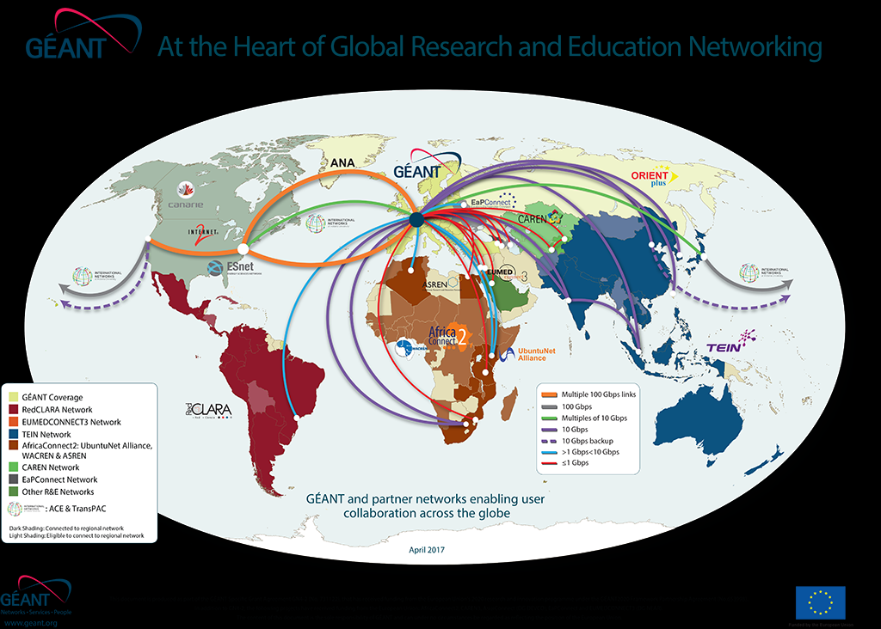
Central Asian Research Education Network

Slide 4
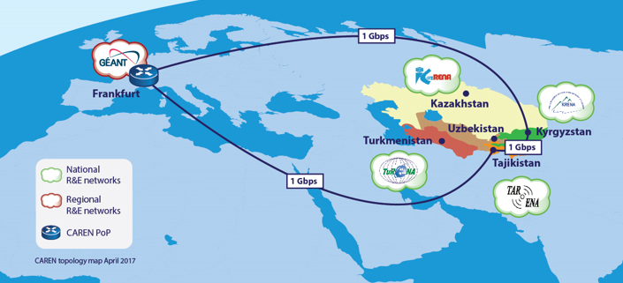

Slide 5
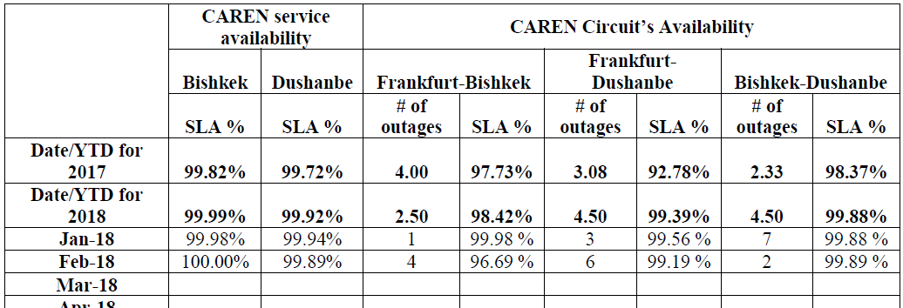
High level overview of the CAREN service

Slide 6

3-nd CAREN Regional Networking Conference (CRNC2017)
23-24 October, 2018 Dushanbe, Tajikistan

Slide 7
IPv6 deployment in the region by country
Kazakhstan: IPv6 Deployment : 16.8% (Prefixes : 21.28% | Transit AS : 67.19% | Content : 46.96% | Users : 0%) Relative Index : 1.8 out of 10
Kyrgyzstan: IPv6 Deployment : 13.08% (Prefixes : 33.33% | Transit AS : 52.3% | Content : 45.9% | Users : 0%) Relative Index : 1.4 out of 10
Tajikistan: IPv6 Deployment : 0.87% (Prefixes : 25% | Transit AS : 1.39% | Content : 48.43% | Users : 0.01%) Relative Index : 0.1 out of 10
Turkmenistan: IPv6 Deployment : 2.59% (Prefixes : 0% | Transit AS : 0% | Content : 59.65% | Users : 0.2%) Relative Index : 0.5 out of 10
Uzbekistan: IPv6 Deployment : 0.14% (Prefixes : 18.75% | Transit AS : 0.57% | Content : 43.92% | Users : 0%) Relative Index : 0 out of 10
Reference: http://6lab.cisco.com/stats/
Updated on 2018-6-4

Slide 8
IPv6 capability in the region
CC | Country | IPv6 Capable | IPv6 Preferred | Samples | Weight | Weighted Samples
KZ | Kazakhstan | 0.01% | 0.01% | 3,940,578 | 0.75 | 2,941,992
KG | Kyrgyzstan | 0.01% | 0.01% | 415,891 | 1.45 | 604,401
TJ | Tajikistan | 0.01% | 0.01% | 178,947 | 2.73 | 487,894
TM | Turkmenistan | 0.01% | 0.01% | 139,656 | 1.74 | 243,069
UZ | Uzbekistan | 0.01% | 0.01% | 672,486 | 7.03 | 4,728,729
Source: https://stats.labs.apnic.net/ipv6/XR

Slide 9
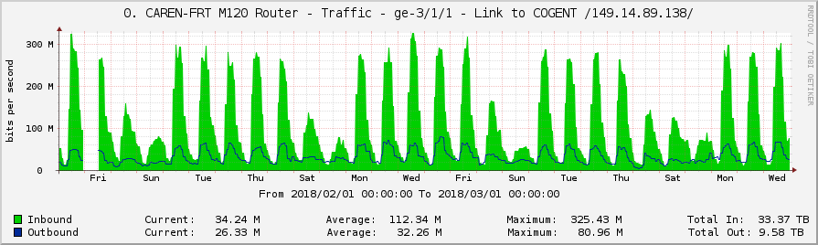
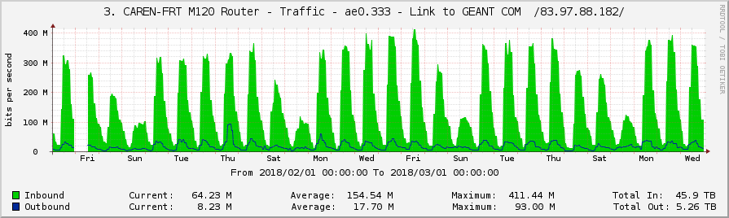
Some measurement data from CAREN
Overall CAREN Traffic Graphs for February 2018

Slide 10
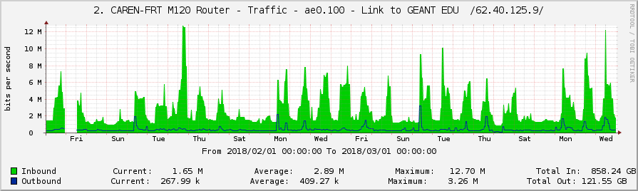
Some measurement data from CAREN
Overall CAREN Research Traffic Graphs for February 2018

Slide 11
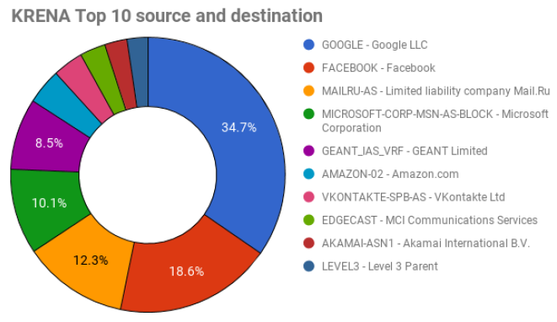
Results of Netflow collection for KRENA

Slide 12
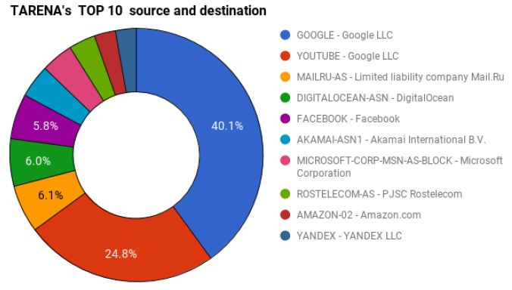
Results of Netflow collection for TARENA

Slide 13

American University of Central Asia

Slide 14
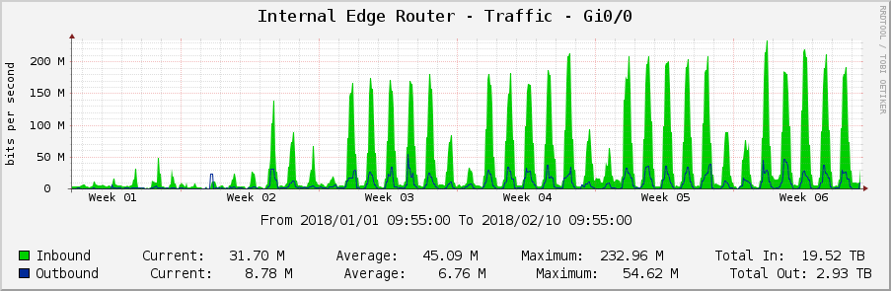
Some measurement data from AUCA
AUCA Edge Router Traffic
Period: October2017 - January2018
This graph represents overall internet traffic usage details separated into
inbound and outbound traffic.

Slide 15
CAREN and RIPE NCC cooperation
Membership
Internet measurement and data analysis (Atlas probes, etc) development
University curricula integration (credits for online courses)

Slide 16
Thank you very much!
bakenov_a@auca.kg

