Slide 1


Users’ fingerprinting techniques from TCP traffic
LUCA VASSIO
DANILO GIORDANO - MARTINO TREVISAN - MARCO MELLIA - ANA COUTO DA SILVA

Slide 2









Luca Vassio - About me
Italian Mathematical engineer with a multidisciplinary profile
PhD in Telecommunication Engineering – now postdoc
Research interests
          Data science
                Big data analytics
                Data mining and machine learning
          Human behaviour analysis and modelling
                Recommendation systems
                Social networks behaviour
                Web browsing habits
                Smart cities design
          Optimization
                Metaheuristics

Slide 3

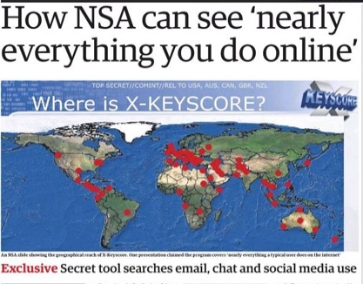
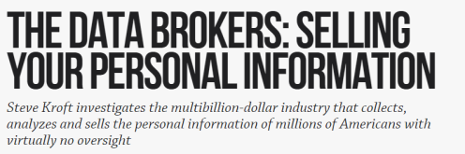

Are our interests private?
Not at all!
Huge number of trackers that record user web activities with different techniques

Slide 4

Can we be anonymous?
From a network point of view
  Does our traffic characterize us?
Users can change
  Application
  Device
  Network
HTTPS limits access to third parties
Can we still use network visible information for user fingerprinting?

Slide 5
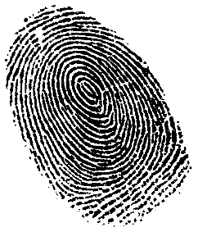














Fingerprinting: user or device?
What characterize the behaviour of the user when online
  The web-services the user access
What characterize the behaviour of the used device
  The web-services the user access
  Services that support these web-services (e.g., CDNs)
  The installed applications (e.g., software updates)

Slide 6

Contributions
Goal
Study capabilities of tracking using only visited domains (server FQDN)
Domains obtained from passive traces (TCP logs)
What is novel?
1. Only consider the name of the contacted server
2. Compare different metrics for tracking
3. Propose a methodology to identify domains intentionally requested

Slide 7
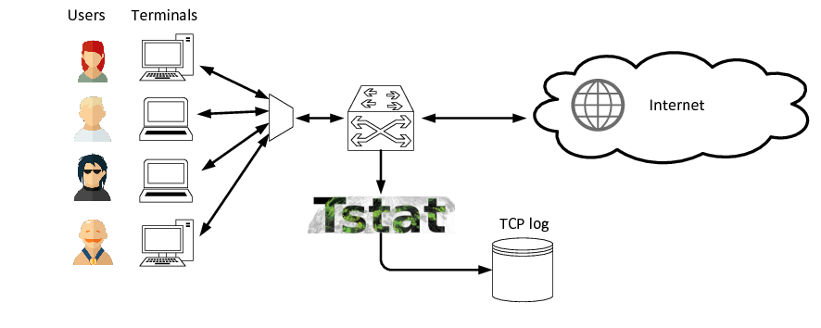
Passive network measurements
  Process of measuring the traffic exchanged between devices interconnected by a network
  Traffic generated by others and observed on client/server/network
  Example: through Tstat
ISP
network

Slide 8
TSTAT: TCP Statistics and Analysis Tool
Tstat
  Captures traffic and processes it in real-time
  Logs more than 100 statistics per TCP flow
  Logs information from every HTTP request and response
  Original server domain name retrieved by HTTP/TLS deep packet inspection
  Tracks DNS conversations to retrieve original server domain name (DN-Hunter)
More information at tstat.polito.it
Client IP | Client port | Client bytes | Server IP | Server port | Server bytes | Domain | …
12.132.54.94 | 1197 | 18938 | 87.250.137.92 | 443 | 992221 | Acme.com | ...
12.132.54.94 | 3441 | 16541498 | 123.220.231.13 | 8080 | 78661 | Example.com | ...

Slide 9

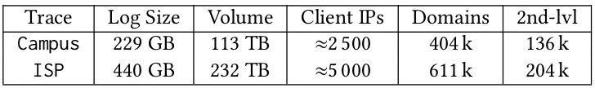
Datasets
University campus
ISP
Users with fixed IP addresses - used as client ID
4 weeks in 2017
Software: Apache Spark in a 20-machine Hadoop cluster
Computation: reading and processing Campus dataset in ~20 minutes

Slide 10


Ethics & Privacy
University ethical board: data collection reviewed and approved
Protect leakages of private information
Anonymize IP addresses - irreversible hash functions
Save only data strictly needed
i) Anonymized IP addresses
ii) Name of domain
iii) Timestamp of the TCP connection
ISP dataset: reviewed and approved by ISP security board
i) No information about ISP customers
ii) Domain names never saved

Slide 11

Similarity computation
Hypothesis: users are repetitive over time!
Goal: identify user among profiles built in the past by checking visited domains
Profile the users creating fingerprints
Identify user in a later trace
Performance metric: percentage of users correctly identified
Select a fixed number of users in all tests → meaningful comparisons

Slide 12
Similarity computation
Three methodologies for similarity among fingerprinting sets
1. JACCARD INDEX
2. MAXIMUM LIKELIHOOD ESTIMATION
3. COSINE SIMILARITY BASED ON TF-IDF

Slide 13
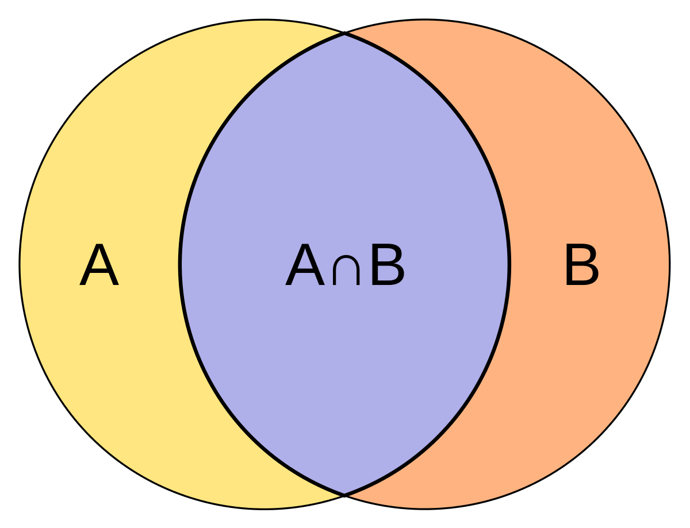
1. Jaccard index
Size of intersection divided by size of the union of two sample sets
Just depends on two domains sets
Fast computation time

Slide 14

2. Maximum likelihood estimation
Behavioral model: user’s likelihood of visiting a domain governed by
(i) Domain overall popularity
(ii) Whether domain already appeared in her previous domains set
Each user has personalized factor of attraction towards past domains
Identification: for each user, likelihood of generating the future set with the model
Model proposed in:
J. Su, A. Shukla, S. Goel, and A. Narayanan. 2017. De-anonymizing Web Browsing Data with Social Networks. Proocedings of the WWW 2017. 1261-1269.
Future
Past

Slide 15
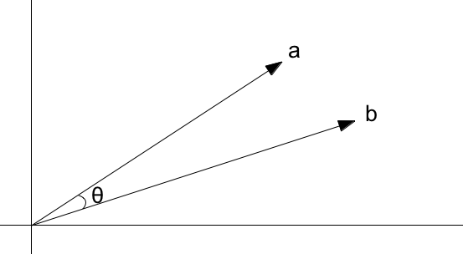
3. Cosine similarity with TF-IDF
TF-IDF
Statistic per domain and per user
Reflects
  How important a domain is for a user (TF – Term Frequency)
  With respect to all users (IDF – Inverse Document Frequency)
Identification:
Cosine distance of vectors of TF-IDFs of domains

Slide 16

Computational complexity
M users each with ≈ N domains
P is the total number of domains seen by all the M users, with N ≤ P ≤ M · N
Jaccard index computation costs at most O (M · N^2)
TFIDF and MLE methodologies cost at most O (M · N · P), using larger set of all domains
Hashing methodology could be used on top of our computation to speed-up the process. Computation cost decrease to O (M · N) for Jaccard and O (M ·P) for MLE and TFIDF
In case of very large population, it is therefore much faster to use the simpler Jaccard similarity

Slide 17
Core and support domains
Are all domains equal?
Core domain: are intentionally requested by a user to download the page HTML document
e.g.: www.facebook.com and en.wikipedia.org
Support domains: remaining ones triggered by website visits, or by background applications
e.g.: static.xx.fbcdn.net and client.dropbox.com
Core domains might be more important for fingerprinting
      Accuracy
      Interpretability
      Independence from device
www.facebook.com
Html
static.xx.fbcdn.net
image
video
dl-client.dropbox.com
CSS
JavaScript
static.xx.fbcdn.net
cdn.01.com

Slide 18

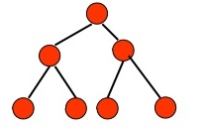
Identify core domains
Classification task
Machine learning methodology: decision tree classifier
Build a labeled dataset for training and testing
Get features: active crawling visiting home page of each domain (Selenium)
Features selection: HTML document size and redirection to external domain
Classifier training: C4.5
Results: accuracy 96%
Execution time: 1 hour for classifying 404 k domains
Bottleneck: Internet access speed (1Gbps)

Slide 19
Results

Slide 20
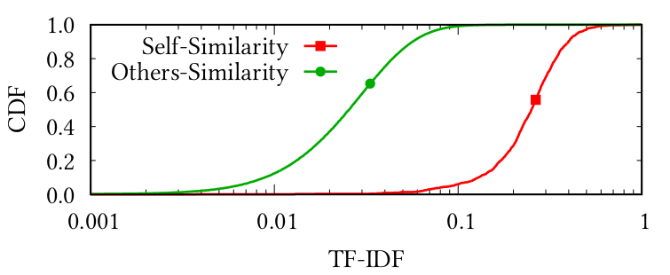
Is user browsing repetitive?
Campus dataset
One week for profiling and identification
Users behave similar over time
Users are different among themselves
Discriminative power of the profiles

Slide 21
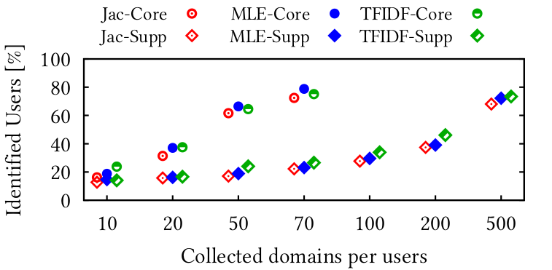
Number of domains
Campus dataset
Core/support domains for profiling and identification tasks
The bigger the set, the better the identification
Core domains better characterizing - 500 support ~ 70 core
Jaccard index worst method
TFIDF best results
MLE slightly better with core domains

Slide 22
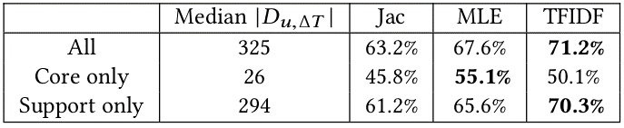
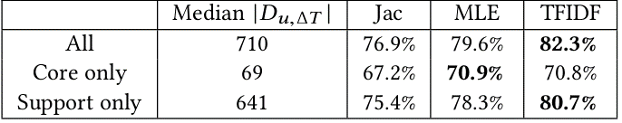
Observation time
Campus dataset
Users have different rates for discovering domains
Keep constant observation time (profiling/identification)
Two consecutive days Two consecutive weeks
Much more support domains than core ones
Quantity of support domains helps identification (personalized ads/tracking)
Jaccard worst performance
TFIDF overall best performance
With few core domains MLE better
domains
domains

Slide 23
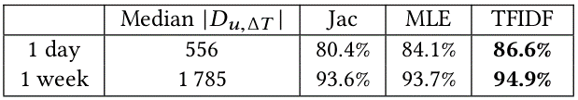
The ISP case
Let’s apply what we have learned to the ISP case
Residential access
  More heterogeneous users
  Devices multiplexed on same IP address of the access gateway
  All domains – no distinction between core/support
Bigger amount of data
More distinct and repetitive behavior: easier to fingerprint and identify
domains

Slide 24
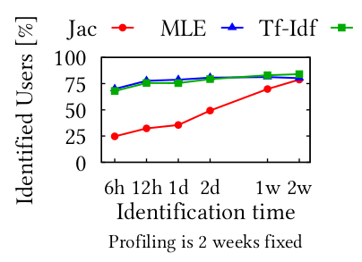
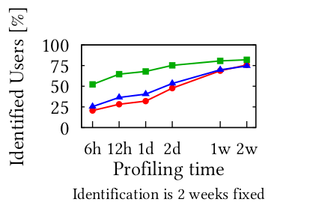
Longer profiling or identification?
Campus dataset
2. Fixed 2 weeks identification, variable profiling time
Fixed 2 weeks profiling, variable identification time
Jaccard is symmetric
TFIDF and MLE account for whole population when profiling
TFIDF and MLE good even with few hours of identification
Large profiling sets more important than identification

Slide 25

Conclusions
Still no privacy and anonymity online, even from the network point of view
Good similarity metrics and machine learning application can improve forensics applications:
A simple TFIDF approach can solve identification problem
Web-services intentionally requested (core) better characterize users
But support domains are also important due to their quantity
Future work: analyze point of view of tracker applications
Foster new studies and permit results reproducibility!
Data and models available at bigdata.polito.it/content/domains-web-users

Slide 26

Luca Vassio, Danilo Giordano, Martino Trevisan, Marco Mellia, Ana Paula Couto da Silva, Users' Fingerprinting Techniques from TCP Traffic, ACM SIGCOMM Workshop on Big Data Analytics and Machine Learning for Data Communication Networks, 2017
Want to talk with me? Propose something interesting for my future?
Luca Vassio luca.vassio@polito.it
lucavassio.wordpress.com

