Slide 1
Anti Spoofing. Reboot.
Alexander Azimov <aa@qrator.net>

Slide 2
IP Spoofing
Attacks on TCP stack;
TCP floods (SYN, ACK,…);
Reflection Attacks;
Amplification Attacks.

Slide 3
DDoS Amplifiers
Source: Qrator Labs annual report 2017

Slide 4
BCP84: uRPF
https://tools.ietf.org/html/bcp84
Strict mode;
Feasible mode;
Loose mode.

Slide 5
Strict Mode
Provider C
Ingress Traffic
Egress Traffic
Provider A
Provider B
Provider | AS_PATH
A | X
B | X
C | A X
x.x.x.0/24
x.x.x.0/24
CustomerX
Rule: incoming interface = interface for the best route for SRC_IP

Slide 6
Loose Mode
Provider C
Ingress Traffic
Egress Traffic
Provider A
Provider B
Provider | AS_PATH
A | X
B | X
C | A X
x.x.x.0/24
x.x.x.0/24
CustomerX
Rule: there is a route for SRC_IP

Slide 7
Feasible Mode
Provider C
Ingress Traffic
Egress Traffic
Provider A
Provider B
Provider | AS_PATH
A | X
B | X
C | A X
x.x.x.0/24
x.x.x.0/24
CustomerX
Rule: incoming interface = interface for the best route for SRC_IP

Slide 8
Feasible Mode
Provider C
Ingress Traffic
Egress Traffic
Provider A
Provider B
Provider | AS_PATH
A | X
B | C A X
C | A X
x.x.x.0/24
CustomerX
Rule: incoming interface = interface for the best route for SRC_IP

Slide 9
BCP84: uRPF
https://tools.ietf.org/html/bcp84
Strict mode – not working;
Loose mode – does nothing.
Feasible mode – not working;

Slide 10
Problem Statement
A distance-vector protocol isn't the best way to propagate availability information.

Slide 11
Option №1: New SAFI

Slide 12
Hacking

Slide 13
Option №2: AS-SETs
Provider C
Ingress Traffic
Egress Traffic
Provider A
Provider B
Provider | AS_PATH
A | X
B | X
C | A X
x.x.x.0/24
x.x.x.0/24
CustomerX
Rule: Check that SRC_IP belongs to customer’s AS_SET

Slide 14
Option №2: AS-SETs
Transformation of ingress filters into ACLs.
Positive:
We do not need to change specification;
We do not need to ship new software;
Can be used by any ISP, isn't it?
Negative:
AS-SETs are outdated, unauthorized;
Scalability problems.

Slide 15
Option 3: GRSH + Feasible Mode
Provider C
Ingress Traffic
Egress Traffic
Provider A
Provider B
Provider | AS_PATH
A | X
B | C A X
C | A X
x.x.x.0/24
x.x.x.0/24
GRSH
CustomerX
A new transit well-known community that sets LOCAL_PREF to 0.

Slide 16
Option 3: GRSH + Feasible Mode
Provider C
Ingress Traffic
Egress Traffic
Provider A
Provider B
Provider | AS_PATH
A | X
B | C A X
C | A X
x.x.x.0/24
x.x.x.0/24
GRSH
CustomerX
Provider B sees x.x.x.0/24 route, but doesn’t use it.
x.x.x.0/24 route marked with GRSH – informational message

Slide 17
Option 3: GRSH + Feasible Mode
Provider C
Ingress Traffic
Egress Traffic
Provider A
Provider B
Provider | AS_PATH
A | X
B | C A X
C | A X
x.x.x.0/24
x.x.x.0/24
GRSH
CustomerX
Works only for multihomed ISPs…
But it more then 85% of all ISPs in the world!

Slide 18
Option 3: GRSH + Feasible Mode
GRACEFUL_SHTUTDOWN community creates informational message for directly connected peers.
Positive:
We do not need to change specification;
We do not need to ship new software;
We solve problem for multihomed of ISPs.
Negative:
A lot of work with customers is required;
Doesn’t work between transit ISPs.

Slide 19
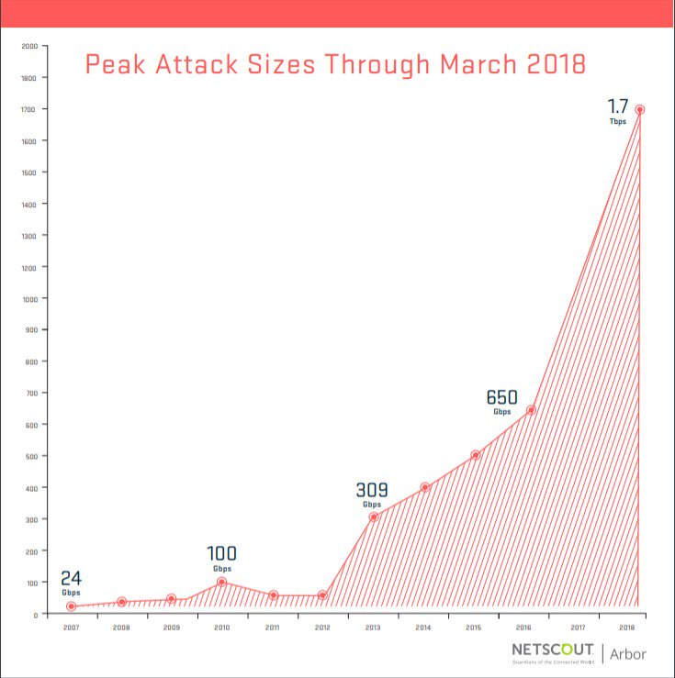
Option 4: Do Nothing.
But are you prepared?

Slide 20
http://etc.ch/kfR6/

