Slide 1



NAT64/DNS64 real life experiments and one useful tool – NAT64Check
...from go6lab.si and IPv6-lab.net
Brought to you by:
Jan Žorž Sander Steffann
zorz@isoc.org sander@steffann.nl

Slide 2
Problem statement and real world status
(Six Degrees of Inner Turbulence)
IPv6 and IPv4 are incompatible on the wire.
We need transition and translation mechanisms between the two protocols
Mobile operators are massively switching devices to IPv6-only connectivity
  millions of users
  using 464XLAT (Android) or plain NAT64 (Apple) as a transition tool to access IPv4 content
Some people do weird stuff while adding AAAA to their DNS records
Important questions:
  Do content providers know how their content will be seen from such environments?
  Do connectivity providers know what their users’ experience on IPv6-only would be?

Slide 3

Credits, acknowledgments and supporters
(Metropolis, Pt. 1: The Miracle and the Sleeper)
Projects like this and all the massive amount of work cannot be performed without great support of people and companies that we work with:
Internet Society - for Jan’s working time and funding of the numerous travels where we got the idea of the IPv6 issues while talking to operators and also future travels where we’ll talk about this topic (we are here, aren’t we? :) )
Go6 Institute Slovenia - for funding and running the Go6lab where we got connectivity, HW, SW and place to experiment with all this things IPv6
SJM Steffann for Sander’s working time, coding skills, massive energy and also HW/SW in their ipv6-lab.net to make this tool redundant.
Corinne Pritchard for a lovely design of a tool’s front-end. Hugs :)

Slide 4
Go6lab NAT64/DNS64 public test-bed
(The Test That Stumped Them All)
Aimed at everyone who would like to test NAT64/DNS64 functionality
4 different implementations, 4 different instructions how to direct traffic there
Used by operators
  Testing the idea of providing NAT64/DNS64 and/or 464XLAT to their users
Used by application providers
  To see how their apps works in NAT64/DNS64 environment
Used by HW/SW vendors
  Testing their solutions against multiple NAT64 vendors
Gained quite some traction and momentum this days
Instructions: https://go6lab.si/current-ipv6-tests/nat64dns64-public-test/

Slide 5
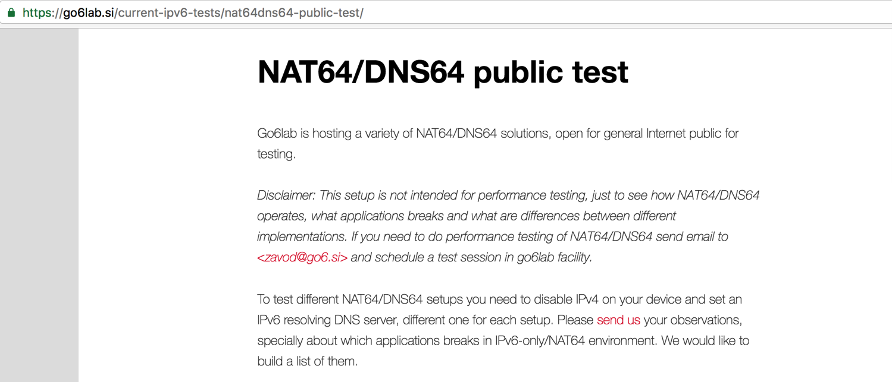
Go6lab NAT64/DNS64 test-bed

Slide 6
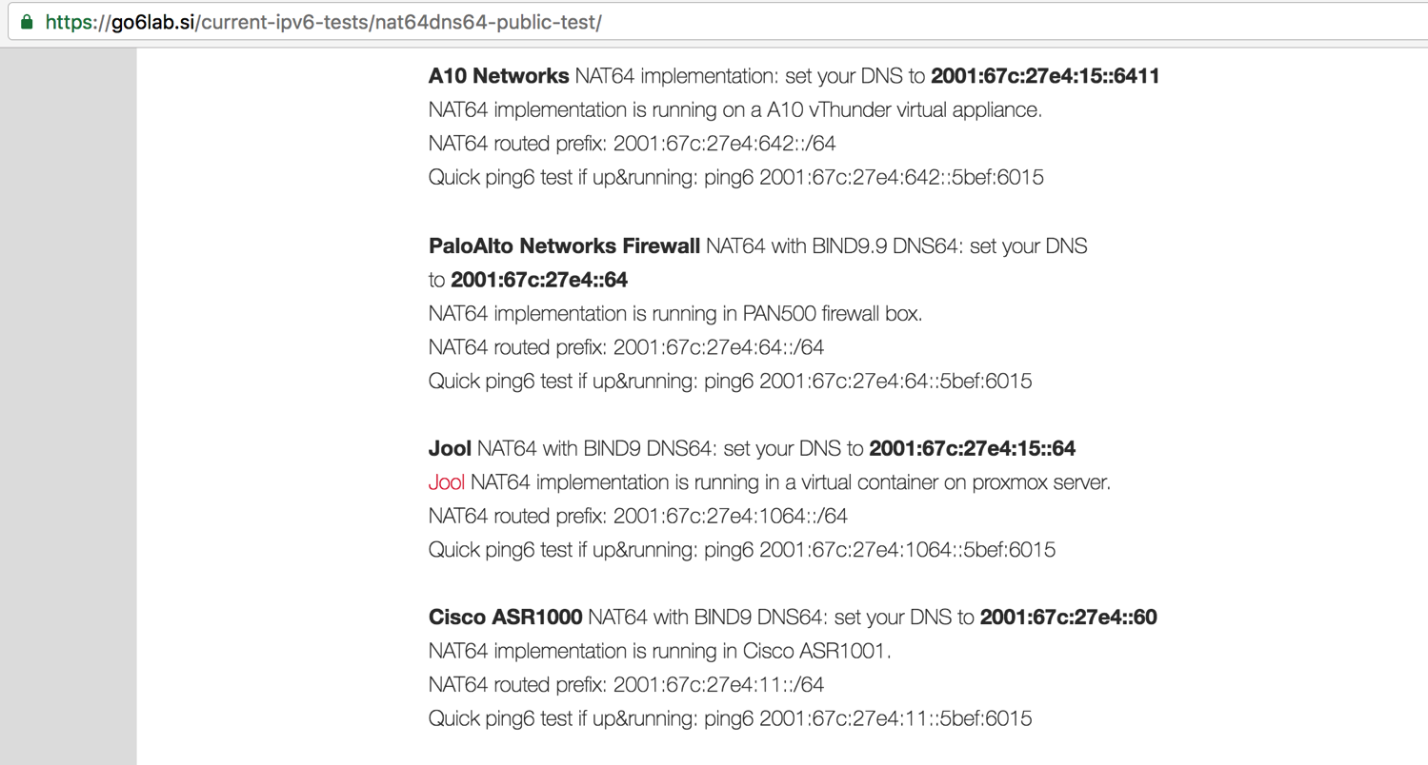
Go6lab NAT64/DNS64 test-bed

Slide 7
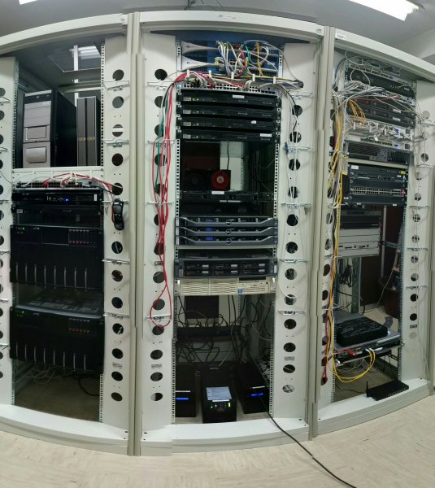
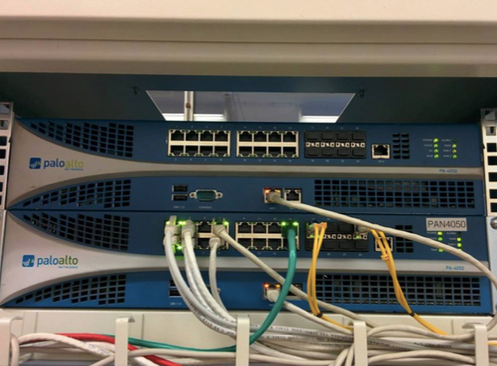
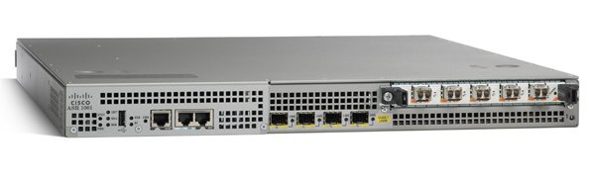
Go6lab NAT64/DNS64 test-bed HW/SW
(Systematic Chaos)

Slide 8
Some DNS admins put “crap” in AAAA records
(The Enemy Inside)
Have you ever seen any of this values for AAAA record?
  ::
  ::1
  ::ffff:[IPv4_addr]
  fe80::[some_value]
  64:ff9b::[some_value]
  2001:DB8::[some_value]
If you have seen something like this and you know who did it, talk to that people and tell them to fix it. This sort of thing isn’t useful to anybody and severely impacts user experience.
More: http://www.employees.org/~dwing/aaaa-stats/ (courtesy of Dan Wing)

Slide 9
Causing confusion with or without www
(Breaking All Illusions)
sander@MacPro:~$ host www.firstinsight.com
www.firstinsight.com is an alias for 160569.group19.sites.hubspot.net.
160569.group19.sites.hubspot.net is an alias for cos2mdc.hubspot.net.mdc.edgesuite.net.
cos2mdc.hubspot.net.mdc.edgesuite.net is an alias for a1711.b.akamai.net.
a1711.b.akamai.net has address 88.221.254.18
a1711.b.akamai.net has address 88.221.254.10
sander@MacPro:~$ host firstinsight.com
firstinsight.com has IPv6 address ::
firstinsight.com mail is handled by 10 mx1.emailsrvr.com.
firstinsight.com mail is handled by 20 mx2.emailsrvr.com.

Slide 10
When deploying in real life you need “fixes”
(Build Me Up, Break Me Down)
So, what can we do about it?
We can figure out who this people are, contact them, warn them about the issue, educate them and ask them to fix the problem.
Remember: If you are not part of solution, you are part of the problem.
At the same time we can protect our users from bad user experience and set the “exclude” rules in our DNS64 servers. IANA allocated 2000::/3 as global unicast address pool, so whatever else is used in AAAA - it’s by default bogus and we can safely ignore that.

Slide 11
When deploying in real life you need “fixes”
(Stream of Consciousness)
BIND9 example of DNS64 configuration in go6lab:
dns64 2001:67c:27e4:64::/96 {
clients { any; };
mapped { !rfc1918; any; };
exclude { 0::/3; 4000::/2; 8000::/1; 2001:DB8::/32; };
break-dnssec yes;
};
Explanation of “exclude” configuration parameter: If DNS64 server gets an AAAA record with a value of anything outside 2000::/3 - it ignores it and synthesizes the AAAA record from NAT64_prefix::IPv4_address

Slide 12
When deploying in real life you need “fixes”
(Moment Of Betrayal)
This fixes the most common errors and keeps your users relatively safe from bad user experience when using 464XLAT and NAT64
This also prevent issues when AAAA record contains an IPv6 documentation prefix, that is inside 2000::/3 block.
“Break-dnssec yes” configuration directive:
  By default, DNS64 module does not process queries that request DNSSEC data (DO = 1) or that have DNSSEC RRs in the answer. Setting break-dnssec yes will override this default and cause policy processing on all DNSSEC queries. However, the constructed response will not have any DNSSEC records added and therefore cannot be verified by the client (it may have the unintended consequence of looking like a bogus response or even an injection attack to the client).

Slide 13
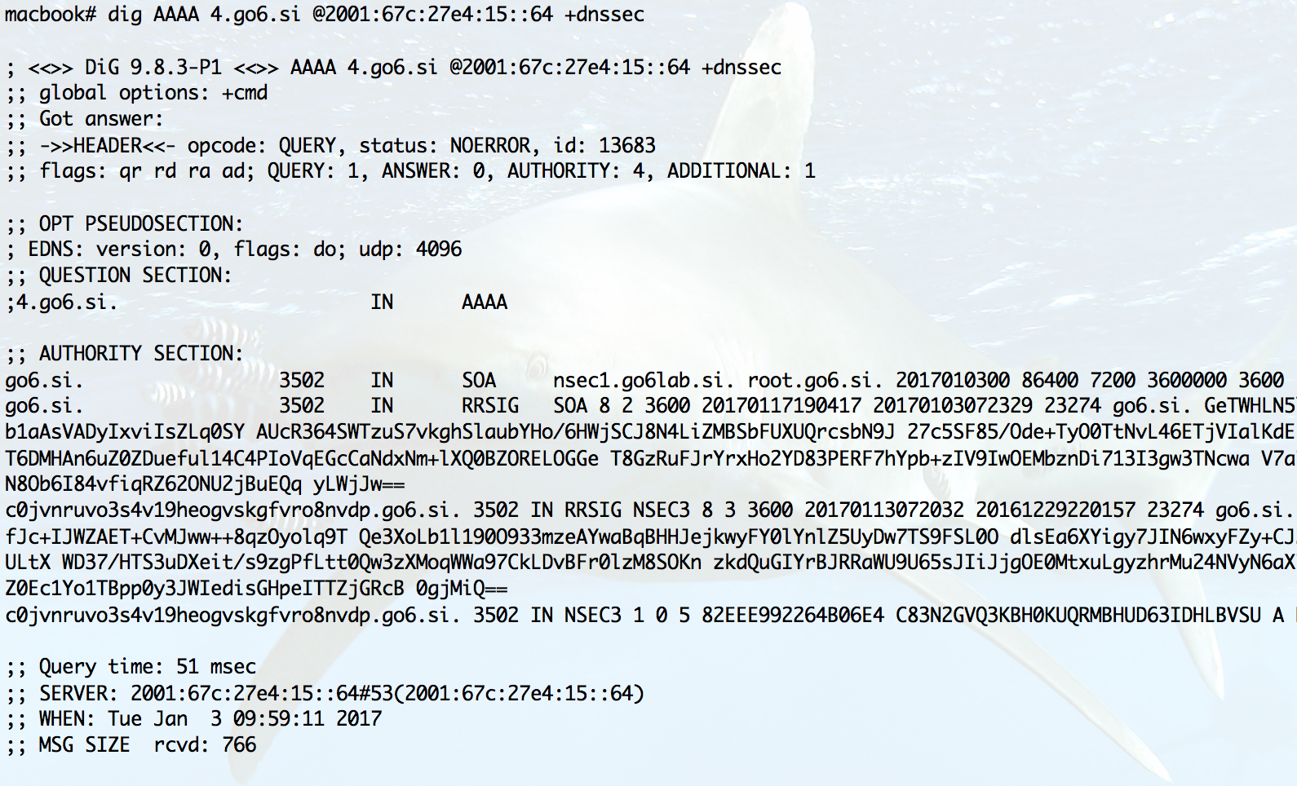
Without
break-dnssec yes;
(Enigma Machine)
???

Slide 14
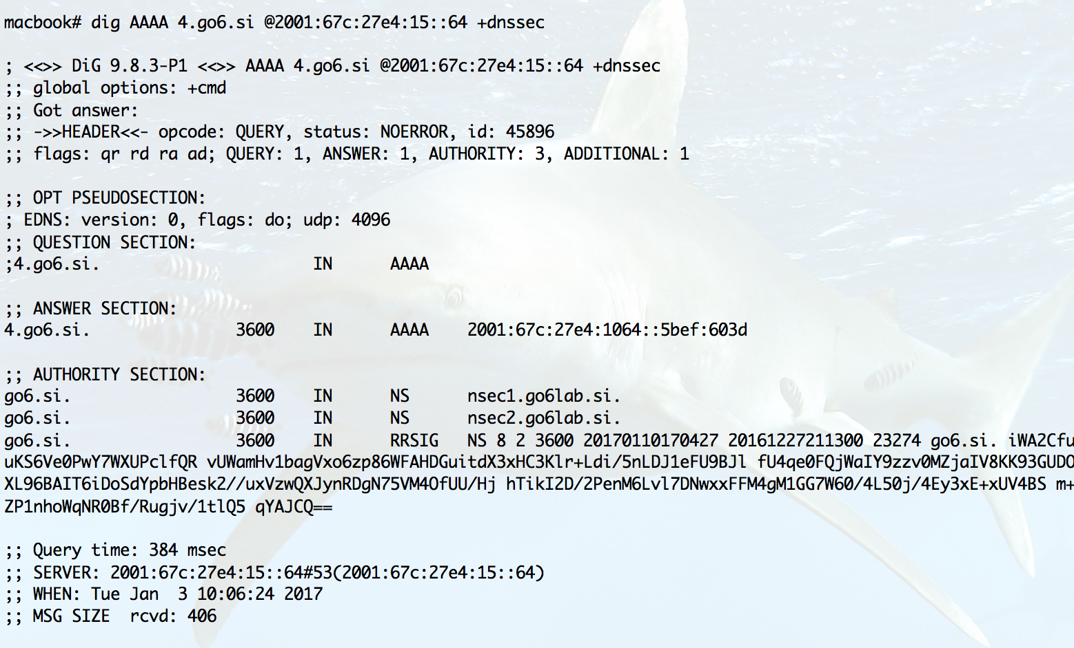
With
break-dnssec yes;
(Enigma Machine)

Slide 15
When deploying in real life you need “fixes”
(Stream of Consciousness)
Unbound example of DNS64 configuration in go6lab:
server:
module-config: "dns64 validator iterator"
dns64-prefix: 2001:67c:27e4:64::0/96
private-address: 0::/3
private-address: 4000::/2
private-address: 8000::/1
private-address: 2001:DB8::/32
# private-address: 64:FF9B::/96
# private-address: ::ffff:0:0/96
# private-address: ::1/128
# private-address: ::/128
interface: 2001:67c:27e4::64

Slide 16
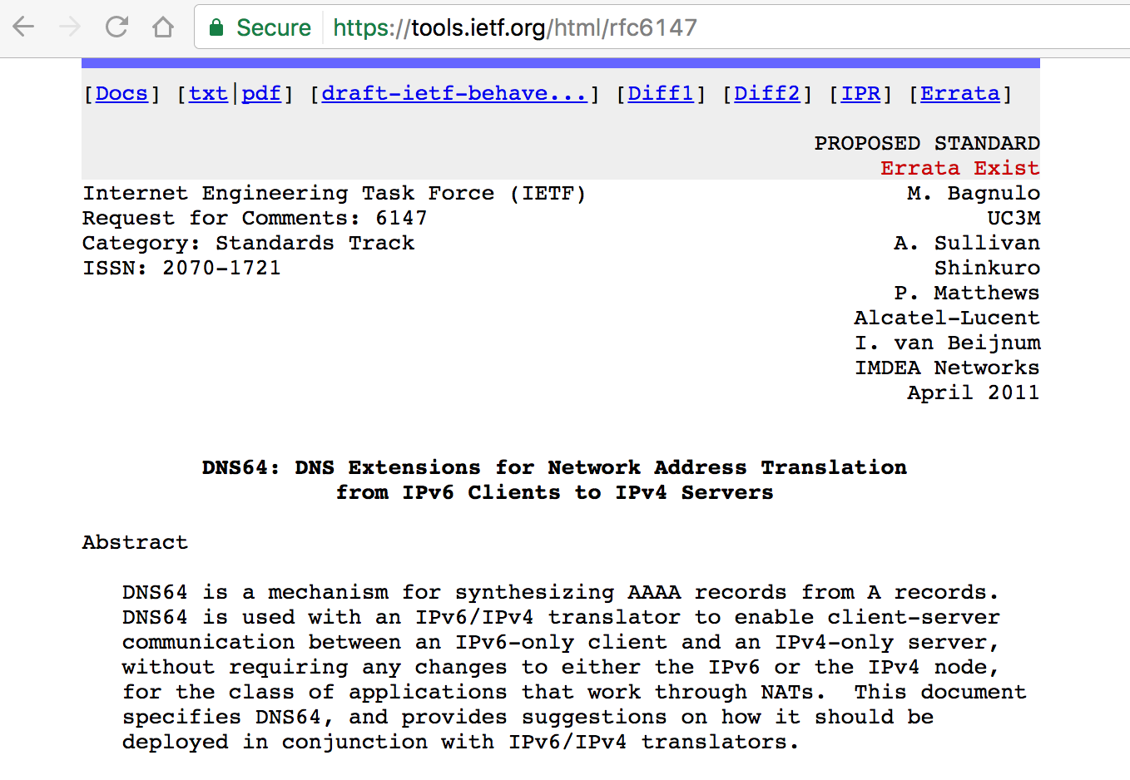
More reading on DNS64 and DNSSEC – RFC 6147

Slide 17

Oops: firewalls.com
IPv4
NAT64

Slide 18
Oops: firewalls.com
Still waiting for that timeout…
IPv4
NAT64

Slide 19
Oops: firewalls.com
Indeed, very secure...
IPv4
NAT64

Slide 20
Oops: firewalls.com
Indeed, very secure, running on ::ffff:209.59.134.0…
IPv4
NAT64

Slide 21


Good DNS, bad server: notificaciones.060.es
IPv4
IPv6 and NAT64

Slide 22
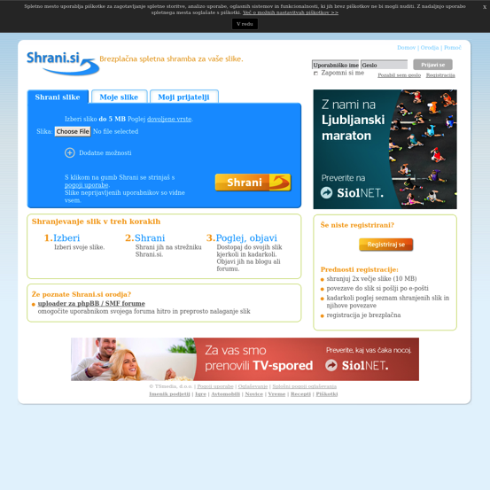
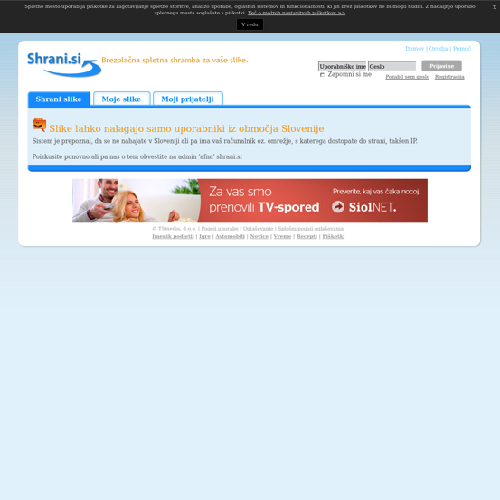
Good DNS, bad geolocation tool: shrani.si
IPv4
IPv6 and NAT64

Slide 23
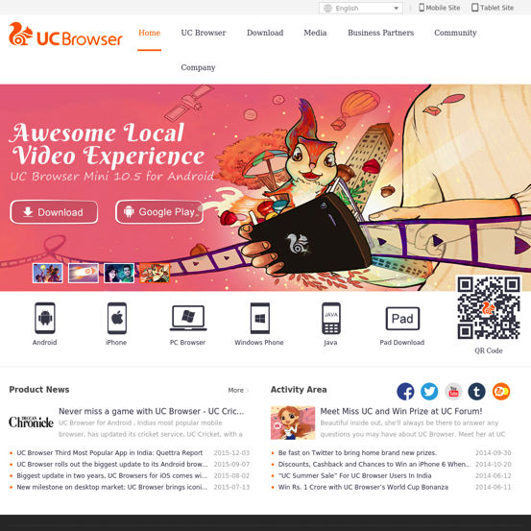
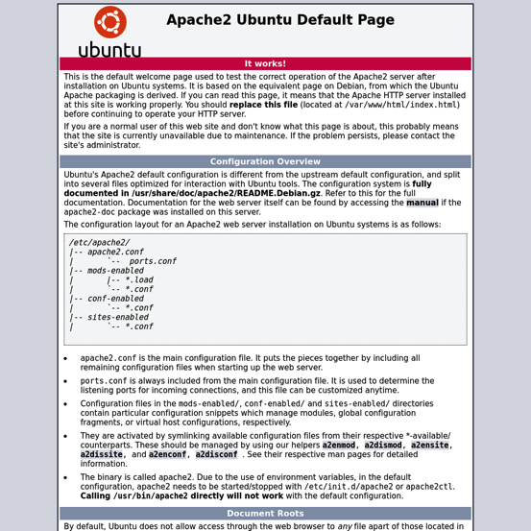
No AAAA, server still confused: uc.cn
IPv4
NAT64

Slide 24
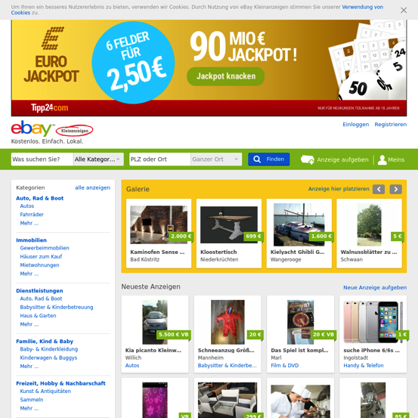
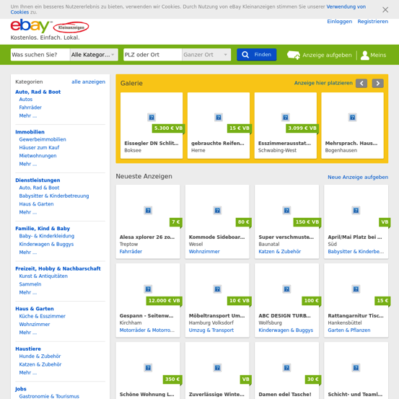
Good server, bad content: ebay-kleinanzeigen.de
IPv4 and NAT64
IPv6

Slide 25


Good server, bad content: thegatewaypundit.com
IPv4 and NAT64
IPv6

Slide 26
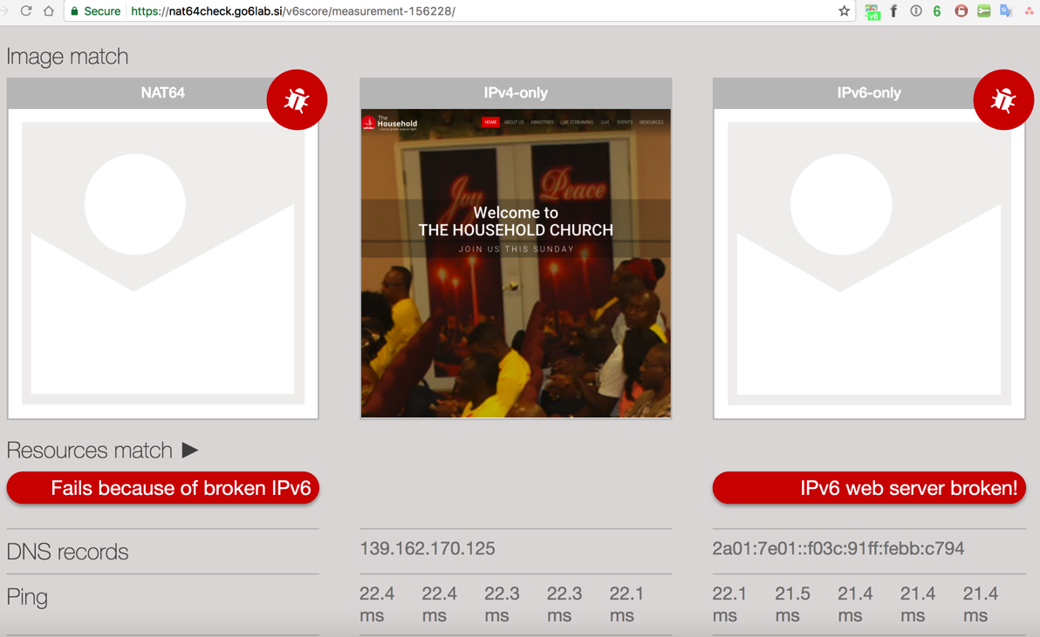
Non working AAAA record = broken NAT64 ☺

Slide 27
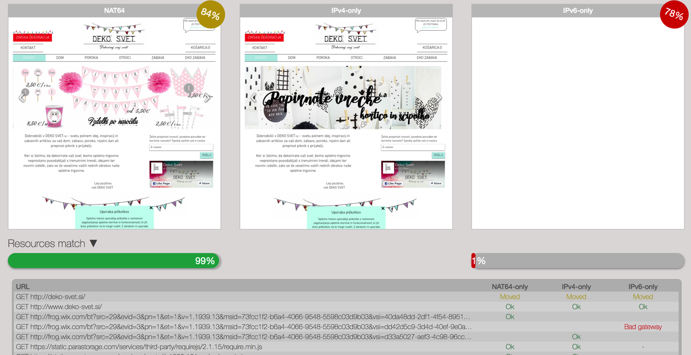
Working AAAA record and IPv4-only content

Slide 28
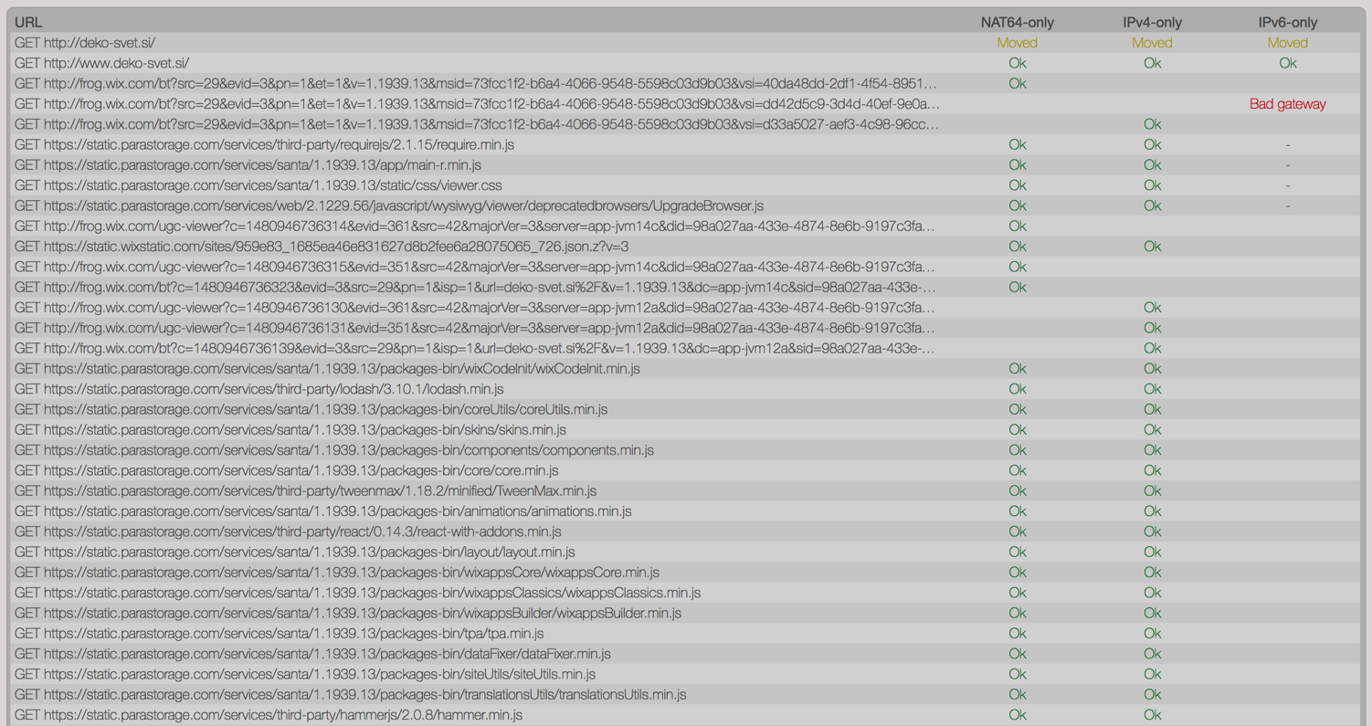
Working AAAA record and IPv4-only content

Slide 29
How to test for all of these things?
(The Looking Glass)
There are many things to test:
  Test on NAT64
  Test on IPv6-only
  Did all resources (images, stylesheets, scripts) load ok?
  Does it look good to the user?
  Do we see any pMTUd issues?
One service to test them all: NAT64Check !!!

Slide 30
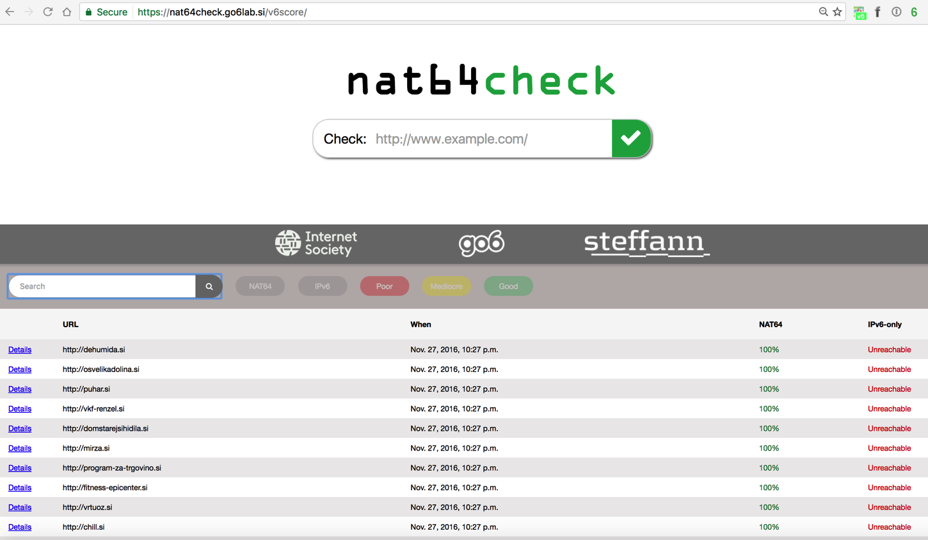
(Caught in a web)

Slide 31
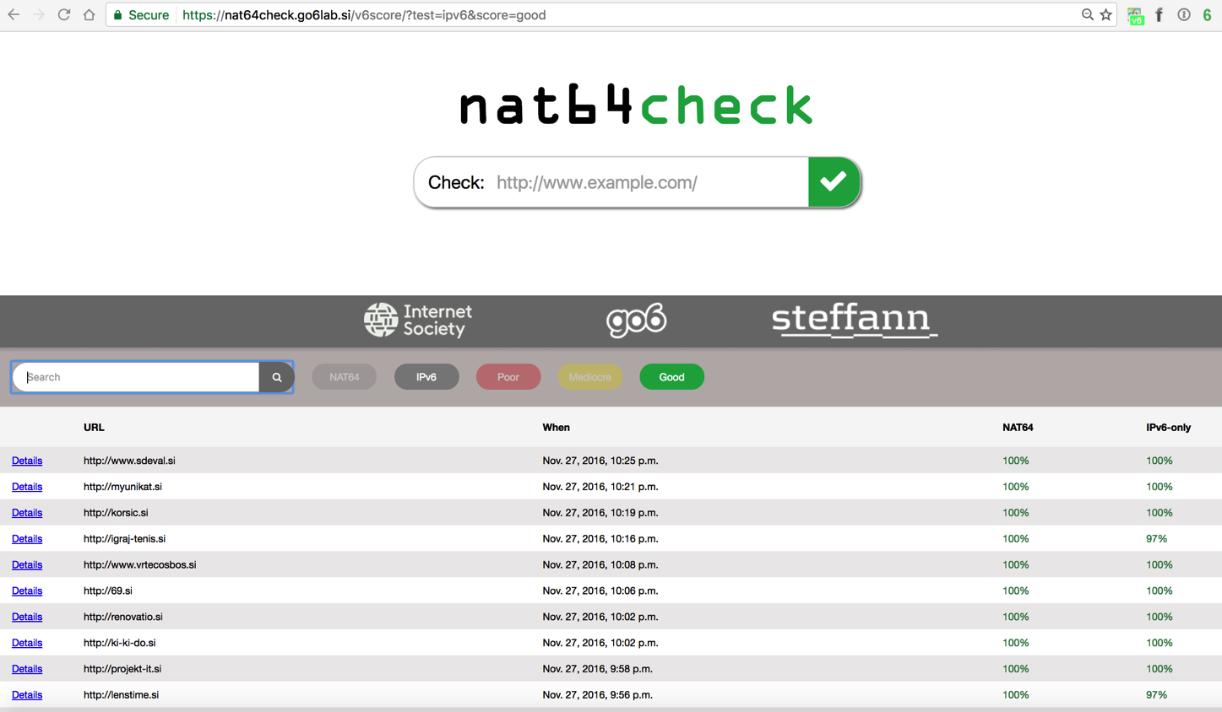
(Caught in a web)

Slide 32
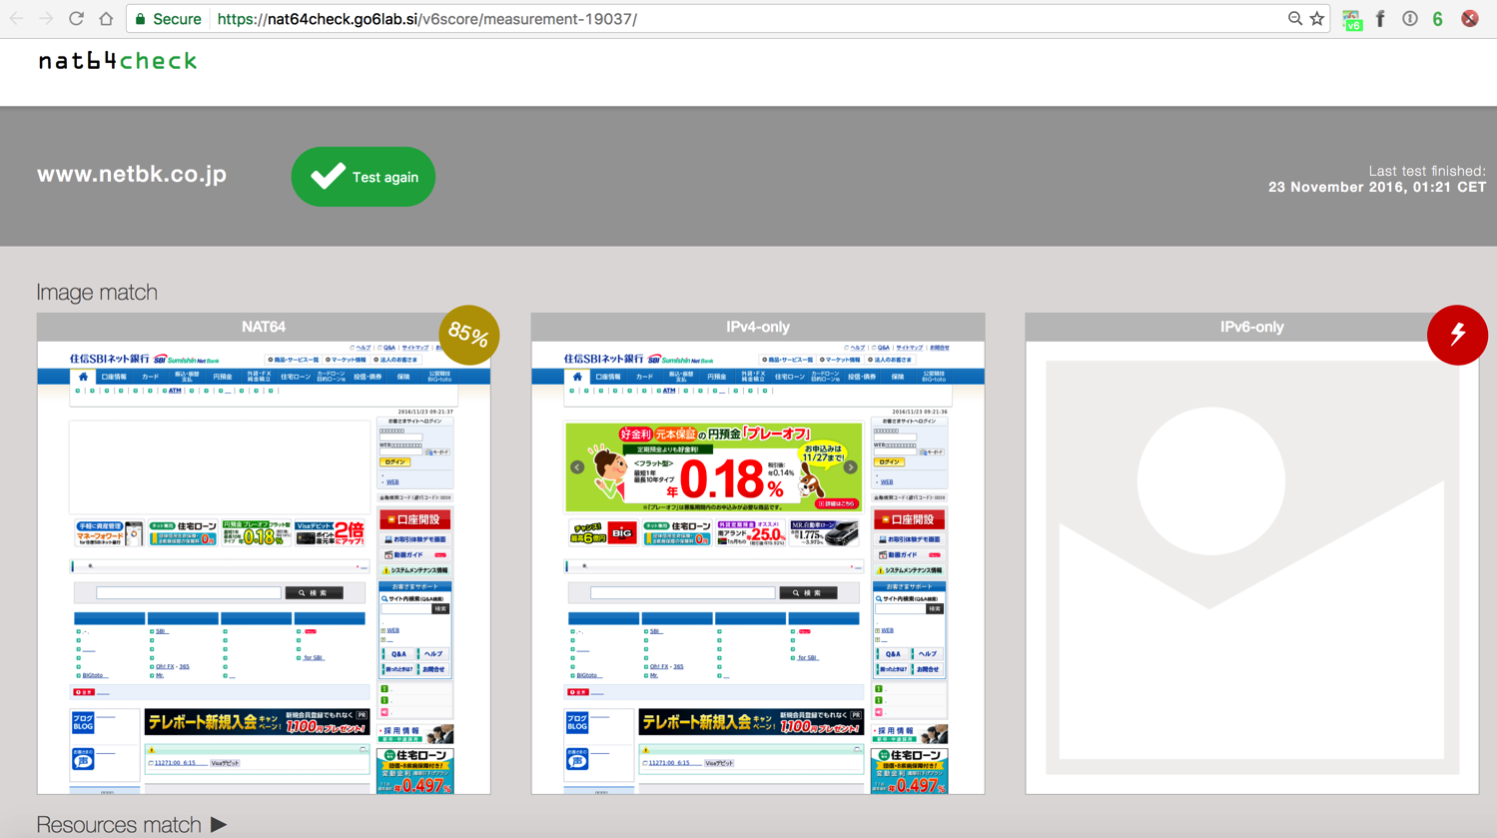
(The Mirror)

Slide 33
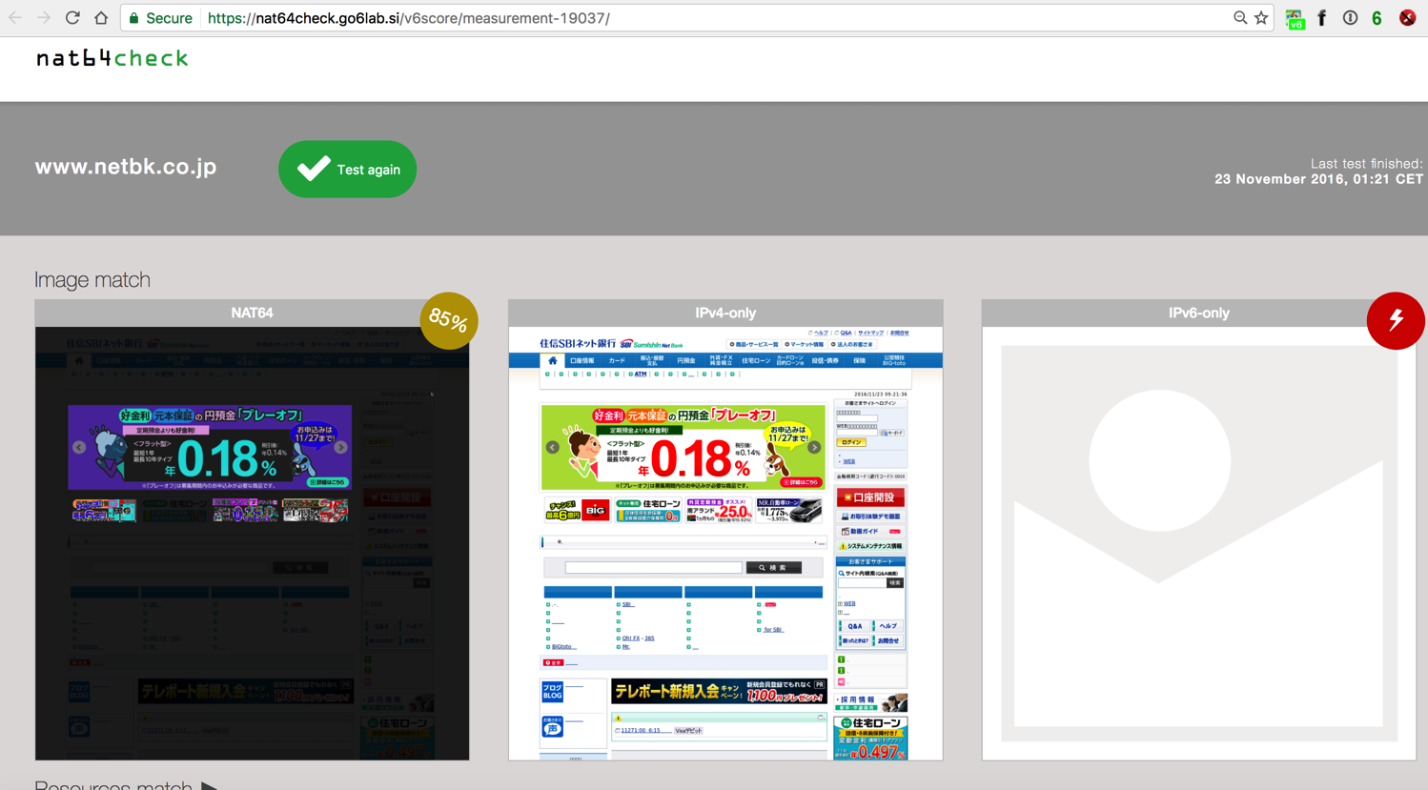
(The Shattered Fortress)

Slide 34
We don’t “fix” brokenness
(Lines in the Sand)
For NAT64/DNS64 implementations in go6lab, we try to avoid AAAA bogus records and all our DNS64 configs are tuned like we have shown in previous slides.
For NAT64 Check tool, however, we don’t exclude anything. We are trying to show how it is in reality and not mask problems. Those people, causing problems needs to find out the situation and fix it.
https://nat64check.go6lab.si/
https://nat64check.ipv6-lab.net/

Slide 35
How does this work?
(Illumination Theory)
Four servers:
  Management server and web interface
  Server with only IPv4
  Server with only IPv6
  Server with NAT64
  Go6lab specific: All servers are virtual machines (LIX) on Proxmox 4.2 virtualization cluster
  IPv6-lab.net specific: All running on virtual machines (Ubuntu) on a VMware cluster
Using phantomjs as a command-line browser
  Keep track of all loaded (or not) resources
  Make a screenshot when the page has loaded
Compare images with each other
Check for resources that could not be loaded

Slide 36
How does this work?
(Images and Words)
Master and web interface
IPv4-only
Web client
IPv6-only
Web client
IPv6-only + NAT64/DNS64
Web client
DNS64
NAT64
IPv4 internet
IPv6 internet

Slide 37

Run the test and calculate the score
(Take the Time)
Enter the domain name or URL that you would like to test and submit it to the system.
The process of starting all needed browsers, get the results, grab the screen and calculate/compare all the results takes some time, so please be patient.

Slide 38
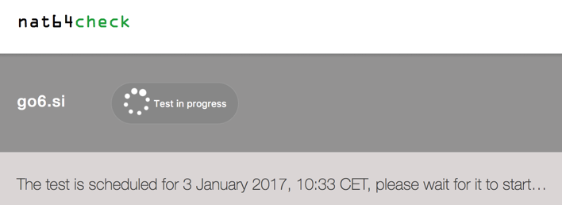
Run the test and calculate the score
(Take the Time)
You’ll see something like this for some time after you start the measurement...
The system will show you when the test was requested, when test was started and will also show you the result in the same page after some time.
No need to hit the “Back” button, it will happen, just give it some time. We promise. Scout’s word of honor. :)

Slide 39
Wash, rinse and repeat
(Lifting Shadows of a Dream)
Test your website
      Are you sure all the images, analytics scripts etc. load over IPv6?
If you don’t have IPv6 on your server:
    Did you hard-code any IPv4 addresses in your HTML code? In this case NAT64/
    DNS64 will fail. You might get away with it on 464XLAT, but don’t count on it.
Why you don’t have IPv6 on your server yet?
If things fail - make sure you are persistent enough to find the issues. There are
millions of potential viewers of your content on IPv6-only connection at this precise
moment, make sure you don’t mess it up and that our tool shows the 100% good result.
Test again
Repeat until your website is no longer broken
If you are fixing a DNS misconfiguration - it might take some time before our tool gets and sees the new and fixed AAAA value. DNS propagation is slow.

Slide 40
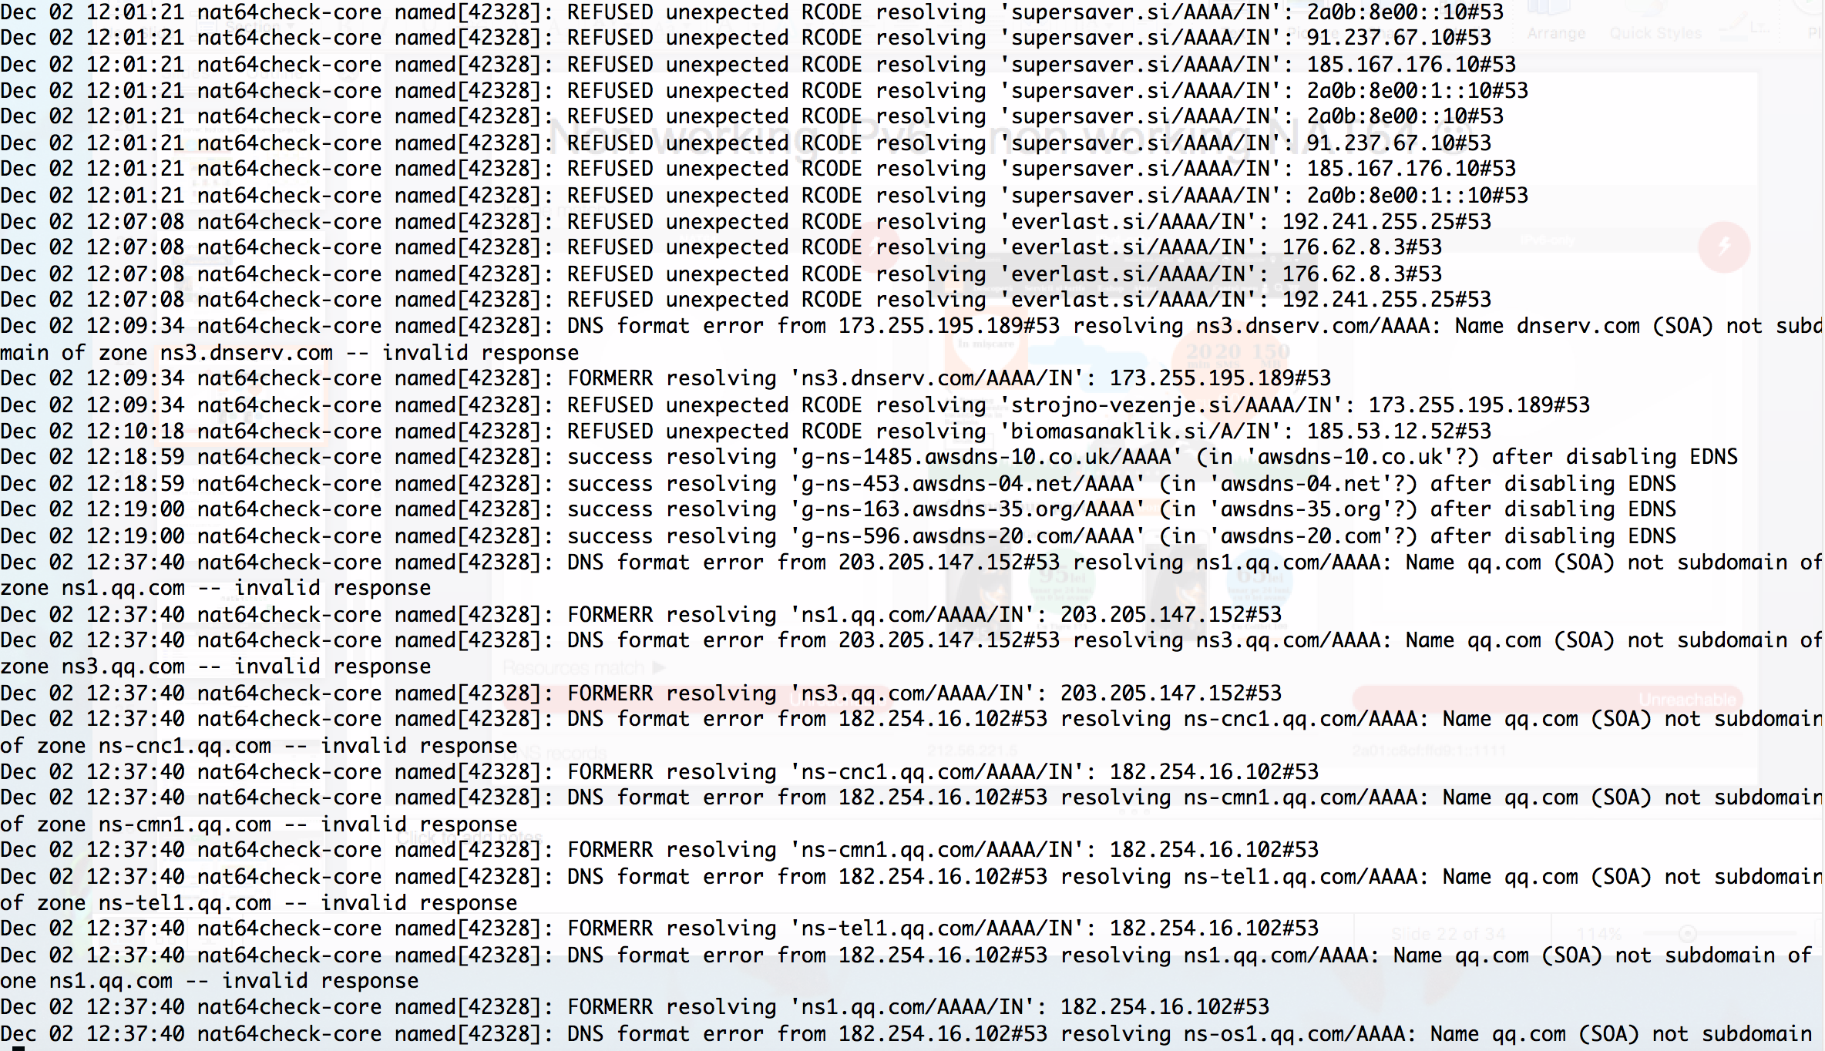
Non properly working target domain = no content!
(Learning To Live)

Slide 41
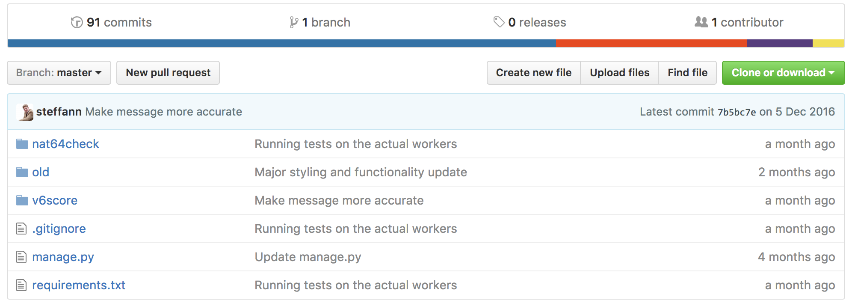
NAT64Check code available on GITHUB
(In Constant Motion)
All code is free and open and it lives on GitHub.
Feel free to use it and/or contribute:
https://github.com/sjm-steffann/nat64check

Slide 42
Conclusions, questions, suggestions?
(Act II: Scene Eight: The Spirit Carries On)
If you are content provider: test how people sees your content from different environments
If you are connectivity provider: test how IPv6-only and 464XLAT/NAT64-DNS64 users sees content
If both: all of the above ☺
You might be surprised. Well, you probably will be surprised.
https://nat64check.go6lab.si/
https://nat64check.ipv6-lab.net/
Jan Žorž Sander Steffann
zorz@isoc.org sander@steffann.nl

