Slide 1
Detecting Peering Infrastructure Outages ENOG14, Minsk
Vasileios Giotsas †∗, Christoph Dietzel † §, Georgios Smaragdakis ‡ †, Anja Feldmann †, Arthur Berger ¶ ‡, Emile Aben #
†TU Berlin ∗CAIDA §DE-CIX ‡MIT ¶Akamai #RIPE NCC

Slide 2
Peering Infrastructures are critical part of the interconnection ecosystem
Internet Exchange Points (IXPs) provide a shared switching fabric for layer-2 bilateral and multilateral peering.
Largest IXPs support > 100 K of peerings, > 5 Tbps peak traffic
Typical SLA 99.99% (~52 min. downtime/year)¹
Carrier-neutral co-location facilities (CFs) provide infrastructure for physical co-location and cross-connect interconnections.
Largest facilities support > 170 K of interconnections
Typical SLA 99.999% (~5 min. downtime/year)²
¹ https://ams-ix.net/services-pricing/service-level-agreement ²http://www.telehouse.net/london-colocation/
Notes:
GEORGE: Maybe also mention the critical infrastructure nature of interconnections (DHS, EU)?
The physical topology matters
I would change it slightly -- CFs and IXPs are key enablers for this transition

Slide 3
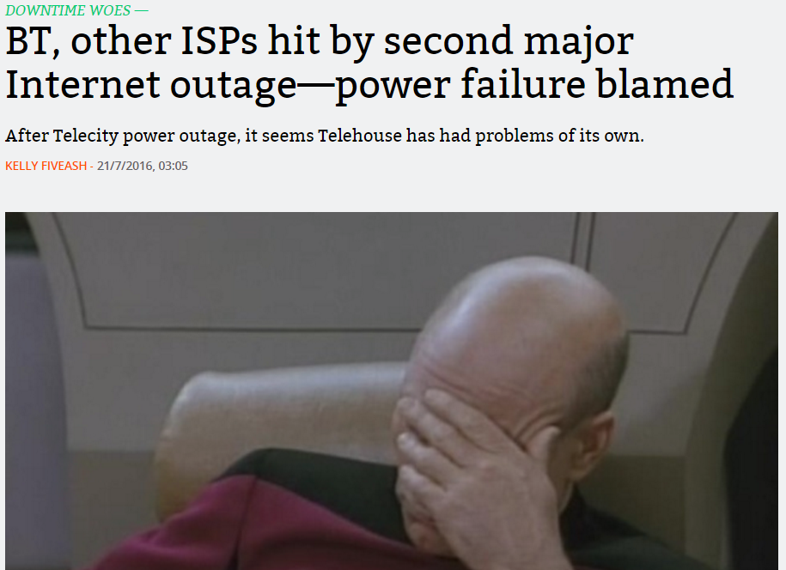
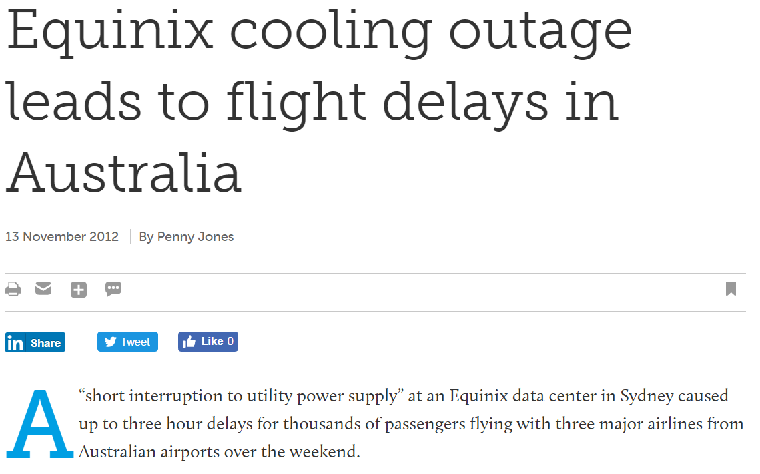
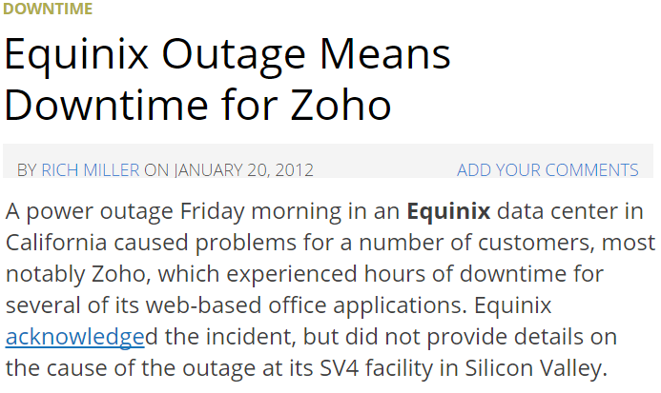
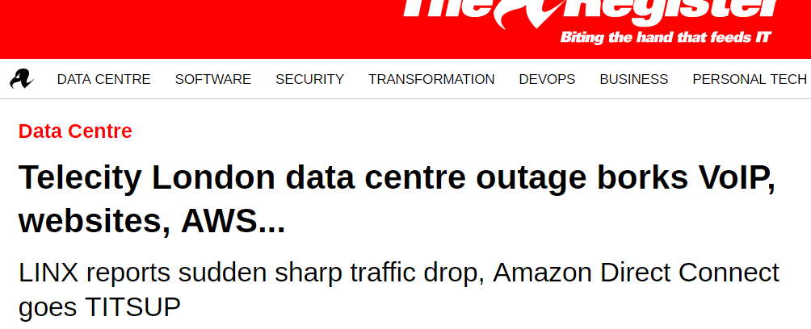
Outages in peering infrastructures can severely disrupt critical services and applications
Notes:
I would use the term externalities here; effect to economy and users
Outages happend and when they do have severe implications

Slide 4
Outages in peering infrastructures can severely disrupt critical services and applications
Outage detection crucial to improve situational awareness, risk assessment and transparency.

Slide 5
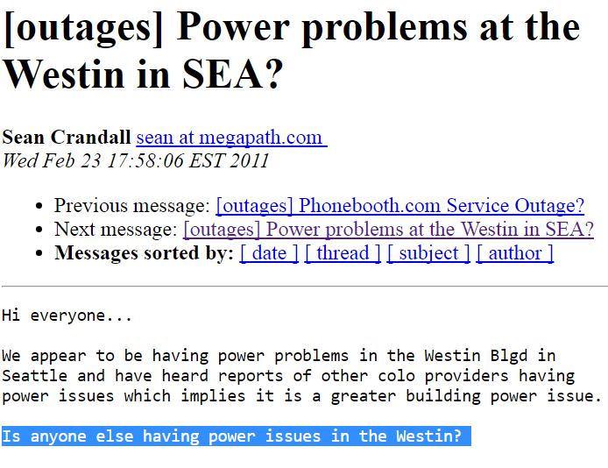
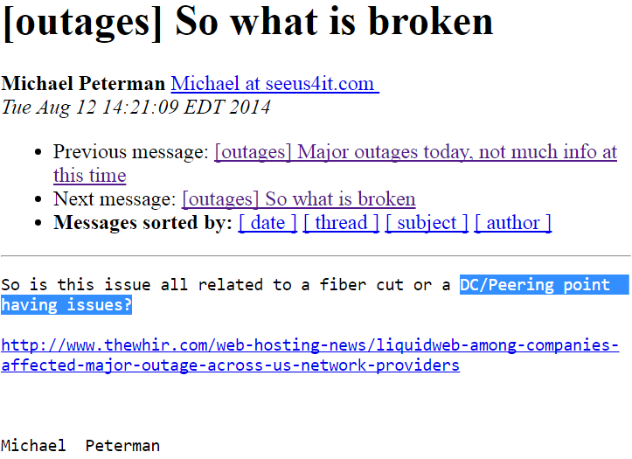
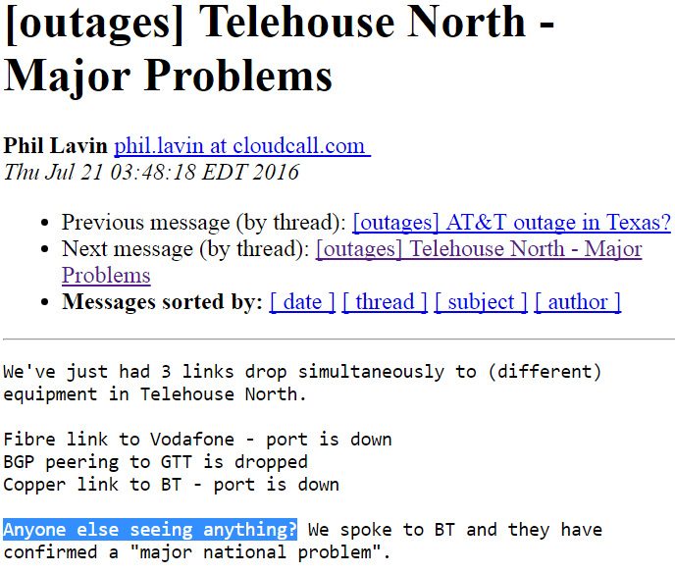
Current practice: “Is anyone else having issues?”
ASes try to crowd-source the detection and localization of outages.
Inadequate transparency/responsiveness from infrastructure operators.
Notes:
Although this is so important, the way we currently detect such outages is ad-hoc

Slide 6
Our Research Goals
Outage detection:
Timely, at the finest granularity possible
Outage localization:
Distinguish cascading effects from outage source
Outage tracking:
Determine duration, shifts in routing paths, geographic spread
Notes:
In this work we aim to automate this process and provide hard evidence of what happened hopefully even provide forensics
Automated
Finest granularity
HARD evidence
Towards (future goal) to use for forensics
Active measurements incur large overhead, don’t scale well

Slide 7
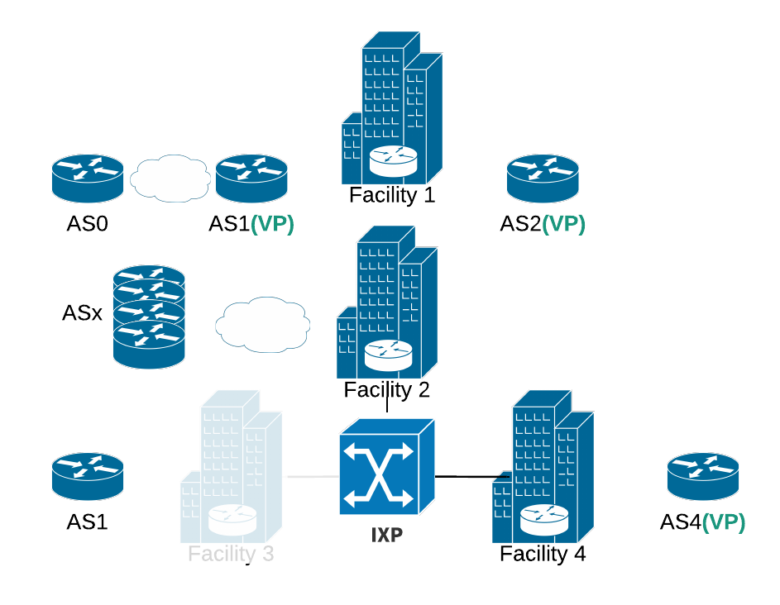
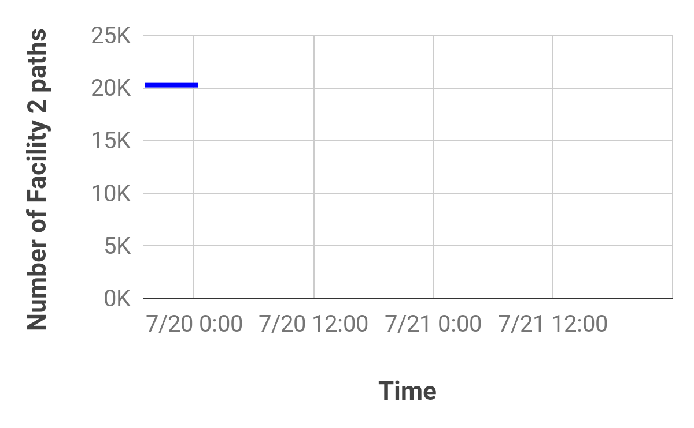
Passive outage detection: Initialization
Time
For each vantage point (VP) collect all the stable BGP routes tagged with the communities of the target facility (Facility 2)
Notes:
GEORGE:: bottom of the Figure: animation of failure -- and how the links move elsewhere
In order to understand how this work in practice, let's take the example of the AMSIX outage.
Through a BGP listener we can find the number of paths that cross a specific facility or IXP for some time. For example here we can see 30K paths crossing AMS-IX through BGP communities.

Slide 8
Passive outage detection: Initialization
AS_PATH: 1 x
COMM: 1:FAC2
AS_PATH: 2 1 0
COMM: 2:FAC2
AS_PATH: 4 x
COMM: 4:FAC2
Time
For each vantage point (VP) collect all the stable BGP routes tagged with the communities of the target facility (Facility 2)
Notes:
GEORGE:: bottom of the Figure: animation of failure -- and how the links move elsewhere
In order to understand how this work in practice, let's take the example of the AMSIX outage.
Through a BGP listener we can find the number of paths that cross a specific facility or IXP for some time. For example here we can see 30K paths crossing AMS-IX through BGP communities.

Slide 9
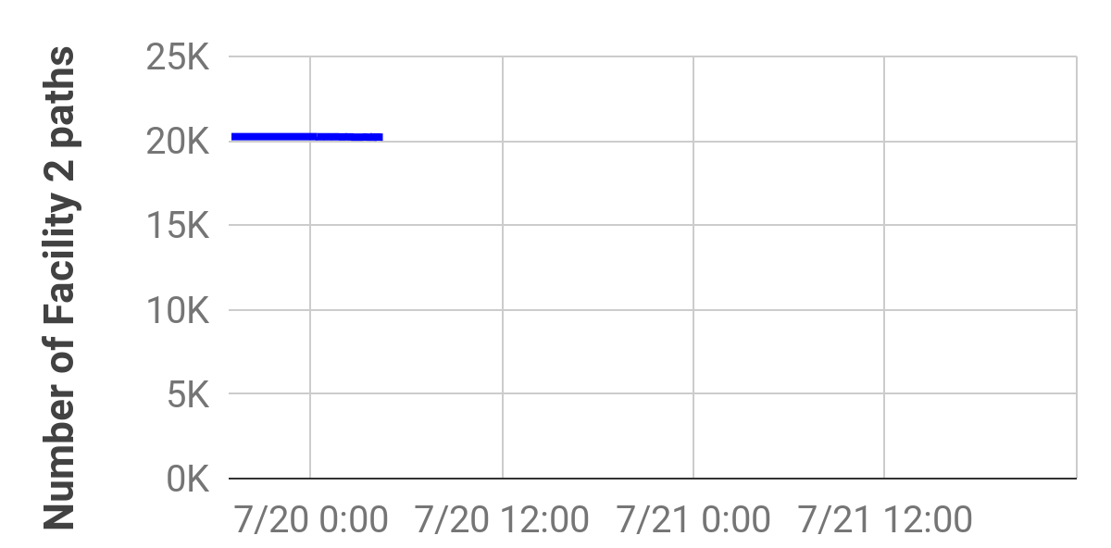
Passive outage detection: Monitoring
Time
Track the BGP updates of the stable paths for changes in the communities values that indicate ingress point change.
Notes:
GEORGE:: bottom of the Figure: animation of failure -- and how the links move elsewhere
In order to understand how this work in practice, let's take the example of the AMSIX outage.
Through a BGP listener we can find the number of paths that cross a specific facility or IXP for some time. For example here we can see 30K paths crossing AMS-IX through BGP communities.

Slide 10
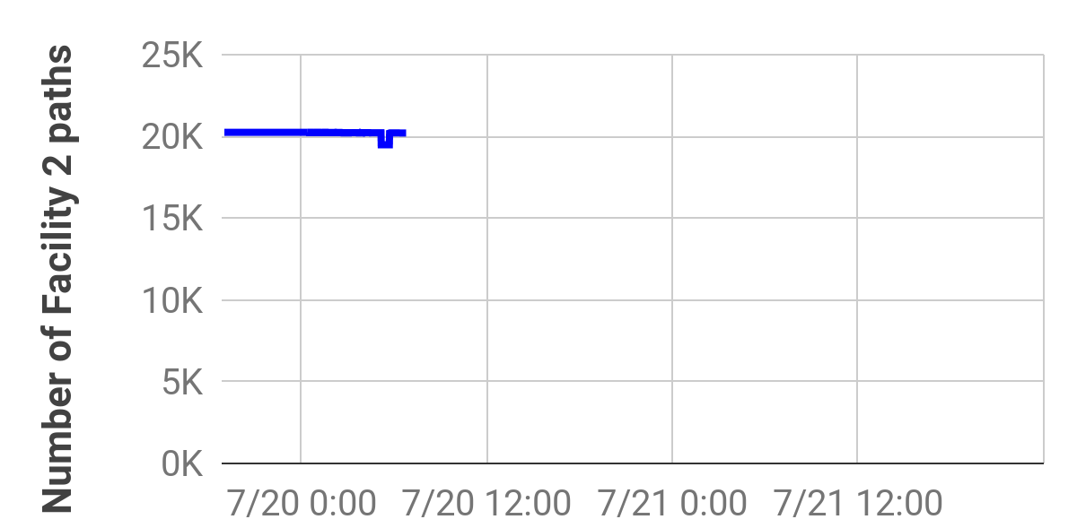
Passive outage detection: Monitoring
AS_PATH: 2 1 0
COMM: 2:FAC1
Time
We don’t care about AS-level path changes if the ingress-tagging communities remain the same.
Notes:
GEORGE:: bottom of the Figure: animation of failure -- and how the links move elsewhere
In order to understand how this work in practice, let's take the example of the AMSIX outage.
Through a BGP listener we can find the number of paths that cross a specific facility or IXP for some time. For example here we can see 30K paths crossing AMS-IX through BGP communities.

Slide 11
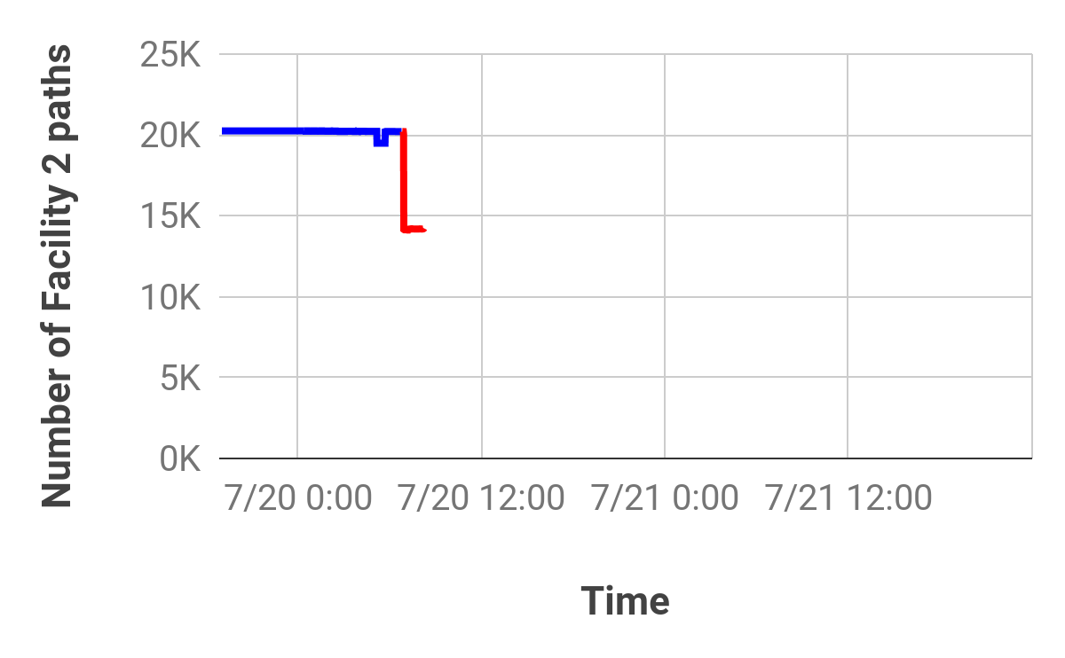
Passive outage detection: Outage signal
AS_PATH: 1 x
COMM: 1:FAC1
AS_PATH: 2 1 0
COMM: 2:FAC1
AS_PATH: 4 x
COMM: 4:FAC4
4:IXP
Time
Concurrent changes of communities values for the same facility.
Indication of outage but not final inference yet!

Slide 12
Passive outage detection: Outage signal
AS_PATH: 1 x
COMM: 1:FAC1
AS_PATH: 2 1 0
COMM: 2:FAC1
Partial outage
AS_PATH: 4 x
COMM: 4:FAC4
4:IXP
Time
Concurrent changes of communities values for the same facility.
Indication of outage but not final inference yet!

Slide 13
Passive outage detection: Outage signal
AS_PATH: 1 x
COMM: 1:FAC1
AS_PATH: 2 1 0
COMM: 2:FAC1
Partial outage?
De-peering of large ASes?
Major routing policy change?
AS_PATH: 4 x
COMM: 4:FAC4
4:IXP
Time
Concurrent changes of communities values for the same facility.
Indication of outage but not final inference yet!
Notes:
Necessary but not sufficient!

Slide 14
Passive outage detection: Outage signal
AS_PATH: 1 x
COMM: 1:FAC1
AS_PATH: 2 1 0
COMM: 2:FAC1
Partial outage?
De-peering of large ASes?
Major routing policy change?
AS_PATH: 4 x
COMM: 4:FAC4
4:IXP
Time
Signal investigation:
Targeted active measurements.
How disjoint are the affected paths?
How many ASes and links have been affected?

Slide 15
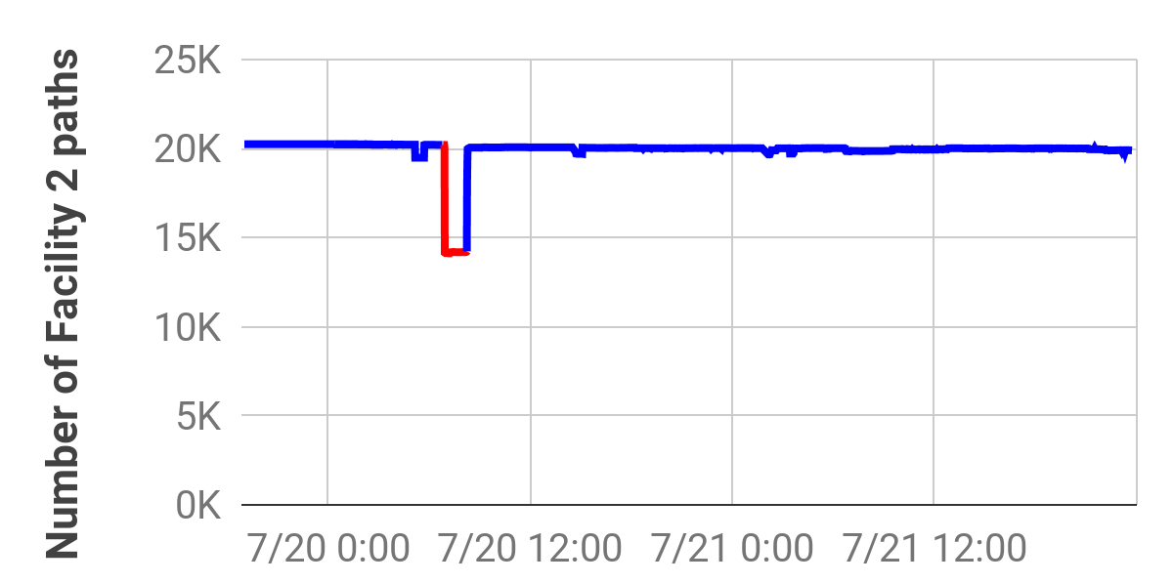
Passive outage detection: Outage tracking
AS_PATH: 1 x
COMM: 1:FAC2
AS_PATH: 2 1 0
COMM: 2:FAC2
Time
End of outage inferred when the majority of paths return to the original facility.

Slide 16
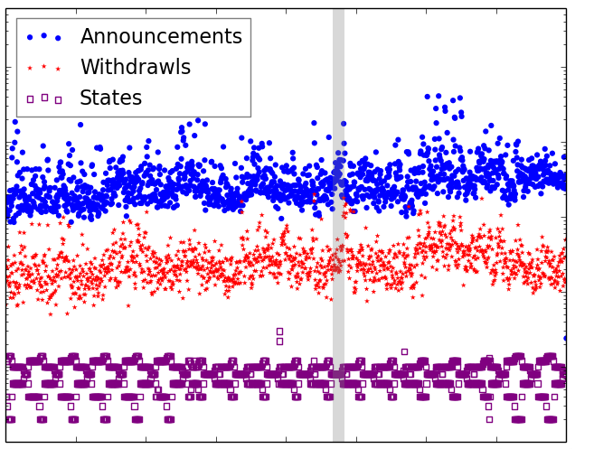
De-noising of BGP routing activity
10⁵
10³
Number of BGP messages (log)
10¹
Time
The aggregated activity of BGP messages (updates, withdrawals, states) provides no outage indication.
Notes:
-- Top: call it the off-the-shelf solution is prone to false alarms, e.g., there are peaks that are not related to any outage; can be e.g., peaks in announcements, related to BGP mirroring or re-announcements

Slide 17
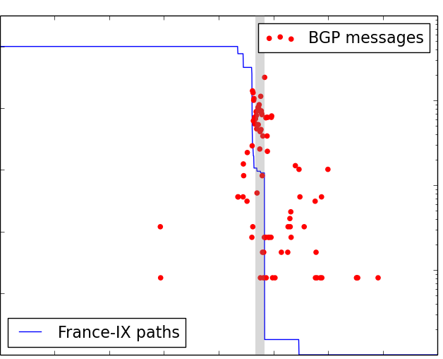
De-noising of BGP routing activity
10⁵
1.0
10⁵
0.8
10³
0.6
10³
Number of BGP messages (log)
Fraction of infrastructure paths
Number of BGP messages (log)
0.4
10¹
0.2
10¹
0
Time
Time
The aggregated activity of BGP messages (updates, withdrawals, states) provides no outage indication.
The BGP activity filtered using communities provides strong outage signal.
Notes:
-- Top: call it the off-the-shelf solution is prone to false alarms, e.g., there are peaks that are not related to any outage; can be e.g., peaks in announcements, related to BGP mirroring or re-announcements

Slide 18
Outage localization is more complicated!
The location of community values that trigger outage signals may not be the outage source!
Communities encode the ingress point closest to our VPs (near-end infrastructure)
ASes may be interconnected over multiple intermediate infrastructures
Failures in intermediate infrastructures may affect the near-end infrastructure paths

Slide 19
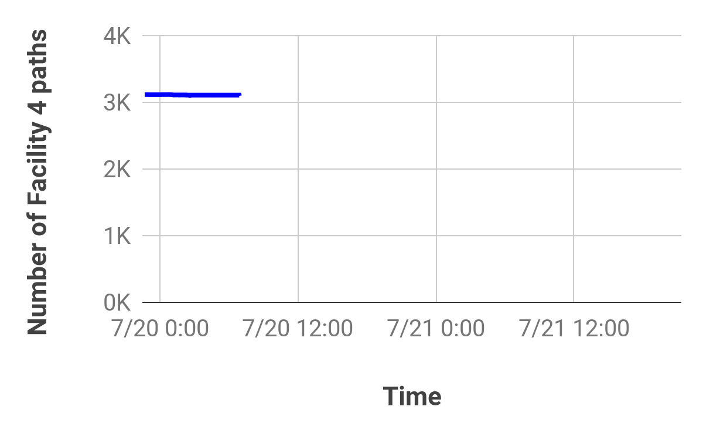
Outage localization is more complicated!
Time

Slide 20
Outage localization is more complicated!
Time

Slide 21
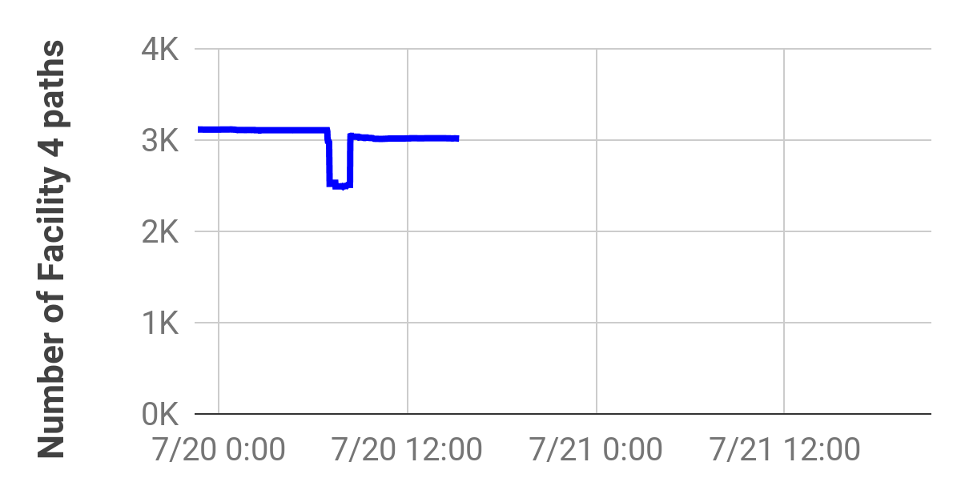
Outage localization is more complicated!
Outage in Facility 2 causes drop in the paths of Facility 4!
Time

Slide 22
Outage localization is more complicated!
Time

Slide 23
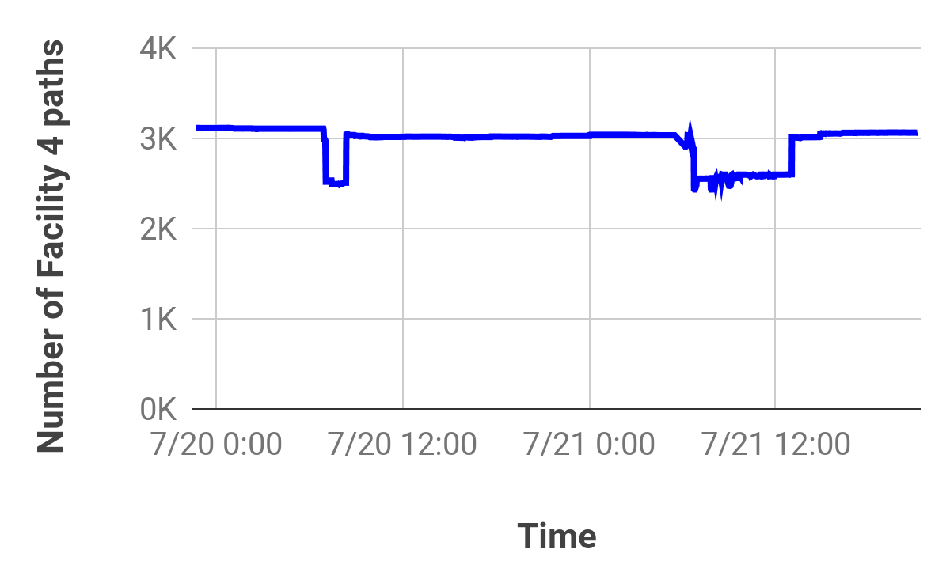
Outage localization is more complicated!
Outage in Facility 3 causes drop in the paths of Facility 4!
Time

Slide 24
Outage source disambiguation and localization
Create high-resolution co-location maps:
AS to Facilities, AS to IXPs, IXPs to Facilities
Sources: PeeringDB, DataCenterMap, operator websites
Decorrelate the behaviour of affected ASes based on their infrastructure colocation.
Notes:
We localize the outage signal by studying the behaviour of each of the affected ASes in relationship to the infrastructures in which it is present, and we try correlate the behaviour of networks in the same infrastructures
Part of this work is to maintain an accurate colocation map. Tricky because networks are located in multiple sources

Slide 25
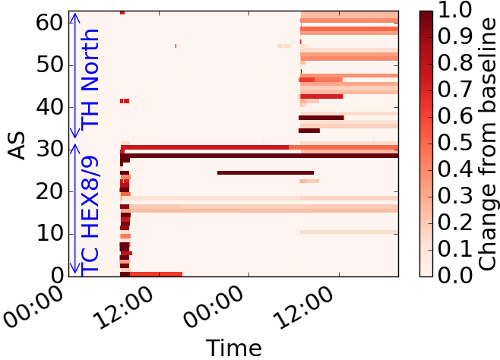
Outage source disambiguation and localization
Paths not investigated in aggregated manner, but at the granularity of separate (AS, Facility) co-locations.
London Telecity HE8/9 outage
London Telehouse North outage
Time
Notes:
The previous case of outage detection is a simple one because the location of the outage corresponds to the location encoded in the Communities that triggered the signal. However, the location encoded in the BGP communities of a signal may not correspond to the location of the outage. As we saw earlier, between two ASes there may be multiple intermediate facilities but the Communities tag only the nearest one. Therefore, when an intermediate facility fails the signal will be reflected on the nearest facility even if it’s not the outage source. For instance, consider this example which shows the number of paths that cross the Telehouse East facility.

Slide 26
Outage source disambiguation and localization
Paths not investigated in aggregated manner, but at the granularity of separate (AS, Facility) co-locations.
London Telehouse North outage
London Telecity HE8/9 outage
London Telehouse North outage
Time
London Telecity HE8/9 outage
Notes:
We can see which ASes are affected, and for how long. In many cases networks are affected by both cases.

Slide 27
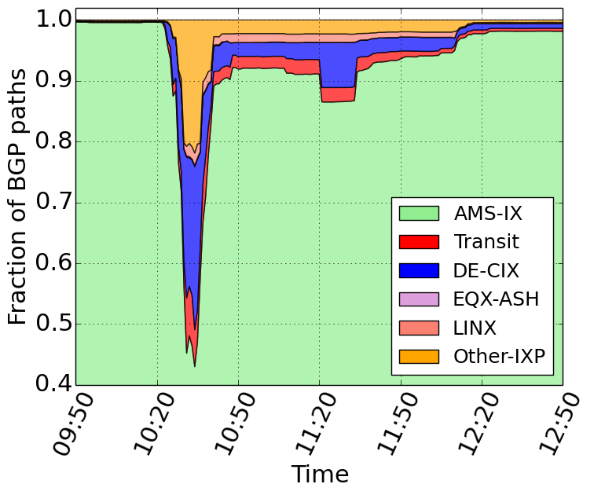
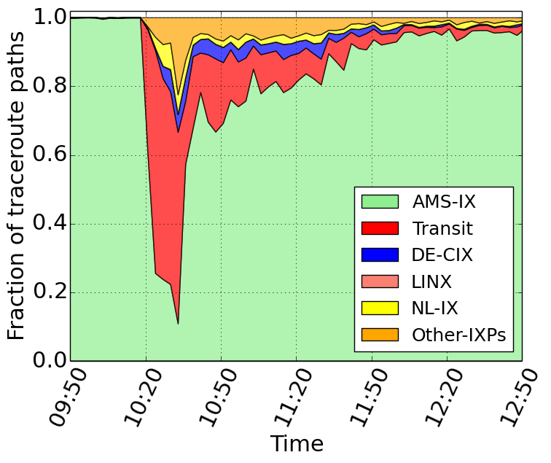
Tracking the progress of outages
Active tracking:
Execute targeted traceroutes based on the hints of the BGP signals.
Passive tracking: Monitor how location-tagging BGP Communities change during the outage.
Notes:
On the top of each figure add the outage, AMS-IX and TC HEX8/9 and remove it from the text
-- Maybe you want to show the differences in the delays in the left figure; Do you want also to include figure 13a and 13b and have one slide for AMS-IX [you can include this figure after the AMS-IX outage discussion, i.e., after slide 34] and the next slide for the global effect of the outage
-- Names some of the locations in the right one, .e.g, Taiwan, etc.

Slide 28
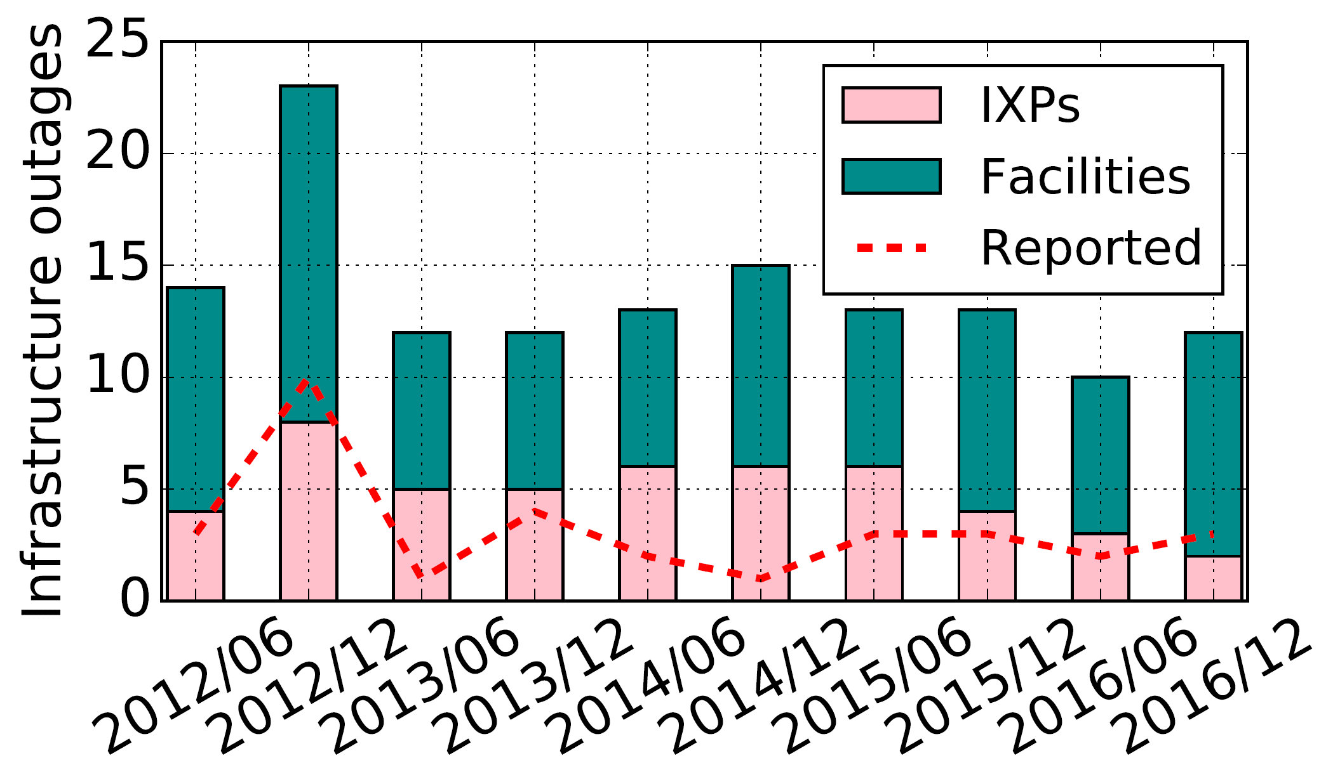
Detecting peering infrastructure outages in the wild
159 outages in 5 years of BGP data
76% of the outages not reported in popular mailing lists/websites
Validation through status reports, direct feedback, social media
90% accuracy, 93% precision (for trackable PoPs)
Notes:
-- bottom figure: this refers to the facilities that had an outage and then you want to check if the outage lasted less than X.XXXX%

Slide 29
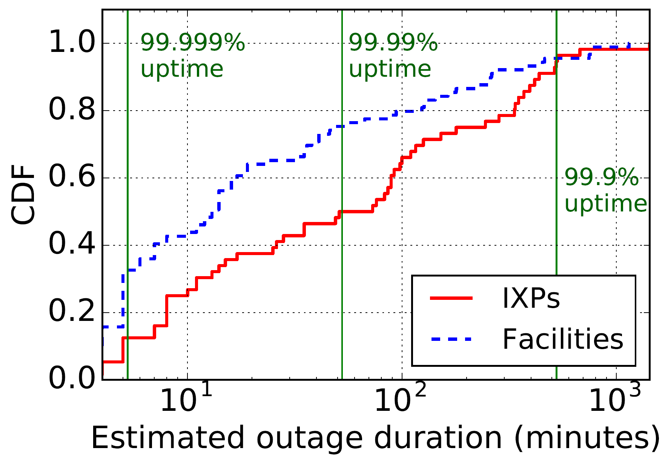
Effect of outages on Service Level Agreements
~70% of failed facilities below 99.999% uptime
~50% of failed IXPs below 99.99% uptime
5% of failed infrastructures below 99.9% uptime!
Notes:
-- bottom figure: this refers to the facilities that had an outage and then you want to check if the outage lasted less than X.XXXX%

Slide 30
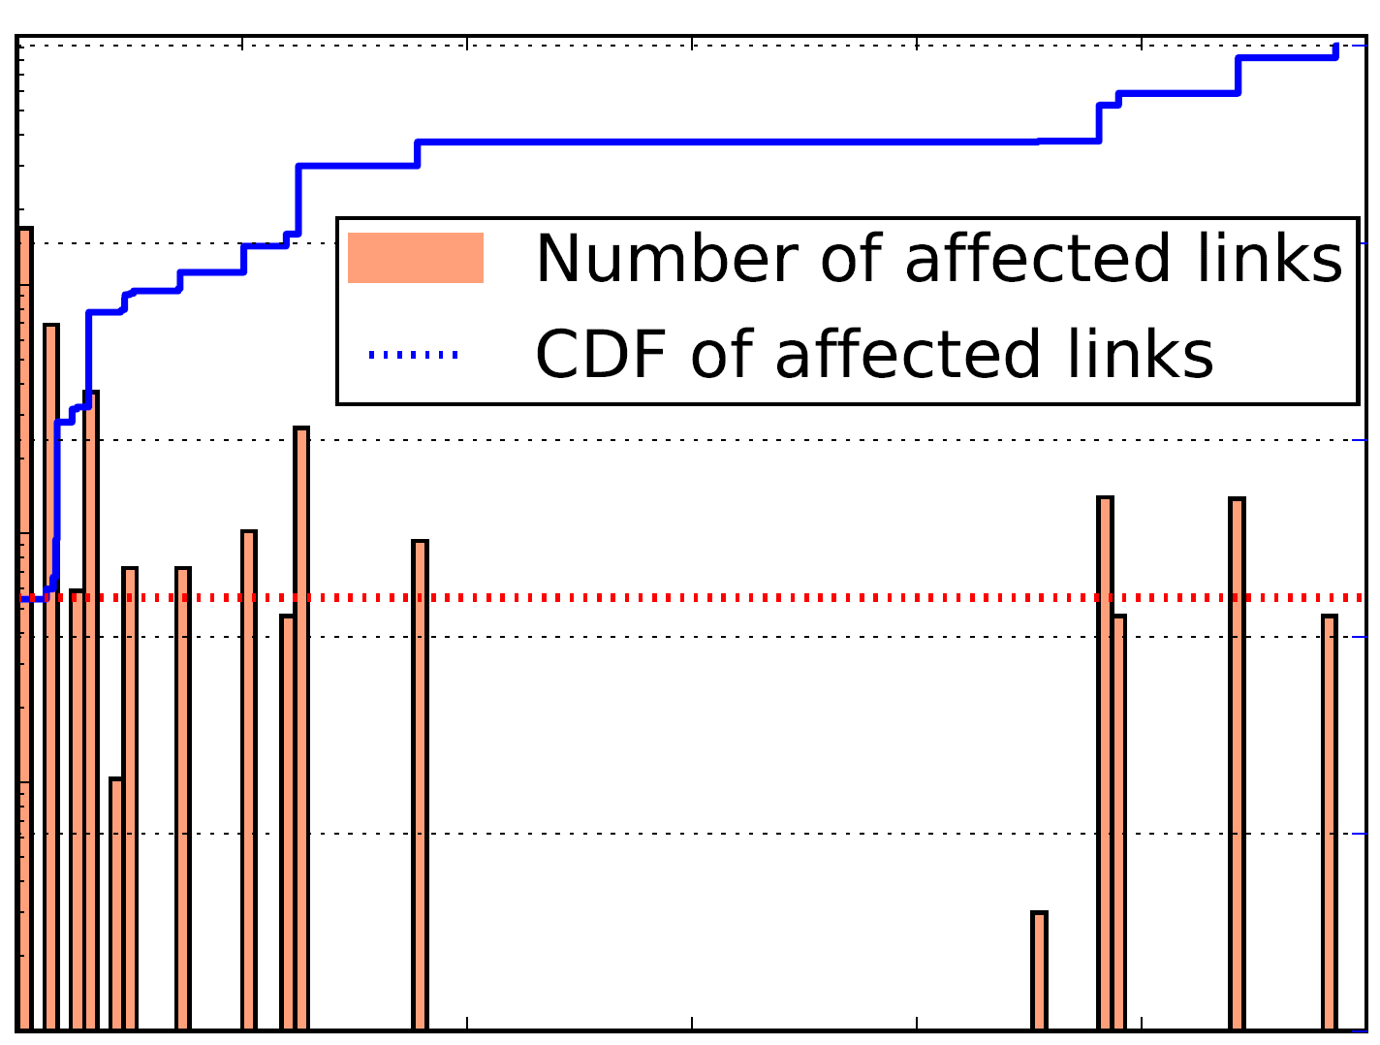
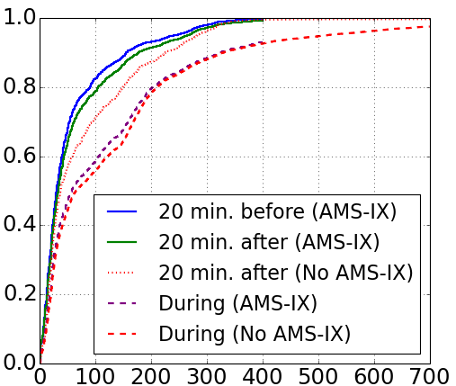
Measuring the impact of outages
10⁵
1.0
0.8
0.6
10³
Number of affected links (log)
0.44
Fraction of paths
CDF
0.4
0.2
10¹
0
0
2K
4K
6K
8K
10K
12K
Distance from outage source (km)
RTT (ms)
> 56 % of the affected links in different country, > 20% in different continent!
Median RTT rises by > 100 ms for rerouted paths during AMS-IX outage.
Notes:
On the top of each figure add the outage, AMS-IX and TC HEX8/9 and remove it from the text
-- Maybe you want to show the differences in the delays in the left figure; Do you want also to include figure 13a and 13b and have one slide for AMS-IX [you can include this figure after the AMS-IX outage discussion, i.e., after slide 34] and the next slide for the global effect of the outage
-- Names some of the locations in the right one, .e.g, Taiwan, etc.

Slide 31
Conclusions
Timely and accurate infrastructure-level outage detection through passive BGP monitoring
Majority of outages not (widely) reported
Remote peering and infrastructure interdependencies amplify the impact of local incidents
Hard evidence on outages can improve accountability, transparency and resilience strategies
Notes:
-- Mention that you create a data base and a dashboard that policy makers, researchers, etc can explore. The insights can improve the design and operation of the internet.
In backup add the AMSIX/DECIX traffic interdependence

Slide 32
Questions / Comments?

Slide 33
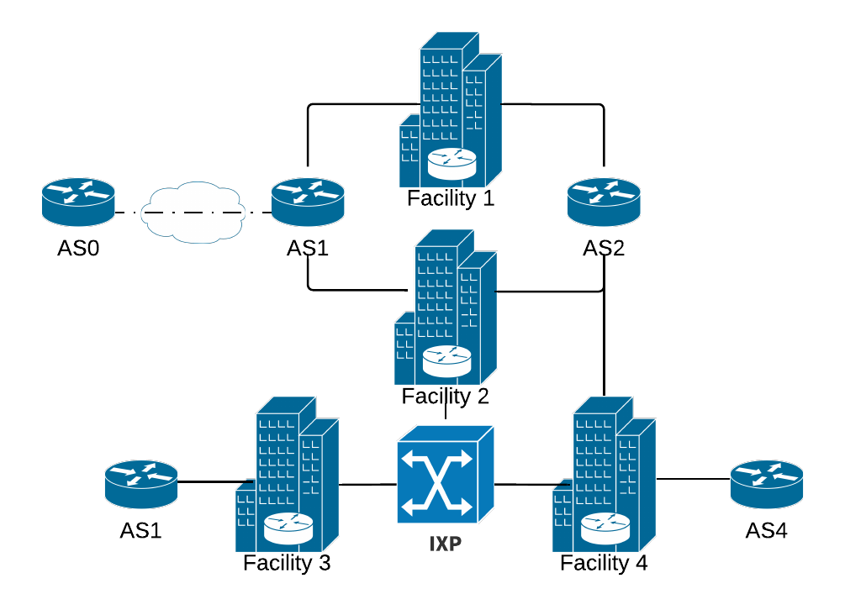
Challenges in detecting infrastructure outages
Capturing the infrastructure-level hops between ASes
Correlating the paths from multiple vantage points
Continuous monitoring of the routing system
Passive BGP monitoring
Before outage
VP
During outage
The initial hops changed
VP
During outage
No hop changes

Slide 34
Challenges in detecting infrastructure outages
Capturing the infrastructure-level hops between ASes
Correlating the paths from multiple vantage points
Continuous monitoring of the routing system
BGP encodes AS paths
Passive BGP monitoring
Before outage
VP
During outage
The initial hops changed
VP
During outage
No hop changes

Slide 35
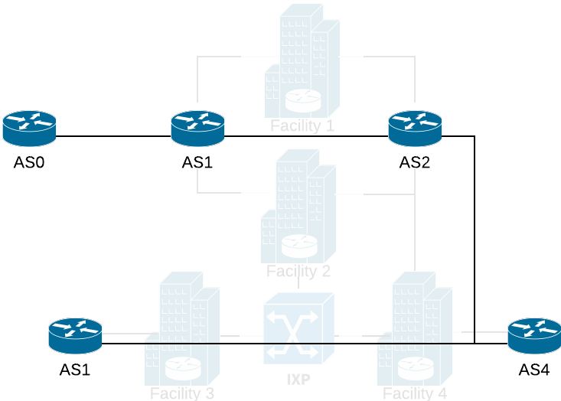
Deciphering location-metadata in BGP
BGP not entirely information-hiding!
Communities BGP attribute:
Optional, tags BGP routes with arbitrary metadata
Often encodes the ingress location of prefixes

