Slide 1
ENOG13 Saint Petersburg
Diego Luis Neto
SW developer @ NL-ix

Slide 2
BIRD route-server configuration?
Click, DONE!

Slide 3
Route-server limitations
No peers selection possibility
Not transparent
Manual and time consuming
No Latency control

Slide 4
Challenges
Maximum flexibility for peers selection
Automated
Easy setup and usage for peers
Secure
Fault tolerant and feedback rich
Easy to integrate

Slide 5
NL-ix route-server configurator
Full fine-grained control (IP, location, latency)
Support for filtering and prepending
Completely automated
Sexy web interface
Modular design + API/WebHooks
100% Open-Source based

Slide 6
DEMO

Slide 7
NL-ix route-server configurator

Slide 8
Architecture
UI
API-Server
Orchestrator
Route-server

Slide 9
Stackstorm?
Brocade product
Runs on Linux, made with/for Python coherent with NL-ix tech stack
Actions, rules, workflows, audit
Plugin structure
Wide selection of available packs (https://exchange.stackstorm.org/)

Slide 10
BIRD St2 pack
bird
Generic St2 pack for BIRD configuration
BIRD config file generation and deployment

Slide 11
Generate config
User
input
BIRD config
template
St2 pack
config

Slide 12
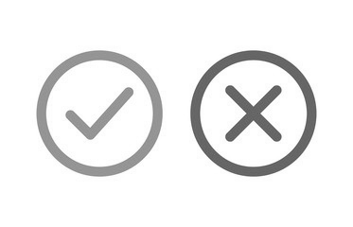
Deploy config
Orchestrator
Route-server

Slide 13
bird-proxy ?
Flask (Python) application
BIRD control via HTTP(S)
Endpoint for BIRD config file deployment (open for expansions)

Slide 14
Security
Django REST framework authentication
Application RRBAC
User confirmation token
St2 API-key authentication
BIRD-proxy secret key
BIRD-proxy endpoints design

Slide 15
NL-ix route configurator
Available for all NL-ix peering members
Open BIRD automation core
Info
dlneto@nl-ix.net (tech)
nlix@nl-ix.net (general info)

Slide 16
Q&A

