Slide 1
SDN Traffic Engineering with Segment Routing
The Next Evolution
Cengiz Alaettinoglu

Slide 2
Traffic Engineering (TE)
Minimize the worst link utilization
  Alleviate traffic congestion
  Better/longer use of equipment/port/fiber
Route traffic around congested links
  Put traffic on non-shortest paths

Slide 3
Evolution of Traffic Engineering
Offline traffic engineering
  Optimal, but not adaptive
On-device traffic engineering
  Adaptive, but not optimal
Software defined networking
  Best of both worlds, yet simpler; simplicity enabled by:
    Segment routing
    Push-based telemetry
    SDN Traffic Engineering application

Slide 4
Offline Traffic Engineering
Topology model
Traffic demand matrix
Optimization algorithm computes routes so that the worst link utilization is minimized
  Linear programming

Slide 5
Pros/Cons of Offline Traffic Engineering
Very good link utilization values
Network model is hard to keep accurate
Traffic demand matrix is hard to compute
Optimization algorithm is very slow
  Hours to days
Can not adapt to failures
Too many tunnels (N²)
Some paths may be surprisingly long

Slide 6
On-Device Traffic Engineering
RSVP-TE/CSPF
Routers flood available bandwidth of links in IGP
Each router
  Sets up one (or more) tunnels to other routers
  Monitors the utilization of these tunnels (auto-bandwidth)
  Triggers re-optimization when utilization changes
  Uses CSPF (constraint-based shortest path first) to compute the paths
  Signals the path and reserves bandwidth using RSVP

Slide 7
Pros/Cons of On-Device Traffic Engineering
Not so good link utilization values
  Each router is selfish in optimization
  No network-wide optimization
Network model is readily available
Traffic demand matrix is easy with auto-bandwidth
CSPF is fast
Can adapt to failures
Too many tunnels (N²)
Some paths may be surprisingly long
Flooding available bandwidth impacts IGP, particularly convergence time
Race conditions after failures
  Long-lived FRR
RSVP-TE overhead is high due to N² tunnels
  Protocol and management overhead

Slide 8
Example Deployments
 | Small | Medium | Large
Routers | 75 | 450 | 1,900
Links | 300 | 2,000 | 8,000
Tunnels | 1,600 | 20,500 | 132,000
Majority of the tunnels have very small amount of traffic
  No TE needed

Slide 9
Link / Tunnel Distribution
Most links carry a small number of tunnels
Small number of links carry a lot of tunnels

Slide 10
A Tunnel Path -
Before, During and After a Link Failure
2015-12-27 12:04:05
2015-12-27 12:04:05.200490
2015-12-27 12:14:00
A wide-area link fails at 2015-12-27 12:04:05.200490
  It was carrying 327 tunnels from 22 head-end routers
The tunnel above fails to optimize, but why?

Slide 11
Re-Optimization after Link Failure
22 head-end routers get a signal via RSVP-TE and try to re-optimize
  Race to available bandwidth
Each router optimizes for itself
  It does not know what the other 21 routers need
  It doesn’t even know there are other routers/tunnels interested in this bandwidth
9 tunnels fail to optimize
  5 head-end routers
  The example tunnel is one of the unlucky ones
This could have been avoided with network-wide optimization!

Slide 12
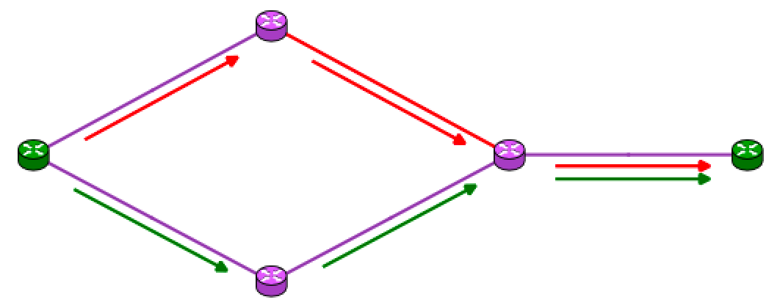
What Happens to the Traffic?
Traffic now takes the IGP path (green arrows)
Tunnel needed 34Mbps which is not available anywhere in the network
The IGP path too does not have this bandwidth available
  Congestion kicks in

Slide 13
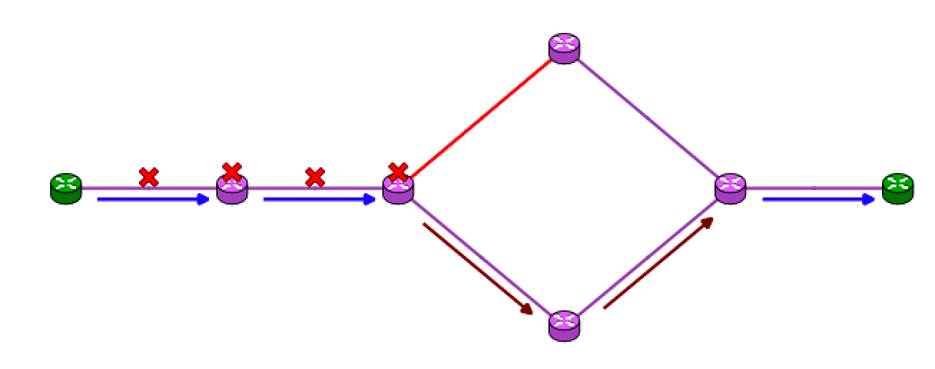
Another Tunnel is Stuck on its FRR
What happens when a tunnel fails to optimize and it is FRR protected?
  FRR is stuck
  Usually no reservations are made on FRR paths
  Congestion will kick in

Slide 14
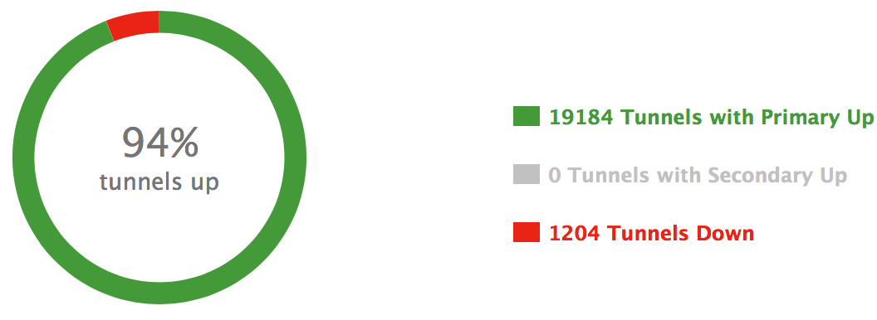
N² Tunnels - Beyond Human Manageability
It is not just 9 tunnels that are down
1204 down tunnels is too many for any operator to figure out the root cause
  If these tunnels are for traffic engineering, can we really say we are successfully doing traffic engineering?
  It is time for software/devops to manage the network

Slide 15
An SDN approach

Slide 16
What Do We Really Need?
Real-time model
  Alleviate congestion, especially after a link failure
Create as few tunnels as necessary
  Very small signaling overhead
  Very small IGP overhead
    Do not want IGP dynamics due to available bandwidth changes
Network-wide optimization
Simple to deploy and operate

Slide 17
SDN Promises a Solution
Segment routing (SR) replaces RSVP
  Provides uncompromised functionality
  Simple control plane with very low overhead
Push-based telemetry for traffic matrices
  YANG model based
  Frees IGP
SDN controller is part of the network control plane
  Has real-time topology
  Enables manipulating paths on the devices using standard south bound protocols
Traffic Engineering becomes an SDN application
  Optimizes paths network-wide
  As few tunnels as necessary

Slide 18
Segment Routing
Segment routing simplifies IP/MPLS control plane
  No need to run LDP or RSVP-TE
Functionality is not compromised
  Can forward traffic on non-shortest paths for traffic engineering
  Detour, bypass FRR (fast re-route), and IP LFA protection
  Secondary paths
  SLA-conforming service specific paths (e.g. L2/L3 VPNs)
  SDN programmability

Slide 19
TE Needs Shortest and Non-Shortest Paths;
SR Can Encode Any Path
A
B
C
D
Z
1 Segment (shortest IGP path)
Go to Z on shortest path (node segment)
V
W
X
Y
A
B
C
D
3 Segments
Go to C on shortest path
Go to X on link 3 (adjacency segment)
Go to Z on shortest path
Z
V
W
X
Y
5 Segments
Go to B on shortest path
Go to W on shortest path
Go to Y on shortest path
Go to D on shortest path
Go to Z on shortest path
A
B
C
D
Z
V
W
X
Y

Slide 20
Push-Based Telemetry Eases
Traffic Demand Matrix Generation
How much customer traffic enters the network in Hanoi and is destined for Tokyo?
  Demand does not change based on internal routing
Traditionally, NetFlow is used for this and can still be used
Push- and model-based telemetry have very promising features, including real-time traffic visibility

Slide 21
YANG Model Pushed by Ingress Routers
+--ro traffic-collector
+--ro afs
+--ro af* [af-name]
+--ro counters
+--ro prefixes
+--ro prefix*
+--ro ipaddr? string
+--ro mask? string
+--ro label? Tc-oper-local-label
+--ro base-counter-statistics
| +--ro transmit-packets-per-second-switched? uint64
| +--ro transmit-bytes-per-second-switched? uint64
| +--ro count-history*
| +--ro event-start-timestamp? uint64
| +--ro event-end-timestamp? uint64
| +--ro transmit-number-of-packets-switched? uint64
| +--ro transmit-number-of-bytes-switched? uint64
| +--ro is-valid? boolean
+--ro traffic-matrix-counter-statistics
| +--ro transmit-packets-per-second-switched? uint64
| +--ro transmit-bytes-per-second-switched? uint64
| +--ro count-history*
| +--ro event-start-timestamp? uint64
| +--ro event-end-timestamp? uint64
| +--ro transmit-number-of-packets-switched? uint64
| +--ro transmit-number-of-bytes-switched? uint64
| +--ro is-valid? boolean
+--ro prefix? string
Similar content to NetFlow for traffic matrix generation
  Misses port/proto level detail
Pushed from the routers
  Few seconds to minutes
Efficient transfer of data
  Binary encoded using ProtoBuf

Slide 22
Traffic Engineering as an SDN App.
SDN application manages traffic demand
  Current as well as future reservations
  IGP does not have to signal available bandwidth
  Push-based telemetry or NetFlow-based matrices can be generated
SDN application computes paths and allocates bandwidth
  Centralization yields network-wide resource optimization
  Creates the fewest tunnels necessary
SDN application adapts to failures and repairs
  SDN controller provides real-time topology view
  No race conditions after failures and repairs
Segment routing can be used for network simplification
  SDN controller makes this an abstraction for the application
  RSVP-TE can still be used where SR is not available

Slide 23
Reducing the N² Tunnels
Only generates tunnels for traffic going over congested links
  Tunnels no longer need to be configured a priori at the routers
    Only create them if they will have a positive impact
  Special case:
    Under normal conditions don’t generate any tunnels
    Under failure conditions generate enough to alleviate congestion
Do not create tunnels when IGP path satisfies the constraints
Easy to implement in software with a global view, but hard to do one device at a time

Slide 24
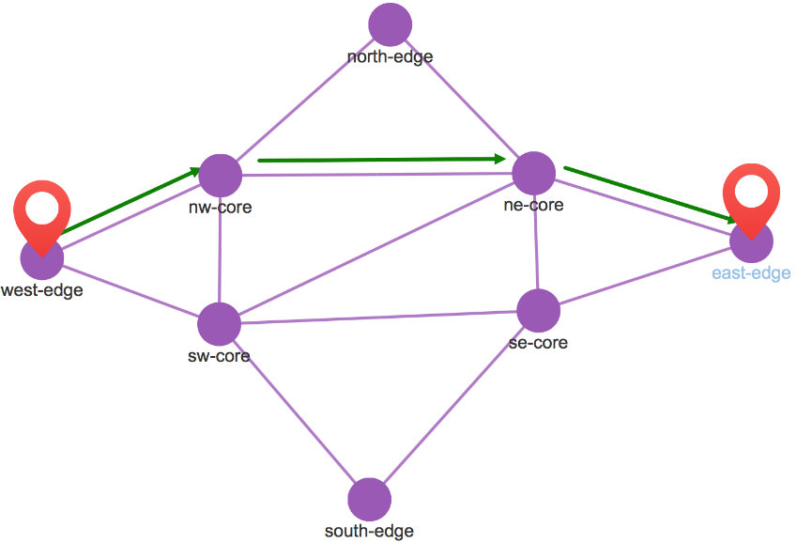
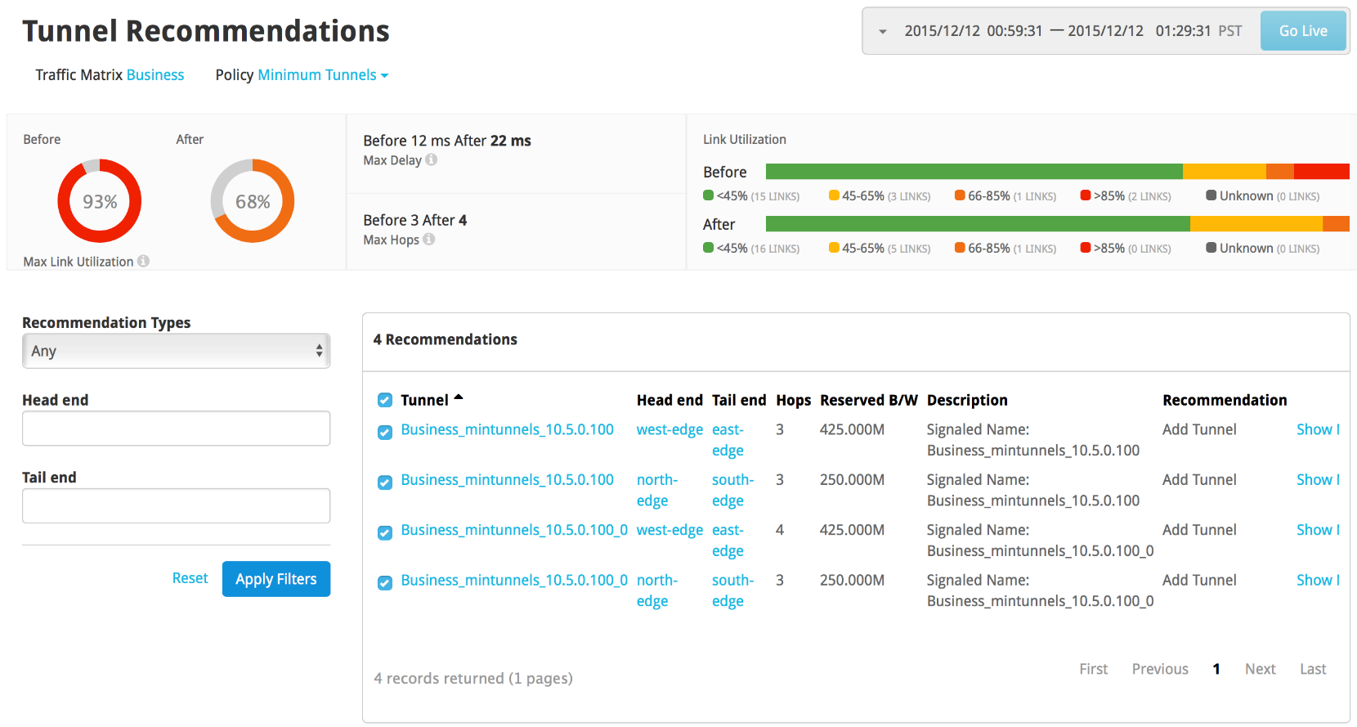
Illustration
1 Gbps links
Two elephant flows
  850Mbps west to east
  500Mbps north to south
Lots of mice flows

Slide 25
Concluding Remarks
SDN simplifies running a traffic engineered network
  Application is the SDN revolution
SDN application needs enablers from the infrastructure
  Controller
  Segment routing (or RSVP-TE when not available)
  Push-based telemetry
  NETCONF/YANG, PCEP, and other southbound protocols

