Slide 1
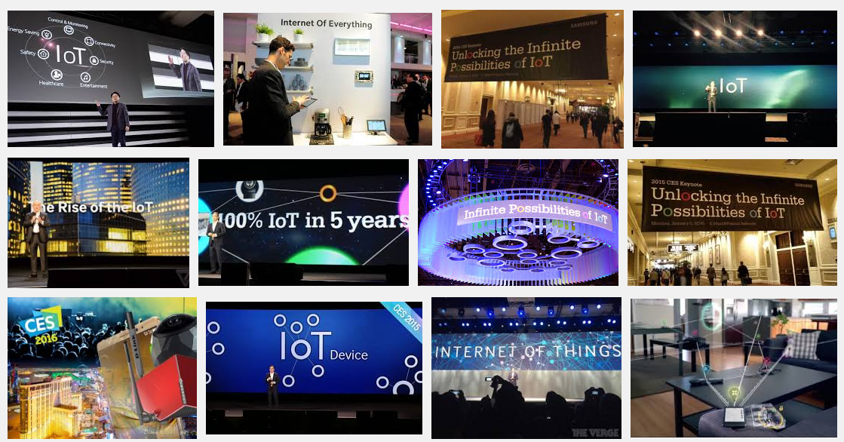
What’s all this I hear about the Internet of Things?
(A recent visit to CES in Las Vegas)
Notes:
Yes – IoT has become a marketing term blurring the lines between “things”. Could be a light bulb or a car or a medical device …or… a router or a firewall. BTW: That IoT light bulb is connected to the same home network on which you do your banking transactions…hmmm.
Accompanied with hype there is investment and IoT is another example of a lot of investment.

Slide 2
BS or Not BS?
Does it matter?
Where do “WE” fit in?
Notes:
Royal WE

Slide 3
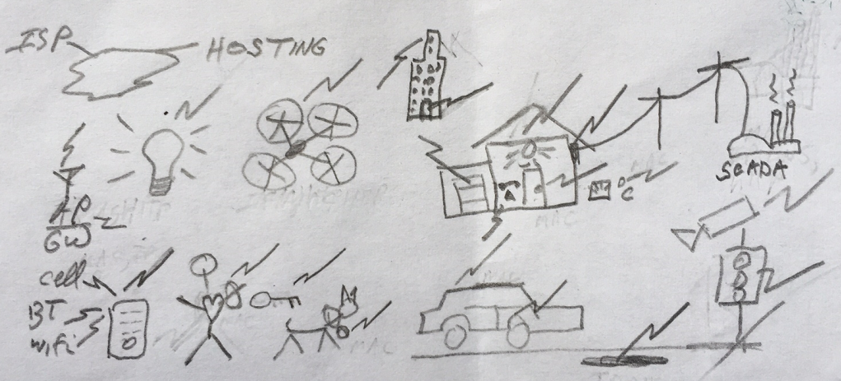
A picture is worth 1001 words (but I am no artist)
Notes:
Currently a mixture of gateway systems between Internet and other protocols. But technology and efforts quickly catching up to make all devices Internet capable.

Slide 4
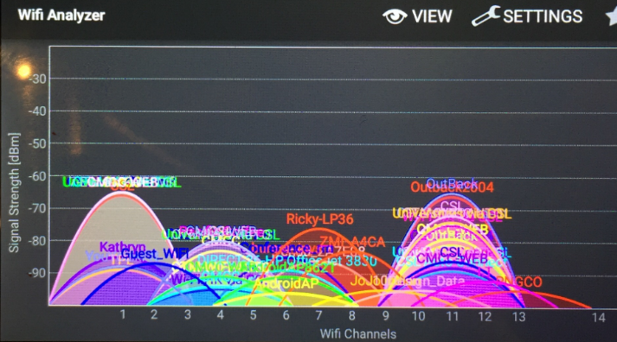
Numbers, Identifiers, Protocols
Spectrum ..13.56MHz, 900MHz, 2.4/5GHz, 24GHz… (GOVTs/ITU)
Modulation, Media Access Control, e.g. bluetooth, wifi, zigbee,.. (IG/IEEE)
MAC addresses, e.g., 00:20:68:XX:XX:XX/ISDYNE (IEEE)
Other numbers: ports: 80/HTTP, 161/SNMP, OID/PEN: 1.3.6.1.4.1.2011/Huawei (IETF/ICANN)
IPv4, IPv6: 199.7.83.42, 2001:500:9f::42 (RIR/ICANN)
ASN: AS2706/Wharf TT… (RIR/ICANN)
Domain Names: www.co.tt … (ICANN)
HTTP, SMTP, SIP, XMPP, RTP, app specific… (IETF/ITU/IG)
Security: SSL/TLS, RSA, ECC, AES, … (Academia/IG/IETF/GOVTs)
Notes:
IoT is a reason for IPv6, i,.e., IPv6lopan

Slide 5
Obviously we need domain names to lay claim to our presence on the Internet
…and to provide a mechanism for customers to locate our services
But where might domain names fit in the IoT discussion?

Slide 6

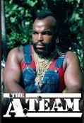
DNS: The first Cloud service?
DNS
DNS has been part of the Internet since 1983
Faithfully managed by 100s of operators and
1000s of entities
Already built into software
Currently mostly one way from static DNS servers to clients
Why not both ways?
Notes:
The DNS has already been increasingly relied upon for machine-to-machine communication.
e.g., between email systems.
Why not IoT?

Slide 7
Sure, this “channel” is slow but most IoT applications are low data rate (e.g., door open, door closed)
Examples of DNS data channel use:
  Botnet command and control
  Internet accesses over DNS (e.g., iodine)
  Web analytics
Caching delays can be controlled or eliminated
Relatively easy to write/modify nameserver to act on specific queries, e.g.,
  set-light-on-<changing-string>.my.iot.domain
  get-alarm-state-<changing-string>.my.iot.domain
Notes:
I have one setup xxxxx.iot.dc.org that ESP8266/$2 IoT devices use to communicate with each other.
Responses can be application specific encoded/encrypted.

Slide 8
DNSSEC: Solution to IoT’s Security Headache?
Security is a well known missing piece for IoT
Many IoT applications have physical safety implications
DNS with DNSSEC can solve this problem
Examples:
  DANE: publish public keys in the DNS. End user validates using DNSSEC.
  SmartGrid
Result: a secure, global, cross-organizational, trans-national communication channel between devices
Notes:
Holy grail of true end-2-end security. Makes some nervous. German ISPs have embraced DANE.
This is a recognized issue but businesses are too busy focusing forward.
This will be an issue and is therefore an opportunity for those looking ahead with skills.
BTW: That IoT light bulb is connected to the same home network on which you do your banking transactions…hmmm.

Slide 9

A thought: Scalable Security for IoT
root
DNS is already there
DNSSEC adds security
com
and crosses organizational boundaries.
google.com
za
co.za
security.co.za
electric.co.za
iotdevices.co.za
water.rickshome.security.co.za
car.rickshome.iotdevices.co.za
aircond.rickshome.electric.co.za
window.rickshome.security.co.za
thermostat.rickshome.iotdevices.co.za
meter.rickshome.electric.co.za
door.rickshome.security.co.za
refrigerator.rickshome.iotdevices.co.za
Animated slide
Notes:
An opportunity to build security into IoT devices from the start.

Slide 10
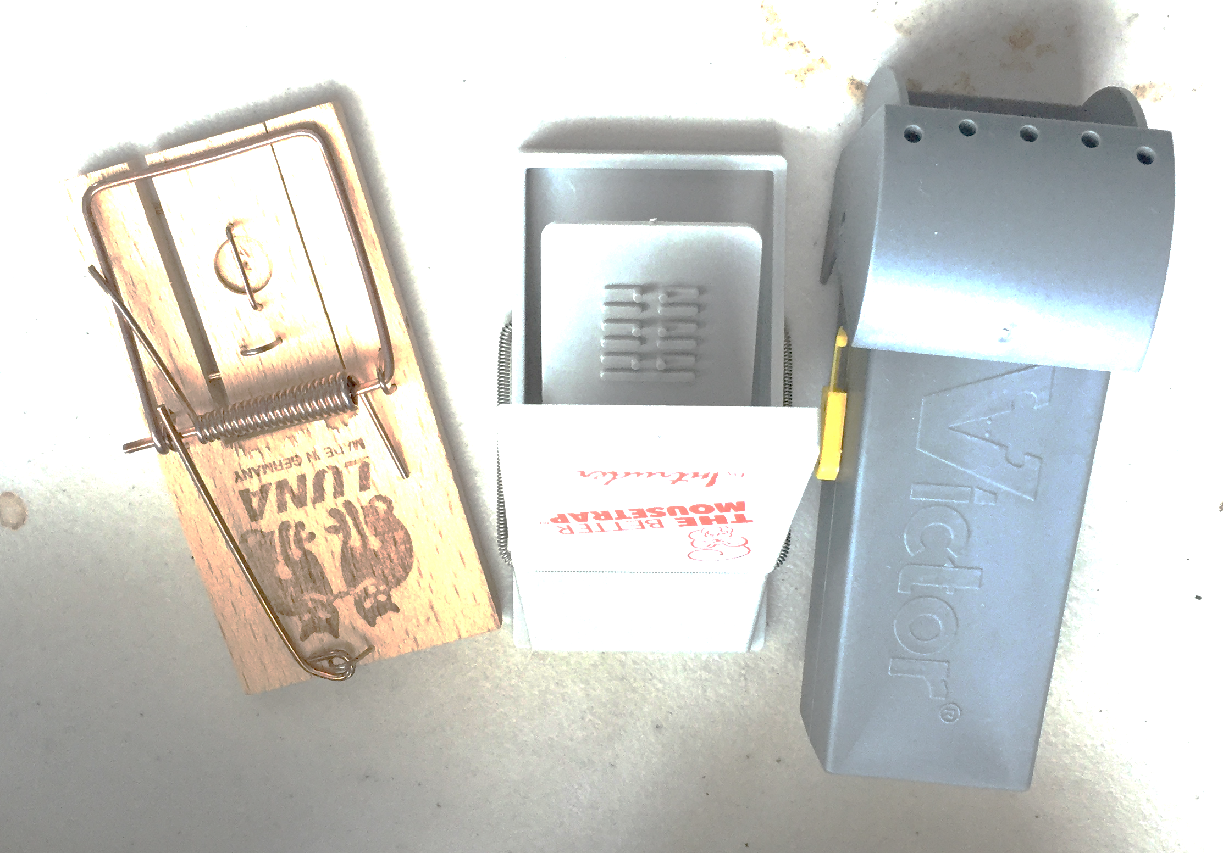
Lets take advantage of the hard won experience and cooperative environment to develop the solutions for “tomorrow’s” IoT!
?
Notes:
IoT is not just about H/W. It is about (securing) the services behind the IoTs. That innovation could happen here in Nepal.
I know you have the expertise – I have met many of them personally.
Embrace IPR. Don’t let your ideas get stolen. There is a well established rule of law here.

Slide 11
Ideas ?
Domain Names as a ubiquitous, scalable, decentralized (cloud) communication channel for IoT infrastructure
Locked down with DNSSEC to secure the channel and bootstrap application specific security mechanisms

