Slide 1

Launch of the First Georgian IXP in Tbilisi
ENOG 12, Oct 4,2016, Yerevan
George Gotoshia – MD Newtelco Georgia, ggotoshia@newtelco.ge

Slide 2
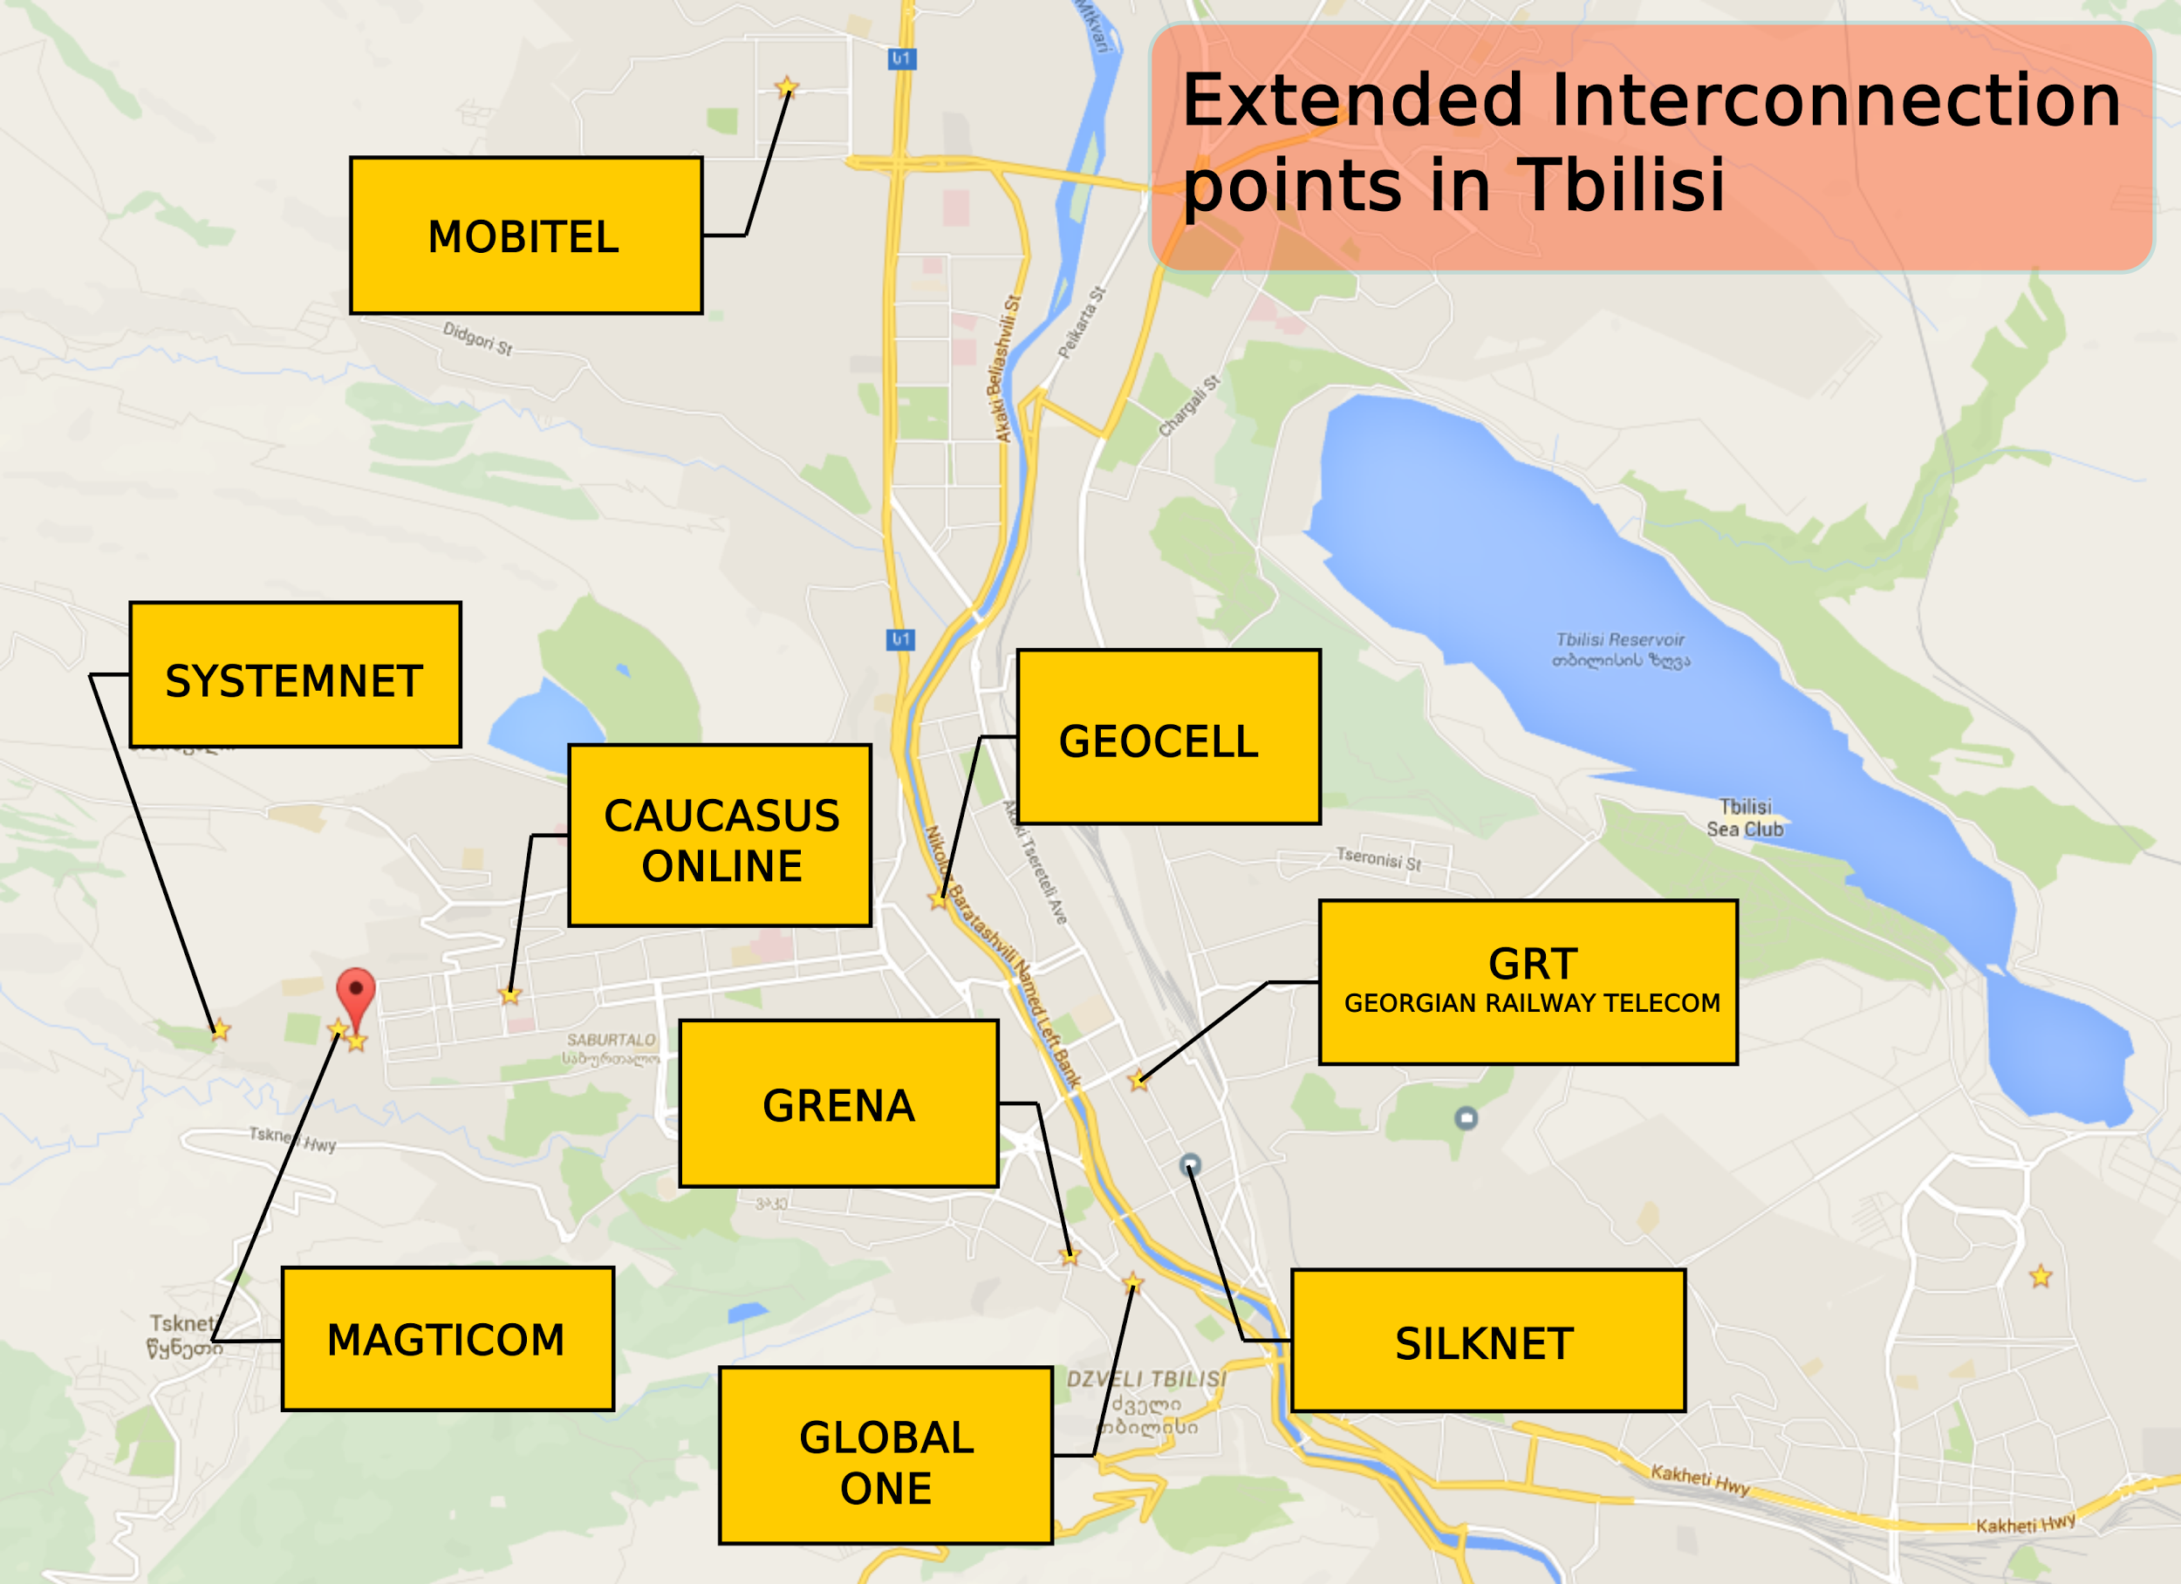

Slide 3
Revenue Service webpage rs.ge often looks like this picture, when companies try to upload their financial documents from different providers.

Slide 4





Georgian IXP founders
NEWTELCO GEORGIA
TOA – Georgian Association of Small and Medium Telecommunications Operators (23 companies)
ISPs joined
AlterNET Global Erty GrandNet
Ordunet FREEnet SIMNET CDN
GRENA – The Georgian Research And Education Network Association
The first Internet Exchange Point (IXP) in Georgia was launched on September the 28th, 2016 during the official ceremony held at the Courtyard Marriott Tbilisi with the support of Newtelco Georgia and TOA. Eight Georgian ISPs have established the first IXP in Georgia as a NFP association.
GIX.GE
info@gix.ge

