Slide 1
Rolling the Root Zone DNSSEC
Key Signing Key

Slide 2
Motivation for the Talk
ICANN is about to change an important configuration parameter in DNSSEC
For a network DNS operator, this may create a need for action
This discussion is meant to inform: What is happening, when, and what to do if troubleshooting is needed

Slide 3
DNSSEC in the Root Zone
DNSSEC in the Root Zone is managed by:
  ICANN, as the IANA Functions Operator
  Verisign, as the Root Zone Maintainer (RZM)
Some changes to the naming of the functions may happen in the future

Slide 4

DNSSEC Key Management in the Root Zone
DNSSEC key management is divided into:
  Key Signing Key (KSK), self-signs the key set
  Zone Signing Key (ZSK), signs other zone data
These roles are meaningful to the operators of signed zones
  The significance is that the roles are separated

Slide 5
KSK and ZSK
ICANN, as IANA Functions Operator, manages the KSK
  Same KSK since operations began in 2010
  The KSK signs the ZSK quarterly in a ceremony
Verisign, as Root Zone Maintainer, manages the ZSK
  ZSK is changed quarterly

Slide 6
Why Change the KSK?
Primary reason – operational preparedness
  KSK has no expiration date, currently no weakness
  No key should live forever: bad crypto practice
  DNSSEC Practice Statement states the key will be rolled
  Prefer to exercise process in normal conditions
    As opposed to abnormal, such as key compromise
Big challenge
  Involves countless/uncountable participants
  No test environment can cover all possibilities

Slide 7
The KSK Roll Plan Documents
The plan consists of five documents:
  2017 KSK Rollover Operational Implementation Plan
  2017 KSK Rollover Systems Test Plan
  2017 KSK Rollover Monitoring Plan
  2017 KSK Rollover External Test Plan
  2017 KSK Rollover Back Out Plan
The documents are available at: https://www.icann.org/kskroll

Slide 8
Communications Approach
Target technical audiences performing DNSSEC validation (e.g., Network Operating Groups)
  How to participate in the KSK rollover
Broader communication
  General awareness, resources available
Integrated communications approach
  Traditional channel (email, presentations)
  Social media (#KeyRoll)
  Leverage ICANN staff and stakeholder groups

Slide 9
Operational Implementation Plan Phases
Preparation Phases
  System engineering, KSK creation and replication
  Little to no operational impact on Internet
Automated Updates (RFC 5011) Phases
  KSK-2017 (new) pre-published, signs DNSKEY set
  KSK-2010 (current) is revoked
Post Rollover Phases
  Deletion of KSK-2010 from system
  Project experiences documented

Slide 10
Operational Implementation Plan Dates
Plans publicly available from July 22, 2016
Key signing ceremonies
  Q4 2016 ceremony (October 27): generate KSK-2017
  Q1 2017 ceremony (February): KSK-2017 operationally ready
DNS changes
  KSK-2017 added to root zone on July 11, 2017 (with KSK-2010 still there)
  KSK-2017 signs DNSKEY RRset (instead of KSK-2010) beginning October 11, 2017
  KSK-2010 revoked on January 11, 2018 but is still in the root zone

Slide 11
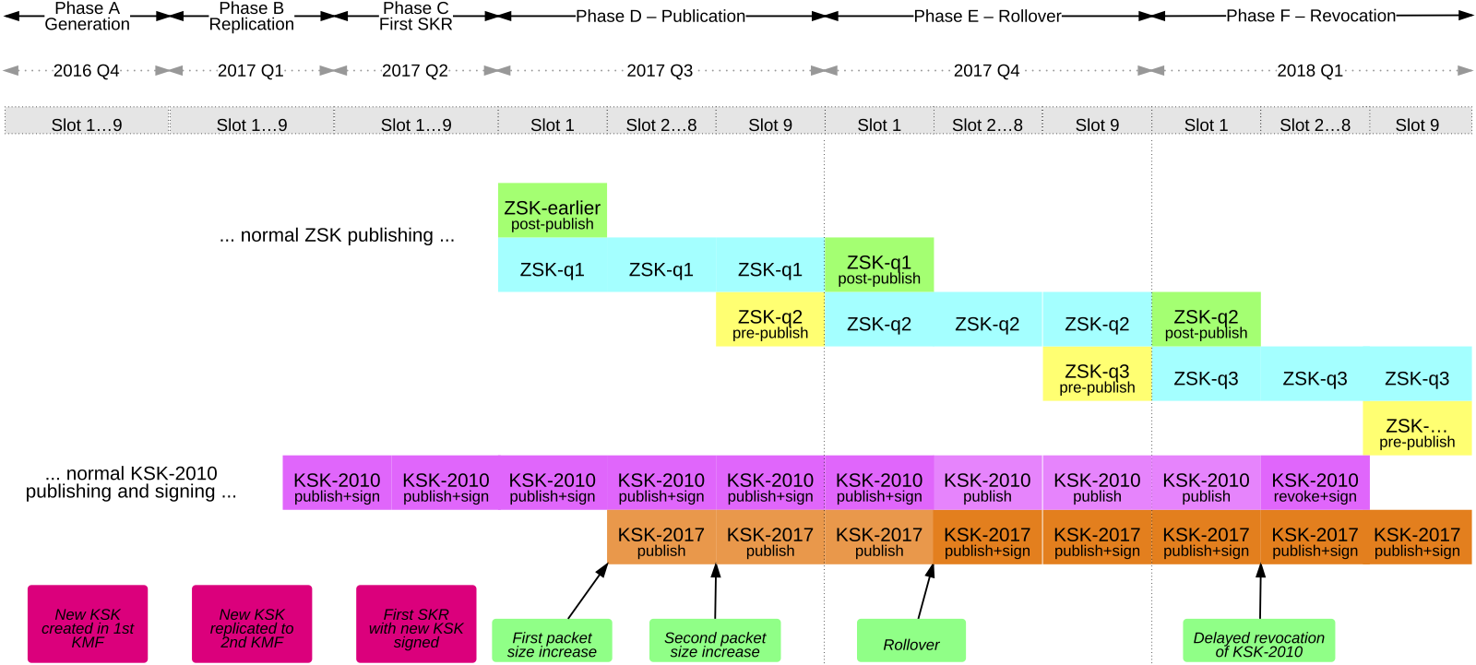
Operational Implementation Plan Timeline

Slide 12
Systems Test Plan
Testing internal systems for these components
Key Management
  Lifecycle
Key Processing
  Key Signing Request to Signed Key Response
Trust Anchor Publication
  Generation of the trust anchor file as formatted in eXtensible Markup Language (XML)

Slide 13
Monitoring Plan
Automated monitoring involving
  ICANN’s L-root server
  Information Science Institute’s B-root server
Looking for
  Low-level fragmentation issues, indicating responses are too large
  Elevated query rates for the DNSKEY resource record set, indicating misconfigured trust anchors
Plus a means for ad hoc reporting

Slide 14
External Test Plan
Resources targeted for software developers
  Two third-party “accelerated” RFC 5011 test environments with accelerated clocks
    http://toot-servers.net
    http://keyroll.systems
Resources more suitable for operators
  “Real time” RFC 5011 test environment being developed by ICANN
  Roll a test zone trust anchor with actual 30-day Add Hold-Down timer

Slide 15
Back Out Plan
Plan includes back out capability
  If necessary, can stay in current state or back out at every phase
  Until KSK-2010 is revoked in Phase F
Multiple back out DNSKEY Resource Record Sets (RRsets) signed at each ceremony
  Back out can be immediate
  No need for extra key ceremony

Slide 16
What You Need to Know
Manage Your Trust Anchors
  Be aware of your software tools for managing trust anchors
  Be aware of the new KSK
When Events Happen
  Keep an eye on dates
  Be mindful of when changes are scheduled and monitor appropriately

Slide 17
Managing Trust Anchors
Trust anchors are configured data in DNSSEC validators
  If Automated Updates of DNSSEC Trust Anchors (RFC 5011) is enabled and working, the rollover is automatic
  Otherwise manual intervention is required
    Add the KSK-2017 before October 11, 2017 (assuming all is on track)
    Remove KSK-2010 at a later date

Slide 18
Planned KSK Rollover Dates
Plans publicly available from July 22, 2016
Key signing ceremonies
  Q4 2016 ceremony (October 27): generate KSK-2017
  Q1 2017 ceremony (February): KSK-2017 operationally ready
DNS changes
  KSK-2017 added to root zone on July 11, 2017 (with KSK-2010 still there)
  KSK-2017 signs DNSKEY RRset (instead of KSK-2010) beginning October 11, 2017
  KSK-2010 revoked on January 11, 2018 but is still in the root zone

Slide 19
For More Information
Join the ksk-rollover@icann.org mailing list:
  https://mm.icann.org/listinfo/ksk-rollover
Follow on Twitter
  @ICANN
  Hashtag: #KeyRoll
Visit the web page:
  https://www.icann.org/kskroll
Notes:
Note: inserted graphics

Slide 20








Engage with ICANN
Thank You and Questions
Reach us at:
Email: ksk-rollover@icann.org
Website: icann.org/kskroll
twitter.com/icann
gplus.to/icann
facebook.com/icannorg
weibo.com/ICANNorg
linkedin.com/company/icann
flickr.com/photos/icann
youtube.com/user/icannnews
slideshare.net/icannpresentations
Notes:
You can adjust the email/web address to whichever email or web address is best suited to your presentation. This should be your final slide.

