Slide 1

Vulnerability Risk management for everyone
arkenoi@gmail.com
ENOG12

Slide 2
the open Net
mobilize technical Internet community
provide technical expertise
talk to other stakeholders

Slide 3
Why bother
Risk Management is the essence and purpose of all Information Security activities
Everything you do for Information Security is some kind of risk management!

Slide 4
Who cares?
60% of respondents stated company executives are only “somewhat” to “not at all” informed about the risk posed to their business from today’s security threats
(NopSec 2016 Outlook: Vulnerability Risk Management and Remediation Trends)

Slide 5
What is risk management
GRC: Governance, Risk management and Compliance
Stage 0: ad hoc
Stage 1: missing! (a lot of bad stuff happens just here)
Stage 2: compliance driven (things that cannot be ignored)

Slide 6
Nature of risk management gap
Cultural (“It is compliance driven stuff, we do not care, we have business to do”)
Financial (“Only wealthy companies can afford this”)
Technological (“We have no resources to waste on your complicated toys”)

Slide 7
Measurement: Quantitative?
Risk = Impact ($) * Probability
Both variables are mostly unknown, yet estimated. The formula might get complicated if you add more variables (means, motive, controls, whatever)
Reliability of data sources is questionable, yet if you present any numbers rather than none it looks more convincing

Slide 8
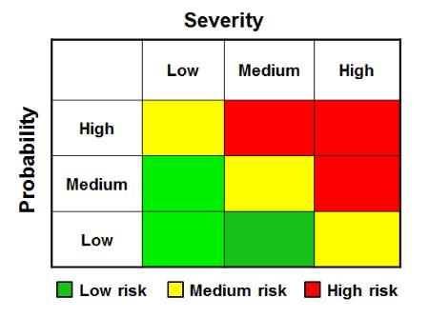
Measurement: Qualitative?
Better for decision making
You may or may not have real quantitative data as input
Google deeper: Cox’s risk matrix theorem

Slide 9
Threat Intelligence
“What’s happening out there”? Understanding risk through external context.
Not just about 0-days and IoCs for IPS/SIEM
Both APT-like actors and opportunistic attackers matter

Slide 10
Network operators as natural data source for threat intel
Huge coverage
Already having tools (IDS, traffic analysis, DPI, DNS request data, etc)
Managed security services for customers

Slide 11
Creating effective collaboration
How should joint CERT work?
Anything is always better than nothing.
Coordinate, aggregate, analyse and share.
Distributed tasks are easier.

Slide 12
Three functions of joint CERT
CC: coordinate effort and promote information exchange (here we start!)
CSIRT: incident investigation, response and tactical analysis (easier!)
SOC: realtime and retrospective event processing (harder!)

Slide 13
Let’s get practical
Why vulnerability management?
Most of the breaches involve vulnerability of some kind
Manageable and measurable (involves less social context, as we know machines are easy and humans are hard)

Slide 14



Vulnerability Management
Stage 0: none
Stage 0.5: [a]periodic scans, huge vulnerabilities lists, panic and depression (significant human effort is required in this struggle)
Stage 1: continuous vulnerability management and first attempts to prioritise on the fly (here VM vendors jump in and ask for big $$)
Stage 2: more or less futile attempt to bring both variables into the risk equation (RM vendors jump in and ask for even more $$)

Slide 15
Why pay premium price
Because it is obviously valuable. And there is (or at least seems to be) no alternative.
51% of organizations are suffering from data overload (and I think many more either have massively incomplete data or do not admit their difficulties)
24% do not know how to prioritize
22% use CVSS and maybe some internal data
21% do manual correlation with threat intel
31% use commercial tools
(NopSec 2016 Outlook: Vulnerability Risk Management and Remediation Trends)

Slide 16



Notable players (VM)
Nessus one of best yet cheapest security scanners, but continuous vulnerability management (SecurityCenter) is expensive. Risk management capabilities are limited.
A nice try to integrate threat intelligence and advanced asset management into vulnerability scanning, again, big $$
As authors of Metasploit, the penetraion testing tool, Rapid7 is notable for highly practical approach to vulnerability management.

Slide 17


Notable players (RM)
An Israeli start-up, first (known to me) attempt to break vendor lock-in for the vulnerability risk management. Has connectors to multiple scanners. Starts with $30K or so.
If you are not from Russia, you probably never heard about this one. It’s a shame because the capabilities are impressive.
GRC vendors without specific focus on VM (like RSA etc) are not listed here for obvious reason.

Slide 18
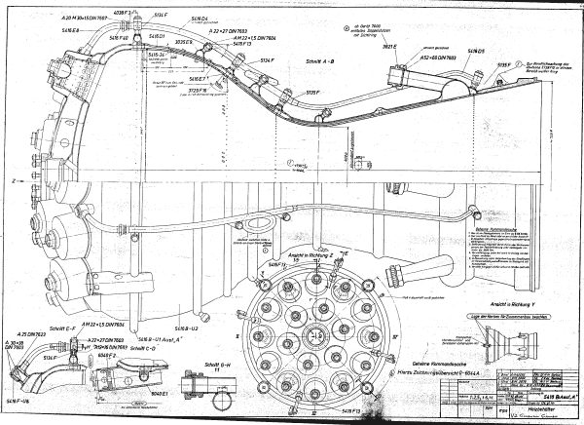
Industry’s Dirty Little Secret

Slide 19
As easy as that
“Continuous vulnerability management” requires a database backend, vulnerability scanner connectors and a few reporting tools. And it is already here (Seccubus project, developed by Schuberg Philis)
“Vulnerability risk management” requires (surprisingly) an asset management tool with good heuristics to assist evaluation (think hostnames, software inventory, LDAP lookups etc), a method to integrate environmental factors (firewall configuration, protective tools,..), possible threat intelligence data and vulnerability assessment as is.
(if you are interested in risk assessment methodology per se, refer to Open Group’s FAIR (*), it simple)
(*) Factor Analysis of Information Risk

Slide 20
How to evaluate vulnerability
Like hackers (well, or pentesters ;-) do!
The only things you need to know are:
Is this vulnerability exploitable in your configuration?
Is there a pre-built exploit for your system available?
What is the real impact?
If you know that, you get part of the equation solved. The other parts are the asset value, protection countermeasures and you chances to be attacked.

Slide 21
A real life example
Winshock (MS14-066) vulnerability
Unauthenticated RCE in Windows SChannel code
“Exploits are available”, given top priority by all vulnerability scanners
Maximum posible CVSS score of 10.0
Actually no RCE exploits in the wild, just DoS!

Slide 22
Simply put
Traditional vulnerability scanning software scares you into thinking you have an immediate and imminent threat and you should concentrate your efforts on fixing that. While there actually could be more important things for you to do, because the cost and complexity of the attack is much higher than was implied!

Slide 23
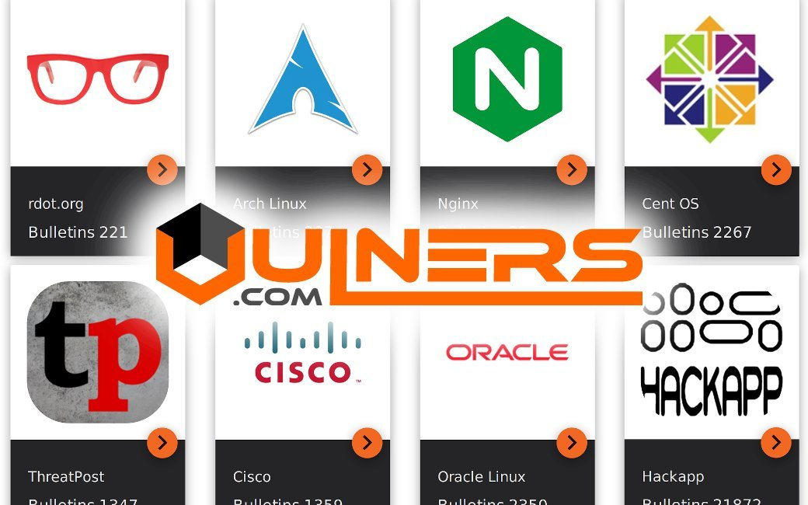
Enter Vulners
A search engine for exploits and security bulletins, contains 60+K exploits to date
Non-profit and free to use

Slide 24
But, wait
Vulners exploit search is for humans
No formal definition exists for exploit capabilities
Time to fix that!

Slide 25
Enter ECDML and EACVSS
Exploit Capability Definition Markup Language – describe exploit properties via CVE, CPE and supplementary information (CCE, common configuration enumeration is dead, sorry)
EACVSS – Exploit Adjusted CVSS – evaluate real exploit capability

Slide 26
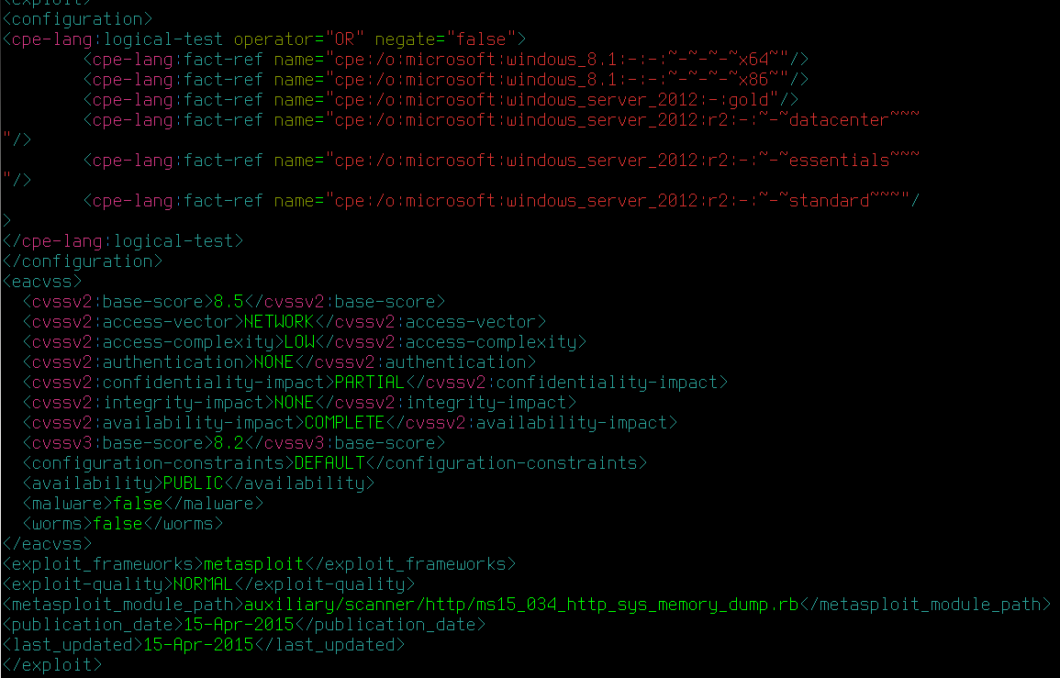
Sorry for non-readable text ;-)

Slide 27
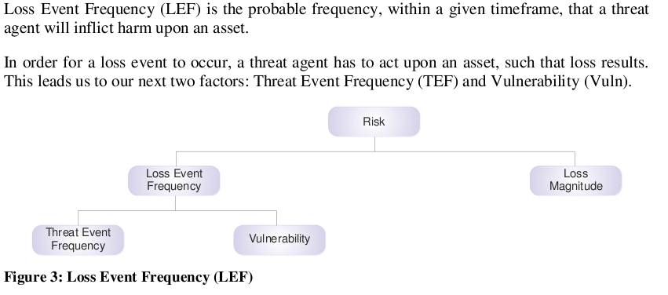
Back to risk analysis and FAIR methodology

Slide 28
What’s next
Augment risk intelligence with Threat Event Frequency
Implement (mostly) automated risk assessments using FAIR methodology
That’s where joint CERT could provide extremely valuable information!

Slide 29
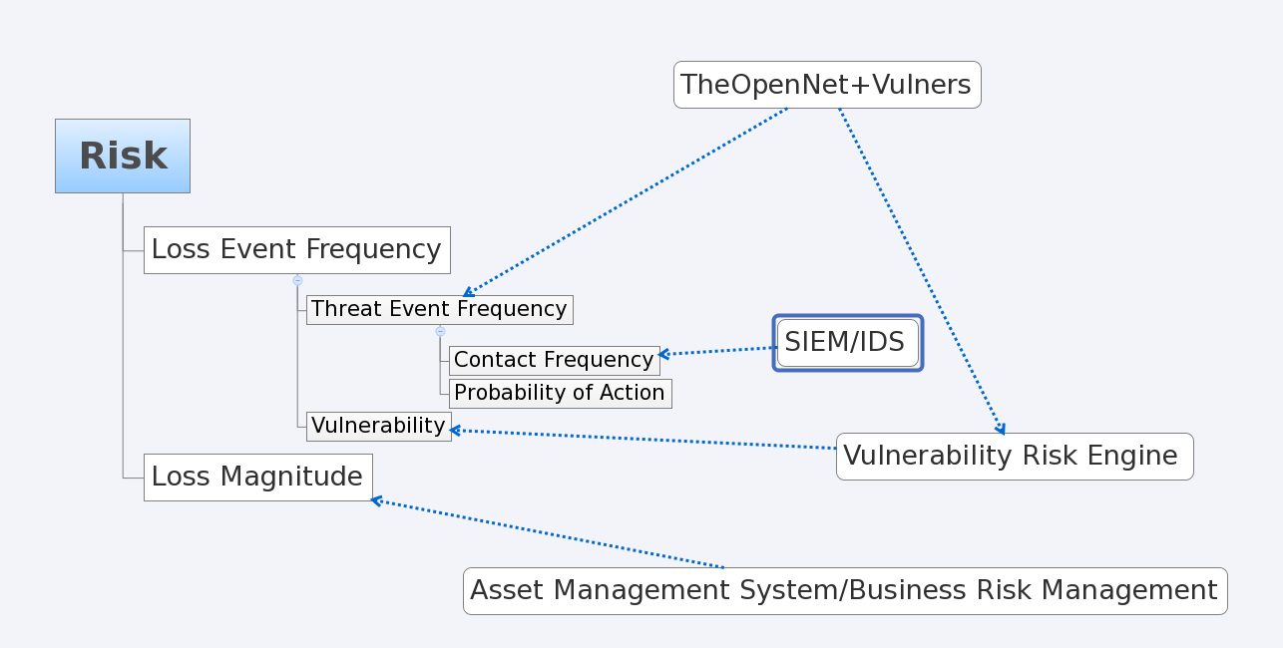
Dreams ;-)
How state of the art risk analysis should work

Slide 30
Not covered here
Advanced vulnerability management issues like detecting and avoiding vulnerability scan gaps, “scannerless” data collection ,etc etc
Seccubus implementation and deployment details (ask me if you want to discuss any of those later)
FAIR methodology in depth
Privacy issues for threat intel
Threat intel information exchange formats

Slide 31
Useful links
http://theopennet.ru
https://www.vulners.com
https://www.seccubus.com

Slide 32
Thank you!
Questions?

