Slide 1



Welcome to ENOG and DigiWeek Armenia
September 30-October 2
October 3-4
October 5
October 5-7

Slide 2










Slide 3

Industry Development Organizations
Union of Information Technology Enterprises (UITE)
ARMIX Foundation
ISOC Armenia
Union of Employers of ICT
Enterprise Incubator Foundation (EIF)
Young Programmers NGO

Slide 4
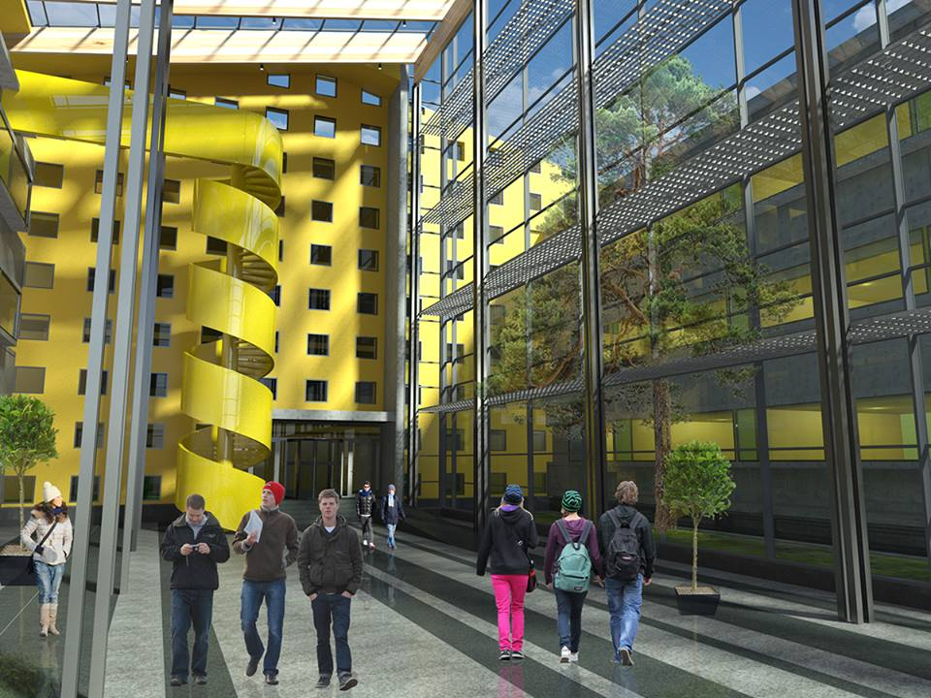
Some Industry Development Projects in Armenia
Technology Centers
in Gyumri (2nd) and
Vanadzor (3rd)
Engineering City
Tumo center for creative
technologies
Innovation Centers in the regions, supported by providers-Koghb (Ucom), Ejmiatsin (Arpinet)

Slide 5
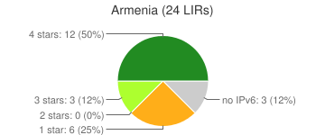
Some Data on ICT development in Armenia
One of the highest rates in RIPEness index
24 LIRs

Slide 6

Some Data on ICT development in Armenia
4G-Vivacell-MTS, Beeline
4G+UCOM
Over 2.2 million of Internet users that is over 70 % of population
Over 21% of growth rate in 2015 in Software and Services Sectors

Slide 7

State regulation and development
Transition of stewardship to one state body-Ministry of Transport, Communications and Information Technologies

Slide 8

Multistakeholder Approach
Information Technologies Development Support Council
Internet Governance Council

Slide 9
ARMIX-ARMENIAN INTERNET EXCHANGE
Current Value Added Services
Internet Traffic Exchange-100 Mbit, 1 Gbit, 10 Gbit and 40 Gbit ports
Google Global Cache, AKAMAI Cluster
Telecom sector oriented event organization and management in Armenia and abroad (RIPE NCC Regional Meeting in 2015, ENOG 12, delegations to CEBIT, MENOG, EURO-IX Meetings, ENOG 11, etc)
Lobbying the interests of telecom sector
13 organizations have already joined ARMIX
10G of traffic
Upcoming-DNS Node, Clowdflare, CDN, new connected parties

Slide 10








Local and International Partnerships
Equipment Donation, Service Support, Event Management

Slide 11
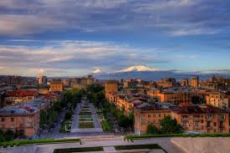
Welcome to Armenia
ENJOY ENOG and Arm IGF

