Slide 1

DNSSEC Implementation Considerations and Risk Analysis
ENOG 12 Yerevan, Armenia Oct 2016
richard.lamb@icann.org

Slide 2
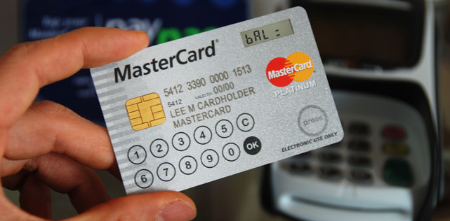





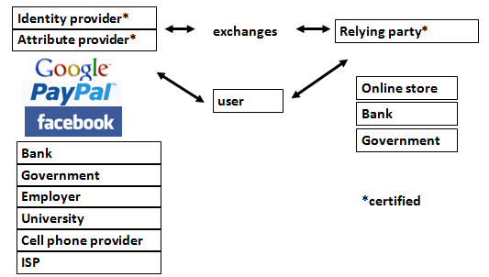
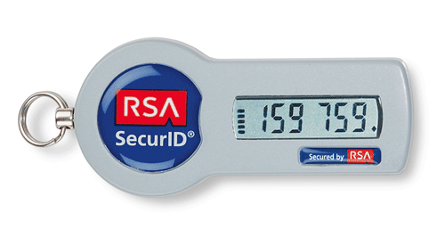

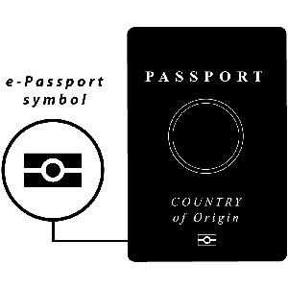

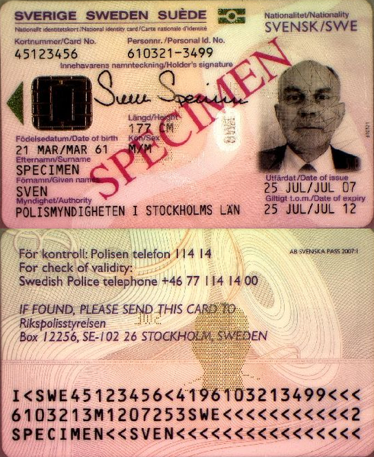
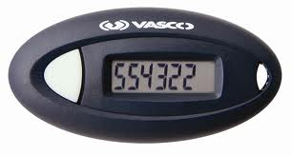

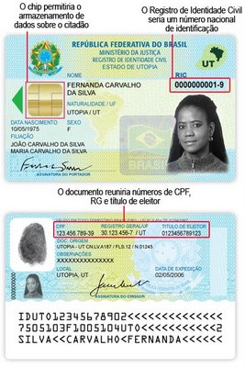

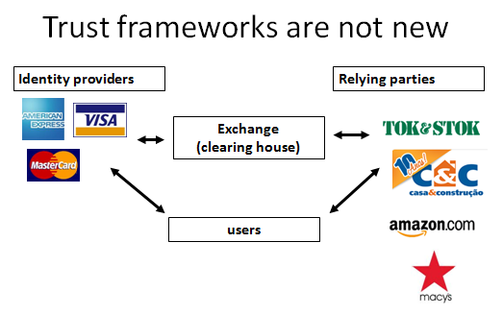

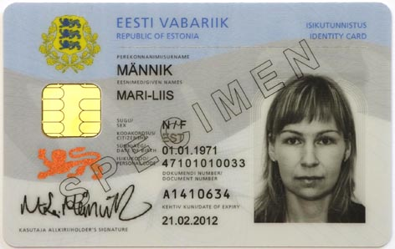

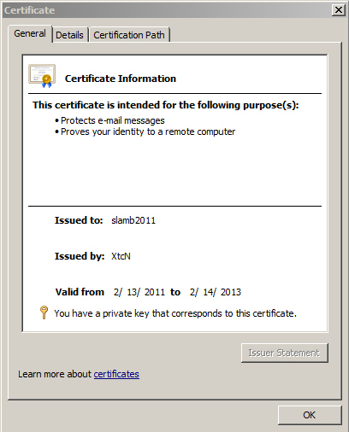

DNS is a part of all IT ecosystems
(much more than one expects)
US-NSTIC effort
+1-202-709-5262
VoIP
OECS ID effort
Smart Electrical Grid
lamb@xtcn.com
mydomainname.com
Notes:
Every time you create an account on a service, logon, buy something you rely on the honesty of DNS.
Even CAs rely on DNS to issue credentials so SSL is suspect. “lazy” CA is as good as “thorough” CA.
PKI and ID systems also rely on DNS to connect to databases to offer services and transfer authentication info.
VoIP relies on the e164 DNS zone as well.
Even with a FOB, you are relying on non-MITM connectivity to the service.

Slide 3
The Problem:
DNS Cache Poisoning Attack
www.majorbank.se = 1.2.3.4
www.majorbank.se=?
DNS Resolver
DNS
Server
5.6.7.8
Attacker
www.majorbank.se = 5.6.7.8
Get page
Attacker
webserverwww @ 5.6.7.8
Login page
Username / Password
Error
Password database

Slide 4
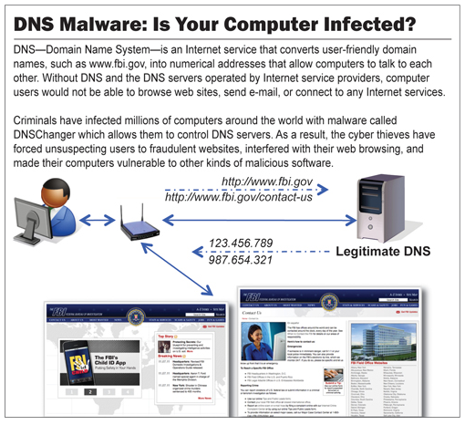
The Bad: DNSChanger - ‘Biggest Cybercriminal Takedown in History’ – 4M machines, 100 countries, $14M
Nov 2011 http://krebsonsecurity.com/2011/11/malware-click-fraud-kingpins-arrested-in-estonia/
End-2-end DNSSEC validation would have avoided the problems
Notes:
end-2-end DNSSEC validation would have avoided the problems.

Slide 5
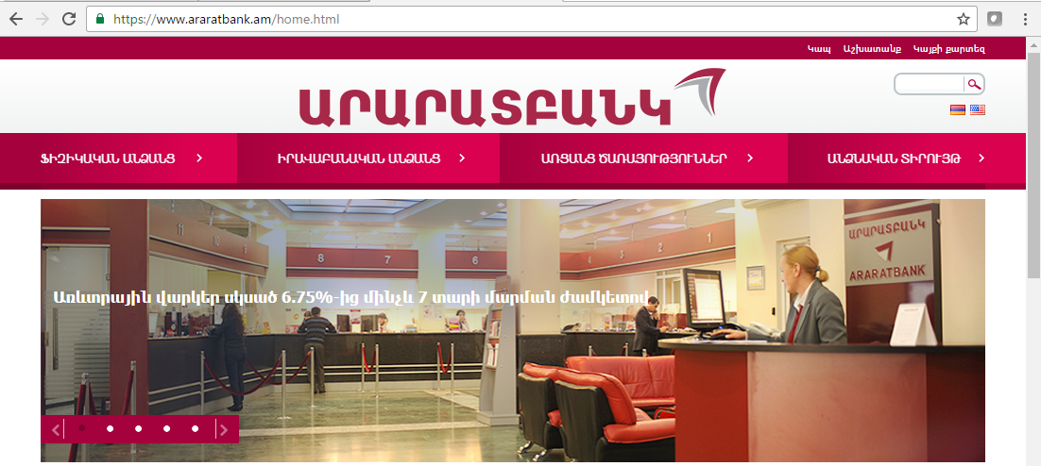
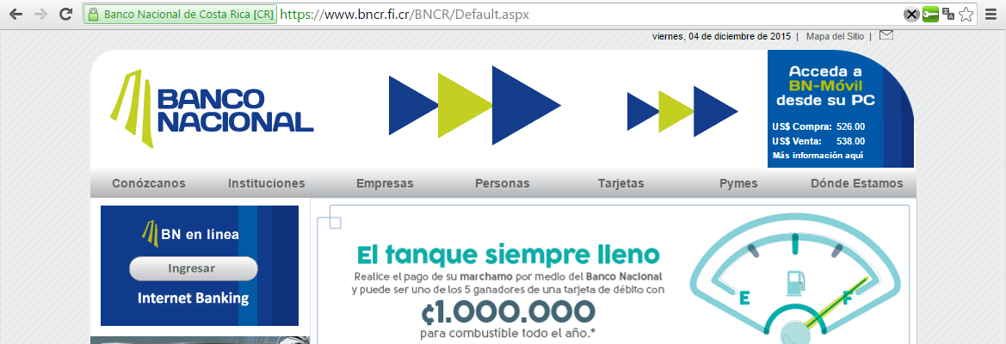
Securing it
DNS converts names (www.bncr.fi.cr) to numbers (201.220.29.26)
Make sure we get the right numbers (DNSSEC)
Verify the identity and encrypt data
SSL
DNSSEC
Notes:
Plug in to show DNSEC lock available at https://www.dnssec-validator.cz/

Slide 6
The Bad: Other DNS hijacks*
25 Dec 2010 - Russian e-Payment Giant ChronoPay Hacked
18 Dec 2009 – Twitter – “Iranian cyber army”
13 Aug 2010 - Chinese gmail phishing attack
25 Dec 2010 Tunisia DNS Hijack
2009-2012 google.*
  April 28 2009 Google Puerto Rico sites redirected in DNS attack
  May 9 2009 Morocco temporarily seize Google domain name
9 Sep 2011 - Diginotar certificate compromise for Iranian users
SSL / TLS doesn't tell you if you've been sent to the correct site, it only tells you if the DNS matches the name in the certificate. Unfortunately, majority of Web site certificates rely on DNS to validate identity.
DNS is relied on for unexpected things though insecure.
*A Brief History of DNS Hijacking - Google
http://costarica43.icann.org/meetings/sanjose2012/presentation-dns-hijackings-marquis-boire-12mar12-en.pdf

Slide 7
The Business Case for DNSSEC
Cyber security is becoming a greater concern to enterprises, government, and end users. DNSSEC is a key tool and differentiator.
DNSSEC is the biggest security upgrade to Internet infrastructure in over 20 years. It is a platform for new security applications (for those that see the opportunity).
DNSSEC infrastructure deployment has been brisk but requires expertise. Getting ahead of the curve is a competitive advantage.
Notes:
Cyber interest at C-level, and govt mandates. Large US ISP says: it used to be speed, now its security too.
DNS /w DNSSEC: a foothold for trust built into the Internet infrastructure.
94/316 tld + required for new gTLDs, 84% domains can deploy dnssec (but only 1% of 200M+) , s/w support,..

Slide 8
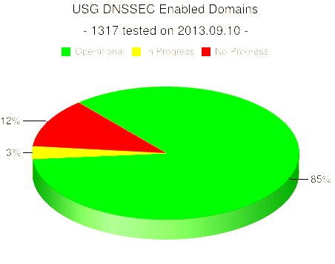
DNSSEC interest from governments
Sweden, Brazil, Netherlands, Czech Republic and others encourage DNSSEC deployment to varying degrees
Mar 2012 - AT&T, CenturyLink (Qwest), Comcast, Cox, Sprint, TimeWarner Cable, and Verizon have pledged to comply and abide by US FCC [1] recommendations that include DNSSEC.. “A report by Gartner found 3.6 million Americans getting redirected to bogus websites in a single year, costing them $3.2 billion.,”[2].
2008 US .gov mandate. 85% operational. [3]
[1] FCC=Federal Communications Commission=US communications Ministry
[2] http://securitywatch.pcmag.com/security/295722-isps-agree-to-fcc-rules-on-anti-botnet-dnssec-internet-routing
[3] http://www.whitehouse.gov/sites/default/files/omb/memoranda/fy2008/m08-23.pdf
http://fedv6-deployment.antd.nist.gov/snap-all.html
Notes:
Side note: dnssec may help remove chaff in determining the source of cyber attacks. Attribution is one of the the key elements in a successful approach to stemming the tide of cyber attacks.

Slide 9
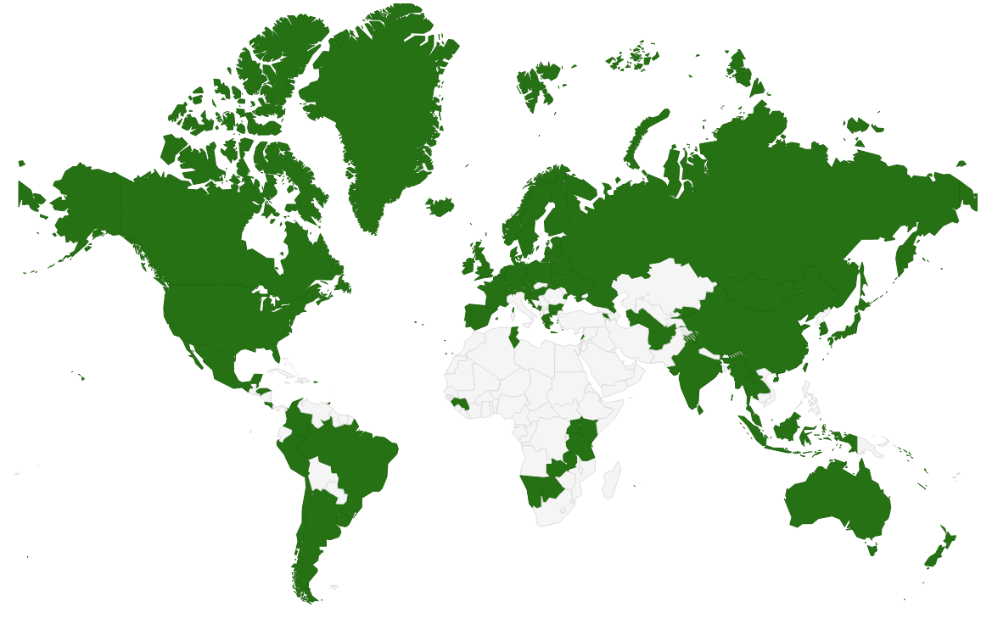
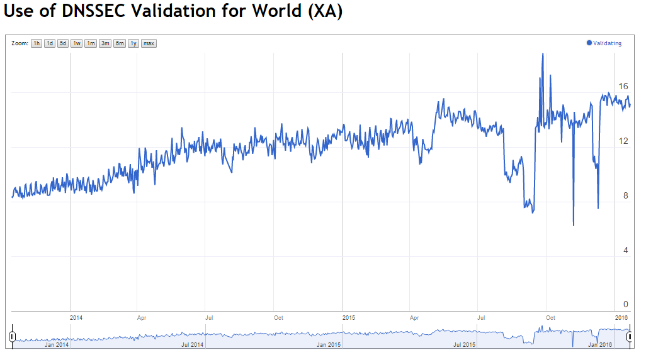
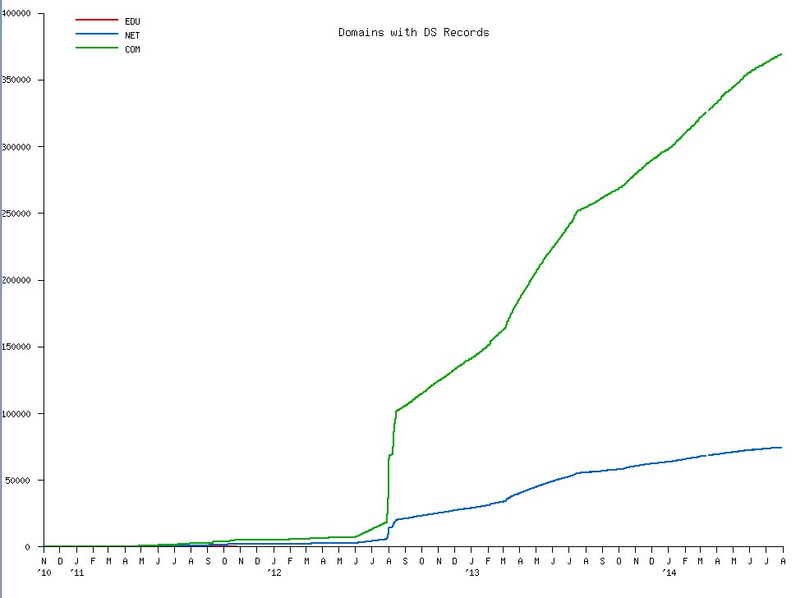
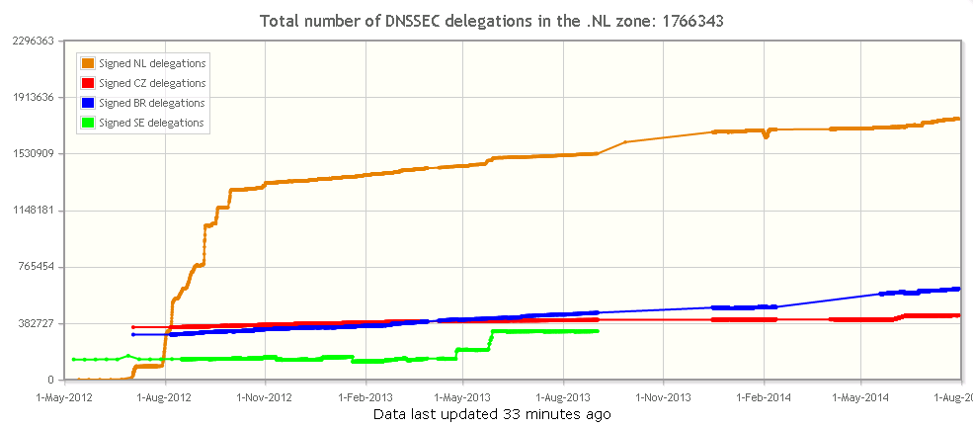
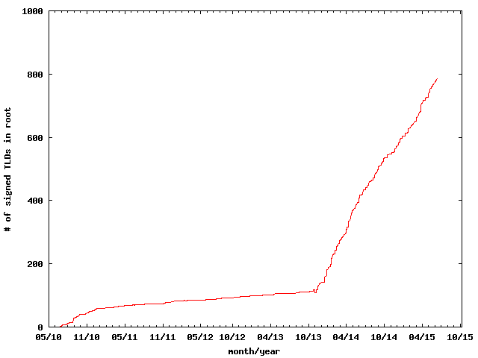
COM
Thank you Geoff Huston
DNSSEC TLDs
NL

Slide 10
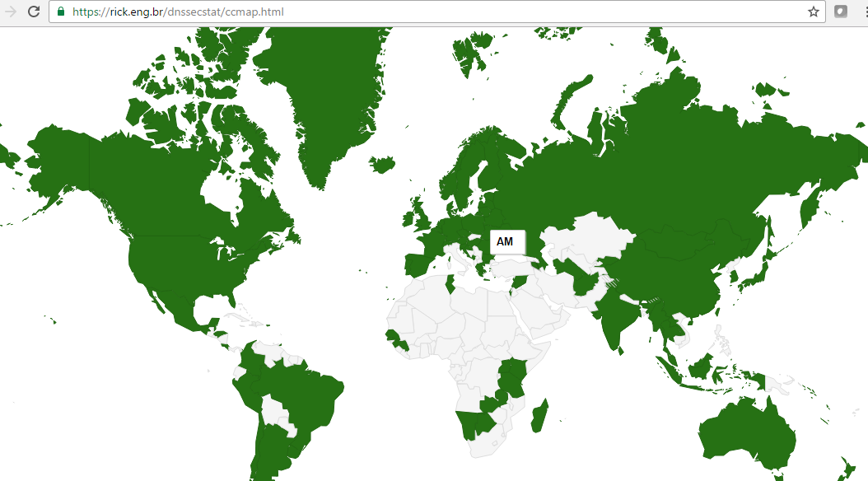
Feb 2011

Slide 11
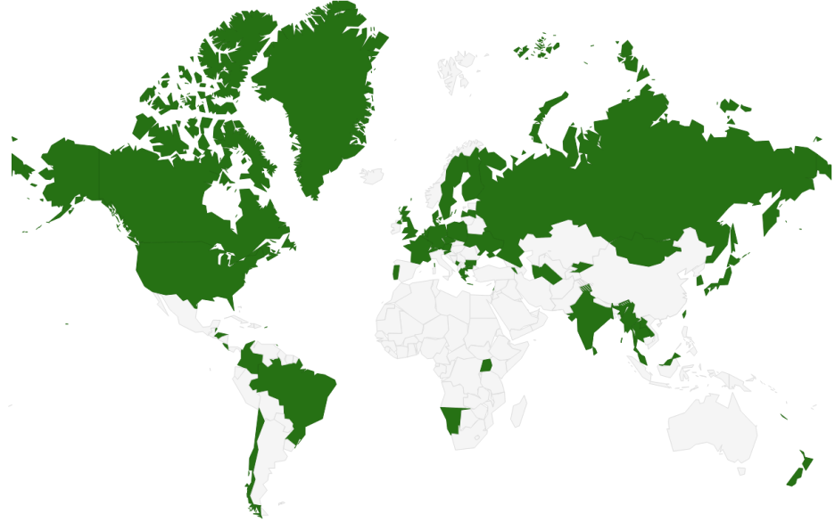
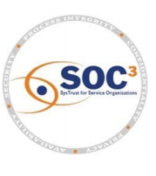

DNSSEC - Where we are
Deployed on 1340/1500 TLDs (2 Oct 2016 .am .in .af .tm .kg .cn .se .de .ru .рф .com .uk .nl .fr .in .jp .us .my مليسيا .asia .tw 台灣, .kr 한국 .net, .org, .post, +ntlds, .ibm .berlin)
Root signed** and audited
> 89% of domain names could have DNSSEC
Required in new gTLDs. Basic support by ICANN registrars
Growing ISP support* - ~16% end users “validate”.
3rd party signing solutions***
S/W H/W support: NLNetLabs, ISC, Microsoft, PowerDNS,KNOT, Secure64…? openssl, postfix, XMPP, mozilla: early DANE support
IETF standard on DNSSEC TLS certificates (RFC6698) and others
Growing support from major players…(Apple iPhone/iPad, Google 8.8.8.8, hosting co Cloudflare DNSSEC by default, German email providers…)
Stats: https://rick.eng.br/dnssecstat/
* COMCAST /w 20M and others; most ISPs in SE ,CZ.
**Int’l bottom-up trust model /w 21 TCRs from: TT, BF, RU, CN, US, SE, NL, UG, BR, Benin, PT, NP, Mauritius, CZ, CA, JP, UK, NZ…
*** Partial list of registrars: https://www.icann.org/en/news/in-focus/dnssec/deployment
Notes:
http://rick.eng.br/dnssecstat/
Major layers: 8.8.8.8/Google, IOS6/Apple
Root: 21 TCRs from TT, BF, RU, CN, US, SE, NL, UG, BR, Togo, PT, NP, Mauritius, CZ, CA, JP, UK, NZ.
DNS over HTTP Chrome-ish, proprietary solutions: MSFT active directory, OpenDNS
All 18M COMCAST Internet customers. Also TeliaSonera SE, Vodafone, Telefonica, CZ, T-mobile NL
US ISP Comcast DNSSEC deployment plan for 18M customers and >5000 domain names http://blog.comcast.com/2011/12/dnssec-deployment-update.html
http://www.icann.org/en/news/in-focus/dnssec/deployment

Slide 12
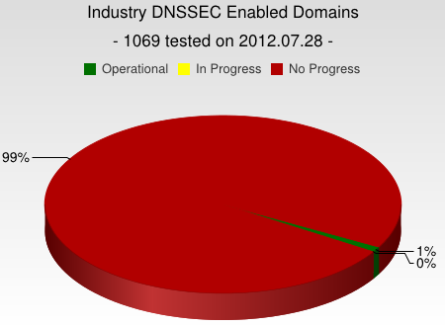
But…
But deployed on only ~3% of 2nd level domains. Many have plans. Few have taken the step (e.g., yandex.com, paypal.com*, comcast.com).
DNSChanger and other attacks highlight today’s need. (e.g end-2-end DNSSEC validation would have avoided the problems)
Innovative security solutions (e.g., DANE) highlight tomorrow’s value.
* http://fedv6-deployment.antd.nist.gov/cgi-bin/generate-com http://www.thesecuritypractice.com/the_security_practice/2011/12/all-paypal-domains-are-now-using-dnssec.html
http://www.nacion.com/2012-03-15/Tecnologia/Sitios-web-de-bancos-ticos-podran-ser-mas-seguros.aspx
Notes:
I was beaten into submission by APNIC’s to-notch PC to clarify this.
The future value of end2end dnssec as a foothold for securing applications.
OS or browser needs to validate. Not too hard a nut to crack but will take patience.
Note that “hotel/airport/hotspot” and other DNS interception networks would have saved you from DNSChanger as well since many force DNS requests to their own DNS resolvers regardless.
“people still get their domains social engineered out from under them at the registry/registar level, but would agree that it is a useful component to a larger solution”
Paypal deploys DNSSEC http://www.thesecuritypractice.com/the_security_practice/2011/12/all-paypal-domains-are-now-using-dnssec.html

Slide 13
DNSSEC: So what’s the problem?
Not enough IT departments know about it or are too busy putting out other security fires.
When they do look into it they hear old stories of FUD and lack of turnkey solutions and CDN support.
Registrars*/CDNs/DNS providers see no demand leading to “chicken-and-egg” problems.
*but required by new ICANN registrar agreement
Notes:
Ask 1) how many have dnssec deployed on corporate domains
and 2) if any of their resolvers have validation turned on.
“ISP support for DNSSEC is necessary even in a future in which end points perform all validation. They must be able to, at a minimum, recognize DNSSEC-related traffic and allow it to pass for the smooth functioning of an end-to-end, DNSSEC-secured system.”
Tools like DNS-Trigger, the CZ plug-in, etc help test this.
~6000 .COM 12 Dec 2011
For a virtuous cycle of secure DNSSEC implementations towards full deployment.
…and brings to bear improvements in overall IT security processes and practices that will address growing number of exploits such as hijacking.

Slide 14
DNSSEC: A Global Platform for Innovation or..
I* $mell opportunity !
Notes:
*and a few others. See all the patent filings relying on DNSEC !!

Slide 15
Game changing Internet Core Infrastructure Upgrade
“More has happened here today than meets the eye. An infrastructure has been created for a hierarchical security system, which can be purposed and re‐purposed in a number of different ways. ..” – Vint Cerf (June 2010)

Slide 16
For Techies and other Dreamers

Slide 17

Too many CAs. Which one can we trust? DNSSEC to the rescue….
CA Certificate roots ~1482
Symantec, Thawte, Godaddy
DNSSEC root - 1
Internet of Things
IoT
Content security “Free SSL” certificates for Web and e-mail and “trust agility” DANE
Cross-organizational and trans-national authentication and security
Content security Commercial SSL Certificates for Web and e-mail
Crypto currencies and e-commerce?
DANE and other yet to be discovered security innovations, enhancements, and synergies
E-mail security SMIME,
DKIM RFC4871
Securing VoIP
Login security SSHFP RFC4255
Domain Names
https://www.eff.org/observatory
http://royal.pingdom.com/2011/01/12/internet-2010-in-numbers/
Notes:
SSL cert for tata.in can be provided by 1482 CAs including govts!! How do you know who to trust?
The Internet community started by with just trying to secure the DNS but we ended up with something much more. (see Vint Cerf’s quote)
With so many, trust is diluted. Used to be good when there were fewer.
Any one can encrypt. Few can Identify : Encryption != Identity
Examples of this problem: Comodo, MD5 crack, DigiNotar etc.. Failures.
Fact is that DNS has been unfortunately used as an independent authentication tool for some time: e.g. email authentication
Looking forward:
Build and improve on established trust models, e.g., CAs
Greatly expanded SSL usage (currently ~4M/200M)
Make SMIME (secured email - SMIMEA) a reality. All email packages already have support for this. They just don’t have a way to distribute keys. /w DNSSEC – now they do.
May work in concert with in enhancing or extending other cyber security efforts like digital Identities, WebID, BrowserID, CAs, ..
Securing VoIP
Simplify WiFi roaming security
Secure distribution of configurations (e.g., blacklists, anti-virus sigs)
Cryptocurrency??

Slide 18
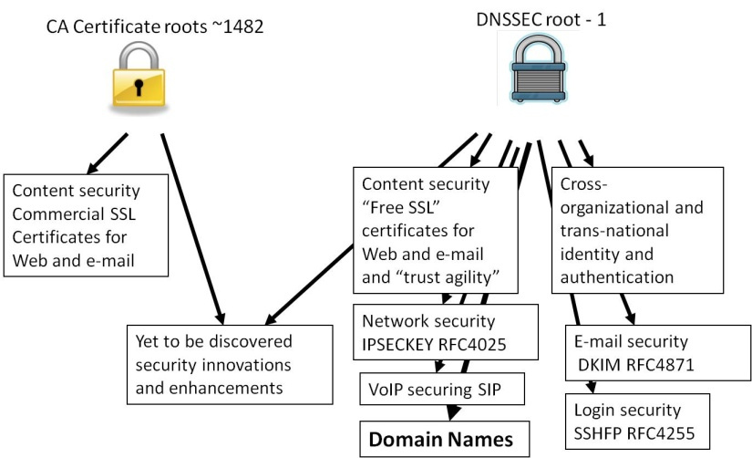
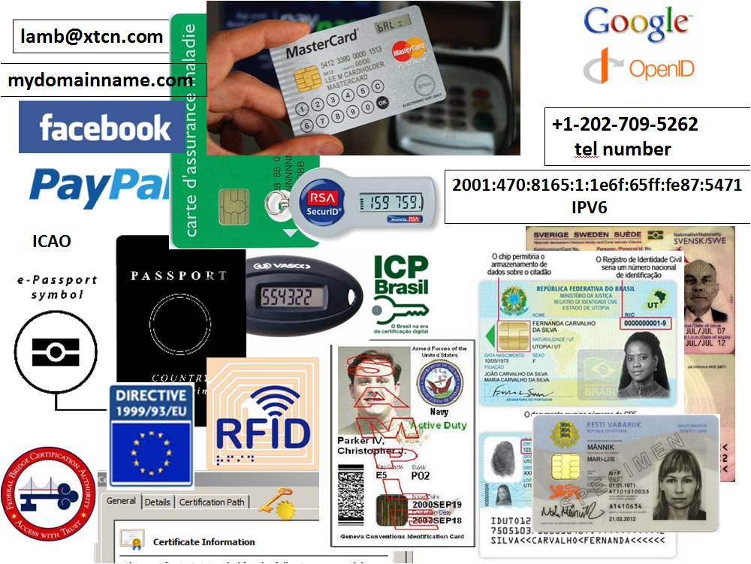
Opportunity: New Security Solutions
Improved Web SSL and certificates for all*
Secured e-mail (SMTP+S/MIME) for all*
Validated remote login SSH, IPSEC*
Securing VoIP
Cross organizational authentication, security
Secured content delivery (e.g. configurations, updates, keys) – Internet of Things
Securing Smart Grid efforts
Increasing trust in e-commerce
Securing cryptocurrencies and other new models
First global FREE PKI
A good ref http://www.internetsociety.org/deploy360/dnssec/
*IETF standards complete and more currently being developed
Notes:
Configuration data examples: anti-virus signatures, blacklists, etc…
Imagine if you could trust “the ‘Net” – again?
Inter email server exchange (SMTP) security using DNSSEC+DANE+TLS is becoming very popular in Germany and elsewhere post-Snowden.
At the 2015 Prague IETF meeting Snowden (via video conference) publicly singled out DNSSEC as a key technology for enhancing privacy.

Slide 19
DNSSEC: Internet infrastructure upgrade to help address today’s needs and create tomorrow’s opportunity.

Slide 20
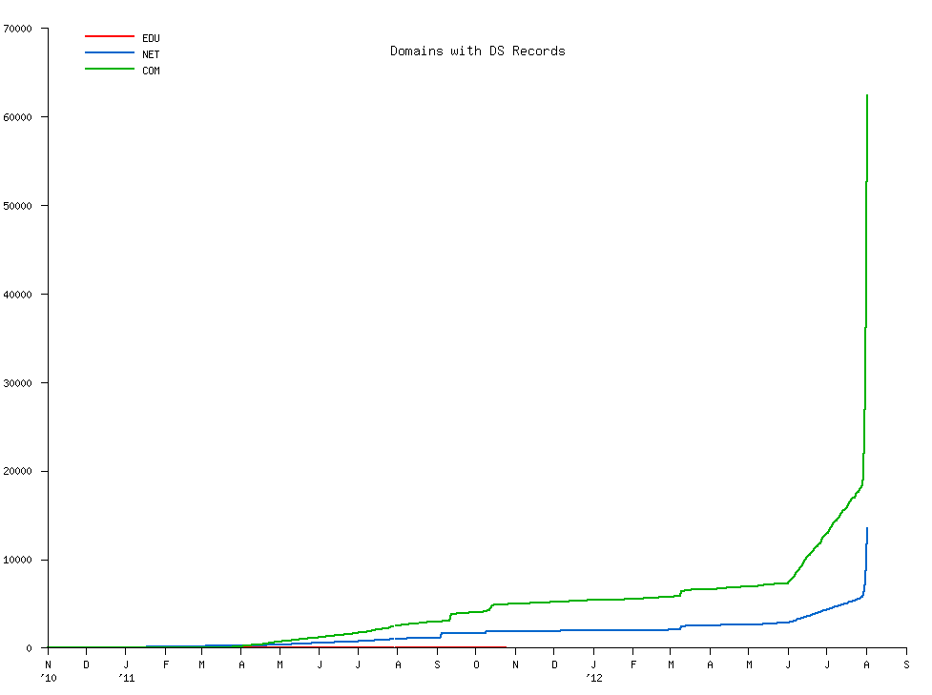
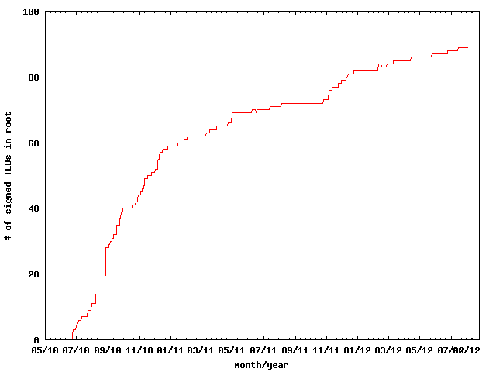
DNSSEC: We have passed the point of no return
Fast pace of deployment at the TLD level
Deployed at root
Supported by software
Growing support by ISPs
Required by new gTLDs
→ Inevitable widespread deployment across core Internet infrastructure
Notes:
The genie is out of the bottle.

Slide 21
Design Considerations

Slide 22
How do I sign a zone?

Slide 23
That’s it
dnssec-signzone mydomain.zone mydomain.zone.signed
www.abc.com. IN A 192.101.186.125
www.abc.com. IN A 192.101.186.125
IN RRSIG A 8 3 3600 20130926030000 20130909030000 32799 www.abc.com. N7upFHNplnIiXAEMOTefeuJrwymNxF 8D6/poAoRVDThHVOnXniaIj2WuGVbCGvUMjayDhVNk9vAQtVHUIAnxZXsIlP4ZbtIgtZ/hbTKByySx1Y0u9aRD1ik=

Slide 24
One way to do this
keys
nameserver
signer
mydomain.zone
mydomain.zone.signed

Slide 25
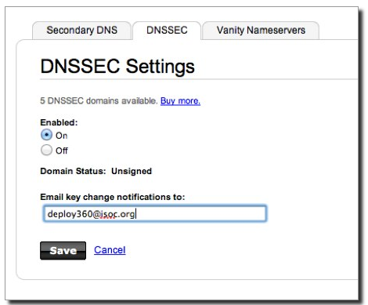
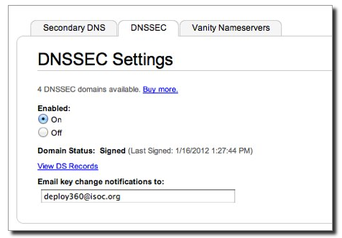
or…another
http://www.internetsociety.org/deploy360/resources/how-to-sign-your-domain-with-dnssec-using-godaddy-com/

Slide 26
It’s a question of risk / trust, but is does not have to be expensive

Slide 27
Goals
Reliable
Trusted
Cost Effective (for you)
Notes:
Trust – learn from existing formal IT security practices like SysTrust Principles: “Security, Availability,
Processing Integrity, Confidentiality, and Privacy”

Slide 28
Reliable
Keep design simple
Monitoring – DNSSEC is time sensitive!
People – develop checklists and documentation

Slide 29
Cost Effectiveness

Slide 30
Cost Effectiveness
Risk Assessment
Cost Benefit Analysis

Slide 31
Business Benefits and Motivation
(from “The Costs of DNSSEC Deployment” ENISA report)
Become a reliable source of trust and boost market share and/or reputation of zones;
Lead by example and stimulate parties further down in the chain to adopt DNSSEC;
Earn recognition in the DNS community and share knowledge with TLD’s and others;
Provide assurance to end-user that domain name services are reliable and trustworthy;
Look forward to increasing adoption rate when revenue is an important driver. Deploying DNSSEC can be profitable;

Slide 32
Risk Assessment
Identify your risks
  Reputational
    Competition
    Loss of contract
  Legal / Financial
    Who is the relying party?
    SLA
    Law suits
Build your risk profile
  Determine your acceptable level of risk
Notes:
Acceptable level of risk - e.g. reputtation: no-compromise; An attack can only take place if key compromise goes unnoticed. Can recover otherwise.; Be real: will not protect against terrorist attack; internal collusion – pick a number: 1 in a million?; irrelevancy/non-use: stakeholder involvement.

Slide 33
Vulnerabilities
False expectations
Key compromise
Signer compromise
Zone file compromise
Notes:
False expectations – e.g. lack of “SLA” and or “DPS” to set expectations on compromise recovery for child key (how long) as well as for parent keying material (backup keys, how long). No one can offer perfect security. But
Involve stakeholders to minimize reputational / legal risks.
Insecure DS handling – broken chain of trust
Private key compromise: bad rng, too short; background checks?, threats, bribed -> collusion
bad Signer: unvalidated s/w; vulnerable code.
Undetermined: loss of chain of custody (careless handling, sabotage, environment, access control failure, structure weakness, collusion)

Slide 34
Cost Benefit Analysis
Setting reasonable expectations means it doesn’t have to be expensive

Slide 35
From ENISA Report
“….organizations considering implementing DNSSEC can greatly benefit from the work performed by the pioneers and early adopters.”
Few above 266240 Euros: Big Spenders: DNSSEC as an excuse to upgrade all infrastructure; embrace increased responsibility and trust through better governance.
Most below 36059 Euros: Big Savers: reuse existing infrastructure. Do minimum.

Slide 36
Anticipated Capital and Operating Expense
Being a trust anchor requires mature business processes, especially in key management;
Investment cost also depends on strategic positioning towards DNSSEC: leaders pay the bill, followers can limit their investment;
Financial cost might not outweigh the financial benefits. Prepare to write off the financial investment over 3 to 5 years, needed to gear up end-user equipment with DNSSEC.

Slide 37
Other Cost Analysis
People
  Swedebank – half a FTE
  Occasional shared duties for others
Facilities
  Datacenter space
  Safe ~ $100 - $14000
Crypto Equip ~ $5-$40000
Bandwidth ~ 4 x
http://www.internetdagarna.se/arkiv/2008/www.internetdagarna.se/images/stories/doc/22_Kjell_Rydger_DNSSEC_from_a_bank_perspective_2008-10-20.pdf
Notes:
http://www.internetdagarna.se/arkiv/2008/www.internetdagarna.se/images/stories/doc/22_Kjell_Rydger_DNSSEC_from_a_bank_perspective_2008-10-20.pdf
Too much?
Outsource all
Opportunity for some

Slide 38
Trusted

Slide 39
Trust
Transparent
Secure

Slide 40
Transparency

Slide 41
Transparency
The power of truth
    Transparency floats all boats here
Say what you do
Do what you say
Prove it

Slide 42
Say what you do
Setting expectations
Document what you do and how you do it
Maintain up to date documentation
Define Organization Roles and responsibilities
Describe Services, facilities, system, processes, parameters

Slide 43
Learn from CA successes (and mistakes)
The good:
  The people
  The mindset
  The practices
  The legal framework
  The audit against international accounting and technical standards
The bad:
  Diluted trust with a race to the bottom (>1400 CA’s)
  DigiNotar
    Weak and inconsistent polices and controls
    Lack of compromise notification (non-transparent)
    Audits don’t solve everything (ETSI audit)
Notes:
The people: e.g., Tomofumi Okubo, Fredrik Lundgren, Paul Hoffman, David Miller (AEP)
The people (those willing to share in this secret art)
The mindset (trust in process. not people)
The practices (physical, logical, cryptographic security)
The legal framework (setting expecations. liability limitations)
HEBC/USHER – US university system PKI example.
SysTrust similar to WebTrust – economies of similarity. Number of SSL: 4M/200+M sites Could have many more. Many countries use VRSN for govt dig sign. Why not own country?
ETSI failed for DigiNotar

Slide 44
Say What You Do - Learn from Existing Trust Services
Borrow many practices from SSL Certification Authorities (CA)
  Published Certificate Practices Statements (CPS)
    VeriSign, GoDaddy, etc..
  Documented Policy and Practices (e.g., key management ceremony, audit materials, emergency procedures, contingency planning, lost facilities, etc…)
Notes:
Learn from existing formal IT security practices.
CPS and instructive CA key/backup document for HEBCA: http://usher.internet2.edu/practices/ca1/cps.pdf http://tinyurl.com/34zzmne
CA’s are a good start (they know the trust business) but most of internal Practices are kept private.
Line between current CA offerings and DNS will become blurred – but real CAs provide critical value on the ground, e.g., EV certs.
Note: Cant just copy CPS – usually copyrighted.

Slide 45
Say What You Do - DNSSEC Practices Statement
DNSSEC Policy/Practices Statement (DPS)
  Drawn from SSL CA CPS
  Provides a level of assurance and transparency to the stakeholders relying on the security of the operations.
  Regular re-assessment
  Management signoff
    Formalize - Policy Management Authority (PMA)
Notes:
Policy may be used by TLD mgrs or regulatory authorities to express requirements to registry operator.
Or may simply be the registry’s own standards to follow.
May be one document or two.
RFC for DNS framework / check list in draft (Fredrik Lundgren)
Examples: SE DPS http://www.iis.se/docs/se-dnssec-dps-eng.pdf Root http://www.iana.org/dnssec
Describe PMA

Slide 46
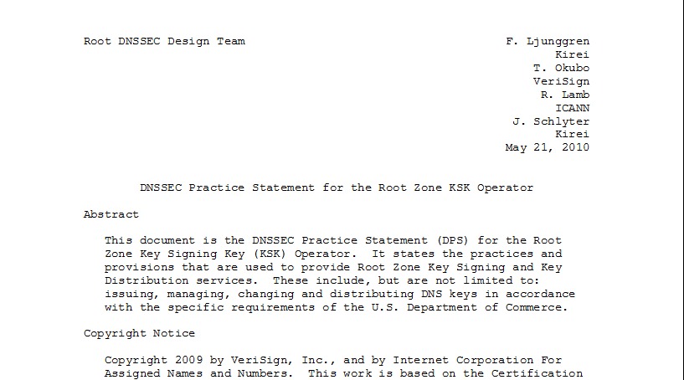
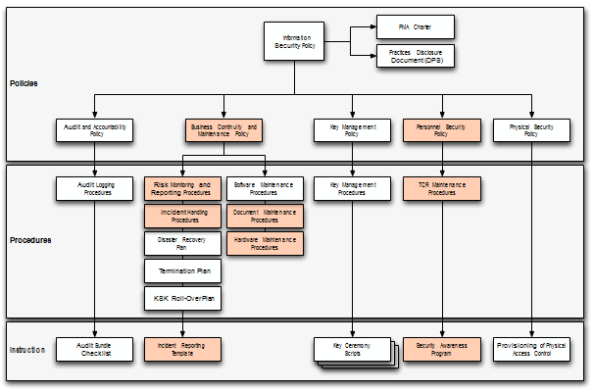
Documentation - Root
91 Pages and tree of other documents!
Root DPS
Notes:
Spells out multiparty controls (e.g., at least two)

Slide 47
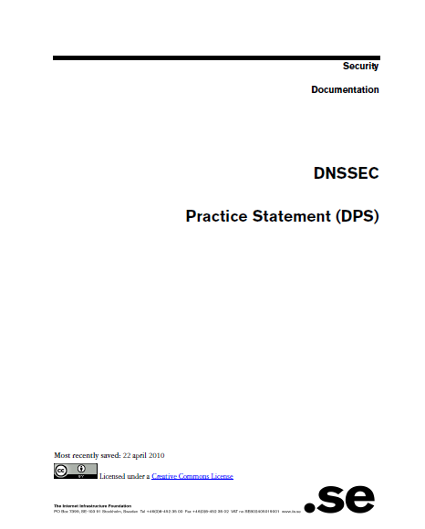
Documentation - .SE
22 pages, Creative Commons License!
.SE DPS
Notes:
Just go through and replace “SE” with “your TLD” for a great starting point for your lawyers.
**BR just had checklists. Bottom line – transparency buys trust.

Slide 48
Do what you say
Follow documented procedures / checklists
Maintain logs, records and reports of each action, including incidents.
Critical operations at Key Ceremonies
  Video
  Logged
  Witnessed

Slide 49
Key Ceremony
A filmed and audited process carefully scripted for maximum transparency at which cryptographic key material is generated or used.
Notes:
Point to root zone key ceremonies document

Slide 50

Prove it
Audits
  3rd party auditor $$
  ISO 27000 $$ etc..
  Internal

Slide 51
Prove it - Audit Material
Key Ceremony Scripts
Access Control System logs
Facility, Room, Safe logs
Video
Annual Inventory
Logs from other Compensating Controls
Incident Reports
Notes:
Some elements above may need to be attested to or signed by management as determined by auditor.
Logs should have entry/exit, open/close, removal/return.
Compensating Controls are your friend – other logs, logging, video etc…

Slide 52
Prove it
Stakeholder Involvement
  Publish updated material and reports
  Participation, e.g. External Witnesses from
      local Internet community
      Government
  Listen to Feedback

Slide 53
Prove it
Be Responsible
  Executive Level Involvement
    In policies via Policy Management Authority
    Key Ceremony participation

Slide 54
Security

Slide 55
Building in security
Getting the machinery for DNSSEC is easy (BIND, NSD/Unbound, OpenDNSSEC, etc..).
Finding good security practices to run it is not.

Slide 56
Security
Physical
Logical
Crypto

Slide 57
Physical
  Environmental
  Tiers
  Access Control
  Intrusion Detection
  Disaster Recovery

Slide 58
Physical - Environmental
Based on your risk profile
Suitable
  Power
  Air Conditioning
Protection from
  Flooding
  Fire
  Earthquake
Notes:
California reference – risk profile balances operational, cost, and environmental

Slide 59
Physical - Tiers
Each tier should be successively harder to penetrate than the last
  Facility
  Cage/Room
  Rack
  Safe
  System
Think of concentric boxes

Slide 60
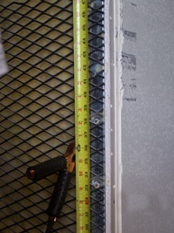
Physical - Tier Construction
Base on your risk profile and regulations
Facility design and physical security on
  Other experience
  DCID 6/9
  NIST 800-53 and related documents
  Safe / container standards
Notes:
Terrorist attack – not protected
Undetected access is worst case
Safe story
EMI – don’t care if HSM rated
Local regulations (e.g. fire)
DCID and various other hard to learn from sources: 9 gague stretched steel, real floor to real ceiling.
DNSSEC at root is rare in that we are sharing such info with public – call it a dividend to the public

Slide 61
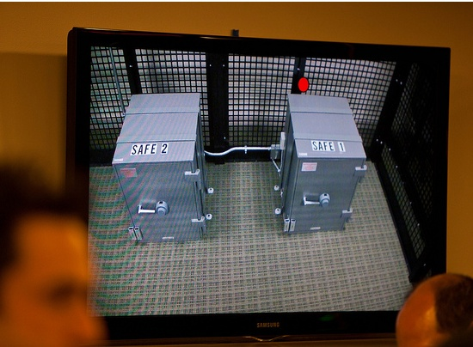
Physical – Safe Tier
Notes:
M of N was 3-of-7 plus SSSC1 SSC2 and multi-person access control to facility

Slide 62
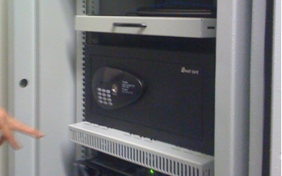
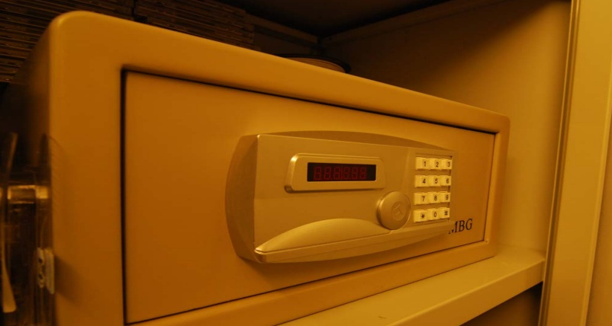
Physical – Safe Tier
Notes:
Looks like your hotel safe – huh. My suggestion – no batteries.

Slide 63
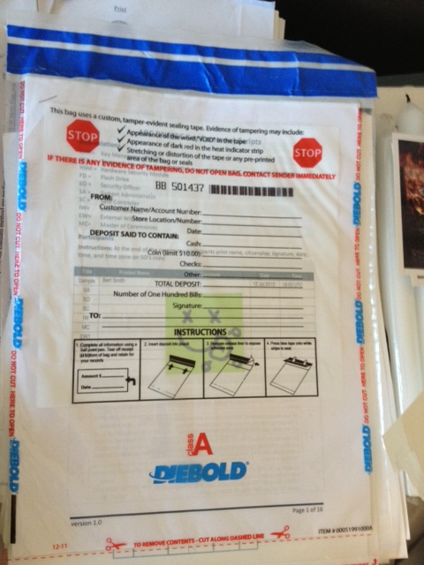
Physical – Tamper Evident Packaging

Slide 64
Physical - Access Control
Base on your risk profile
Access Control System
  Logs of entry/exit
  Dual occupancy / Anti-passback
  Allow Emergency Access
High Security: Control physical access to system independent of physical access controls for the facility
Notes:
Facility is ID + guard – log book
Safe is combination – log sheet
Tiers are card+pin+biometric – ACS logging
All filmed by at least facility

Slide 65
Physical - Intrusion Detection
Intrusion Detection System
  Sensors
  Motion
  Camera
Tamper Evident Safes and Packaging
Tamper Proof Equipment
Notes:
Facility: Manned, video monitor (and archived), monitor access to racks/cage/room
Sensors – door, seismic, water
Risk assessment – worst case: undetected/ unnoticed. So focus on detecting where total prevention is impossible. …and have mechanism to recover from compromise.

Slide 66
Physical - Disaster Recovery
Multiple sites
  Mirror
  Backup
Geographical and Vendor diversity
Notes:
Availability !!! So two sites AND backup of material.
Multiple sites from different facility providers.
Off site Backup could be a bank safe deposit box holding a smartcard in a tamper evident bag.

Slide 67
Logical
Authentication (passwords, PINs)
Multi-Party controls
Notes:
Risk:
lost/guessed password
Collusion

Slide 68
Logical - Authentication
Procedural:
  REAL passwords
  Forced regular updates
  Out-of-band checks
Hardware:
  Two-factor authentication
  Smart cards (cryptographic)
Notes:
Risk: guessed password
Password best practices can be found in various commercial standards PCI
Most of this slide is critical for the “child” user interface (that does not benefit from any physical security) for submitting DS records.
Out of band may be an automated phone call or FAX like many services (e.g. GoDaddy, name.com – “courtesy” call) do.
Pass out various embodiments…
In the case of compromise, Out-of-band authentication mechanism is necessary (e.g. should attacker use compromised key to facilitate a legitimate dnskey/ds rollover) - true for parent or child relationship

Slide 69
Logical - Multi-Party Control
Split Control / Separation of Duties
  E.g., Security Officer and System Admin and Safe Controller
M-of-N
  Built in equipment (e.g. HSM)
  Procedural: Split PIN
  Bolt-On: Split key (Shamir, e.g. ssss.c)
Notes:
Risk: Collusion
Separation of Duties: Different departments in same org or different orgs
Explain split PIN and split-key
Can combine ACS+Safe+MofN to greatly reduce collusion probability

Slide 70
Crypto
Algorithms / Key Length
Crypto Hardware

Slide 71
Crypto - Algorithms / Key Length
Factors in selection
  Cryptanalysis
  Regulations
  Network limitations

Slide 72
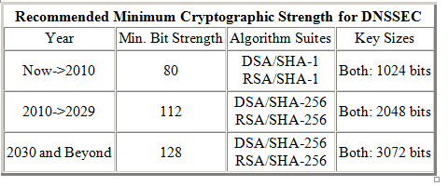
Crypto - Key Length
Cryptanalysis from NIST: 2048 bit RSA SHA256
http://csrc.nist.gov/publications/nistpubs/800-57/sp800-57_PART3_key-management_Dec2009.pdf
Notes:
NIST
http://csrc.nist.gov/publications/nistpubs/800-57/sp800-57_PART3_key-management_Dec2009.pdf
Root rollout did force resolver upgrade to sha256…

Slide 73
Crypto - Algorithms
Local regulations may determine algorithm
  GOST
  DSA
Network limitations
  Fragmentation means shorter key length is better
  ZSK may be shorter since it gets rolled often
  Elliptical is ideal – but not commonplace
Notes:
Signature churn not a problem with RSA 1024 or higher
If problems with 1024 – we have a much bigger problem than DNSSEC.
FWIW: RSA 1024 ~ 6 mo – other anecdotal notes, 10 years estimated, 2048 is ok
Elliptical is encumbered by patent rights but cryptographers love it. It may become standard after a few (>5) years
BTW GOST is elliptical…

Slide 74
Crypto - Algorithms
NSEC3 if required
  Protects against zone walking
  Avoid if not needed – adds overhead for small zones
  Non-disclosure agreement?
  Regulatory requirement?
  Useful if zone is large, not trivially guessable (only “www” and “mail”) or structured (ip6.arpa), and not expected to have many signed delegations (“opt-out” avoids recalculation).
Notes:
Use a dynamic / incremental signing solution for the large zones? BIND 9.7.x

Slide 75
Crypto - Hardware
Satisfy your stakeholders
  Doesn’t need to be certified to be secure (e.g., off-line PC)
  Can use transparent process and procedures to instill trust
  But most Registries use or plan to use HSM. Maybe CYA?
AT LEAST USE A GOOD Random Number Generator (RNG)!
Use common standards avoid vendor lock-in.
  Note: KSK rollover may be ~10 years.
Remember you must have a way to backup keys!
Notes:
Off-line PC: Your know secure64 is just a PC with a TPM chip that encrypts a bundle = FIPS 140-2 level 2
NO RNG = a vulnerability. "random numbers too important to be left for chance."
Backup keys – cant use on smartcard key gen. Bad policy if HSM vendor dies too. See CA HEBCA example.

Slide 76
Crypto - Hardware Security Module (HSM)
FIPS 140-2 Level 3
  Sun SCA6000 (~30000 RSA 1024/sec) ~$10000 (was $1000!!)
  Thales/Ncipher nshield (~500 RSA 1024/sec) ~$15000
  Ultimaco
FIPS 140-2 Level 4
  AEP Keyper (~1200 RSA 1024/sec) ~$15000
  IBM 4765 (~1000 RSA 1024/sec) ~$9000
Recognized by your national certification authority
  Kryptus (Brazil) ~ $2500
Study: http://www.opendnssec.org/wp-content/uploads/2011/01/A-Review-of-Hardware-Security-Modules-Fall-2010.pdf

Slide 77
Crypto - PKCS11
A common interface for HSM and smartcards
  C_Sign()
  C_GeneratePair()
Avoids vendor lock-in - somewhat
Vendor Supplied Drivers (mostly Linux, Windows) and some open source

Slide 78
Crypto - Smartcards / Tokens
Smartcards (PKI) (card reader ~$12)
  Smartcard HSM ~$20
  Feitian ~$5-10
  Aventra ~$11
TPM
  Built into many PCs
Token
  Aladdin/SafeNet/Feitian USB e-Token ~$50
Open source PKCS11 Drivers available
  OpenSC
Has RNG
Slow ~0.5-10 1024 RSA signatures per second

Slide 79
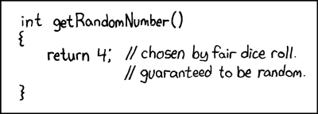

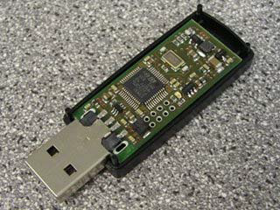
Crypto -Random Number Generator
rand()
Netscape: Date+PIDs
LavaRand
System Entropy (/dev/random-urandom)
H/W, Quantum Mechanical (laser) $$
Standards based (FIPS, NIST 800-90A)
Built into CPU chips
https://www.nist.gov/news-events/news/2015/06/nist-revises-key-computer-security-publication-random-number-generation

Slide 80
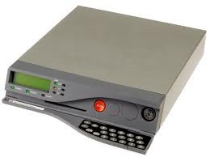
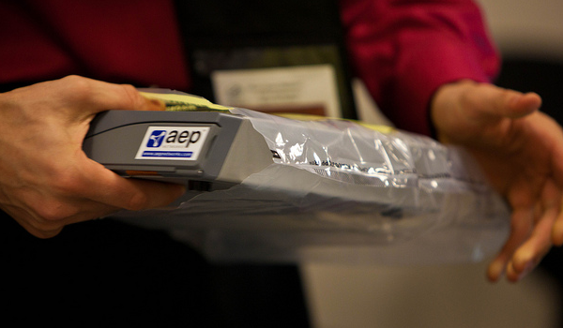
Crypto - FIPS 140-2 Level 4 HSM
Root, .FR, .CA …

Slide 81
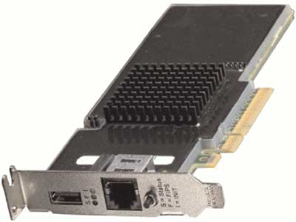
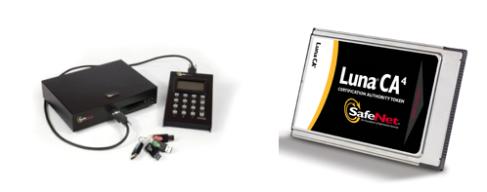
Crypto – FIPS Level 3 HSM
But FIPS 140-2 Level 3 is also common
Many TLDs using Level 3 .com , .se, .uk, .com, etc… $10K-$40K

Slide 82

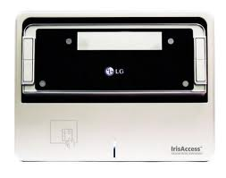
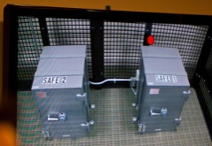
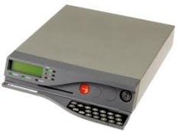
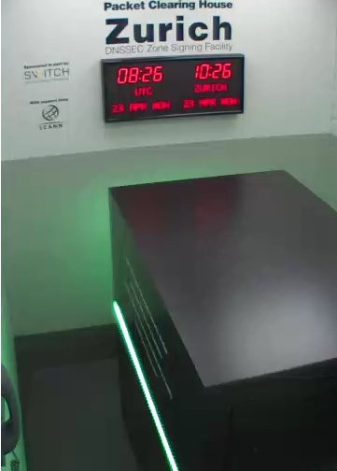
An implementation can be thi$
Notes:
FR, NZ, root, com, UK, DCID 6/9
http://www.pch.net/dnssec/zrh

Slide 83
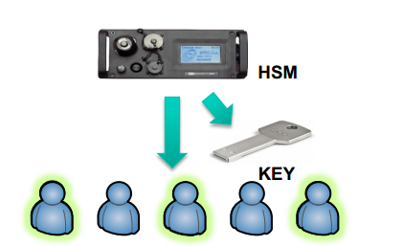
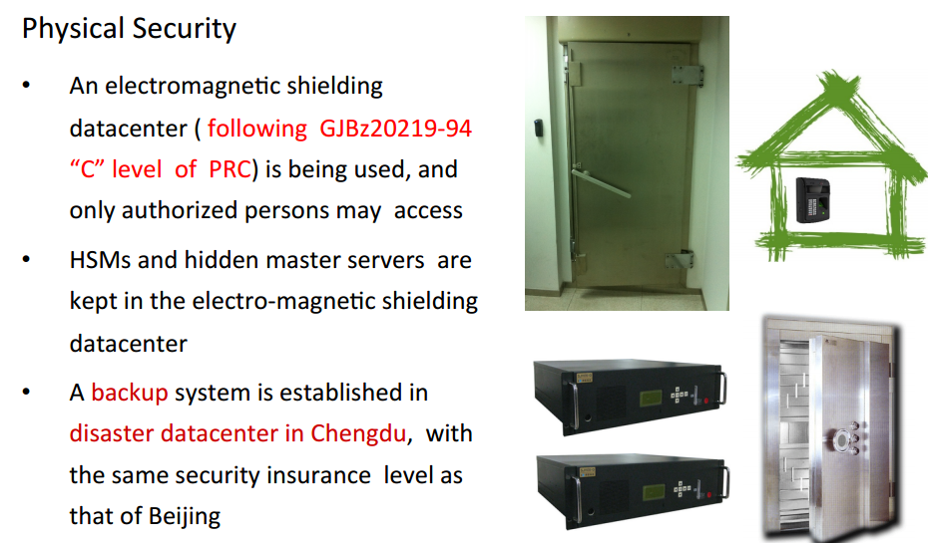
…or this
http://singapore49.icann.org/en/schedule/wed-dnssec/presentation-dnssec-deployment-cn-26mar14-en.pdf

Slide 84

Physical Security

Slide 85


Slide 86




http://www.flickr.com/photos/kjd/sets/72157624302045698/

Slide 87


Slide 88


Slide 89

Notes:
Fips 140-2 level 4
Gsa class 5
Biometrics
Multi-person control
Publicly documented
Draw from CA
Dcid 6/9 9 gauge mesh drywall

Slide 90







…or this
+
TPM
Notes:
JP, old SE, new CR

Slide 91


..or this (from .cr .ar)
Transport KSK signed DNSKEY RRsets
unsigned
zone
Sign ZSKs with KSK
Sign zones with ZSK
Offline Laptop with TPM
Online/off-net DNSSEC Signer with TPM
signed
zone
KSK
Transport public half of ZSKs
Generate KSK
ZSKs
Generate ZSKs
Secure Off-line Environment
Animated slide
Notes:
9 March 2012
…and bnonline.fi.cr
http://www.nacion.com/2012-03-15/Tecnologia/Sitios-web-de-bancos-ticos-podran-ser-mas-seguros.aspx

Slide 92
…or even this
Off-line
Off-net
DATA CENTER
CAGE
DATA CENTER
RACK
CAGE
SAFE
RACK
All in tamper evident bags
FD with public ZSKs
zonefile
ZSKs
KSK on FD
Live O/S DVD
signer
laptop
FD with KSK signed DNSKEY RRsets
firewall
hidden master
RNG
Notes:
From LACTLD training I gave in September. Notes from there on simple separation of duties and even ssss.c for M-of-N. Go thru risk analysis, threats and controls
Pull out TEBs.

Slide 93
Learn from others mistakes

Slide 94
ISP’s and other validating resolver operators
Learn from experience of others*. When someone else’s DNSSEC system fails, e.g., signatures expire, who gets the phone call? YOU DO.
It is happening less and less (a few times a year) but have an email response ready and
If necessary use the Negative Trust Anchor** option found in some resolvers to temporarily disable validating the problematic zone
*COMCAST US ISP ~20M customers
**Appendix A: https://tools.ietf.org/html/draft-livingood-dnsop-negative-trust-anchors-01

Slide 95
Signing Operations – DNSSEC and Vacations
Learn from the experience of others. Technology is easy. Managing people is hard. DNSSEC signatures are time limited. If the signature validity period is too long, you will not be able to recover from a compromise too quickly.
If the validity period is too short, you might not be able to replace failed equipment or get a hold of your engineers on vacation.
Therefore many DNSSEC signatures are good for 1 to 2 weeks (about how long someone in the US takes a vacation ☺ )

Slide 96
Signing Operations – Monitoring Signature Expiry
The biggest problem we have seen with DNSSEC deployments has been expired signatures. Do you really want signatures to renew on December 31 ? Who is going to be around if things fail?
Monitor the expiry time of your zone using a script or an outside service. Send out email/SMS if a DNSSEC signature is about to expire. Plenty of tools*
The Internet technical community is small but global. Have one of them run a script to monitor your systems and you do the same for them. Just like you might do with secondary name servers.
*http://dnsviz.net/
http://www.zonecheck.fr/
http://dnscheck.iis.se/ (note:has undelegated option for testing new zones)

Slide 97
Signing Operations – Openness = Trust
At these early stages of DNSSEC mistakes will happen. Being public about such mistakes and how you fix them builds trust and sets expectations*.
Sharing those experiences helps others and makes you the expert.
Being “found out” later can destroy an operation
*http://en.wikipedia.org/wiki/Chicago_Tylenol_murders#Aftermath
UK http://blog.nominet.org.uk/tech/wp-content/uploads/2010/09/dnssec-incident-report.pdf
FR http://singapore41.icann.org/meetings/singapore2011/presentation-key-deletion-issues-22jun11-en.pdf

Slide 98
Some Recent Recommendations..
“One obstacle for the implementation of DNSSEC is the lack of guidance for individual domain holders regarding which requirements should be defined - in particular for small and medium-sized businesses. In order to remedy that obstacle, .SE has written a guide as an aid and tool for municipalities that have the intention to implement DNSSEC, but this guide also applies to other types of organizations in both the public and private sectors.”
https://www.iis.se/english/domains/tech/recommendations-for-dnssec-deployment/
Anne-Marie Eklund Löwinder
Chief Information Security Officer
.SE (The Internet Infrastructure Foundation)

Slide 99
Setting reasonable expectations means it doesn’t have to be expensive
You do not need a fortress, just detect if something is touched

Slide 100



But all must have:
Published practice statement
  Overview of operations
  Setting expectations
    Normal
    Emergency
  Limiting liability
Documented procedures
Multi person access requirements
Audit logs
Monitoring (e.g., for signature expiry)
Good Random Number Generators
Intel RdRand
DRBGs
FIPS 140
Useful IETF RFCs:
DNSSEC Operational Practices http://tools.ietf.org/html/draft-ietf-dnsop-rfc4641bis
A Framework for DNSSEC Policies and DNSSEC Practice Statements http://tools.ietf.org/html/draft-ietf-dnsop-dnssec-dps-framework
Notes:
CA, NZ, PCH, and others based on pioneering work by SE / Fredrik and RFC draft for DPS. I use one for my training sessions and have one translated into Spanish. I understand JPNIC has one translated into English.
http://cira.ca/knowledge-centre/technology/dnssec/practice-statement/
Recent news of bad random numbers for 10s of 1000’s of SSL certificates (15 Feb). 2 out of 1000 offer no security.
http://www.nytimes.com/2012/02/15/technology/researchers-find-flaw-in-an-online-encryption-method.html?_r=2&hp
DRBG http://csrc.nist.gov/publications/nistpubs/800-90A/SP800-90A.pdf
SysTrust similar to WebTrust – economies of similarity.
Number of SSL: 4M/200+M sites Could have many more.
Many countries use VRSN for govt dig sign. Why not own country?
DNSSEC deployment as an excuse to improve all process (ENISA)
Leverage govt interests in cyber security (+secure smart grid and other infrastructures that rely on DNSSEC) and digital identity efforts.
Opportunity to use DNSSEC requirements and current interest in digital identity systems as an excuse to improve overall DNS and identity ecosystems
DNS/DNSSEC part of all Internet ecosystems.
In order to realize the full benefits of DNSSEC, DNS operators and other entities that make up the chain of trust must embrace transparent IT security processes and practices.
Greater end user and Registrant awareness of the benefits of DNSSEC is needed to drive a virtuous cycle of effective deployment.

Slide 101
Demo Implementation
Key lengths – KSK:2048 RSA ZSK:1024 RSA
Rollover – KSK:as needed ZSK:90 days
RSASHA256 NSEC3
Physical – HSM/smartcards inside Safe inside Rack inside Cage inside Commercial Data Center
Logical – Separation of roles: cage access, safe combination, HSM/smartcard activation across three roles
Crypto – use FIPS certified smartcards as HSM and RNG
  Generate KSK and ZSK offline using RNG
  KSK use off-line
  ZSK use off-net

Slide 102
Off-Line Key generator and KSK Signer
DATA CENTER
CAGE
RACK
smartcards
SAFE
Flash Drive
KSK+RNG
Live O/S DVD
KSK signed DNSKEYs
Encrypted ZSKs
KSK+RNG
reader
laptop
KSK+RNG

Slide 103
Off-Net Signer
DATA CENTER
CAGE
RACK
zonefile
hidden master
Flash Drive
nameserver
KSK signed DNSKEYs
Encrypted ZSKs
nameserver
signer
firewall
hidden master
nameserver

Slide 104
Key Management
Transport KSK signed DNSKEY RRsets
Sign ZSKs with KSK
unsigned
zone
Sign zones with ZSK
Offline Laptop
and Encrypted ZSKs
Online/off-net DNSSEC Signer
signed
zone
Generate ZSKs
KSK
Generate KSK
Secure Key Generation and Signing Environment
Animated slide

Slide 105
DNS+DNSSEC
www.majorbank.se = 1.2.3.4
www.majorbank.se=?
DNS Resolver
DNS
Server
1.2.3.4
Get page
webserverwww @ 1.2.3.4
Login page
Username / Password
Account Data
ISP/ HotSpot / Enterprise/ End Node
Majorbank.se (Registrant)
DNS
Server
.se (Registry)
DNS
Server
Animated slide
. (Root)
Notes:
Actually MANY phone books

Slide 106
Simple Key Management Scripts

Slide 107
Keeping things signed
If the signatures are going to expire soon, sign the zone
Define “soon”
Also sign if a record has changed
That’s it!

Slide 108
while(1) {
t = time
if(exp - t) < 5 days {
inc = t
exp = t + 10 days
touch infile
}
if new infile {
cat infile keys > zonefile
increment zonefile SOA serial
signzone -s inc -e exp zonefile
zsk-current ksk
rndc reload
}
sleep 1 second
}

Slide 109
Rolling keys
Mind the cache – DNS resolvers have memory
Publish the new ZSK before signing with it
  Put the new ZSK in the DNSKEY RRset along with old ZSK and wait until everyone see its
Sign the zone with the new ZSK until you want to change it
But do not un-Publish the old ZSK until no one may need it

Slide 110

Key Rollover Schedule - Root
https://www.iana.org/dnssec

Slide 111
generate zsk-new
cat zsk-new zsk-current ksk > keys
touch infile
sleep >2xTTL
copy zsk-new zsk-current
touch infile
sleep >2xTTL
cat zsk-current ksk > keys
touch infile
sleep >2xTTL

