Slide 1
DNS as a Defense Vector
Paul Vixie, Ph.D
CEO, Farsight Security

Slide 2
TOPIC
DNS Itself

Slide 3
INTERNET AS A TERRITORY
But what is the internet?
  “It's the largest equivalence class in the reflexive transitive symmetric closure of the relationship can be reached by an IP packet from.”
    (Seth Breidbart)
IP addresses, IP packets, underlie everything
We overlay IP with many things, e.g., the web
Most important overlay (for security) is: DNS

Slide 4
DNS AS A MAP
Most everything we do on the Internet…
  B2C Web, B2B Web, E-mail, I-M, <your idea here>
  …relies on TCP/IP, and begins with a DNS lookup
Mobile Internet is dominated by search…
  …but search itself relies extensively upon DNS
DNS has a rigorous internal structure
  Things that are in fact related, are related in DNS
  You can have whois privacy, but not DNS privacy

Slide 5
CRIMINAL DNS
The Internet has been a great accelerator of human civilization
  Inevitably, this includes human crime
Online crime is impossible without DNS
  Cheap throw-away domain names
  DNS registrars and servers in bad neighborhoods
  Whois privacy or simply bad whois data
Nature, to be commanded, must be obeyed.
  (Francis Bacon)

Slide 6
SO, ABOUT THAT INTERNAL STRUCTURE
Domain names are grouped into zones
  Like root zone, or “COM”, or “EXAMPLE.COM”
A zone has one or more name servers
  Like “COM. NS a.gtld-servers.net.”
Each name server has one or more addresses
  Like “a.gtld-servers.net. A 192.5.6.30”
Other domain names also have addresses
  Like “www.apnic.net. A 203.119.102.244”
IP addresses are grouped into netblocks
  Like “192.5.6.0/24” or “203.119.102.240/28”

Slide 7
DNS SECURITY FEATURES
TSIG secures heavy weight transactions
  Like UPDATE, IXFR/AXFR; but not QUERY
DNSSEC secures data end-to-end
  Zone is signed; responses contain signatures
  Zone has keys; these are signed in parent zone
  QUERY initiator can validate signatures
  Requires universally trusted root signing key
Use TSIG and DNSSEC: they work, they’ll help
  But: our actual topic today lies elsewhere

Slide 8
DNS DATA FLOW
13 root servers,
~250 cCtld’s
~15 old Gtld’s
~2000 new Gtld’s
~500M 2LD/etc
Campus,
Enterprise,
OpenDNS,
GoogleDNS
Servers, Laptops
Smartphones
Embedded devs
(COPY)

Slide 9
TOPIC
DNS as Abused

Slide 10
SPOOFED SOURCE ATTACK
(COPY)

Slide 11
DNS RESPONSE RATE LIMITING (RRL)
If you run a DNS content (“authority”) server, it has to be massively overprovisioned
Because OPN’s don’t have SAV, your server is a purpose-built DNS DDoS reflecting amplifier
BIND, NSD, Knot now support DNS RRL, which accurately guesses what’s safe to drop
Your authority servers need this, whereas your recursive servers need to be firewalled off

Slide 12
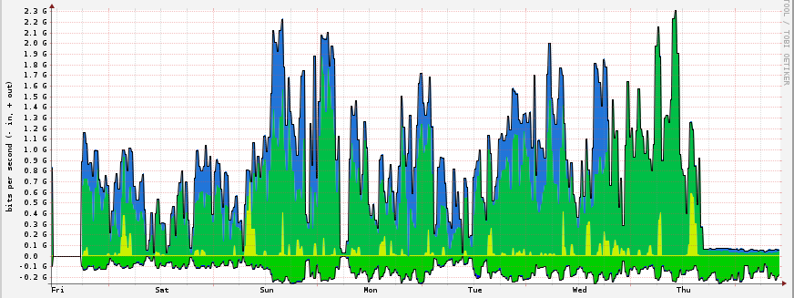
RRL IN ACTION: AFILIAS

Slide 13
“…TOO CHEAP TO METER”
SpamAssassin as a teaching tool
  For example: dotted quads in body as spamsign
RRP and EPP: solving “the .COM problem”
  Running a race to the bottom (cheaper; sooner)
Quantity and fluidity having only one purpose
  30 seconds? Really?
Fitting Sturgeon’s revelation
  “90% of <thing> is crap”

Slide 14
TAKEDOWN: FAR-END TRICKS
Since we can’t prevent it…
  …we’ll have to evolve coping strategies
Takedown as a Service (TaaS?)
  Yes, you can outsource this now
A new profit center! (.TK)
  “Kill all you want, we’ll make more!”
Whack-a-mole as a Service (WaaS?)
  Incrementalism breeds better criminals

Slide 15
FIREWALLS: NEAR-END TRICKS
If we can’t prevent it and takedown is hard…
  …then we’ll have to fight them at our doorstep
We can filter IP+port, URL, and now even DNS
  But, bad guys are endlessly adaptive
  Ergo, so must we be
We can’t afford manual configuration
  So, firewall config now follows a pub-sub model

Slide 16
DNS FIREWALLS WITH RPZ
Uses DNS zones to carry DNS Firewall policy
  R-P-Z = Response Policy Zones
Pub-sub is handled by NOTIFY/TSIG/IXFR
  Many publishers, many subscribers, one format
Subscribe to multiple external feeds
  And create your own, for local policy reasons
Simple failure or walled garden, as you choose
  We call this “taking back the DNS”

Slide 17
RPZ CAPABILITIES
Triggers (RR owners):
  If the query name is $X
  If the response contains an address in CIDR $X
  If any NS name is $X
  If any NS address is in CIDR $X
  If the query source address is in CIDR $X
Actions (RR data):
  Synthesize NXDOMAIN
  Synthesize CNAME
  Synthesize NODATA
  Synthesize an answer
  Answer with the truth

Slide 18
WHY USE RPZ?
Easy stuff:
  Block access to DGA C&C’s
  Block access to known phish/driveby
  Block e-mail if envelope/header is spammy
More interesting stuff:
  Block DNS A/AAAA records in bad address space
    E.g., import Cymru Bogons or Spamhaus DROP list
  Block domains having some computable attribute
    E.g., Farsight Newly Observed Domains (NOD) list

Slide 19
KEY RPZ TAKEAWAYS
Implications:
  Open market for producers and consumers
  Differentiated service at a global scale
  Instantaneous wide area takedown
Deployment:
  The RPZ standard is open and unencumbered
  So far implemented in BIND, Unbound, PowerDNS
  BIND RPZ performance is not unreasonable (~5% QPS loss)
  New RPZ features will be backward compatible
  RPZ is not an IETF standard

Slide 20
TOPIC
DNS as Observed

Slide 21
PASSIVE DNS DATAFLOW
(COPY)

Slide 22
OWNER LOOKUP, SHOW HISTORY
(COPY)

Slide 23
OWNER WILDCARDS (LEFT OR RIGHT SIDE)
(COPY)

Slide 24
DATA LOOKUP, BY NAME
(COPY)

Slide 25
DATA LOOKUP, BY IP ADDRESS
(COPY)

Slide 26
DATA LOOKUP, BY IP ADDRESS BLOCK
(COPY)

Slide 27
TECHNICAL FORMATTING NOTES
(COPY)

Slide 28
DNSDB DEPLOYMENT NOTES
FSI Passive DNS sensor is open source (PCAP)
  ‘dnstap’ is coming soon, for server embedding
The FSI DNSDB API is open (now an IETF I-D)
  FSI, 360.CN, NIC.AT, &others have servers
FSI DNSDB is quasi-commercial:
  Full grant for students (with advisor’s approval)
  Partial grant for those who operate sensors for us
  Commercially available for use, resale, embedding

Slide 29
LIMITED BIBLIOGRAPHY
https://www.farsightsecurity.com/
http://www.redbarn.org/dns/ratelimits
http://dnsrpz.info/
https://dnsdb.info/
https://dnstap.info/

Slide 30
DNS as a Defense Vector
Paul Vixie, Ph.D
CEO, Farsight Security

