Slide 1
Logjam: new dangers for secure protocols
Dmitry Belyavskiy, TCI
ENOG 9, Kazan, June 9-10, 2015

Slide 2
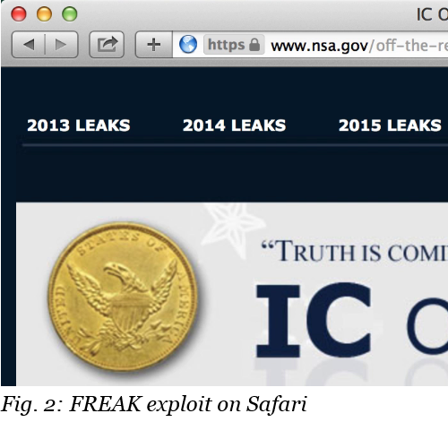
Attack of 2015 – FREAK
Historical reasons
A lot of browsers
A lot of web-servers
512-bit temporary RSA is not secure!
CVE-2015-0204

Slide 3
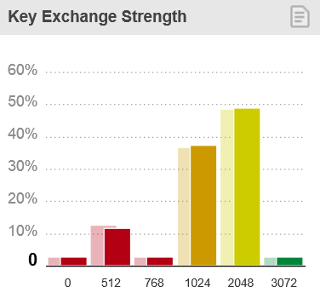
Attack of 2015 – LogJam
In short: too weak Diffie-Hellman parameters (EXPORT DH)
All browsers (middle of May)
All web-servers (depending on settings)
SSH/VPN
512/768/1024 is not enough!
https://weakdh.org/ https://openssl.org/blog/blog/2015/05/20/logjam-freak-upcoming-changes/
https://www.trustworthyinternet.org/ssl-pulse/

Slide 4






Diffie-Hellman scheme
ALICE
+
=
+
=
Common Paint
Secret Colours
Public Transport
Secret Colours
Common Secret
+
=
+
=
BOB
SSL Best Practices
https://www.ssllabs.com/projects/best-practices/

Slide 5
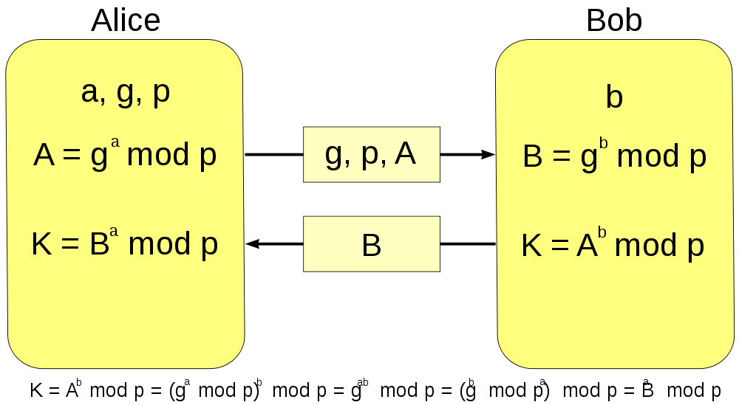
Diffie-Hellman math

Slide 6
Handshake struct
In case of DH key exchange signed data includes:
  opaque client_random[32];
  opaque server_random[32];
  serverDHParams params;
DOES NOT include the negotiating Cipher Suite id
The result will be checked at the end of the handshake

Slide 7
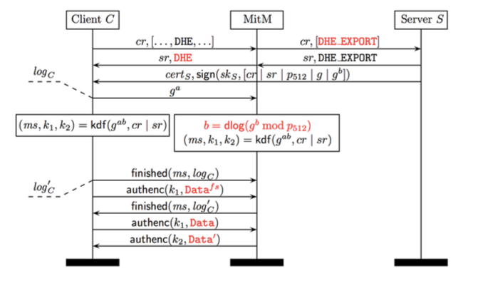
Handshake in case of attack

Slide 8
Why does it work?
Too short parameters:
  Precalc for hard-coded values
  Add some timeouts to provide correct Finished message
  Profit!
2 primes used at 92% Apache sites
512 bits is too short
1024 bits can be attacked too

Slide 9
Who is under the attack?
SSH - 25% if 1024 bits is broken
IKEv1 (IPSEC VPNs) – 66% if 1024 is broken
HTTPS (7% popular sites)
IPSec
POP3S/IMAPS/SMPTP 8-15%
  Postfix enables EXPORT Ciphersuites by default
… all protocols using DH scheme

Slide 10
How to avoid the attack?
Switch to ECDH scheme
Clients should decline too short DH parameters
Old Java versions – not longer 768 bits
Use longer custom parameters (2048 bits)

Slide 11
Questions?
  beldmit@tcinet.ru

