Slide 1

NIX.CZ development:
a broader view
Martin Semrad
ENOG 9
Kazan, 10.6.2015

Slide 2


NIX.CZ introduction
Since 1996
Open non-profit organization
Neutral peering platform
Czech Republic and Slovakia

Slide 3
NIX.CZ current status
127 networks
43 international
5 data centers in Prague
360 Gbps
Functional community

Slide 4
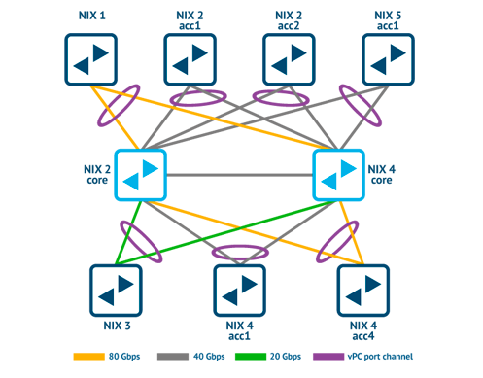
Topology NIX.CZ 2015

Slide 5

NIX.SK
Started March 2015
16 networks
Building community
Keep local traffic local
Not interconnected with Prague
Geographic redundancy
by

Slide 6
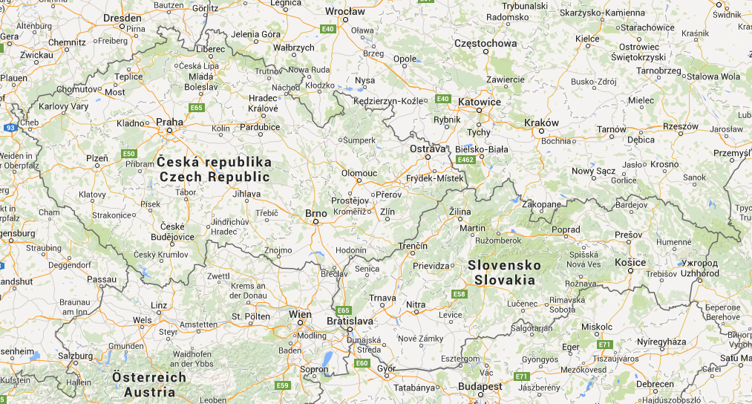
NIX.SK

Slide 7

FENIX
Answer of NIX to DDoS from 2013
Organizational and technical rules
Last resort tool (secure VLAN)
Established by 6 networks
    O2 Czech Republic, Seznam.cz, …
    NIX.CZ supervisor at rules

Slide 8
FENIX - what happened from ENOG7
Year of project FENIX
3 new members
5 candidates
Cooperation with CSIRT.CZ

Slide 9
FENIX - what happened from ENOG7
Started discussions in Slovakia
MoU with CSIRT.SK
1st working group 18. June 2015

Slide 10
Legal WG
Started in 2013
Partnership with government
Bridge GOV <-> Internet industry
Advisor of government
    Voice of the industry

Slide 11
CEE Peering Days
March 2016
Budapest, Hungary
NIX.CZ with VIX.at and BIX
Partnership with RIPE NCC

Slide 12


Questions?

Slide 13



Follow us
.. and at www.nix.cz/sk ☺

