Slide 1
Evaluating the internet end-user experience in the Russian Federation
Initial Findings
Research commissioned from Predictable Network Solutions by Euraisa:Peering

Slide 2


New peering point @ IXcellerate Moscow One data centre
Private and public peering
Connected to LINX and MSK-IX
Where else do we need to be?
На площадке IXcellerate Moscow One доступна услуга «Частный пиринг» , отличительной особенностью, которой является соединение типа «один-с-одним» на основе двусторонней договоренности.

Slide 3

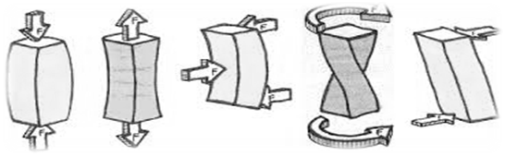
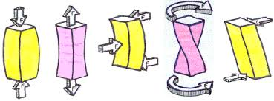
About me - Pete Cladingbowl - обо мне
Mechanical engineer I инженер-механик
Worked in the oil industry and manufacturing on process flows
Then 15+ years in telecoms and data centres I 15 лет телекоммуникации
Seek to understand what impacts flows in packet networks…..
What “forces” impact on network flows?
Воздействие сетевого потока?
∆Q is what I use to inform me about flow and the forces impacting on it
so I know where to put data centres and peering points….
Дельта Q = глубокое понимание
Notes:
What are the network factors that create an end user’s experience over the internet?
Not just bandwidth
All about QoE - Quality of Experience
Why do we need to know this information?
Where to put connections, compute and data - where to put a data centre!

Slide 4

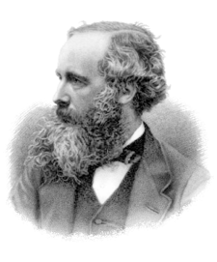
∆Q is quality attenuation of the user experience
But what matters is - does the user notice?????
The science bit:
All packets experience delay and some packets are lost
It is the distribution of delay and loss that applications are sensitive to
∆Q is a proxy for the quality of the user experience
For more info - http://www.slideshare.net/mgeddes/introduction-to-q-extracts
Maxwell
∆Q arises from two sources:
Structural
G - Network topology
S - Speed of links
Variable load
V - The applied load & its pattern
∆Q - “Дельта Q”
качество затухания = “потери и задержки”
состоит из:
G – география
S – скорость
V - скопление
Notes:
It is a single measure from which a rich set of information can be derived
It does not rely on averages, it is Network Performance Science
Many telcos use it to reduce costs and improve service simultaneously

Slide 5
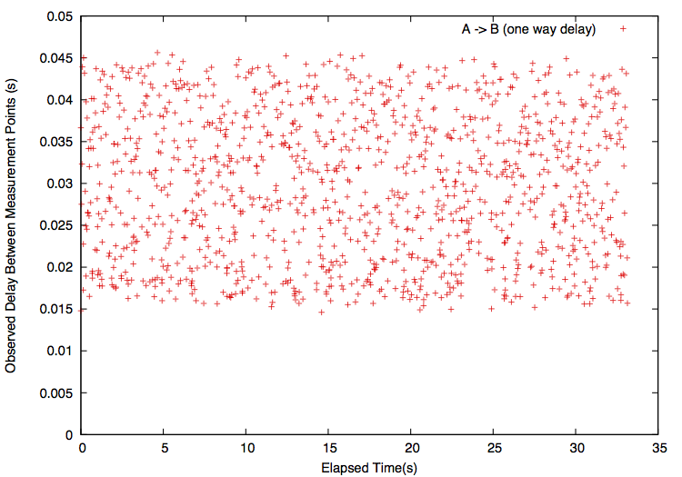
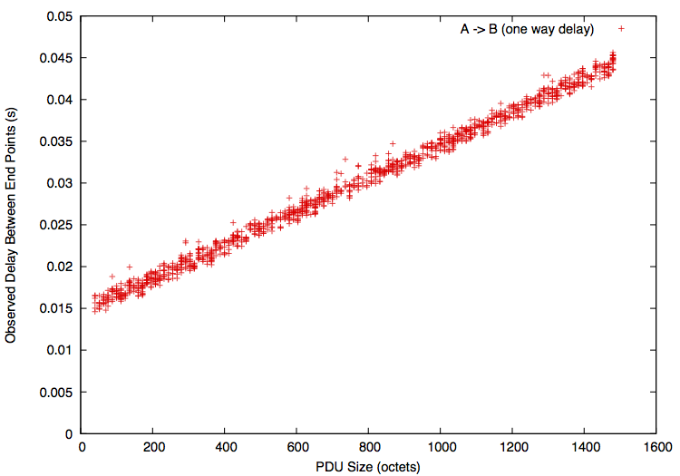
Measuring ∆Q
Delay
Viewing the data by packet size shows the structure
Elapsed Time
Просмотр данных по размеру пакета показана структура
Delay
Packet size
Notes:
This sample of data points looks random – apart from a minimum delay and an obvious spread, not much can be gleaned.

Slide 6
The “forces” impacting flow
All ∆Q is (everywhere and always) comprised of these three basic elements.
Each of those components could also contribute to loss.
V
Variable ∆Q
скопление
Delay
S
Size related ∆Q
скорость
G
Geography ∆Q
география
Packet size
Notes:
G, S, and V form a set of ‘basis vectors’ for the overall ∆Q. It is important to remember that it is this overall ∆Q that determines application outcomes; but for understanding how the network gives rise to ∆Q, G, S and V are very helpful.

Slide 7
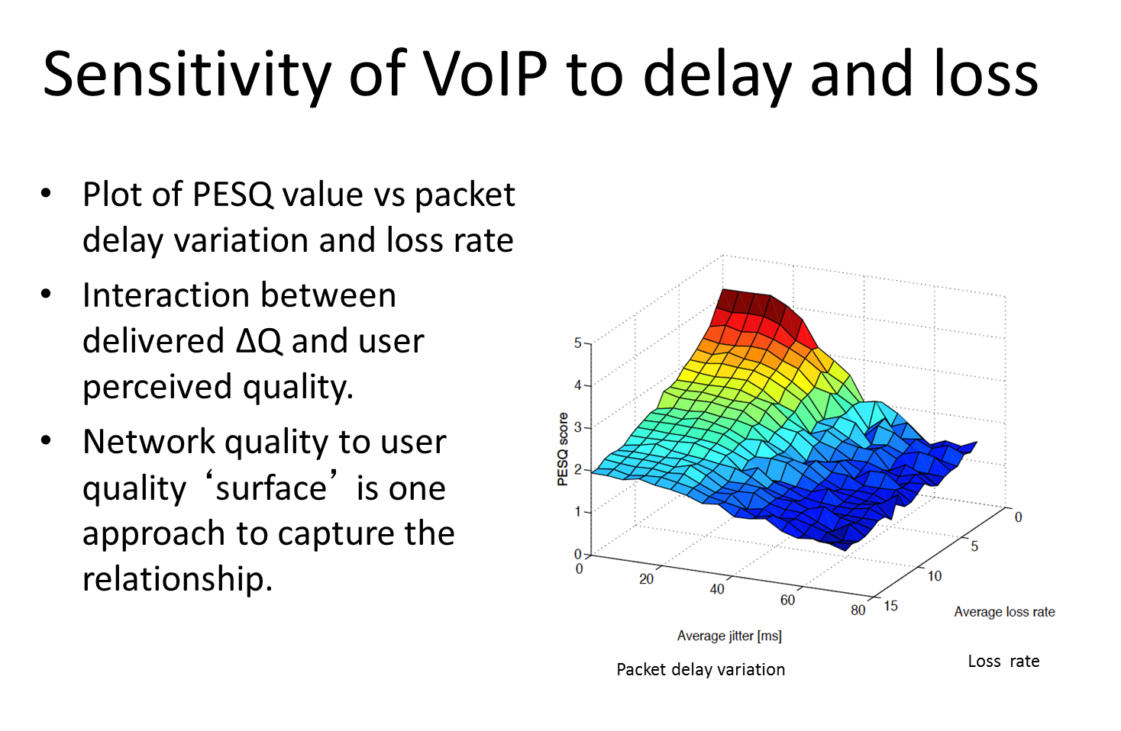
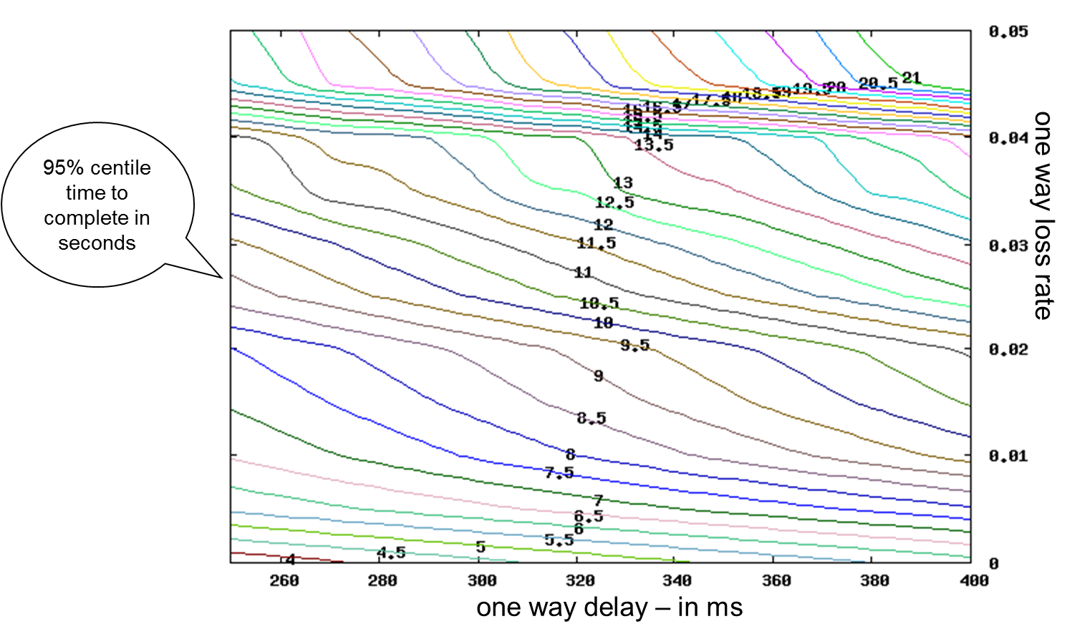
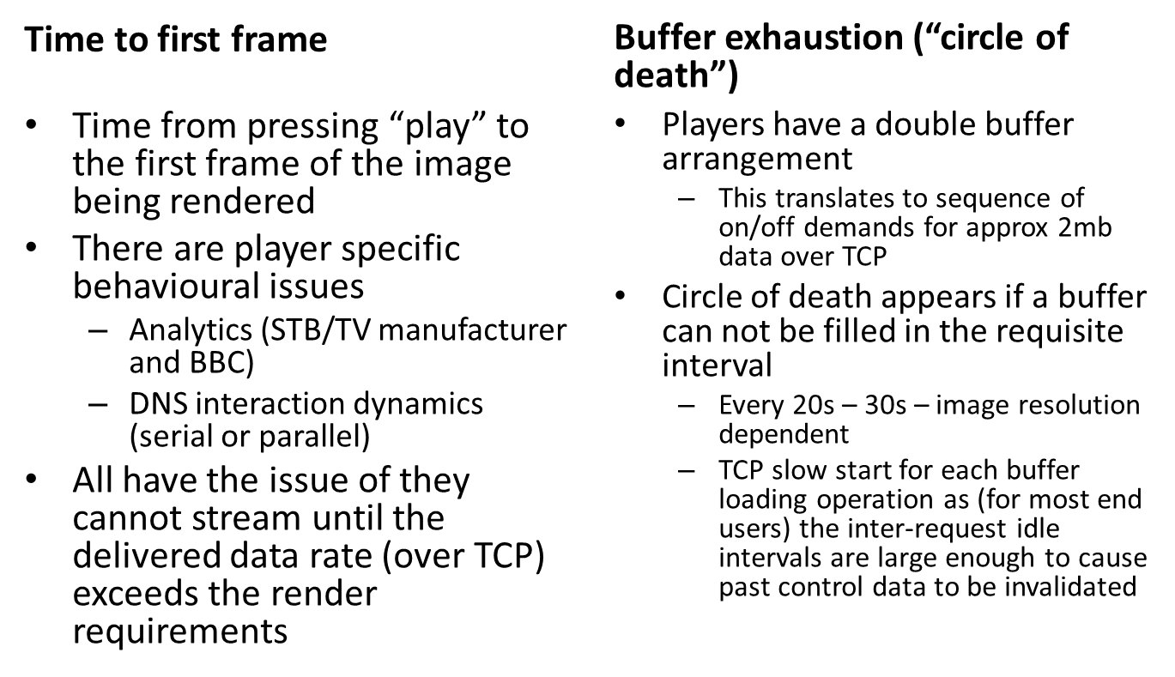
How do we establish the impact on the
User’s experience from the measurement of ∆Q?
It depends on the application……..
HTTP
IPTV
Time to first frame

Slide 8
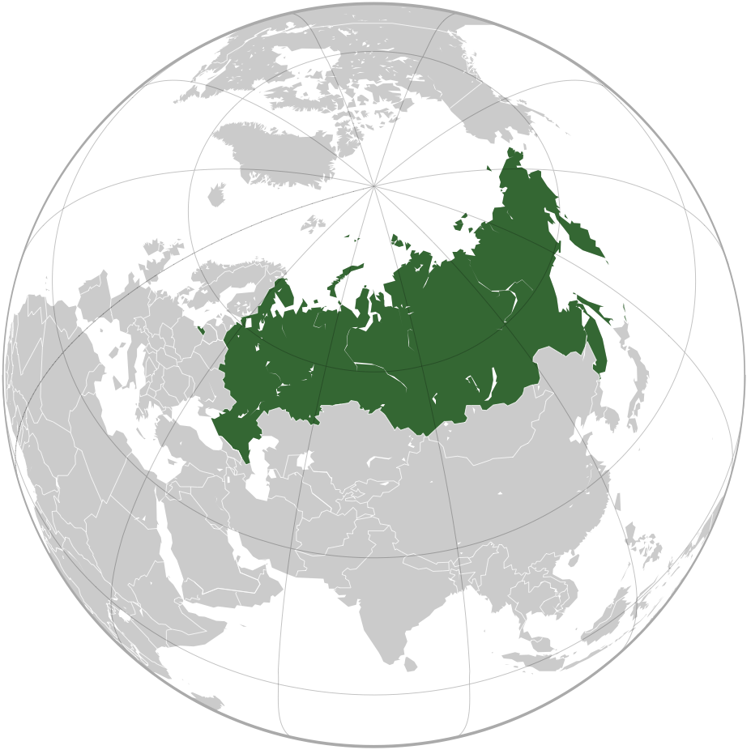
Initial data gathered and the user experience
Date gathered to/from
Moscow
Chelyabinsk
London
Dublin
Frankfurt
Singapore
Nielsen study on user experience
0.1 seconds - the user feels that the system is reacting instantaneously
1.0 second - the user loses interest in the game, transaction , video call
Notes:
More detailed analysis is required to know the quantifiable impact on users
As the data we collect builds to a larger sample size we will map it to the applications our customers’ customers use
For the “snap shot” of the data we have so far we will use the famous Nielsen study as a good general benchmark of response time that we can use to judge the impact of quality attenuation
0.1 seconds - the user feels that the system is reacting instantaneously
1.0 second - the user loses interest in the game, transaction , video call

Slide 9
RTT times in milliseconds derived from ∆Q
двусторонняя задержка
Path | Fiber time | G | Ratio | S(MTU) | V50 | V75 | V95 | GSV95 Total
Moscow-Frankfurt | 19.52 | 45.22 | 2.32 | 1.09 | 0.21 | 0.31 | 10.34 | 57
Moscow-London | 24.15 | 53.10 | 2.20 | 1.09 | 0.32 | 0.80 | 2.35 | 57
Moscow-Chelyabinsk | 14.40 | 24.30 | 1.69 | 2.00 | 0.61 | 0.76 | 1.04 | 27
Moscow-Singapore | 81.29 | 303.19 | 3.73 | 1.15 | 0.23 | 0.30 | 0.46 | 305
Moscow-Ireland | 26.99 | 63.60 | 2.36 | 1.14 | 0.22 | 0.30 | 0.48 | 65
Chelyabinsk-Frankfurt | 33.91 | 65.80 | 1.94 | 1.04 | 0.23 | 0.30 | 0.50 | 67
Chelyabinsk-Ireland | 40.78 | 78.20 | 1.92 | 1.07 | 0.26 | 0.34 | 0.95 | 80
Chelyabinsk-Singapore | 68.52 | 326.83 | 4.77 | 2.28 | 0.29 | 0.42 | 0.77 | 330
Chelyabinsk-London | 38.34 | 85.28 | 2.22 | 1.64 | 0.30 | 0.38 | 0.57 | 87
For comparison “low latency” RTT from specialists are
Moscow - London 48 ms
Moscow – Frankfurt 36 ms

Slide 10
What does the initial data say?
Path | Fiber time | G | Ratio | S(MTU) | V50 | V75 | V95 | GSV95 Total
Moscow-Frankfurt | 19.52 | 45.22 | 2.32 | 1.09 | 0.21 | 0.31 | 10.34 | 57
Moscow-London | 24.15 | 53.10 | 2.20 | 1.09 | 0.32 | 0.80 | 2.35 | 57
Moscow-Chelyabinsk | 14.40 | 24.30 | 1.69 | 2.00 | 0.61 | 0.76 | 1.04 | 27
Moscow-Singapore | 81.29 | 303.19 | 3.73 | 1.15 | 0.23 | 0.30 | 0.46 | 305
Moscow-Ireland | 26.99 | 63.60 | 2.36 | 1.14 | 0.22 | 0.30 | 0.48 | 65
Chelyabinsk-Frankfurt | 33.91 | 65.80 | 1.94 | 1.04 | 0.23 | 0.30 | 0.50 | 67
Chelyabinsk-Ireland | 40.78 | 78.20 | 1.92 | 1.07 | 0.26 | 0.34 | 0.95 | 80
Chelyabinsk-Singapore | 68.52 | 326.83 | 4.77 | 2.28 | 0.29 | 0.42 | 0.77 | 330
Chelyabinsk-London | 38.34 | 85.28 | 2.22 | 1.64 | 0.30 | 0.38 | 0.57 | 87
Severe Congestion for 5% of traffic = poor video call or gaming
Bandwidth looks sufficient
The “G” is almost four times the direct route, rather than around two
The “G” is almost five times the direct route, rather than around two
The data tells different stories depending on what the impact of quality attenuation is on the application

Slide 11
Looking at “distance” only
Moscow and Chelyabinsk to/from
London
Dublin
Frankfurt
Singapore
Round-trip time in point-to-point great-circle fiber
Measured ‘G’
Measured ‘S’ for an MTU
Measured ‘V’ showing 50%, 75% and 95% centiles of variability

Slide 12
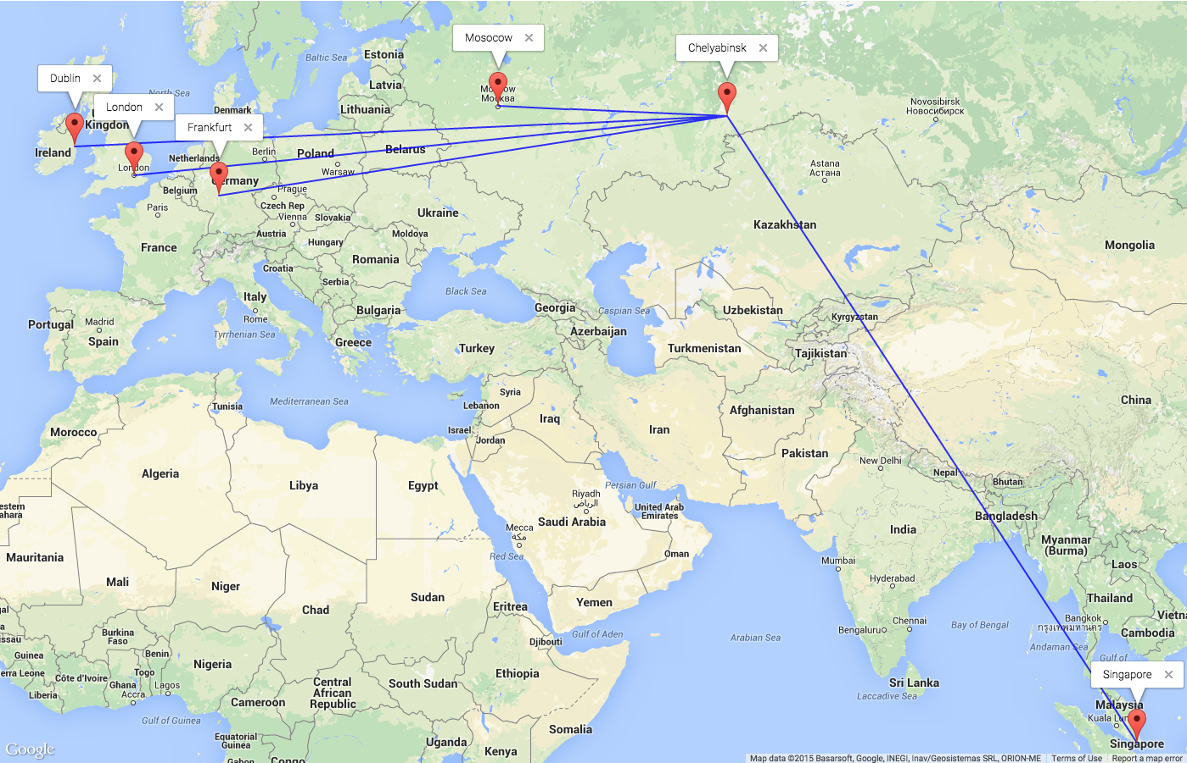
RTT for zero packet size in direct fibre route
двусторонняя задержка прямой маршрут

Slide 13
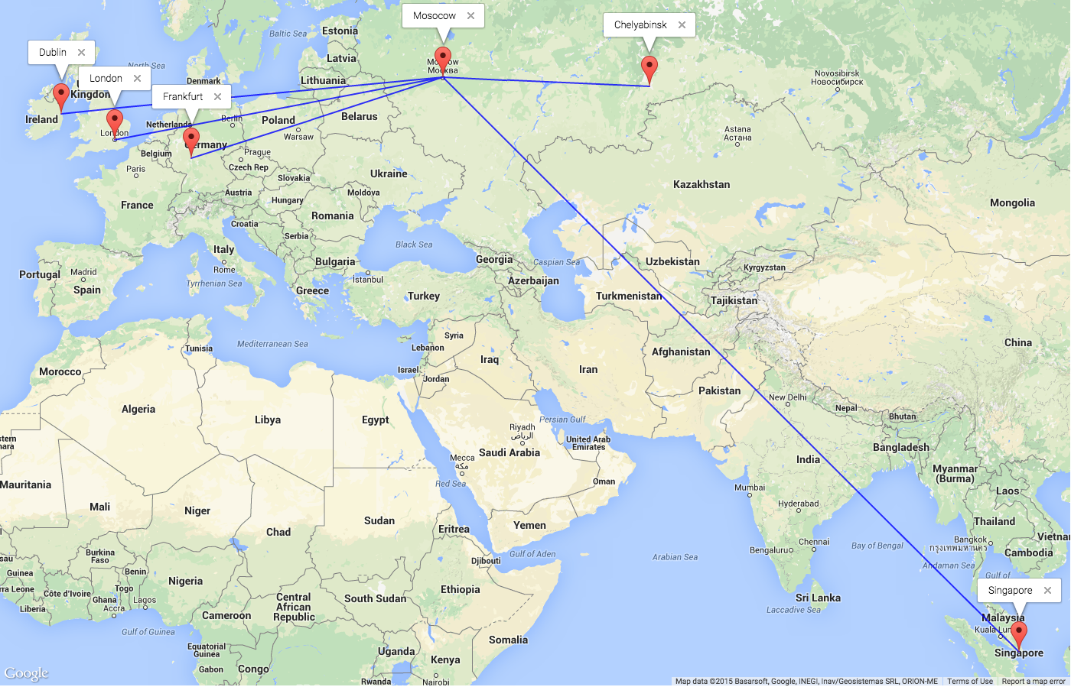

Actual RTT for MTU packet with congestion
“Distance” impact of V – variability due to load
Изменчивость “расстояние”
“Distance” impact of S – bandwidth restriction
ширина полосы “расстояние”

Slide 14

внере есть Frankfurt? I Where is Frankfurt?
?
?
Congestion due to load can have a bigger impact that distance
  Frankfurt could be in Africa or Russia
  London could be in Dublin
Note that the impact of load “V” can be measured (and hence managed) to deliver quality to the end user.

Slide 15


Slide 16
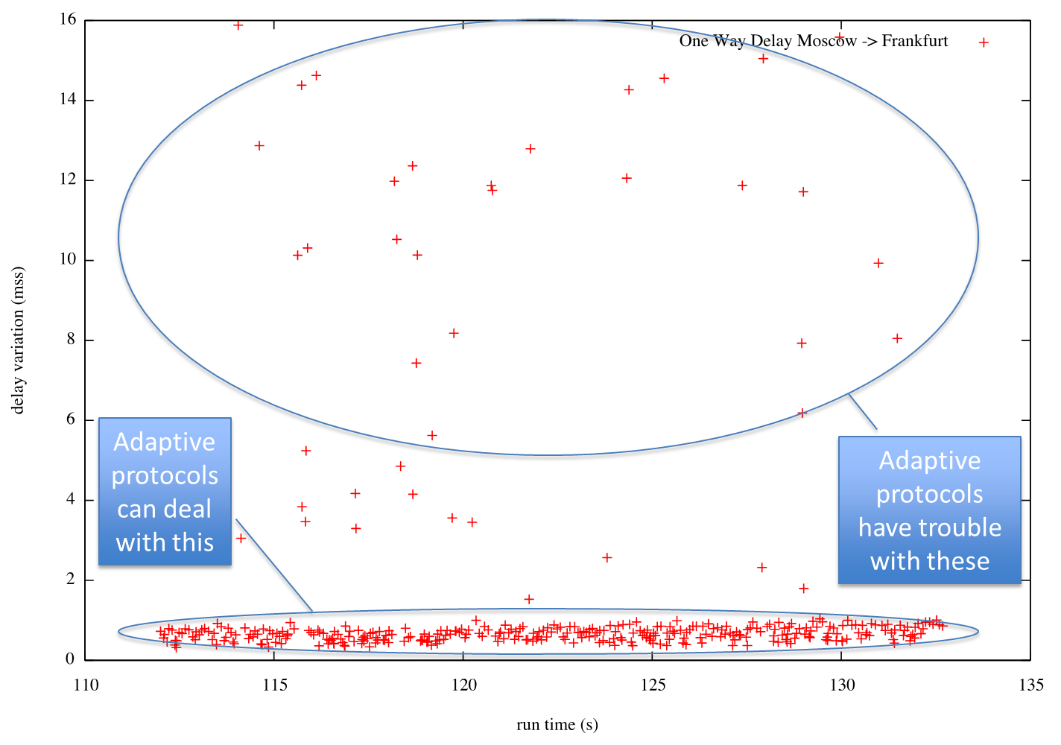
Averages do not tell the whole story….
И это только верхушка айсберга

Slide 17
Summary of initial findings
Internet users can get decent www performance from servers outside of Russia (in western Europe) i.e. < 100 ms delay
But…..
Applications that don’t like “V”, variability, should avoid Frankfurt and London - video, gaming etc
Adding bandwidth will not reduce the congestion
Further research will determine the variability of ∆Q and how certain applications are impacted in different parts of Russia and Eurasia and answer questions like:
Where to put what applications
Where to handoff traffic

Slide 18
Thanks!
pete.cladingbowl@ixcellerate.com

