Slide 1

L-Root
September, 2014
ICANN DNS Operations

Slide 2
What is L-Root?
  “L” is one of 13 independently operated root servers serving the DNS root zone
  The ICANN DNS OPS team operates L under the autonomous system number AS20144 using the following addresses
    199.7.83.42
    2001:500:3::42
  Anycasted since 2007
  Uses the Name Server Daemon (NSD) from NLnetLabs

Slide 3
L-Root Geographical diversity (via Anycast)
Anycast allow multiple copies of a server to be on multiple places, allowing us to:
  Take the service closer to the user
    Lower RTT ( Round trip)
    Improve user experience
  Increase query capacity
  Reduces the likelihood that some types of attack traffic would affect the rest of the internet by keeping it closer to the source
  Flexibility to add/remove instances

Slide 4
L-Root locations
Today L has presence on every continent with over 150 instances
  Added in August 2014:
    Chicago, US (ord02.l.root-servers.org)
      Team Cymru
    San Juan, PR (sju01.l.root-servers.org)
      Gauss Research Laboratory Inc.
    Yekaterinburg, Russia (svx01.l.root-servers.org)
      Yandex LLC.

Slide 5
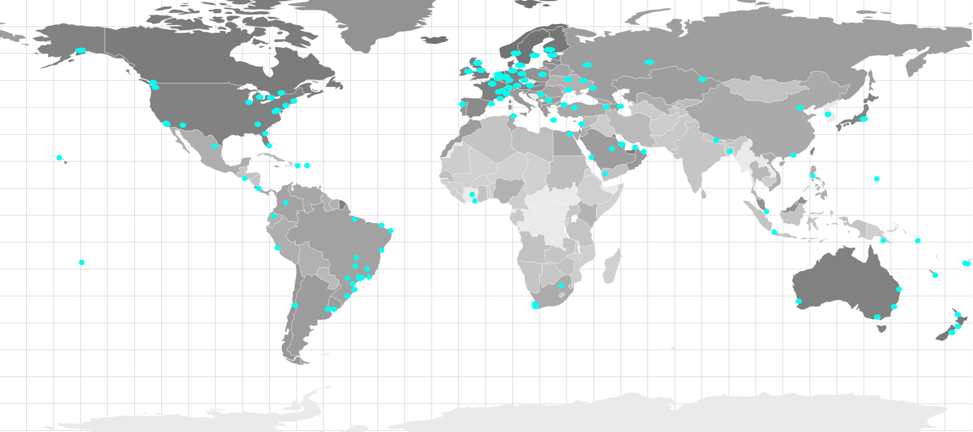
L-Root locations

Slide 6
Want to host an L-Root instance on you network?
Prerequisites:
  Your organization is willing to host a L-Root server instance (L-Single)
  Your organization can provide all the following:
    Sign a Non-Disclosure-Agreement and an ICANN L-Single Agreement
    Provided a server (as spec’d by ICANN)
    Provide housing for the server (hosting/power/connectivity)
    Ability to establish a BGP peering session to propagate L-Root AS20144 prefixes

Slide 7
Hosting an L-Root Workflow:
If the pre-requisites are completely satisfied
  Your organization will need to contact your ICANN GSE local representative and complete a contact information document
  Your organization will then need to sign a NDA and then the provided L-Single contract
  ICANN will return the documents executed
  Your organization will need to complete a technical form with the server details
  ICANN DNSOPS team installs and commissions the servers.

Slide 8
After completed the process, the result is a new instance svx01.l.root-servers.org
Thanks Yandex LLC!

Slide 9
L Instance Statistics
  Hedgehog
    http://hedgehog.dns.icann.org
    Provides near real-time statistics for L-Root instances
    Some of the features available are:
      Per instance:
        Query and type per second
        IP Protocol and Transport Protocol
        Query type and attributes
    Released to the community with a open license in August 2014. More information on http://www.dns-stats.org

Slide 10
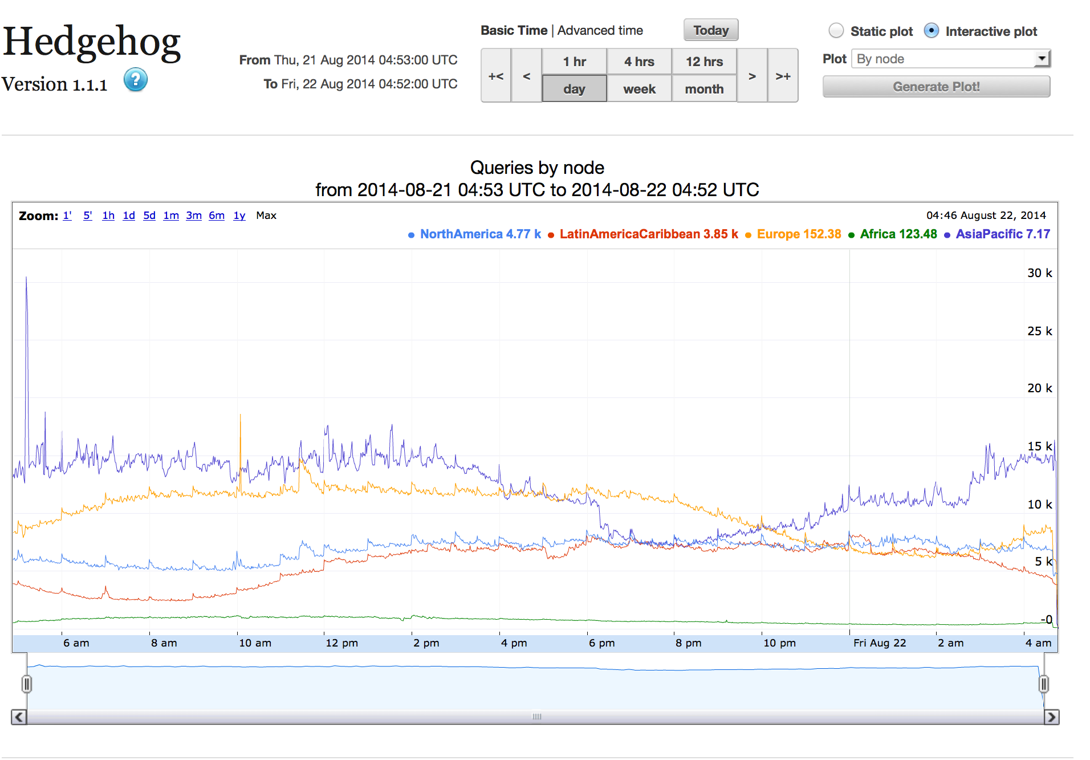

Slide 11
The team behind L-Root
John Bond
David Soltero
Mauricio Vergara
Terry Manderson, Director

Slide 12
Our team goals
DNS expertise and excellence
Strengthen, diversity and growth of
L-Root worldwide
Collaboration within our peers
Best engineering process
Transparency and documented process

Slide 13
How to engage us?
Research bodies (DNS-OARC)
Network Operations (NANOG, LACNOG, AUSNOG, CENTR)
Standard bodies (IETF)
Participation on many different mailing lists
Social media (Website, Twitter)

Slide 14
How to contact us
  http://www.dns.icann.org
  noc@dns.icann.org
  Phone +1 (424) 217-1313

Slide 15
Thank You & Questions?

