Slide 1
PeeringDB 2.0
Arnold Nipper
arnold@peeringdb.com

Slide 2
Agenda
PeeringDB 2.0
Membership and Governance
Committees
Sponsorship
Information and Resources

Slide 3
What is PeeringDB?
PeeringDB is the database of peering information on the Internet
Contains peering location and contact information for
Networks
Exchanges
Facilities
A PeeringDB record makes it easy for people to find you, and helps you to establish peering
If you aren’t registered in PeeringDB, you can register at https://www.peeringdb.com/register
We use basic verification for new accounts and require current whois information
Please update your whois information
Please register from a company email address

Slide 4
PeeringDB 2.0 is Here!
PeeringDB 2.0 launched 15 March, 2016
Backend database (1.0) discontinued simultaneously
Last legacy SQL dump for public consumption: https://peeringdb.com/v1/dbexport/peeringdb.sql
Investigating 404s for old SQL to contact users
Questions to support@peeringdb.com
Challenges during the launch
Very minor bug fixes required, but overall a success!
Lots of support tickets
20C (developer contractor) very responsive to community - thanks!
Current release: 2.0.10

Slide 5
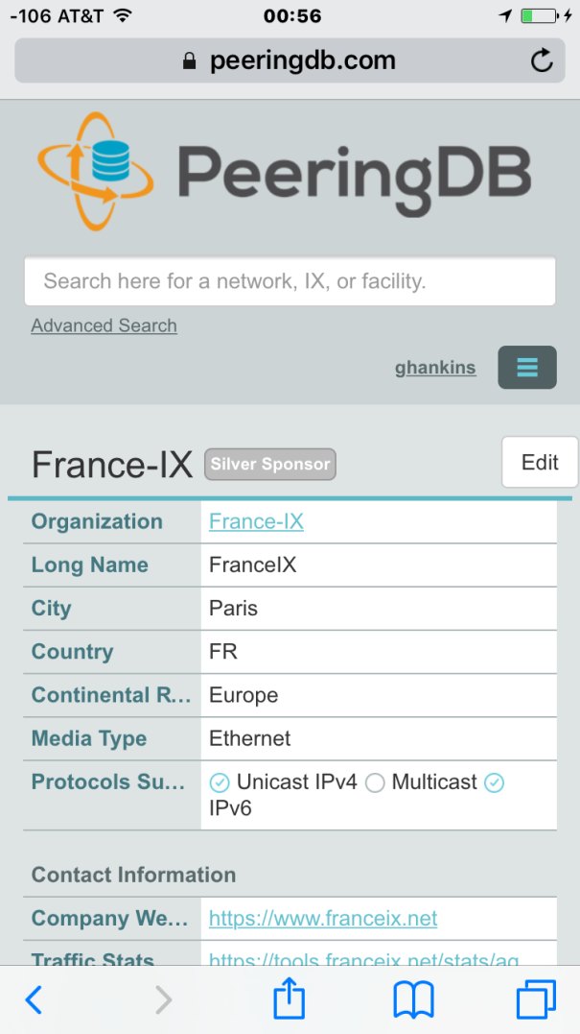
Key New Infrastructure Features
Complete rewrite in Python
Python: fast and clean, widely used and supported
HTML5: adaptive design for desktop and mobile
Support for a multideveloper environment
Redesigned schema with data validation
All data is permissioned and editable
Input validation on fields: IP addresses, email addresses, etc.
Validation in PeeringDB record: dropdown box to select ASN at exchange
Data versioning
Revision history for every data change
Easy to restore and roll back
Historical data import from CAIDA going back to 2010 (not available yet)
RESTful API
Stateless
Incremental database syncs
With documentation and tools, oh my!

Slide 6
Key New User Features
Facilities and exchanges can now update their own info
Networks are still required to associate their record at a facility or exchange
Multiple records of any type can be associated with an organization
Simpler organization management with a single account for network, facility, exchange records
One account can manage multiple organizations
Manage all of the things with a single account
Users can manage their accounts
Admin account for an organization can delegate fine-grained permissions
Contact info has permissions
Private/users/public permissions
All users must register, no more guest account
Public view can see all info except contact info (no login needed)
APIs and local database sync
Sync PeeringDB to a local database in any engine format

Slide 7
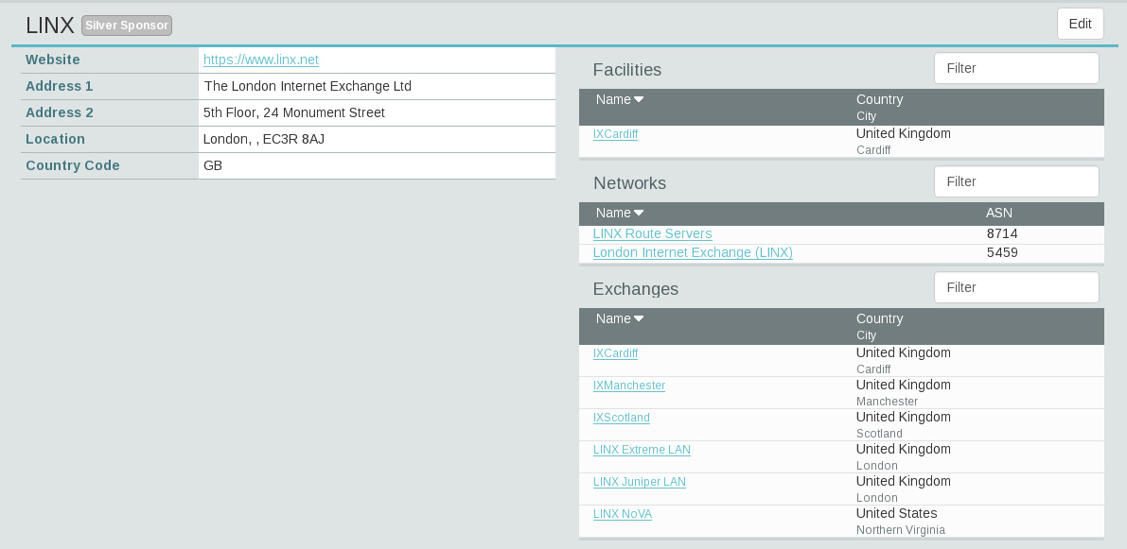
Multiple Records Under a Single Organization
Facilities are Shown Here
LINX has 1 Facility
Networks are Shown Here
LINX has 2 Network Records
Exchanges are Shown Here
LINX has 6 Exchange Records

Slide 8
One Account Managing Multiple Organizations
Account “job” is Affiliated with 4 Organizations

Slide 9
Request Ownership of an Existing Organization
Network records should already have an organization admin copied from PeeringDB 1.0
Facility and exchange records will need to have an organization admin assigned
Click “Request Ownership”
Generates a Support Ticket for Validation and Approval

Slide 10
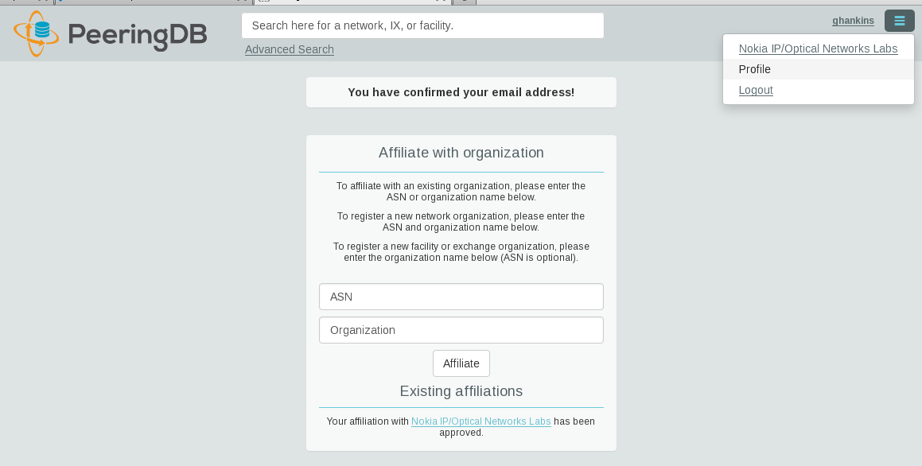
Register or Request Affiliation to an Existing Organization
2. Confirm Email Address
(Click Here if not Confirmed)
1. Go to Your Profile
4. Click “Affiliate”
Existing: Organization Admin Needs to Approve
New: Generates a Support Ticket for Validation and Approval
3. Enter ASN or Organization Here
Autocomplete on Existing ASNs and Organizations in PeeringDB

Slide 11
Organization User Management
Approve or Deny Pending Requests
Delegate Permissions for Members
Admins Have Access to Everything
Change User Access Levels
Admin – Administrator
Member – Delegate Permissions
Remove Users From the Organization
Does not Remove the User Account From PeeringDB

Slide 12
Administrative Permission Delegation
User “equinix-uk” can Manage Several Network Records, but no Exchanges or Facilities
Create – New Entries in Record
Update – Change Existing Entries in Record
Delete – Delete Entries in Record
User “rho” can Manage the “Equinix Connect” Network Record, and Any Exchange or Facility

Slide 13
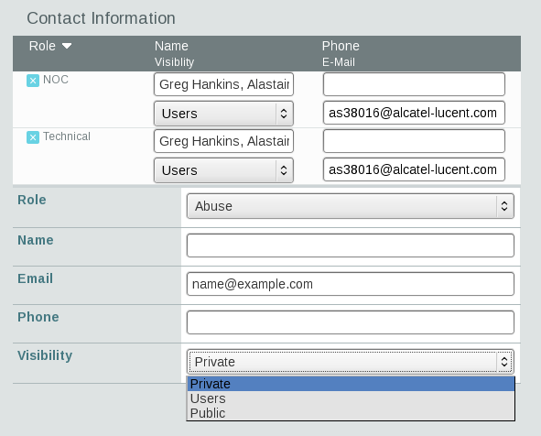
Network Record Contact Information Permissions
Separate Visibility Preferences for Each Role
Private – Organization Only (Default)
Users – Registered Users Only
Public – Anyone (no Login Required)
Roles:
Abuse
Policy
Technical
NOC
Public Relations
Sales

Slide 14
Networks from ENOG area (selected)
IXP | #networks @ PeeringDB | #networks seen @IXP
MSK-IX | 133 | 380
DATA-IX | 80
DTEL-IX | 58 | 95
UA-IX | 44 | 102
SPB-IX | 38 | 85
GigaNET | 26 | 22
Global-IX | 12
EKT-IX | 12 | 43
PIRIX | 11
NSK-IX | 10 | 48

Slide 15
RESTful API Designed for Automation
All operations are supported and are designed to be automated
Read
Create
Update
Delete
Each object type has an associated tag
org
net
ix
fac
List of objects: https://peeringdb.com/apidocs/
API documentation: http://docs.peeringdb.com/api_specs/

Slide 16
Quick Examples Return Output in JSON
List all networks: curl -X GET https://<username>:<password>@www.peeringdb.com/api/net
Show a specific network: curl -X GET https://<username>:<password>@www.peeringdb.com/api/net/20
{"meta": {}, "data": [{"id": 20, "org_id": 10356, "org": {"id": 10356, "name": "20C", "website": "http://20c.com", "notes": "", "net_set": [20], "fac_set": [], "ix_set": [], "address1": "", "address2": "", "city": "Chicago", "country": "US", "state": "IL", "zipcode": "", "created": "2014-11-17T14:59:34Z", "updated": "2016-03-23T20:39:18Z", "status": "ok"}, "name": "20C", "aka": "", "website": "http://20c.com", "asn": 63311, " ... }

Slide 17
Local Database Sync
Database sync gives you a local copy of PeeringDB for customization or internal use
Sync as often as you like
Incremental sync is supported
Improves performance and reduces load on PeeringDB servers
Build custom indexes and interfaces
Add custom fields
Choice of database engines
Currently supported: MySQL, Postgres, SQLite
Sync using the provided tools or build your own using the API

Slide 18
Django Library
django-peeringdb is a Django library with a local PeeringDB database sync
Defines the database schema to create a local database copy
Easy to integrate in a common framework for locals tools and custom interfaces
Supports multiple database engines (MySQL, Postgres, SQLite)
Available at http://peeringdb.github.io/django-peeringdb/

Slide 19
Python Client
peeringdb-py is a Python client for PeeringDB
Gets objects and outputs in JSON or YAML format
Provides a whois-like display of records
Integrated local database sync
Python library for integration with custom tools
Available at http://peeringdb.github.io/peeringdb-py/
Examples at https://github.com/grizz/pdb-examples

Slide 20
Agenda
PeeringDB 2.0
Membership and Governance
Committees
Sponsorship
Information and Resources

Slide 21
Membership and Governance
PeeringDB organization formally formed 16 Dec, 2015
PeeringDB 501(c)(6) filed 7 Jan, 2016 (approved 24 Feb, 2016)
2nd elections held April 2016: 94 organizations registered, 80 voted
292 addresses subscribed to the Governance mailing list (as of 16 May 2016)
A corporation, limited liability company, partnership or other legal business entity may be a Member of the Corporation. Membership is determined by having both an active PeeringDB.com account and an individual representative or role subscription to the PeeringDB Governance mailing list:
http://lists.peeringdb.com/cgi-bin/mailman/listinfo/pdb-gov
More information available at http://gov.peeringdb.com/

Slide 22
Board of Directors and Officers
Chris Caputo – Secretary & Treasurer (Non-Board Member) | Patrick Gilmore – Director (Term Expires 2017) | Matt Griswold – Director (Term Expires 2017)
Aaron Hughes – President (Term Expires 2018) | Arnold Nipper – Director (Term Expires 2017) | Job Snijders – Vice President (Term Expires 2018)

Slide 23
Committees
Admin Committee | Product Committee
Manage administration of user accounts and PeeringDB records
Answer support tickets
Board members Job Snijders (Chair) and Arnold Nipper (Vice Chair)
Seeking 0 community volunteers (1 year term)
Contact: support@peeringdb.com
Ask for input from the community on desired features
Manage roadmap and development priorities
Write SoWs to solicit bids to complete requested features
Board members Aaron Hughes (Chair) and Matt Griswold (Vice Chair)
Seeking 0 community volunteers (1 year term)
Contact: productcom@lists.peeringdb.com

Slide 24
Admin Committee
Kate Gerry | Patrick Gilmore | Charles Gucker | Greg Hankins | Florian Hibler | Eric Lindsjö
Arnold Nipper – Vice Chair | Robert Philips | Eduardo Ascenço Reis | Job Snijders – Chair | Michael Still | Walt Wollny

Slide 25
Product Committee
Karthik Arumugham | Matt Griswold – Vice Chair | Greg Hankins | Aaron Hughes – Chair | Martin J. Levy
Eric Loos | Stephen McManus | Arnold Nipper | Kay Rechthien

Slide 26
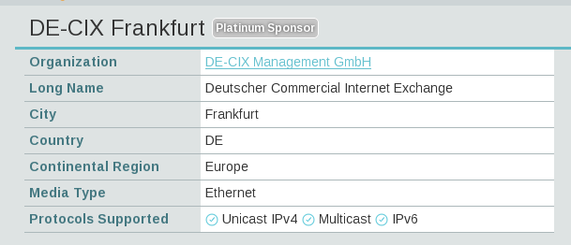
Become a PeeringDB Sponsor!
Diamond Sponsorship - $25,000 / year
Limited to 2 sponsors
Very large logo on top line of Sponsors page
Diamond Sponsor badge display on all records
Platinum Sponsorship - $10,000 / year
Large logo on second line of Sponsors page
Platinum Sponsor badge display on all records
Gold Sponsorship - $5,000 / year
Medium logo on third line of Sponsors page
Gold Sponsor badge display on all records
Silver Sponsorship - $2,500 / year
Small logo on fourth line of Sponsors page
Silver Sponsor badge display on all records
Contact sponsorship@peeringdb.com for sponsorship info

Slide 27
Thank you to our sponsors!
Diamond Sponsors
Platinum Sponsors
Gold Sponsors
Silver Sponsors
27
Notes:
Logo height proportions: 100%, 85%, 65%, 40%

Slide 28
Information and Resources
Announce: http://lists.peeringdb.com/cgi-bin/mailman/listinfo/pdb-announce
Governance: http://lists.peeringdb.com/cgi-bin/mailman/listinfo/pdb-gov
Technical: http://lists.peeringdb.com/cgi-bin/mailman/listinfo/pdb-tech
User Discuss: http://lists.peeringdb.com/cgi-bin/mailman/listinfo/user-discuss
Docs, presentations, guides: http://docs.peeringdb.com/
Board and Officers: stewards@lists.peeringdb.com
Admins: support@peeringdb.com
@PeeringDB
https://www.facebook.com/peeringdb/

Slide 29
Thanks to Richard Turkbergen
The PeeringDB Board hereby expresses its enormous appreciation to Richard A. Turkbergen (née Steenbergen) for his creation and donation of PeeringDB to the organization.

Slide 30
Questions?

Slide 31
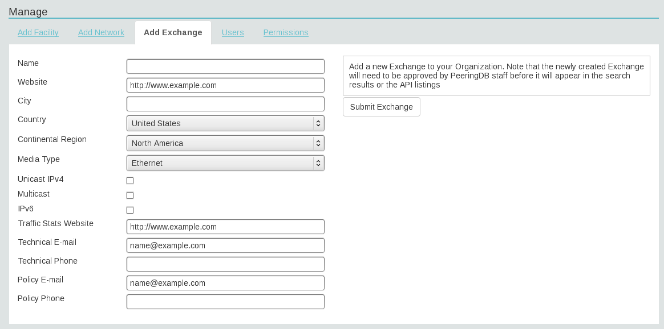
Adding a New Exchange to Your Organization
Generates a Support Ticket for Validation and Approval
Enter Exchange Info Here, Then Click “Submit Exchange”

Slide 32
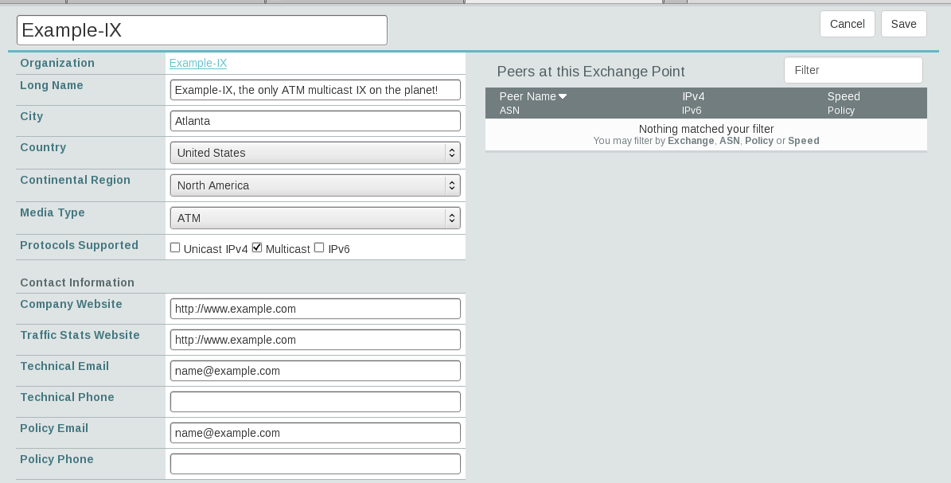
Editing Your Exchange Record
Networks are Still Required to Associate their Record at a Facility or Exchange
Enter Exchange Info Here, Then Click “Save”

Slide 33
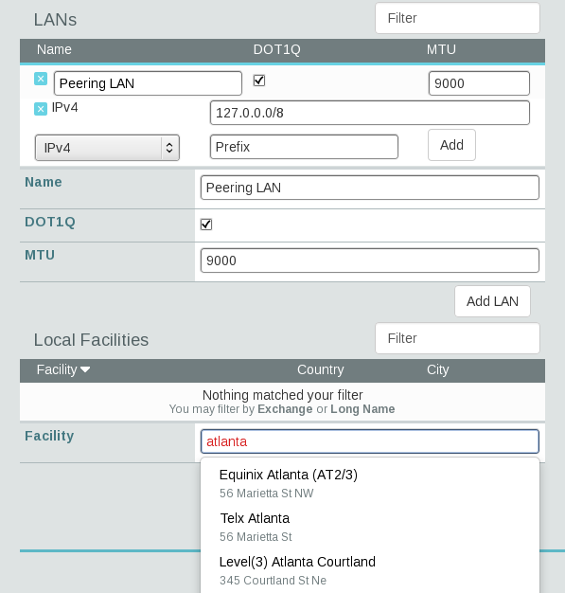
Editing Your Exchange Record
Enter LAN Info Here
Name – Optional Name
DOT1Q – 802.1Q Tag
MTU
IPv4/IPv6 Addresses
Add Facilities Here
Autocomplete on Existing Facilities, Must Contact Support to Add a New Facility

