Slide 1
Let’s Encrypt and DANE ENOG 11 | Moscow | 8 Jun 2016

Slide 2
Disclaimer: I do not work for Let’s Encrypt, but the Internet Society is a sponsor Slides contributed by: Josh Aas (Let’s Encrypt) Jan Žorž (Internet Society) Thanks also to Viktor Dukhovni

Slide 3
A Free, Automated and Open Certificate Authority (CA)
To encourage and simplify adoption of TLS and provide platform for advancing CA and end user security.
Certificates are free for anyone owning a domain name
Software running on a web server can automatically obtain, configure and renew a certificate
All certificates issued or revoked will be publicly recorded and available for anyone to inspect.
The automatic issuance and renewal protocol is published as an open IETF standard that others can adopt.
Let’s Encrypt is an effort to benefit the community beyond the control of any one organisation.

Slide 4
Why do we need it?
The Internet is inherently insecure, unencrypted traffic can be read and modified.
TLS (formerly SSL) is used to encrypt web connections using HTTPS, but can also be used for e-mail, instant messaging, streaming, VoIP and other applications.
Around 40% of Firefox page loads are HTTPS, and 62% of emails received by Gmail are over STARTLS.
Aim is to have 100% of Internet traffic encrypted, and by default.
CAs are (currently) needed to validate domains and link them with public keys used to establish encrypted connections.

Slide 5
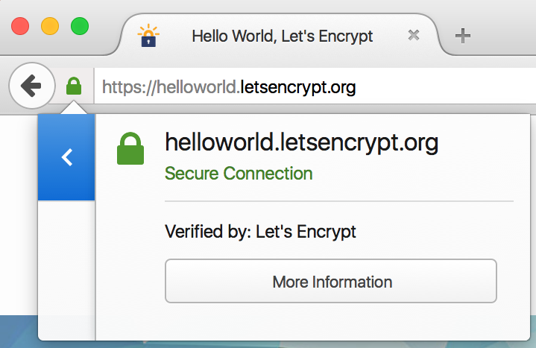
But, authentication via traditional CA is not easy
CAs issue the X.509 certificates required for TLS on the Web
Interaction with CAs for certificate issuance and management is complex

Slide 6
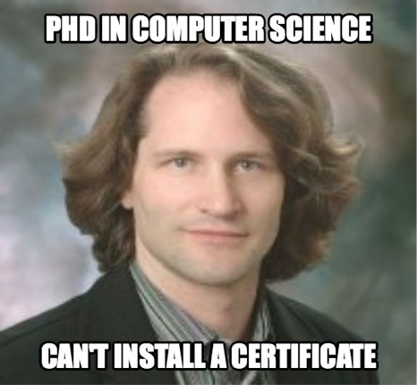
In fact, it’s too hard…
I can’t f’ ing figure out how to get a cert …
God help people that don’t know what a CSR is…
I am like 45 minutes in.
Cullen Jennings, Cisco Fellow

Slide 7
The traditional way…
Figure out you need a certificate
Work out where to get the certificate from
What type of certificate you need - DV, OV, EV or maybe you want the Regular, Pro, Gold or Platinum versions? Hmm...
Figure out how to request a certificate, including making a CSR
Go through manual verification process, hoping that responses go to the right e-mail addresses (assuming they exist in the first place), and your organisation has a publicly listed phone number and/or DUNS number etc..
Pay
Figure out how to install your certificate
Don’t forget to renew it on time!

Slide 8
Let’s Encrypt is born...
Josh Aas and Eric Rescorla decided to address this problem after discussions in IETF HTTP/2 Working Group
Decided solution was to establish CA offering free certificates globally, but (only) supporting automated processes.
Established Internet Security Research Group in May 2013, a foundation with IRS 501(c)(3) status
Mission is to reduce financial, technological and educational barriers to secure communication over the Internet.
Let’s Encrypt announced on Nov 2014, started trials in Sep 2015, public beta in Dec 2015, and entered production service in Apr 2016
Funded by 30+ sponsors making long-term commitments

Slide 9
What’s different?
Automated Certificate Management Environment (ACME), the key to Let’s Encrypt
Provides API for requesting, validating, revoking and otherwise managing certificates
Clients must request certificates from Let’s Encrypt via ACME
Certbot is recommended client software, but others are available
ACME is being standardized:

Slide 10
The technical details…
Let’s Encrypt certificates are Domain Validation (DV) – asserts that holder has control over a domain
Validation is undertaken through challenge verification
HTTP: a file on your web server
DVSNI: provisioning virtual host at your domain’s IP address
DNS: provision a DNS TXT record for your domain
Certificates have 90-day lifetime
Encourages automation
Limits damage from key compromise or mis-issuance
Mitigates the problems of certificate revocation

Slide 11
Trust anchor…
End entity certificates are validated through a chain-of-trust originating from a root certificate, known as the trust anchor
Root certificate trust is established through distribution of root certificates in operating systems or browsers
Main certification programs are Microsoft, Apple and Mozilla
Let’s Encrypt issues certificates from intermediate CA called Let’s Encrypt Authority X3, signed by ISRG Root X1
ISRG Root X1 is not yet trusted in all OSs and browsers so cross-signed by IdenTrust DST Root CA X3

Slide 12
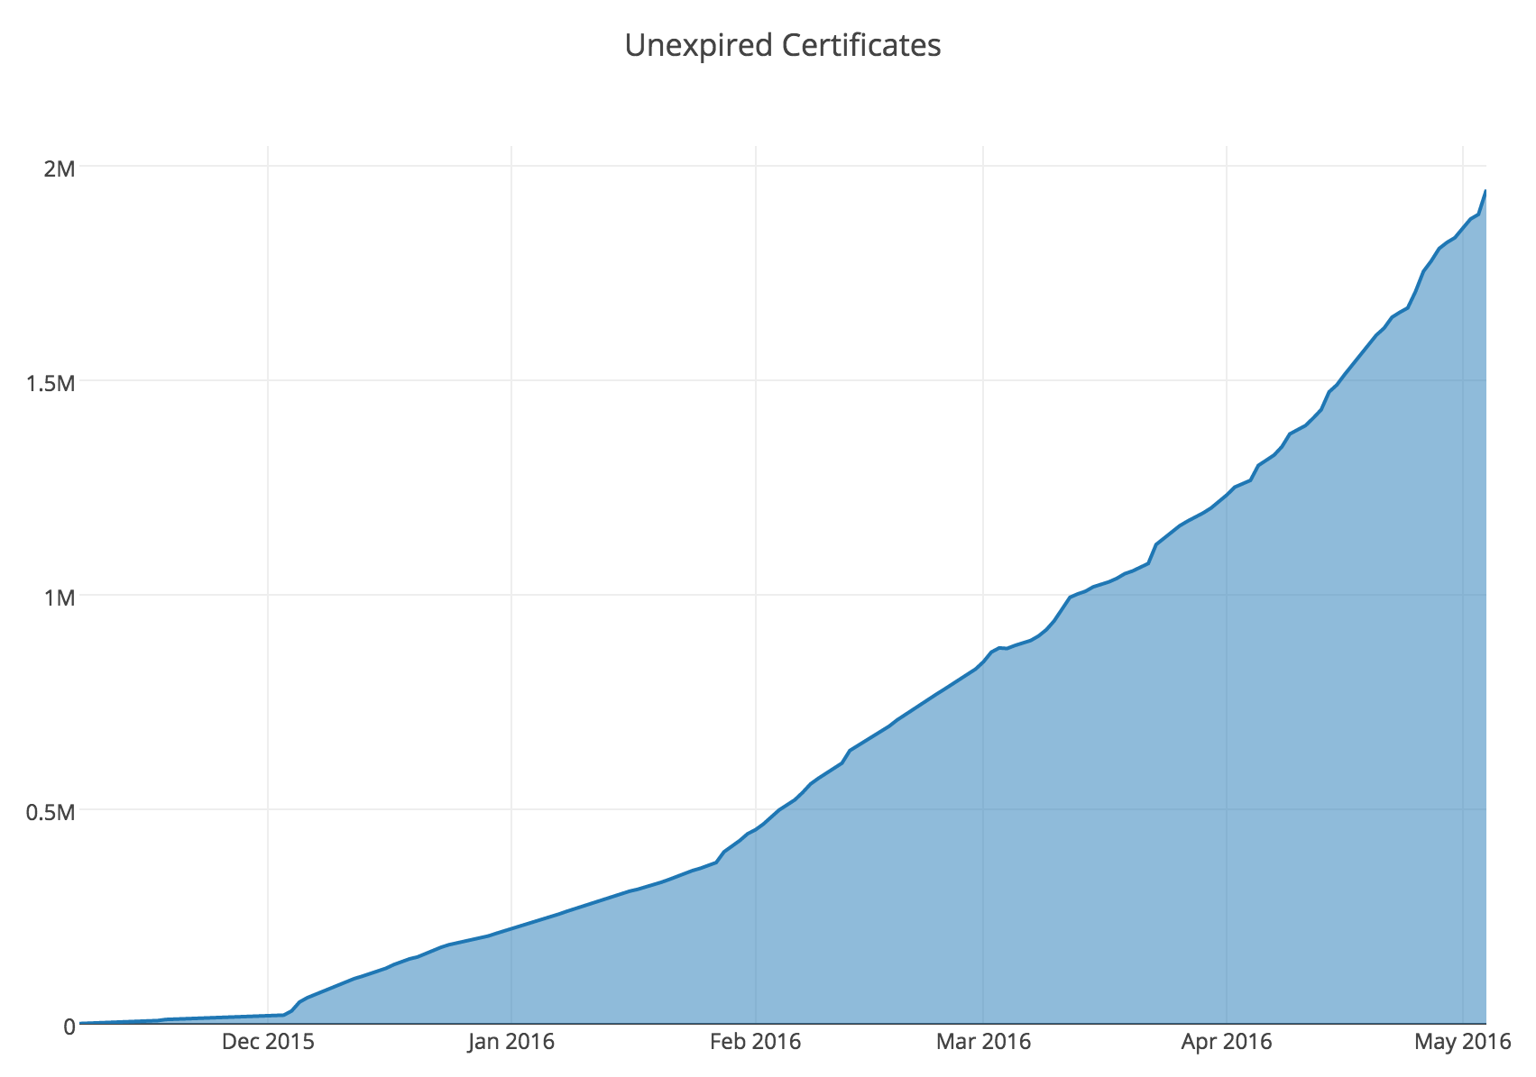
How successful is it?

Slide 13
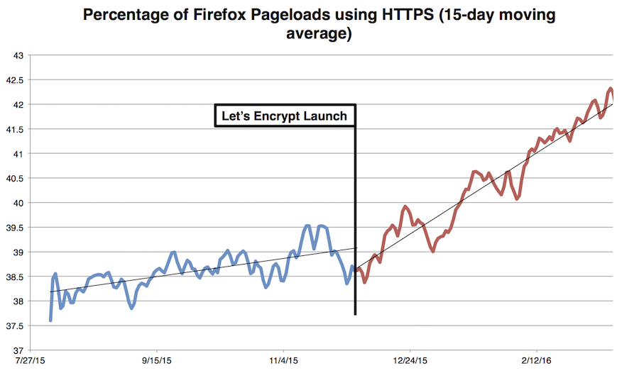
Is it encouraging use of TLS?

Slide 14
The Internet is not just the Web though!
ISOC / Go6Lab tested SMTP connections to top 1 million domain names
70% of attempted sessions were encrypted with TLS
60% of TLS sessions were established with trusted certificate
Other sessions used untrusted certificate or opportunistic TLS
None of the top 10 mail servers and their domains were DNSSEC signed (as of Jan 2016)
Only 128 sites could be verified with TLSA by DANE!
How can this be improved?

Slide 15
DNS-Authenticated Name Entities (DANE)
DANE allows certificates to be cryptographically bound to DNS names
Domain administrators can certify the keys used for establishing TLS sessions by storing them in the DNS
Aims to improve inherent situation whereby any CA can issue certificate for any name
Requires DNS records to be signed with DNSSEC
Clients need to be DNSSEC and DANE aware
DNS TLSA records associate certificates or public keys with domains
Usage, Selector and Matching Types fields determine which CAs, certificates and hashes can be accepted
Let’s Encrypt recommends 2 1 1 and 3 1 1 records

Slide 16
When do things fail in DANE?
When do things fail in DANE?
TLSA record is published in non-DNSSEC zone (therefore can’t trust the data)
Domain where looked up records (e.g. MX) reside are not DNSSEC signed (therefore no verification)
Wrong certificate hash in TLSA record

Slide 17
Let’s Encrypt, DANE and email
Validity of Let’s Encrypt certificate is 90 days
By default the underlying key is changed is changed when renewing
So also is hash, so work needed if planning to publish 3 1 1 TLSA
Using 2 1 1 TLSA means lack of DST Root CA X3 in certificate chain
So need to fetch DST Root CA X3 certificate and add it to fullchain.pem file
However, how do we know if root certificate has changed?
Trick is to use same CSR when Let’s Encrypt certificate is renewed, and generate 2048 bit RSA private key
This means same underlying key can be used for 3 1 1 TLSA records, so hash doesn’t change
Underlying key can be rotated on different schedule

Slide 18
Moral of the story…
70% of e-mail can already be encrypted in some way – so enable TLS on your server!
Let’s Encrypt offers free certificates and automated ordering/installation, so no excuse not to make encryption the default on the Internet
Using DANE is not that difficult and can be automated
But…
We need more DNSSEC signed domains!
We need even more DANE/TLSA verified servers!

Slide 19
Further Information
Deploy360 - DNSSEC
http://www.isoc.org/deploy360/dnssec/
Let’s Encrypt
https://letsencrypt.org/
HOWTO
http://www.internetsociety.org/deploy360/blog/2016/01/lets-encrypt-certificates-for-mail-servers-and-dane-part-1-of-2/
http://www.internetsociety.org/deploy360/blog/2016/03/lets-encrypt-certificates-for-mail-servers-and-dane-part-2-of-2/
https://dane.sys4.de/common_mistakes

Slide 20
Thank You!
Kevin Meynell
Deploy360@isoc.org

