Slide 1
DNSSEC and DANE Deployment Trends, Tools And Challenges
Dan York, Senior Content Strategist Internet Society
ENOG 6, Kiev, Ukraine October 2, 2013

Slide 2
About Deploy360
The Challenge:
The IETF creates protocols based on open standards, but some are not widely known or deployed
People seeking to implement these protocols are confused by a lack of clear, concise deployment information
The Deploy360 Solution:
Provide hands-on information on IPv6, DNSSEC and routing resiliency/security to advance real-world deployment
Work with first adopters to collect and create technical resources and distribute these resources to fast following networks

Slide 3
Deploy360 Components
Web Portal (Online Knowledge Repository)
Social Media (Constant Audience Engagement)
Speaking Engagements (Come Meet Us or Invite Us to Speak)
ION Conferences (Hands-on Educational Events)
Technical documents
Audience-specific information
Blogs & social media
Twitter
Facebook
Google+
YouTube
RSS Feeds
Consumer Electronics Show
IPv6 Summits
Interop
Network Operators’ Groups
Slovenia
India
USA
Canada
Argentina

Slide 4
A Quick Overview of DNSSEC

Slide 5
A Normal DNS Interaction
DNS Svr
root
.com NS
DNS Svr
.com
Web Server
example.com NS
example.com?
DNS Resolver
DNS Svr
example.com
5
2
https://example.com/
1
3
6
Web Browser
10.1.1.123
web page
4
10.1.1.123

Slide 6
Attacking DNS
DNS Svr
root
.com NS
DNS Svr
.com
Web Server
example.com NS
example.com?
DNS Resolver
DNS Svr
example.com
5
2
https://example.com/
1
6
Web Browser
10.1.1.123
web page
3
4
192.168.2.2
AttackingDNS Svr
example.com
192.168.2.2

Slide 7
A Poisoned Cache
Web Server
example.com?
DNS Resolver
Resolver cache now has wrong data:
example.com 192.168.2.2
This stays in the cache until the Time-To-Live (TTL) expires!
3
1
https://example.com/
4
Web Browser
web page
2
192.168.2.2

Slide 8
A DNSSEC Interaction
DNS Svr
root
.com NS DS
DNS Svr
.com
Web Server
example.com NS DS
example.com?
DNS Resolver
DNS Svr
example.com
5
2
https://example.com/
1
3
6
Web Browser
10.1.1.123 DNSKEY RRSIGs
web page
4
10.1.1.123

Slide 9
Attempting to Spoof DNS
DNS Svr
root
.com NS DS
DNS Svr
.com
Web Server
example.com NS DS
example.com?
DNS Resolver
DNS Svr
example.com
5
2
https://example.com/
1
6
Web Browser
10.1.1.123 DNSKEY RRSIGs
web page
3
4
SERVFAIL
AttackingDNS Svr
example.com
192.168.2.2 DNSKEY RRSIGs

Slide 10
The Two Parts of DNSSEC
Signing
Validating
DNS Hosting
Registrars
ISPs
Enterprises
Registries
Applications

Slide 11
DNSSEC Signing - The Individual Steps
Registry
Registrar
DNS Hosting Provider
Domain Name Registrant
Signs TLD
Accepts DS records
Publishes/signs records
Accepts DS records
Sends DS to registry
Provides UI for mgmt
Signs zones
Publishes all records
Provides UI for mgmt
Enables DNSSEC (unless automatic)

Slide 12
DNSSEC Signing - The Players
Registries
Registrars
DNS Hosting Providers
Domain Name Registrants
Registrar also provides DNS hosting services

Slide 13
DNSSEC Signing - The Players
Registries
Registrars
DNS Hosting Providers
Domain Name Registrants
Registrant hosts own DNS

Slide 14
A Quick Overview of DANE

Slide 15
The Typical TLS (SSL) Web Interaction
DNS Svr
root
Web Server
DNS Svr
.com
5
DNS Svr
example.com
https://example.com/
6
TLS-encrypted web page
2
example.com?
DNS Resolver
3
1
10.1.1.123
Web Browser
4
10.1.1.123

Slide 16
The Typical TLS (SSL) Web Interaction
DNS Svr
root
Web Server
DNS Svr
.com
5
DNS Svr
example.com
https://example.com/
6
TLS-encrypted web page
2
example.com?
DNS Resolver
3
Is this encrypted with the CORRECT certificate?
1
10.1.1.123
Web Browser
4
10.1.1.123

Slide 17
Problems?
DNS Server
Web Server
https://www.example.com/
www.example.com?
Firewall
https://www.example.com/
TLS-encrypted web page with CORRECT certificate
1
1.2.3.4
2
Web Browser
TLS-encrypted web page with NEW certificate (re-signed by firewall)

Slide 18
DANE
DNS Server
Web Server
https://example.com/
Firewall (or attacker)
2
https://example.com/
example.com?
TLS-encrypted web page with CORRECT certificate
1
10.1.1.123 DNSKEY RRSIGs TLSA
Web Browser w/DANE
TLS-encrypted web page with NEW certificate (re-signed by firewall)
Log files or other servers
DANE-equipped browser compares TLS certificate with what DNS / DNSSEC says it should be.

Slide 19
DNS-Based Authentication of Named Entities (DANE)
Q: How do you know if the TLS (SSL) certificate is the correct one the site wants you to use?
A: Store the certificate (or fingerprint) in DNS (new TLSA record) and sign them with DNSSEC.
A browser that understand DNSSEC and DANE will then know when the required certificate is NOT being used.
Certificate stored in DNS is controlled by the domain name holder. It could be a certificate signed by a CA – or a self-signed certificate.

Slide 20
DANE – Not Just For The Web
DANE defines protocol for storing TLS certificates in DNS
Securing Web transactions is the obvious use case
Other uses also possible:
Email via S/MIME
VoIP
Jabber/XMPP
PGP
?

Slide 21
DANE Resources
DANE and email:
http://tools.ietf.org/html/draft-ietf-dane-smtp
http://tools.ietf.org/html/draft-ietf-dane-smime
DANE Operational Guidance:
http://tools.ietf.org/id/draft-dukhovni-dane-ops-01.txt
DANE and SIP (VoIP):
http://tools.ietf.org/id/draft-johansson-dane-sip-00.txt
Other uses:
http://tools.ietf.org/id/draft-wouters-dane-openpgp-00.txt
http://tools.ietf.org/id/draft-wouters-dane-otrfp-00.txt

Slide 22
DNSSEC Deployment Trends - Signing

Slide 23
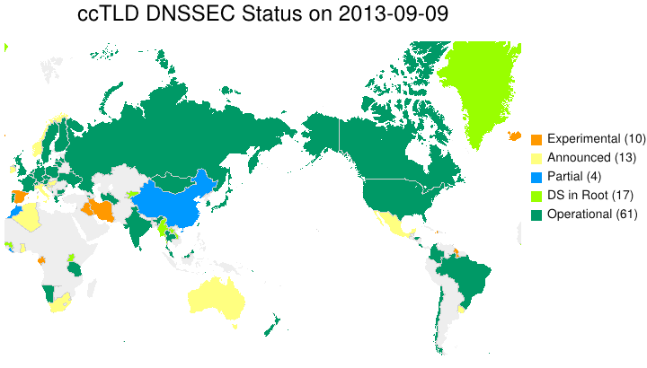
DNSSEC Deployment – Top-Level Domains
Source: http://www.internetsociety.org/deploy360/dnssec/maps/

Slide 24
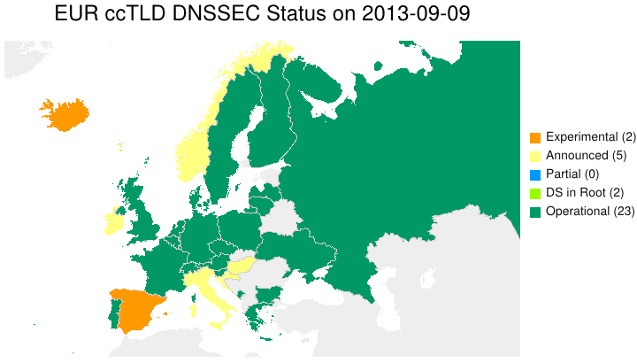
DNSSEC Deployment – Top-Level Domains
Source: http://www.internetsociety.org/deploy360/dnssec/maps/

Slide 25
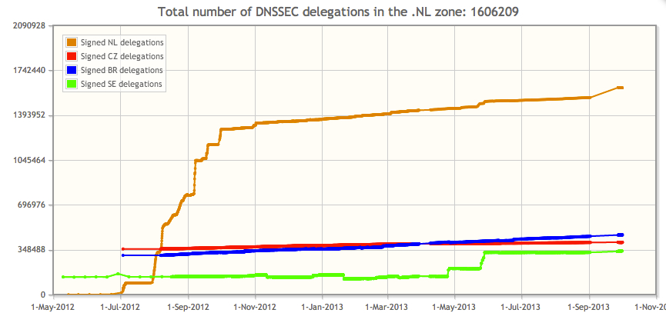
DNSSEC Deployment – Second-Level Domains
Source: https://xs.powerdns.com/dnssec-nl-graph/

Slide 26
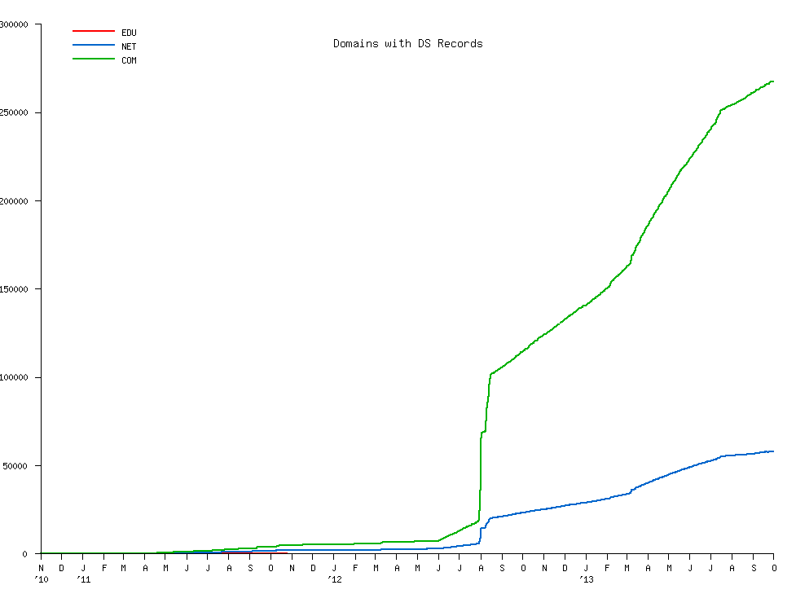
DNSSEC Deployment – .COM
Source: http://scoreboard.verisignlabs.com/count-trace.png

Slide 27
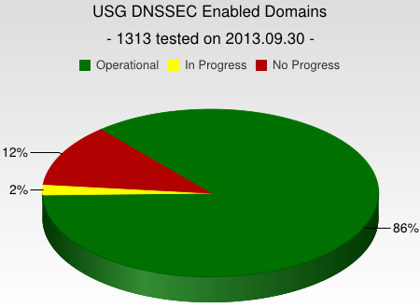
DNSSEC Deployment – .GOV
Source: http://fedv6-deployment.antd.nist.gov/snap-all.html

Slide 28
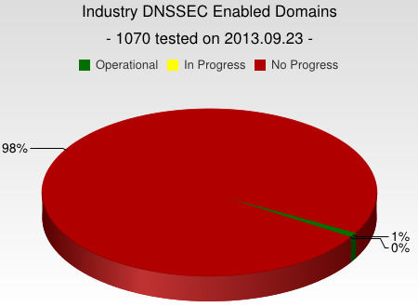
DNSSEC Deployment – Fortune 1000 and U.S. Alexa Top 100 Sites
Source: http://fedv6-deployment.antd.nist.gov/snap-all.html

Slide 29
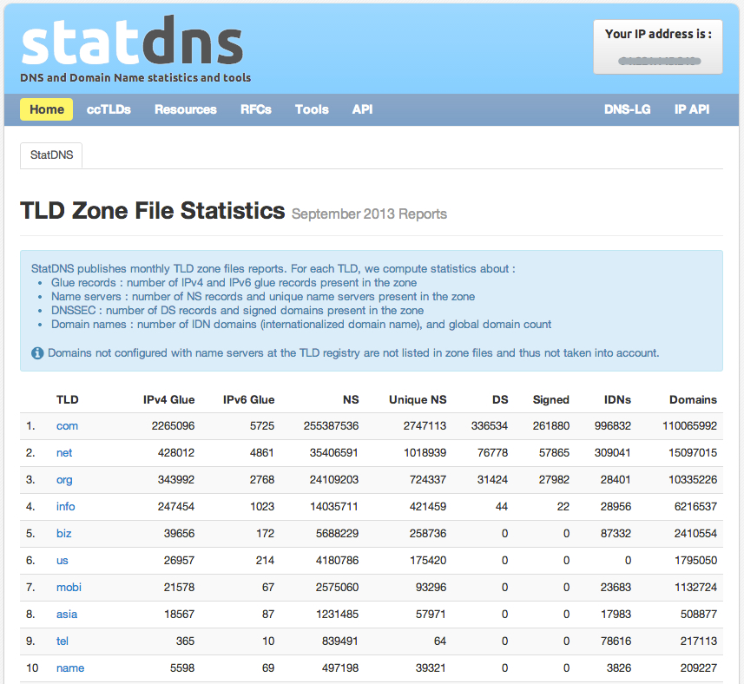
DNSSEC Deployment – New Statistics Site
Source: http://www.statdns.com/

Slide 30
DNSSEC Deployment Trends - Validation

Slide 31
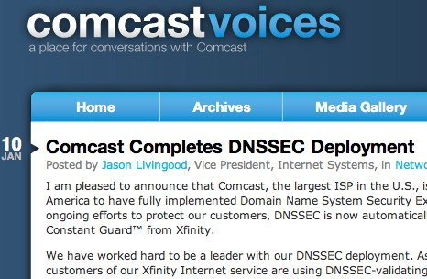
Availability of DNSSEC-Validating Resolvers
Consumers need easy availability of DNSSEC-validating DNS resolvers. Examples:
Google's Public DNS now performing DNSSEC validation by default
Comcast in North America rolled out DNSSEC-validating resolvers to 18+ million customers
Almost all ISPs in Sweden provide DNSSEC-validating resolvers

Slide 32
Impact of Google Public DNS
Geoff Huston's measurements of DNSSEC validation:
"Since March 2013 we've seen the proportion of end users who use DNSSEC resolvers that perform DNSSEC validation rise from 3.3% to 8.1%, or a rise of some 4.7%."
http://www.circleid.com/posts/20130717_dns_dnssec_and_googles_public_dns_service/
July 2013

Slide 33
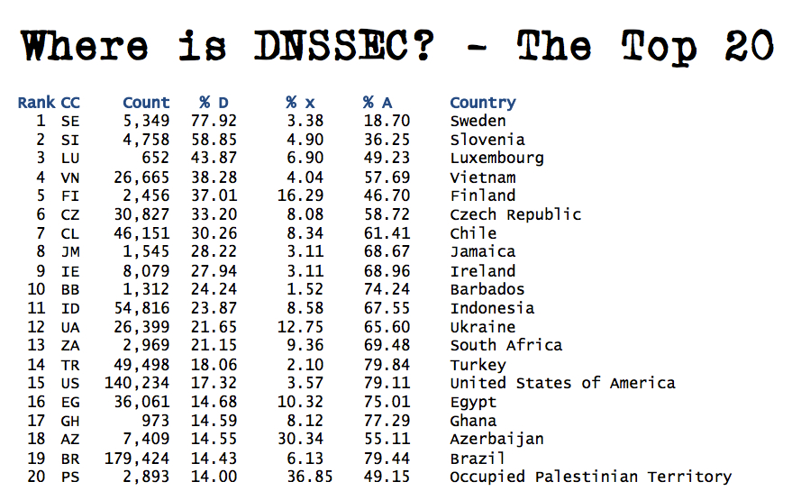
Geoff Huston's Measurements – July 2013
Source: http://iepg.org/2013-07-ietf87/2013-07-28-dnssec.pdf

Slide 34
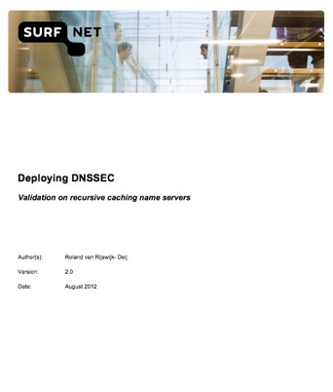
SURFnet Validating Server Whitepaper
http://bit.ly/sn-dnssec-vali
Steps through cost/benefit, requirements, planning
Provides instructions for:
BIND 9.x
Unbound
Windows Server 2012

Slide 35
DNSSEC Deployment Challenges

Slide 36
Key Questions
What needs to be done to get more domains signed with DNSSEC?
How can DNSSEC validation be more widely deployed?
Are there technical issues or are the issues more of communication and awareness?
How can we as a community address these challenges to increase the usage and availability of DNSSEC?

Slide 37
Opportunities to Accelerate Deployment
Registrar / DNS hosting provider engagement
Encouraging more registrars to provide DNSSEC and making it easier for domain name holders.
Validating name servers
Expanding the deployment of DNSSEC-validating name servers at multiple levels, including ISPs, operating systems and applications.
Enterprise signing of domains
Helping enterprises and other large organizations understand the added security value they can achieve with DNSSEC, particularly with the new capabilities of DANE.
Government activity with DNSSEC
Encouraging governments to expand their promotion and usage of DNSSEC

Slide 38
Registrars and DNSSEC - RAA
New ICANN Registrar Accreditation Agreement (RAA) will have section on DNSSEC
Specifically the "Additional Registrar Operations Specification"
http://www.icann.org/en/news/public-comment/proposed-raa-22apr13-en.htm
Impact will be that any registrars wishing to continue their ICANN accreditation will need to learn about DNSSEC and accept records
Must be implemented by January 1, 2014

Slide 39
Registrars and DNSSEC - RAA
New specification states:
1. DNSSEC
Registrar must allow its customers to use DNSSEC upon request by relaying orders to add, remove or change public key material (e.g., DNSKEY or DS resource records) on behalf of customers to the Registries that support DNSSEC. Such requests shall be accepted and processed in a secure manner and according to industry best practices. Registrars shall accept any public key algorithm and digest type that is supported by the TLD of interest and appears in the registries posted at: <http://www.iana.org/assignments/dns-sec-alg-numbers/dns-sec-alg-numbers.xml> and <http://www.iana.org/assignments/ds-rr-types/ds-rr-types.xml>. All such requests shall be transmitted to registries using the EPP extensions specified in RFC 5910 or its successors.
Specification also covers IPv6 and IDNs.

Slide 40
Helping Accelerate DNSSEC Deployment
Public mailing list, “dnssec-coord”, available and open to all:
Focus is on better coordinating promotion / advocacy / marketing activities related to DNSSEC deployment.
Monthly conference calls and informal meetings at ICANN and IETF events.
https://elists.isoc.org/mailman/listinfo/dnssec-coord

Slide 41
DNSSEC Resources

Slide 42
DNSSEC Workshop at ICANN 48
November 20, 2013 Buenos Aires, Argentina
Topics to be discussed include:
Automation of DNSSEC
Root key rollover
Guidance for registrars in supporting DNSSEC
Interfaces between registrars and registries
Regional activities
Will be streamed live over the Internet

Slide 43
Resources
To learn more about DNSSEC and how to get started:
http://www.internetsociety.org/deploy360/dnssec/basics/
http://www.internetsociety.org/deploy360/resources/dane/
Specific resources that may be of interest:
SURFnet whitepaper about deploying validating servers
DNSSEC HOWTO
NIST "Secure DNS Deployment Guide"

Slide 44
Comcast Case Study
Presentation at October 2012 DNSSEC Deployment Workshop at ICANN 45
Slides and audio for workshop:
toronto45.icann.org/node/34375
Comcast presentation:
Customer interaction
Lessons learned
Next steps

Slide 45
Increased Number Of DNSSEC Tools
Lists of tools:
http://www.internetsociety.org/deploy360/dnssec/tools/
http://www.internetsociety.org/deploy360/blog/tag/tools/
DNSSEC Tools Project
http://www.dnssec-tools.org/

Slide 46
DANE Resources
DANE Overview and Resources:
http://www.internetsociety.org/deploy360/resources/dane/
IETF Journal article explaining DANE:
http://bit.ly/dane-dnssec
RFC 6394 - DANE Use Cases:
http://tools.ietf.org/html/rfc6394
RFC 6698 – DANE Protocol:
http://tools.ietf.org/html/rfc6698

Slide 47
Three Requests For Network Operators
Deploy DNSSEC-validating DNS resolvers
Sign your own domains where possible
Help promote support of DANE protocol
Allow usage of TLSA record. Let browser vendors and others know you want to use DANE. Help raise awareness of how DANE and DNSSEC can make the Internet more secure.

Slide 48
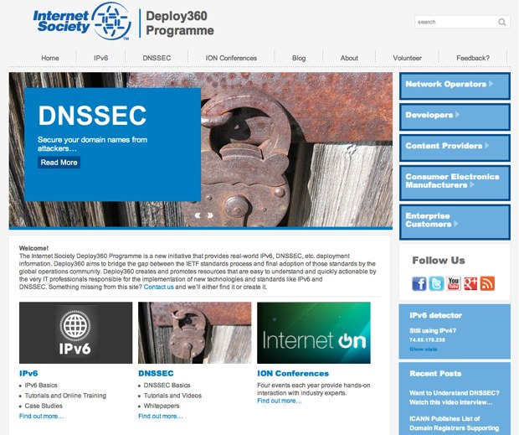
Internet Society Deploy360 Programme
Can You Help Us With:
Case Studies?
Tutorials?
Videos?
How Can We Help You?
www.internetsociety.org/deploy360/

Slide 49
Dan York
Senior Content Strategist Internet Society
york@isoc.org
http://www.internetsociety.org/deploy360/
Thank You!

